Slide 1
The 13 colonies
How America started

Slide 2
Title
Main Idea
  Details (Make Sure You Indent)
  The purpose of notes is to summarize main ideas to study the important information.
  Copy information legibly, highlight vocabulary and main ideas

Slide 3
Essential Questions
Why did Europeans risk everything to move to the New World?
How did colonists adjust to their new environment?
How did Colonial leaders find workers on their new lands?
Who were the winners and losers of the colonial expansion?

Slide 4
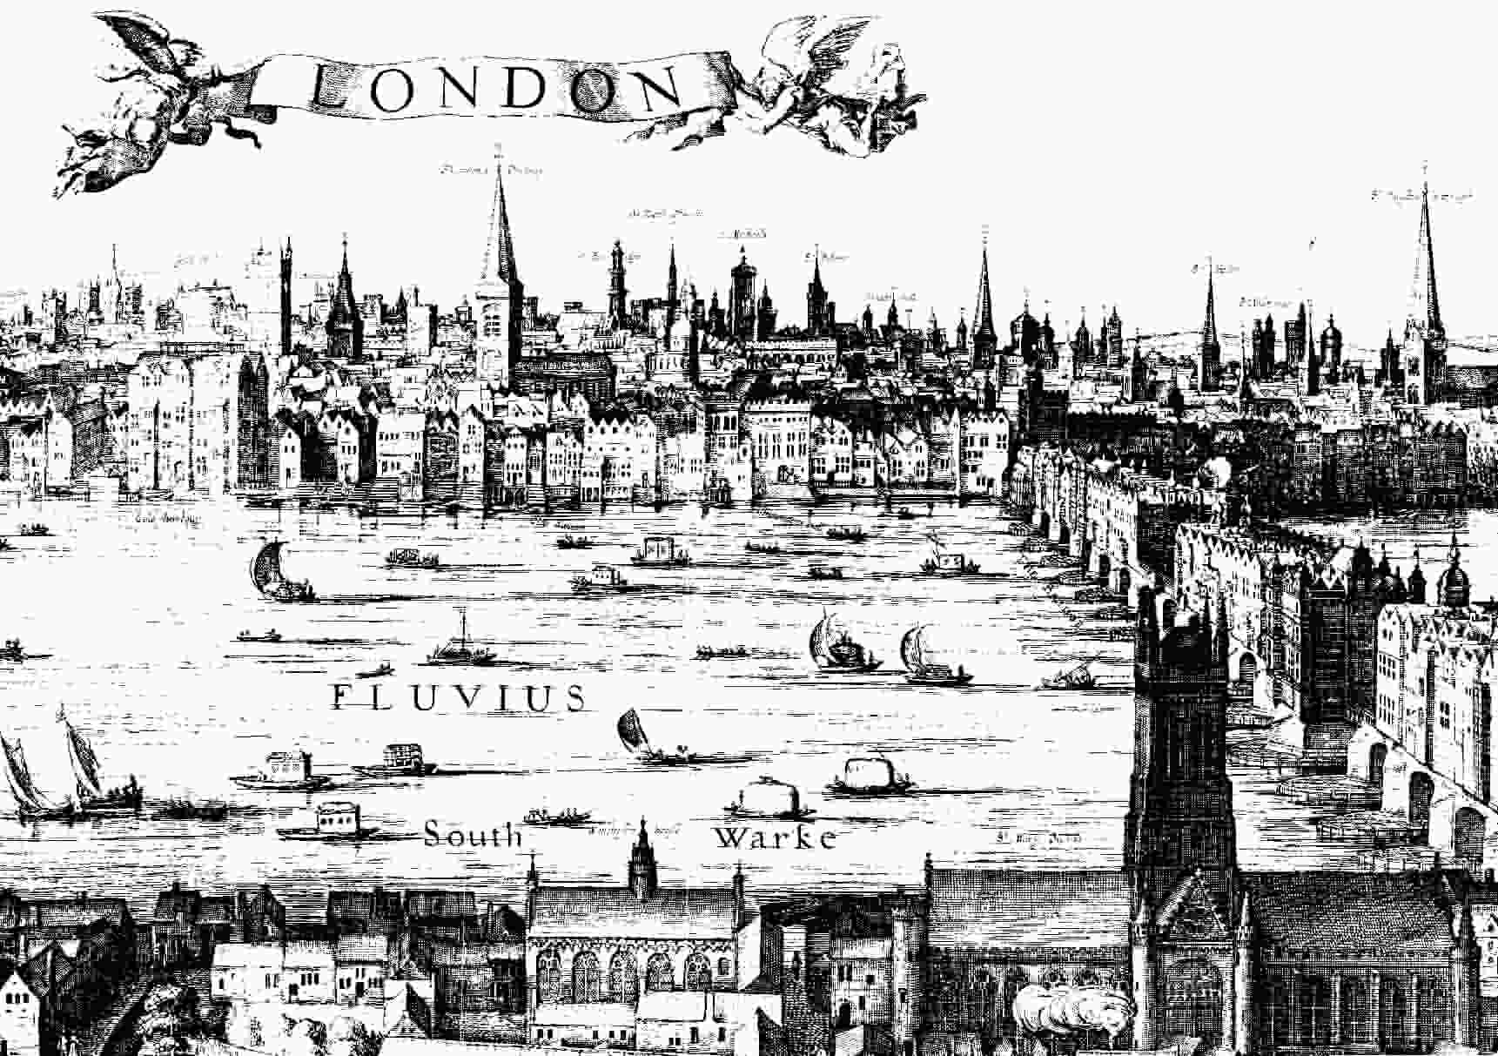
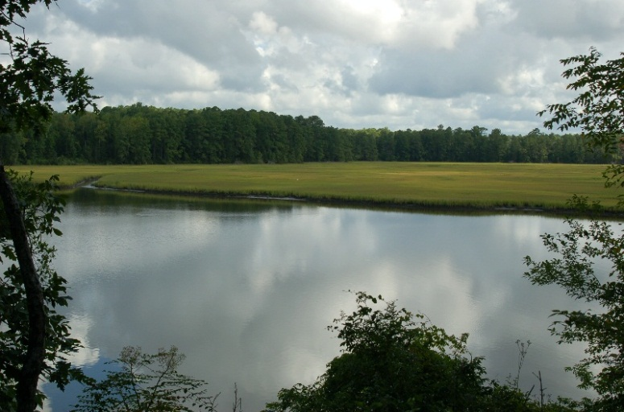
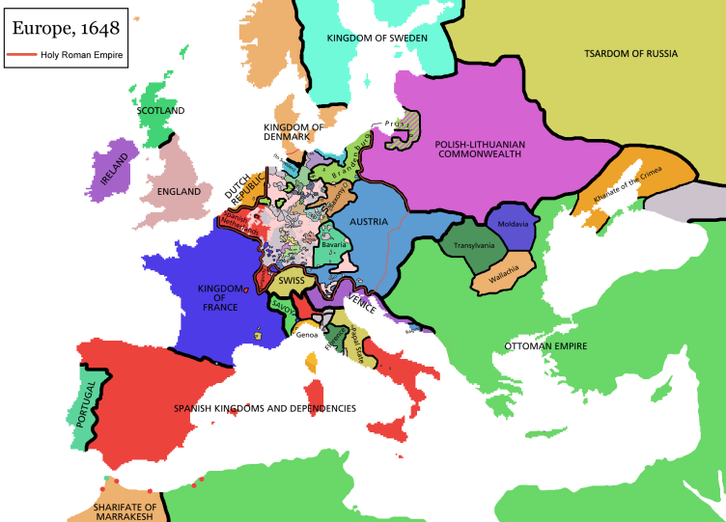
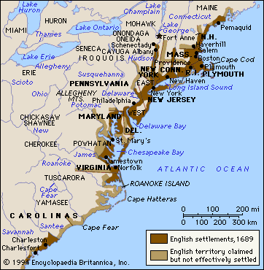
Welcome to the New World
Old World (Europe)
New World (North America)

Slide 5
Why did Europeans settle here?
Searching for sea route to Asia (spice trade)
Searching for gold
Spread Christianity
Competition for land and wealth (Spain vs. France vs. England)
Good soil for cash crops

Slide 6

Stop and Think
Of the reasons listed above, which one do you think was the biggest motivation for settlers to come here? Give reasons to defend your answer.
Think, pair, share

Slide 7
The Southern colonies
States: Georgia, N. Carolina, S. Carolina, Virginia, Maryland
First colony Jamestown (1607)
Who came: wealthy nobles, young males looking to find gold
Geography: warm year round, humid, good soil, many rivers
Economy: plantation farms (cash crops)
  Used Indentured servants and slave labor
Government: wealthy landowners controlled assemblies

Slide 8
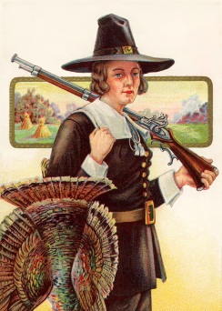
New England Colonies
States: Massachusetts, Rhode Island, Connecticut, New Hampshire
First colony: Plymouth (1620)
Who came: Puritans seeking religious freedom (families)
Geography: mild summers, cold winters, mountainous, poor soil
Economy: Fishing, lumber, craftsmen, trade
Government: democratic town meetings

Slide 9
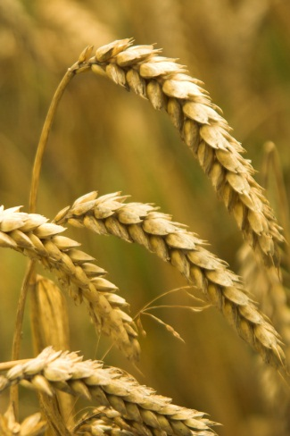
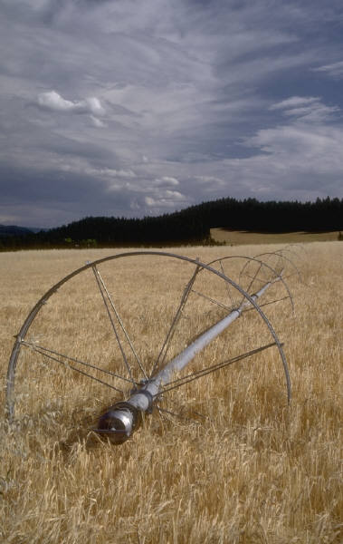
Middle Colonies
States: Pennsylvania, NJ, NY, Delaware
First colony: Philadelphia (1682)
Who came: Quakers
Geography: cold winters, hot summers, good soil
Economy: farming (grains), trade,
  Mostly indentured servants for labor- few slaves
Government: democratic assemblies

Slide 10
Who benefited?
Winners
losers
Wealthy landowners, merchants
Puritans create new homes for themselves
Adventurers seeking new life
Quakers spread ideas of tolerance
Democracy
Natives- lost lands, warfare
Slaves- brought from Africa for cheap labor
Poor workers- hard labor, few rewards
Women- had few rights

