Slide 1
Can The President Do That???
Number your paper 1-10.
For Each statement write yes or no if you think the President can do that

Slide 2

Can The President Do That???
1. Command the military and armed forces.

Slide 3
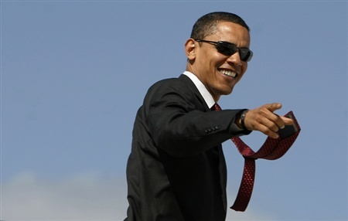
Can The President Do That???
1. YES!!!
The President is the Commander in Chief of the Armed Forces- All military report directly to him/her

Slide 4
Can The President Do That???
2. Create Laws

Slide 5
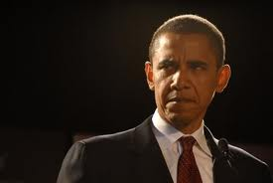
Can The President Do That???
NO!!!
The President can suggest laws to Congress but Cannot just create a Law because he/she wants to.

Slide 6

Can The President Do That???
3. Declare a Law Unconstitutional (goes against the constitution)

Slide 7
Can The President Do That???
NO!!!
The Supreme Court is the final decider on whether laws are unconstitutional or not- Presidents don’t always agree

Slide 8
Can The President Do That???
4. Declare War on enemy nations

Slide 9
Can The President Do That???
NO!!!
Although the President is in Control of the Military he/she CANNOT declare war- Congress must approve the use of extended military action

Slide 10

Can The President Do That???
5. Impeach public officials who are convicted of committing crimes.

Slide 11
Can The President Do That???
NO!!!
Presidents cannot impeach but they can be impeached by Congress
It Happened Twice- Andrew Johnson and Bill Clinton, neither one was found guilty. Richard Nixon resigned from office before congress could officially impeach him

Slide 12

Can The President Do That???
6. Enforce laws

Slide 13
Can The President Do That???
YES!!!
The Attorney General reports directly to the President to enforce federal laws

Slide 14

Can The President Do That???
7. Appoint Federal judges including the Supreme Court

Slide 15
Can The President Do That???
YES!!!
But they cannot just pick anyone- Congress has the right to deny appointment of judges.
Choose wisely because judges serve for life.

Slide 16
Can The President Do That???
8. Move to the country, become a citizen, and then run for Presidential office.

Slide 17
Can The President Do That???
NO!!!
A President must be born in this country and maintain citizenship throughout his/her life.
Sorry Birthers! Obama was born in Hawaii, not Kenya

Slide 18
Can The President Do That???
9. Veto a law passed by congress

Slide 19
Can The President Do That???
YES!!!
The president can veto a law. But congress can override a veto with a 2/3 majority vote (it hardly ever happens)

Slide 20

Can The President Do That???
10. Grant official pardons to convicted criminals

Slide 21
Can The President Do That???
10. YES!!!
The president can overturn any conviction regardless of the crime
Bush pardoned 200 people, Obama pardoned 23 so far. Most pardons are given the last week a President is in office- why do you think they wait so long?

Slide 22

Can The President Do That???
Why is the President so limited in what he/she can do???

Slide 23
