Slide 1
Which Right Is It?
Number paper 1-10, write which amendment relates to each summary

Slide 2
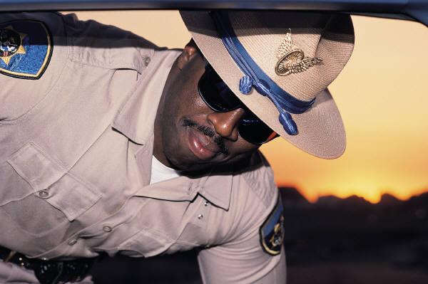
Question 1
Guarantees the right to privacy and protection from police searching your house or listening on your phone without a warrant.

Slide 3
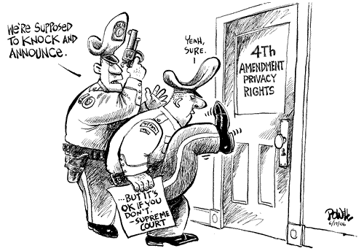
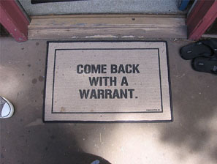
Question 1
The 4th Amendment

Slide 4
4th amendment controversy
Since the Sept. 11th attacks Congress has passed the Patriot Act which gives FBI more flexibility to listen in on phone calls, e-mail, and track purchase of terrorist related books in libraries without a warrant. Is protection from terrorism worth giving up parts of our fourth amendment rights?

Slide 5
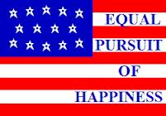
Question 2
States that Bill of Rights is not limited to just the rights mentioned- just because its not written does not mean it is not a right.

Slide 6
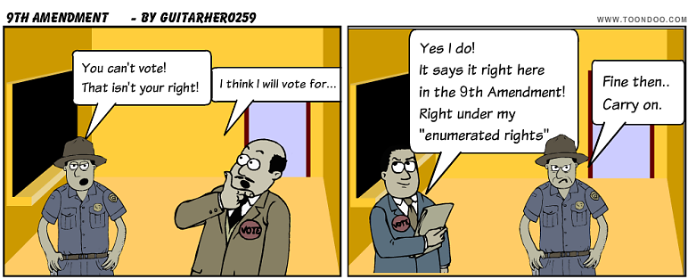
Question 2
The 9th amendment

Slide 7
9th Amendment in Action
Did you know that early in America’s history only white male land-owners had the right to vote? After many years of fighting the poor, women, and African Americans were able to win the right to vote stating, among other laws, our ninth amendment right to participate in our democracy- its not stated directly in the constitution but covered by the 9th amendment.

Slide 8
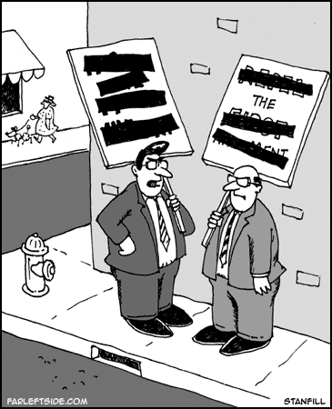
Question 3
Protects our liberties with the freedom of speech, press, and religion. Also protects our rights to protest and petition our government

Slide 9
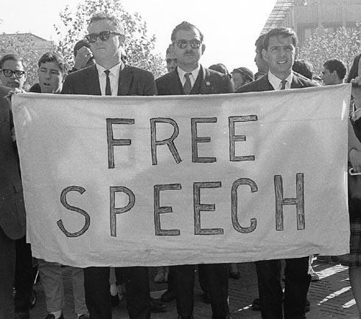
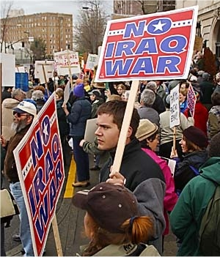
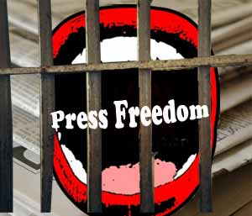
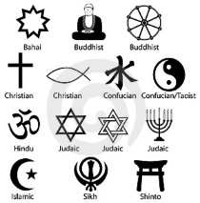

Question 3
1st amendment

Slide 10
1st Amendment
The 1st Amendments has limits
  Threats of violence, speech that endangers others lives are illegal
  The FCC regulates foul language on TV
  You can be sued for Libel (lying about someone)
  JUST BECAUSE YOU HAVE THE RIGHT TO SAY SOMETHING DOESN’T MEAN THAT THERE AREN’T CONSEQUENCES!!!

Slide 11
1st Amendment Controversy
Hate groups such as neo-nazi’s and the KKK use protection of the 1st Amendment to spread their hurtful message. Why is there hurtful speech protected and what danger do we face if we begin censoring certain groups.

Slide 12
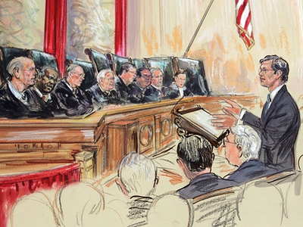
Question 4
If suspected of a crime citizens have the right to a speedy trial by jury. They have the right to face their accusers in court. A defense lawyer will be provided if you cannot afford one.

Slide 13
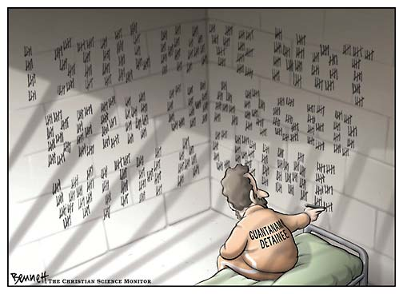
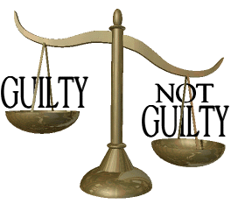
Question 4
6th Amendment

Slide 14
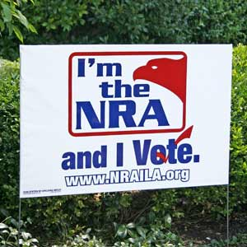
Question 5
Citizens have the right to own weapons in order to protect themselves and the nation

Slide 15
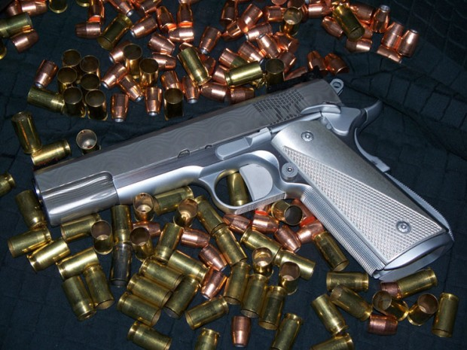
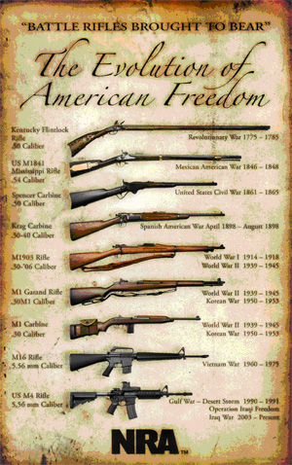
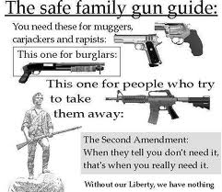
Question 5
The Second Amendment

Slide 16
2nd Amendment Controversy
handguns kill more young males than most other causes, especially in minority populations. Many propose new laws and regulations to stop the spread of handguns and assault rifles in urban areas.
Would new gun laws to keep weapons out of criminals hands go against the bill of rights?

Slide 17

Question 6
Citizens have the right to sue others if injury or damage to personal property is involved

Slide 18
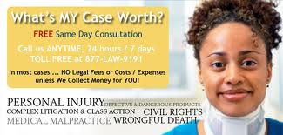
Question 6
7th Amendment

Slide 19
7th Amendment in Action
In the late 1990’s Athlete/actor OJ Simpson was found not guilty of the murder of his ex-wife and her boyfriend in criminal court. He was later sued by the families of the victims and found guilty in civil court. He never had to serve jail time but was forced to pay the families millions of dollars in damages.

Slide 20

Question 7
Citizens can not be forced to house and feed soldiers without consent

Slide 21
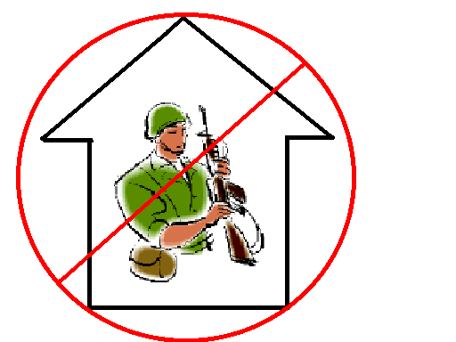
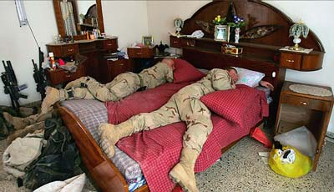
Question 7
3rd Amendment

Slide 22

Question 8
Anything not in the constitution is for the states or the people to decide

Slide 23
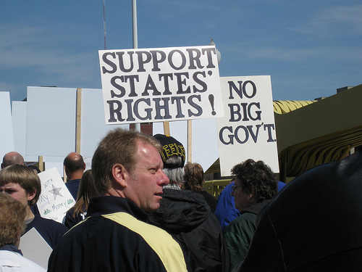
Question 8
The 10th Amendment

Slide 24
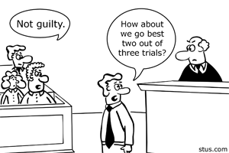
Question 9
Citizens suspected of crimes have the right of a grand jury to decide if the criminal case is valid. Citizens cannot be forced to testify against themselves. No property can be taken without due process and compensation. Also citizens found innocent cannot be retried again for the same crime.

Slide 25
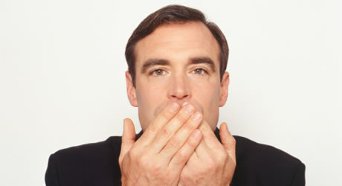
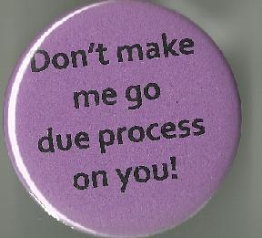
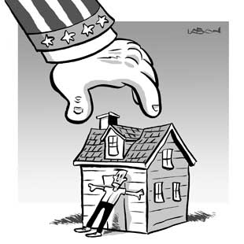
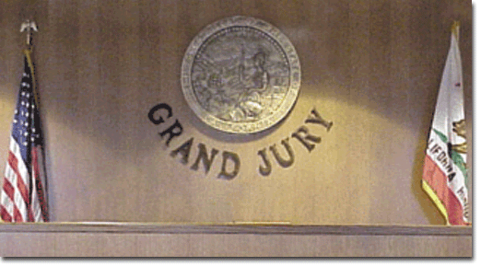
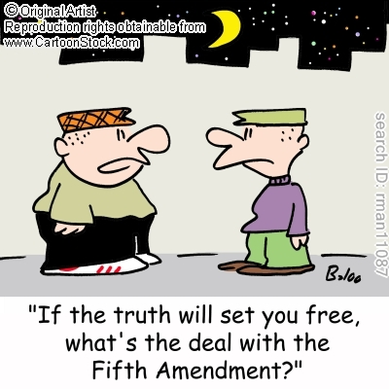
Question 9
The Fifth Amendment

Slide 26
5th Amendment history
In the old days police and judges would torture witnesses until they gave the correct response. Examples include shoving bamboo wedges up a persons finger nail.
Our founding fathers felt we would be better if the accused were found “innocent until proven guilty” and it is the police’s job to investigate and find the evidence- its better that some criminals get away with it than some innocent get accused and convicted of crimes.

Slide 27
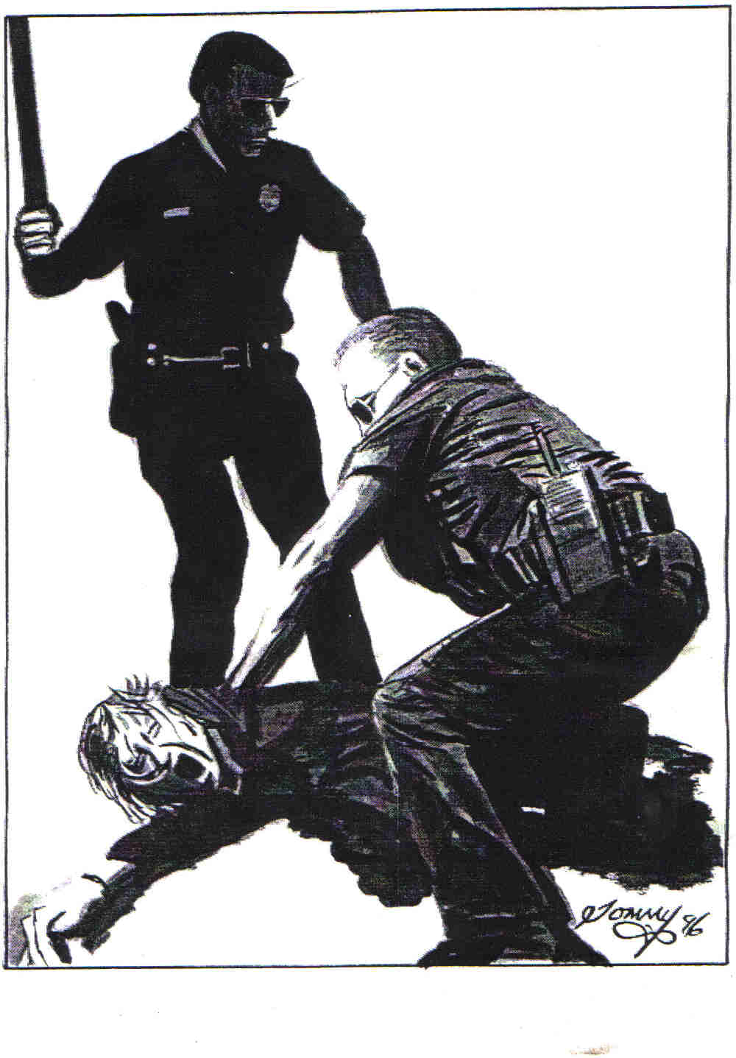
Question 10
Accused criminals have a right to post bail. Courts cannot sentence criminals to “cruel and unusual punishment”.

Slide 28
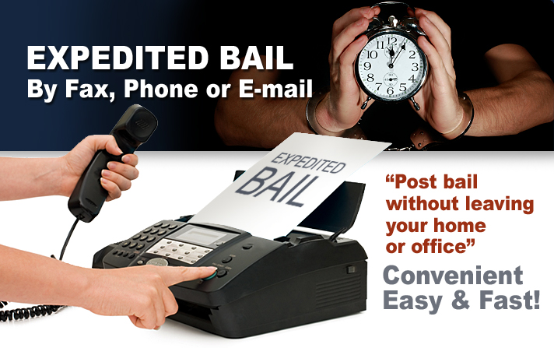
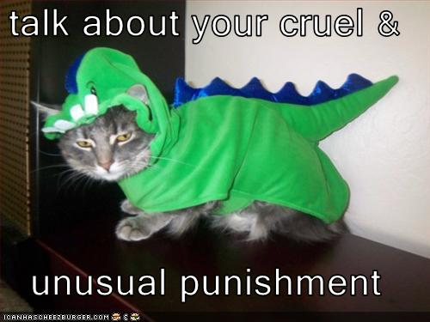
Question 10
8th Amendment

Slide 29
8th amendment
What constitutes cruel and unusual punishment?
  Solitary confinement?
  Death penalty?
  Overcrowding in prison?
  Lack of recreation?
  Chain gangs?
  The definition keeps evolving and changing

Slide 30
Supreme Court Cases- pages 68-71
Read case information
Discuss the merits of the case and there relation to the Bill of Rights
  Were rights being violated? How?
Write a group majority opinion and explain how the case stands up to the Bill of Rights
If anyone disagrees with the majority opinion write their reasons under the minority opinion section.

Slide 31
Tinker Vs. Des Moines (1969)
While the court stated that limitations of free speech for the better of the school community are OK, the school did not provide enough evidence that the student’s protest arm-bands were a threat to the safety of the school community.
7-2 verdict

Slide 32
Hazelwood School District Vs. Kuhlmeier (1988)
The court ruled in favor of the school district censoring the questionable materials. Since the school paid for the production of the newspaper they had editorial rights to control its content.
6-3 decision

Slide 33
Wallace v. Jafree (1985)
The Supreme Court ruled that the school district violated the 1st amendment rights of the students to worship freely when teachers mandated certain prayers during class.
6-3 decision

Slide 34
New Jersey vs. T.L.O.
The Supreme Court ruled that school’s main function is to promote a safe learning environment and therefore DO NOT need probable cause to search a students lockers, book bags, and personal belongings.
6-3 decision

