Slide 1
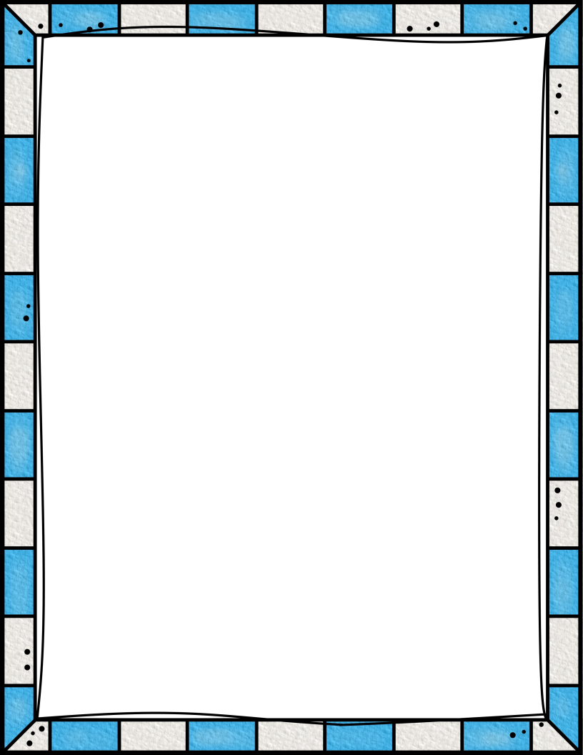
First Grade Supply List
1 box of washable markers (8-count)
1 box of crayons (24 count)
1 box of colored pencils
1 box of sharpend pencils
8 thin, black dry erase markers
2 highlighters
4 glue sticks
1 pair of scissors
4 sturdy, plain bottom pocket folders (1 green, 1 blue, 1 red, 1 any design)
3 (Norcom or Mead) Primary Grade 2 Composition books - 100 sheets
Headphones (NO EARBUDS, PLEASE)
2 boxes of tissues
1 roll of paper towels
1 box of quart Ziploc bags
1 box of gallon Ziploc bags
OPTIONAL
8 1/2 x 11 Colorful Cardstock
1 box of multicultural crayons/colored pencils
***Please label each item with your child’s name***

