Slide 1
ANNUAL TITLE I PARENT MEETING
HERITAGE ELEMENTARY SCHOOL
TUESDAY SEPTEMBER 3, 2024
FEDERAL PROGRAMS
FULTON COUNTY SCHOOLS
2024-2025

Slide 2
Objectives
Understand what makes our school a Title I school including requirements, funding, and associated programs
Understand school provided resources such as curriculum, assessment, parent resources, and staff contact information
Understand Family Engagement at our school

Slide 3
What is a title I school?
The largest federally funded educational program
Provides supplemental funds to districts to assist schools with the highest student concentrations of economic hardship
Provides supplemental funds to districts to assist schools with concentrations of economic hardship to meet school educational goals
A school receiving federal funds for Title I students
Every Student Succeeds Act (ESSA) includes provisions that will help to ensure success for students and schools

Slide 4
How does our school spend title I money?
Personnel
Parent Resource Center
Instructional Materials
Professional Learning

Slide 5
How is title I parent and family engagement money spent?
Parent Resource Center Materials
Parent Workshops (academic, technology, etc.)
Literacy Extravaganza
Technology Tea
Math Night

Slide 6
How does our school participate in the title I program?
Title I Schoolwide Program
A Title I schoolwide program is a comprehensive reform strategy designed to upgrade the entire educational program in a Title I school
Primary goal is to ensure that all students, particularly those who are low-achieving, demonstrate proficient and advanced levels of achievement on state academic standards

Slide 7
What are our school’s title I schoolwide requirements?
Provide high-quality curriculum and instruction
Required to hold an Annual Title I Meeting
Family Engagement
Professional Development
Parent’s right to know
Annual Evaluations

Slide 8
Heritage elementary school
Schoolwide program – past and present
Math and ELA Goals
Heritage Elementary School will increase overall content mastery from 48.3% to 54% by May 2025
School Programs
TAG-Talented and Gifted
EIP-Early Intervention Program
SEC-Students with Exceptionality

Slide 9
What is the state’s grades report for our school?
https://gosa.georgia.gov/dashboards-data-report-card/georgia-school-grades-reports
IMPORTANT Note regarding 2019-2020, 2020-2021, and 2021-2022 data:
For school years 2019-2020, 2020-2021, 2021-2022, and 2022-2023 various pandemic-related issues resulted in incomplete data for most metrics and there was significant variation in student participation rates where data are available. Therefore, it is not advisable to make comparisons between schools and/or districts for these years. Additionally, the GaDOE did not calculate a CCRPI for school years 2019-2020, 2020-2021, and 2021-2022. Since GOSA’s A-F grade is based on the school’s CCRPI calculation, this site will not include a letter grade for the affected years.

Slide 10
What curriculum does our school use?
Fulton County uses the Standards Mastery Framework to ensure all students are meeting mastery of state standards
State standards are provided by Georgia Department of Education

Slide 11
What is the Standards Mastery Framework?
Standards Mastery Framework in FCS
The Standards Mastery Framework (SMF) is a set of tools designed to ensure a guaranteed and viable curriculum and deeper personalization of the learning experience for FCS students.
The tools include:
Learning Maps that consist of
Prioritized Standards
Proficiency Scales
Evidence Blueprints
Assessment items and tasks
Scoring guides and student exemplars
Scales for reporting student success skills
Focus lessons
With the Standards Mastery Framework, teachers may enable each student to advance within and between courses upon demonstrated mastery and plan their instruction by considering 5 essential questions:
What do students need to know?
How do we know that they know it?
What is the plan for initial learning?
What do we do if they don’t know it?
What do we do if they already know it?

Slide 12
Essentially, a guaranteed and viable curriculum is one that is being taught in every classroom and can be taught in the time available.
What is a Guaranteed and Viable Curriculum?

Slide 13
What tests will my child be taking?
i-Ready and MAP Diagnostics
An Adaptive Diagnostic Assessment showing what students know and what they are ready to learn. An Adaptive Diagnostic means the questions change based on answers to earlier questions
WriteScore
A standards-based, Georgia Milestones-aligned writing assessment given to students in grades 3-8 that offers data analysis, reporting, and resources for teachers to use throughout the year to improve their student’s writing
WIDAW-APT
WIDA ​ACCESS is administered annually to all English learners in Georgia. ​​​​​​​​​​​​​​​​​​​​​​​​​​​​​​​​​​​​​​​​​​​​​​​​​​​​​​​​​​WIDA ​ACCESS is a standards-based, criterion-referenced English language proficiency test designed to measure English learners’ social and academic proficiency in English. It assesses social and instructional English as well as the language associated with language arts, mathematics, science, and social studies within the school context across the four language domains. ​​​​​​​​​​​​​​​​​​​​​​​​​​​​​​​​​​​​​​​​​​​​​​​​​​​​​​​​​​
GKIDS
GKIDS 2.0 is designed to be "invisible" to students, occurring through routine instruction and classroom activities. Results from GKIDS 2.0 will help identify what your child already knows and needs to learn next. GKIDS 2.0 also provides teachers a way to monitor your child’s growth in kindergarten that is developmentally appropriate.
Georgia Milestones Assessment System (GMAS)
Georgia Milestones is administered to students in grades 3 – 8. GMAS measures how well students have learned the knowledge and skills outlined in the state-adopted content standards in English language arts, mathematics, science, and social studies.
ACCESS for ELLs
ACCESS for ELLs is an English language proficiency assessment administered annually to kindergarten through 12th grade

Slide 14
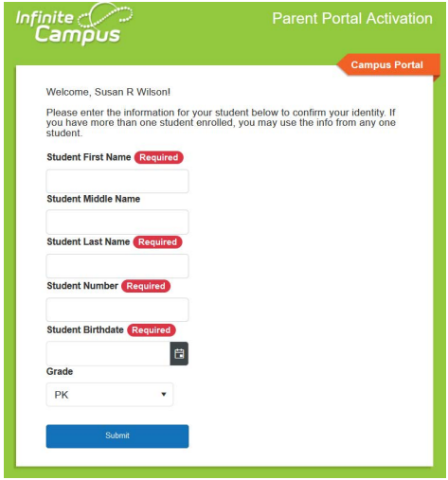
Infinite Campus
Infinite Campus – Parent Portal is the Fulton County Schools system to connect parents and students to student information. All parents must register to begin accessing Campus Parent
All current parents will receive an email to register
All parents new to Fulton will receive an email within 24 hours of enrollment
To register you must provide the following information
Student First Name, Last Name
Student Birthdate
FCS Student ID Number
Grade Level
https://www.fultonschools.org/infinitecampus

Slide 15
What is required by law for parent and family engagement?
Title I requires that all Title I schools ensure that all parents and families are given the opportunity for meaningful consultation in their child’s education:
School-Family Compact
Parent and Family Engagement Plan (PFEP)
District Parent and Family Engagement Plan
Title I also requires staff, families, and students must jointly develop the school compact
Parents & Families
Students
Staff

Slide 16
What is the district’s and school’s Parent and family engagement plan?
https://bit.ly/District-PFEP_Eng
https://bit.ly/District-PFEP_Spa
Heritage ES PFEP FY25 English.pdf

Slide 17
What is a school-family compact?
Shared Responsibility
Linked to Learning
Jointly Developed
Increased Student Academic Achievement

Slide 18
Does my child’s teacher meet professional qualifications?
Parent’s right to know (pg.51)
In the 2024-2025 FCS Code of Conduct and Discipline Handbook
Electronic signature for acknowledgment of receipt form for handbook:
https://www.fultonschools.org/codeofconduct

Slide 19
What opportunities does the school provide for family engagement?
Heritage Elementary opportunities for family engagement, volunteer opportunities and parent decision making meetings are as listed:
Open House August 1, 2024
Curriculum Fair September 3, 2024
Annual Title I Parent Meeting September 3, 2024
ESOL Welcome to SY25 August 22, 2024
Literacy Night October 31, 2024
Digital Citizen Workshop November 14, 2024
Math Workshop December 13, 2024, OR January 16, 2025
Assessments Workshop February 27, 2025
Input Meeting March 20, 2025
Pre- K Transition Workshop April 24, 2025

Slide 20
How responsive will the school be to my questions when staff is contacted?
Heritage Elementary School
2600 Jolly RD.
College Park, GA. 30349
(470)254-8144
https://www.fultonschools.org/heritagees
Principal
Cheryl Parker
parkerc@fultonschools.org
Parent and Family Engagement Coordinator
Ms. Harrell
harrelll@fultonschools.org

Slide 21
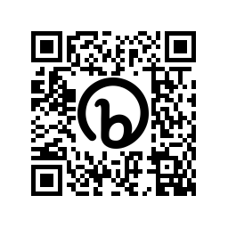
Closing and evaluation Link
Please click the link or type in your browser or scan the QR code below to access and complete our brief evaluation survey about this meeting/event. Your feedback helps us improve the services and events we offer to build your confidence and ability to academically support your child(ren) at home and partner with the school in their education.
When you open the survey:
Select: Elementary School
Select our school: Heritage Elementary School
Choose your role: student, parent, staff
Select Annual Title 1 Meeting as the meeting you attended
Complete the remainder of the survey.
This survey is to evaluate the effectiveness of the meeting.
https://bit.ly/FCSEvaluation_Survey
Scan Me

