Slide 1
Introduction
Joshua Q. Morris
Sixteen years old
Cadet 1st Lieutenant
Junior at Great Oak High School
Lived in Temecula, California for eleven years

Slide 2
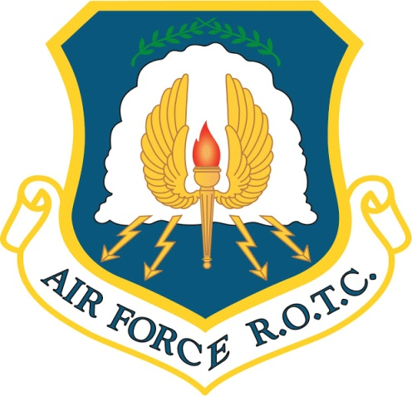
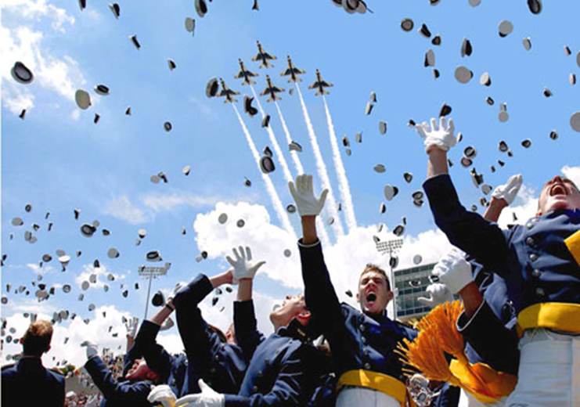
Academics/Goals
After High School would like to either attend one of the Military Academies or a college with an ROTC program
My GPA as of right now in my junior year is a 3.67
My goal in life is to become a pilot for the US military, preferably the Air Force

Slide 3
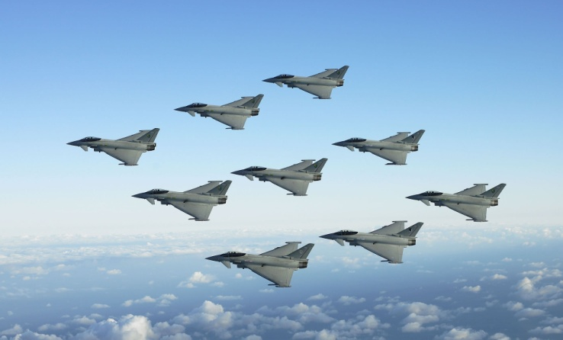
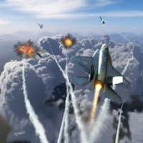
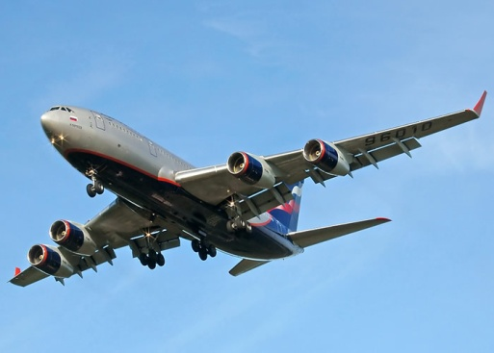
Plan ‘A’
Plan ‘A’ career path is to try and become a pilot for the U.S. Air Force Force for at least 15-20yrs
After the military find employment as a commercial airline pilot
My preference would be international flights so that I can travel the world

Slide 4
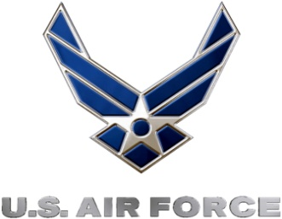
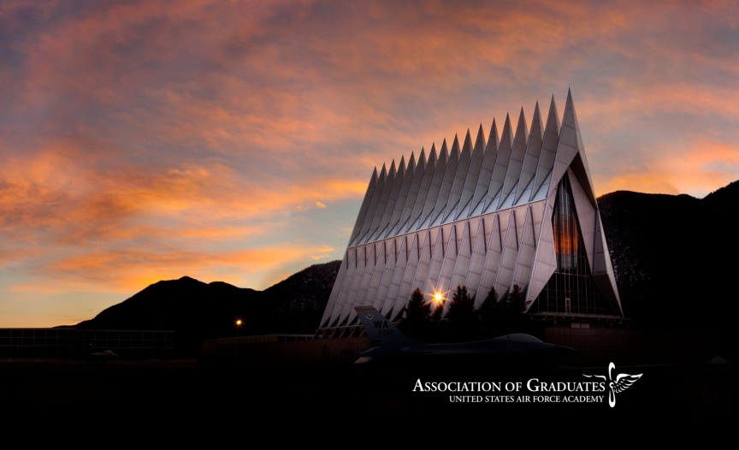
Information on Plan ‘A’
Officer training program comprises of a nine-week training program that is both mentally and physically challenging
2nd Lieutenant in the Air Force earn an average of $33,941per year
After 20 years and rank of Lieutenant Colonel potential to earn average $98,392 per year in today’s dollars
Promotion path in the U.S. Air Force requires flexibility with duty stations both within the U.S. and internationally
Benefits include a retirement plan, tuition assistance, and additional allowances and bonuses

Slide 5
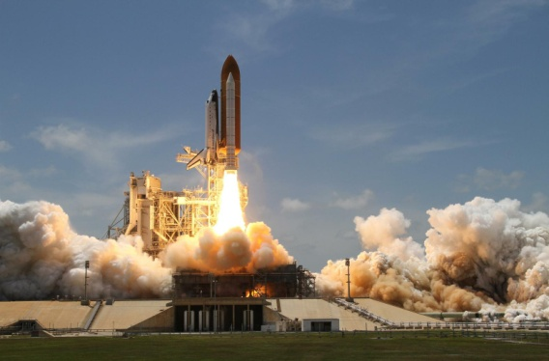
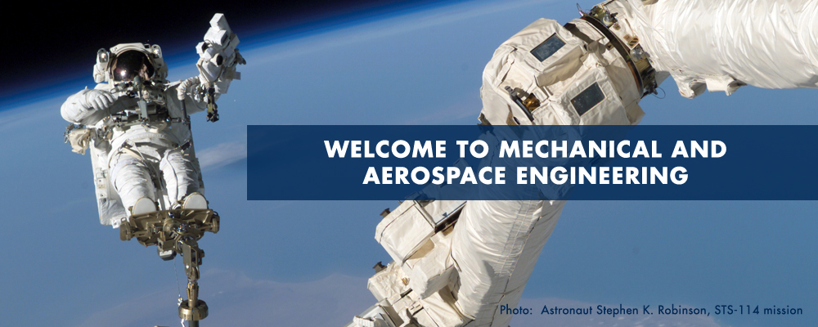
Plan ‘B’
Plan ‘B’, attend college and complete degree in Aerospace Engineering
Officer’s in Air Force requires bachelors degree, so getting degree in aerospace engineering works with Plan ‘A’ as well
Even if I am not accepted in the pilot program I would continue my career in the Air Force and serve my country
I would continue higher education while in the Air force to better my career options after the military

Slide 6
Information on Plan ‘B’
To get a good job in Aerospace engineering it will require a degree from a college or university
One such place is the University of North Dakota
They offer a Ph.D. program in aerospace engineering as one of their majors
There are many other universities and colleges that I could go to get a degree in Aerospace engineering, hopefully one which I’ll be able to get a scholarship

Slide 7
Years plan on serving
For my first career choice I hope to spend 20yrs in the military as a pilot, then an additional 10-15yrs piloting for a commercial airline
The FAA (Federal Aviation Administration) has a law which forces pilots to retire at the age of 65
I may choose to stay in the Air Force for as long as possible even if I was not able to fly the entire time

Slide 8
Retirement
If I were able to follow career path ‘A’, I would complete 20 plus years as military pilot, 20 plus years as commercial pilot, and then retire at age 65 years.
Otherwise path ‘B’, I would stay in the military for 20 plus years and then look for a civilian career related to my military experience until I reached retirement age

