Slide 1
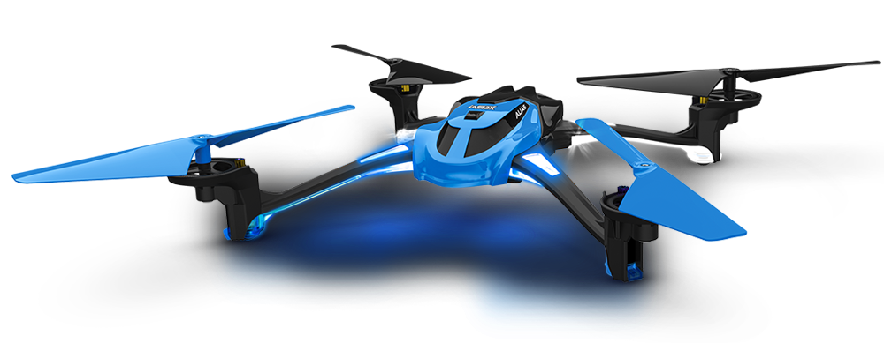
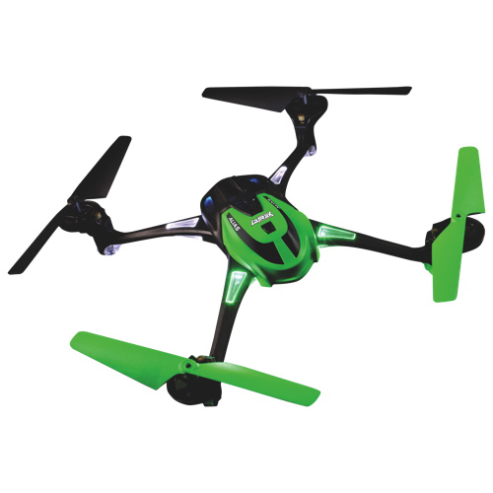
Day two
Quad-copter Instruction

Slide 2
Evaluation of airspace
Always assess wind speed and direction!!
Look for obstacles in the area
i.e. buildings, grandstands, trees, wires, light poles, OTHER AIRCRAFT OF ANY KIND!!!! Etc.
Be aware of people in the area
Always select at least one alternate landing site

Slide 3
Handling the quad-copter as a team
Cadets will work in teams of two
One spotter and one pilot will take their instructions from an instructor/controller
The pilot will focus completely on flying the quad-copter in a calm, controlled manner
The spotter will observe the air space around the quad-copter and warn the pilot of any impending obstacles
As the range increases the spotter can walk along with the quad-copter and help the pilot maintain orientation
COMMUNICATION IS KEY!!!!!!!!

Slide 4
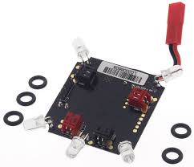
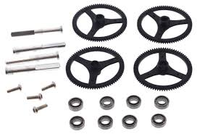
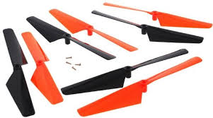
Maintenance
At all times the quad-copter should be kept in perfect flying condition
This will help ensure longevity of the quad-copter

Slide 5
Homework
Label the provided image of the quad-copter with the major components and their functions

