Slide 1
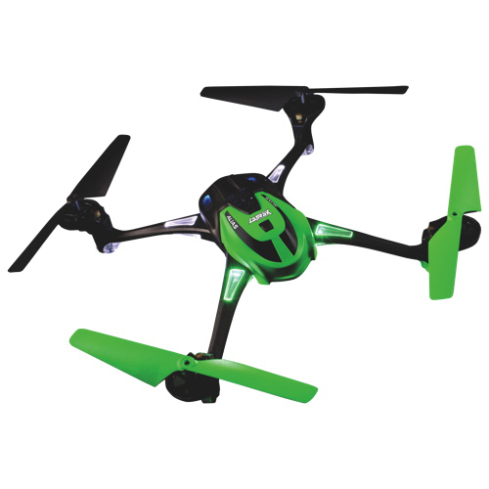
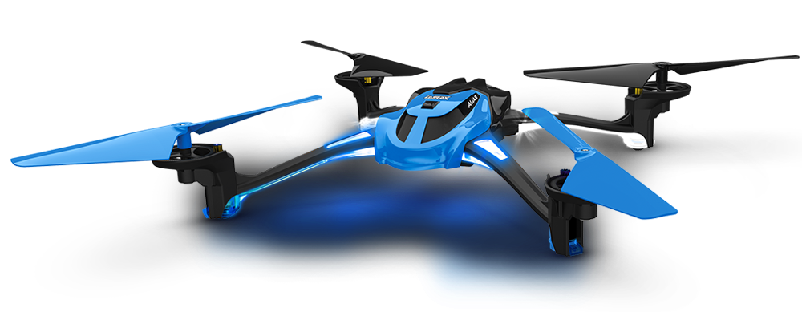
Quad-copter Instructional Program Ca-20052

Slide 2
Safety Brief
Safety is KEY in all operations
Throughout this program safety will be stressed
Failure to follow the safety protocol will result in an instant failure of the course!!!
Always perform a preflight safety check of the quad-copter
If any issues arise immediately notify the instructor and land the quad-copter

Slide 3
Safety brief
Never attempt to fly the quad-copter in adverse weather conditions i.e.: high winds, rain etc.
Do not fly within immediate range of people
Maintain at least 3yds away from the quad-copter when in operation
Do not attempt maneuvers above your skill level unless approved by your instructor
Never operate a quad-copter without your instructor present
Always follow the guidance of your instructor

Slide 4
Faa Regulations
Fly below 400 feet and remain clear of surrounding obstacles
Keep the aircraft within visual line of sight at all times
Remain well clear of and do not interfere with manned aircraft operations
Don't fly within 5 miles of an airport unless you contact the airport and control tower before flying
Don't fly near people or stadiums
Don't be careless or reckless with your unmanned aircraft – you could be fined for endangering people or other aircraft

Slide 5
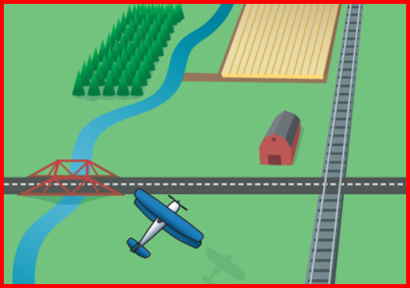
Dead Reckoning
Dead reckoning is navigation based on computations using time, airspeed, distance, and direction
By itself works best over short distances
When flying over land, a pilot can combine dead reckoning with pilotage
Calculation of one's position on the basis of distance run on various headings since the last precisely observed position, with as accurate allowance as possible being made for wind, currents, compass errors, etc.

Slide 6
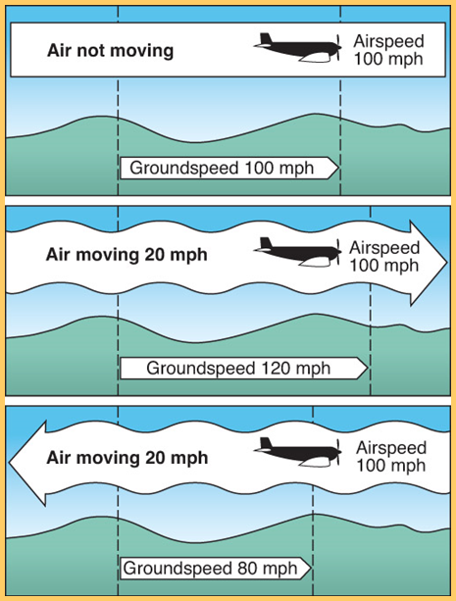
Dead reckoning
Wind is one of the variables when a pilot is using dead reckoning
At the end of an hour-long flight, the plane position is the result of two motions:
The movement of the air mass over the ground
The aircraft’s forward movement through the air mass

Slide 7
hOMEWORK
One paragraph summary on Dead Reckoning and how it pertains to quad-copter operations
Not completing will result in failure

