Slide 1
AFROTC
Scholarship Programs
Mr. Jack Sanders
AFROTC/RRU
Jack.sanders@us.af.mil
334-953-2654

Slide 2
Overview
Purpose
Programs, Types and Challenges
High School Scholarship Program
FY15 and FY16 Select Stats

Slide 3
Purpose
Why do we have a scholarship program?
Meet officer production needs in specific fields for the Air Force
Get the cadet on contract to the USAF
We are NOT a charity or a financial aid institution
We are paying for talent
Authorization: 10 U.S.C. 2107
Requires 50% at in-state tuition rate
Sets max at 4 years except in SAF-approved majors (5th year funding)
Sets maximum age limit (must be under age 31 on Dec 31 of commissioning year)
Side Note
Stipend is a military pay authorized by 37 U.S.C. 209 for contracted cadets—not a scholarship!

Slide 4
Scholarship Program
…the Enabler
AFROTC’s unique capability—On a sustained basis, Air Force ROTC recruits, educates, trains and commissions officers qualified for every Air Force Specialty Code, especially:
Officers that meet USAF Technical requirements
Officers that meet USAF Language requirements
Officers that meet USAF Nursing requirements
Officers that meet the Non Technical requirements
Officers that support diversity goals
AFROTC Scholarship Program enables that capability
at an acceptable level of risk

Slide 5
College Scholarship Programs
High School Scholarship Program (HSSP)
High School Seniors
All 4-year offers (some convert to 3-year offers)
In-College Scholarship Program (ICSP)-Competitive Program
Commander’s Scholarship Program
In-College Scholarship Program Phases 1 & 2
Express/Foreign Language (FLEX) and Flag Ship Programs
Nurse Scholarship Program
Historically Black Colleges and Universities (HBCU)
Enlisted Commissioning Programs (ECP)
Enlisted Commissioning Programs (SOAR, POC-ERP, ASCP, and SL ECP)

Slide 6
Challenges
HSSP versus ICSP
HSSP gets us the critical technical majors
In-College is more effective, but doesn’t get us the majors
In-College effectiveness varies among detachments
Management challenges
Air Force Audit Agency & AF/A1—scholarship-to-major-to-AFSC
AF/A1 & AFPC—improve “STEM Cognizance” and Foreign Lang
Execution Accuracy
Constant and Stable PGL/Budget
Timeliness and accuracy of scholarship estimates
Timeliness of scholarship payments

Slide 7
High School Scholarship Program
Four-Year Scholarship Offers to High School Seniors
Competitively Selected by Central Board
“Primes the Pump” to Meet Officer Production
Requirements 4 to 5 Years from Today
Permits Applicants to Select University and Major

Slide 8
HSSP – Scholarship Types
Type | Annual Cap
1 | Full tuition/fees at any school
2 | $18,000 for tuition/fees at any school
7 | Full in-state tuition/fees (public school)

Slide 9
HSSP - Highlights
High School Seniors
Primarily Targeting Technical Majors (70%)
Foreign Language (15%)
Non-Technical Majors (15%)
High Academic Achievement
1180 SAT
26 ACT
3.00 GPA
Top 15% of Class
Excel in AP/IB Coursework
Strong Leadership Potential
Extra-curricular activities
Demonstrated communication skills (interview)
Minimums to be eligible

Slide 10
HSSP – Application/Eligibility Process
AFROTC.com site opens 1 June 16
On-line application (questionnaire portion) due by 1 Dec 16
Required documents are due by 12 Jan 17
Transcripts, counselor’s certification, SAT/ACT scores, physical fitness assessment, extra-curricular activities sheet,
Once qualified, names posted to ALOWeb for Dets and overseas interviewers
Det or RRUC schedules interview
Interviewer completes AF Form 4060 online (ALOWeb)
Dets complete AFROTC Form 35 (Civil Involvements), AF Form 2030 (Drug Abuse) upload to WINGS

Slide 11
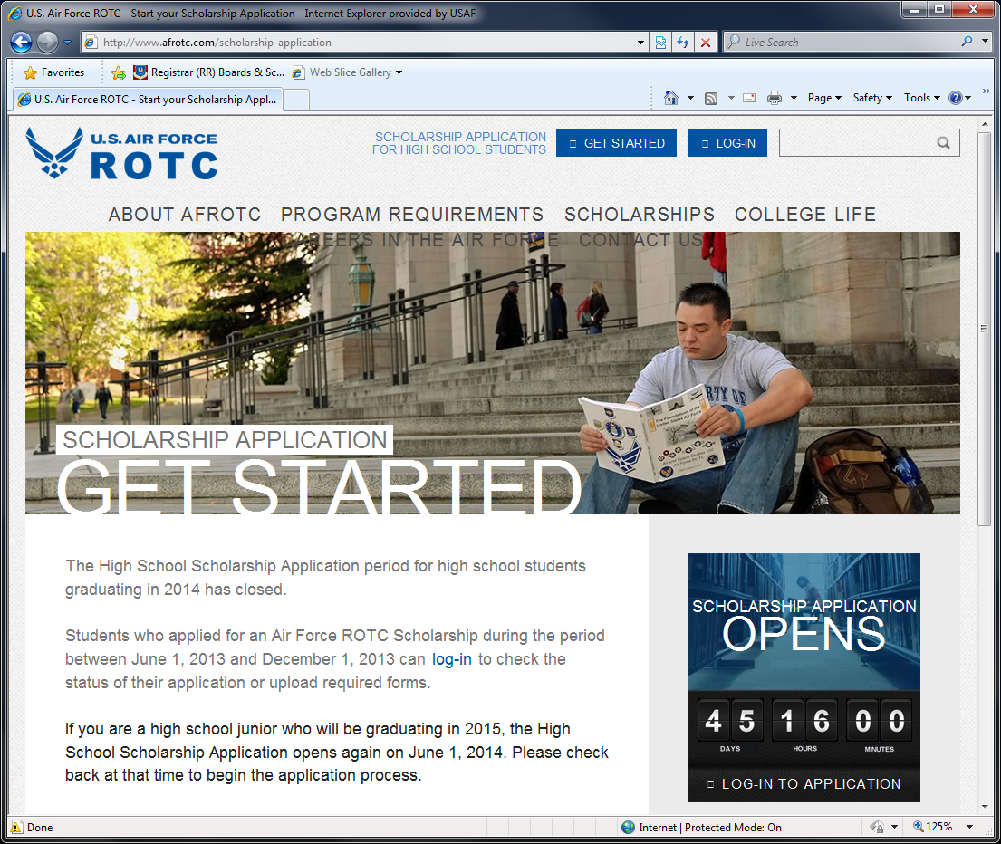
How to Apply

Slide 12
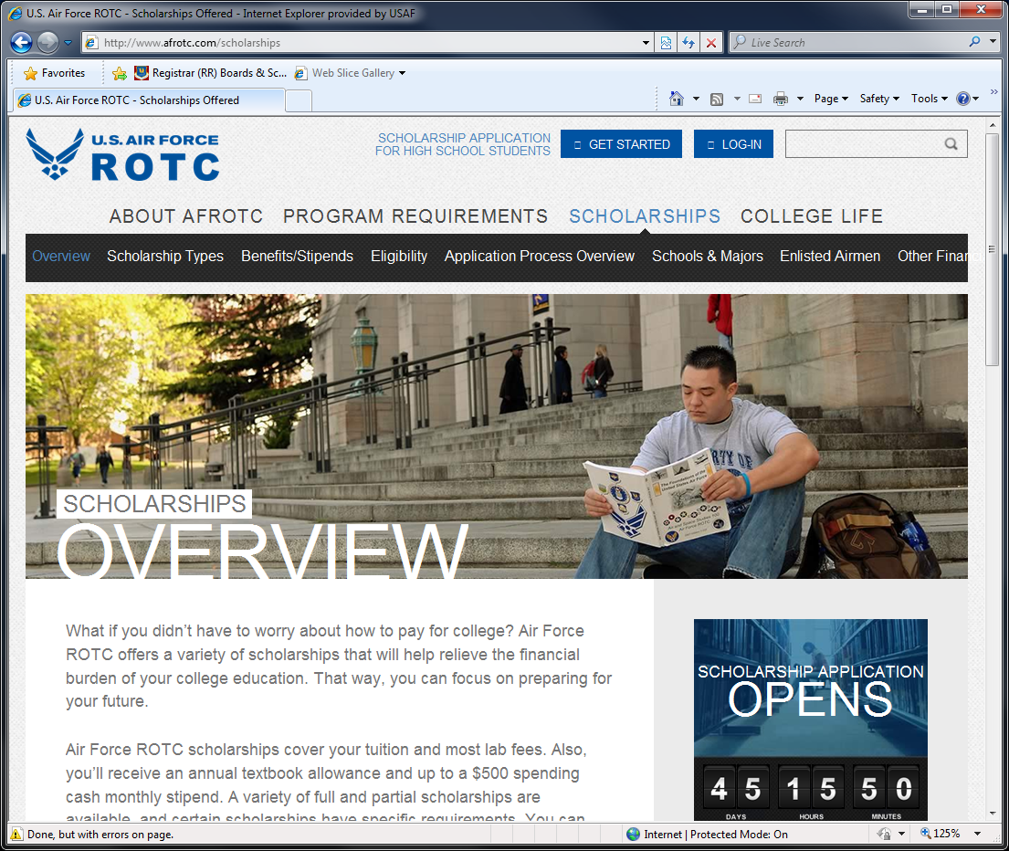
How to Apply

Slide 13
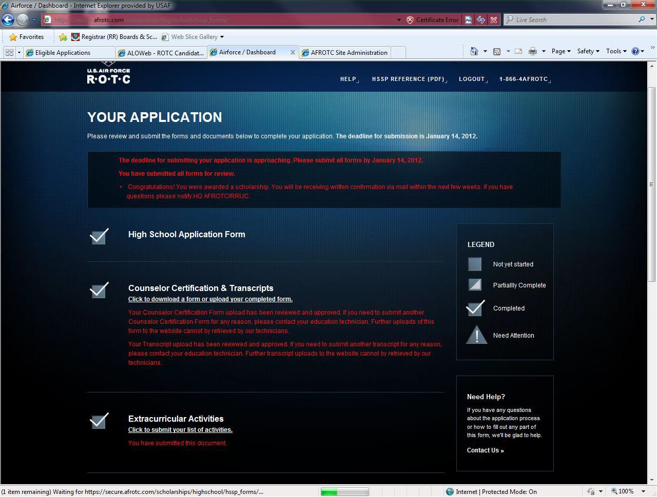
Application Tracker

Slide 14
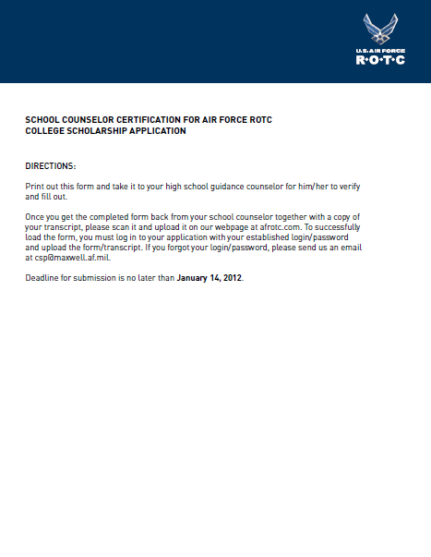
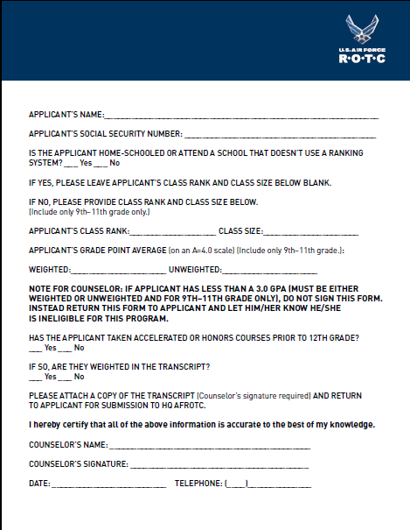
Counselor’s Certification Form
Students download form & bring to counselor
Counselor completes form & signs
Student scans & uploads form to website
Instructions for applicant
Counselor’s Cert Form

Slide 15
SAT/ACT Scores & Transcript
Students upload screenshot/printout of test scores
Students upload official/unofficial transcript
Documents are QC’d at HQ – web updated twice daily
Unapproved forms must be corrected by applicant
Approved forms get a checkmark on tracker after review

Slide 16
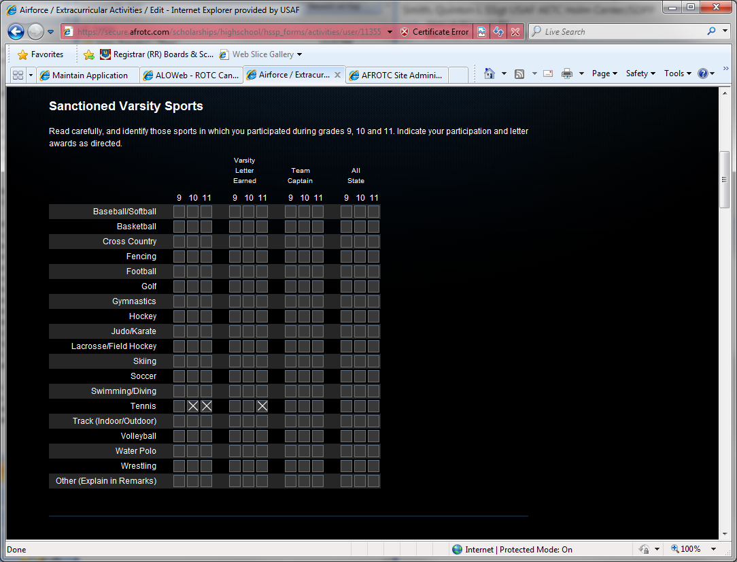
Extra-Curricular Activities Sheet

Slide 17
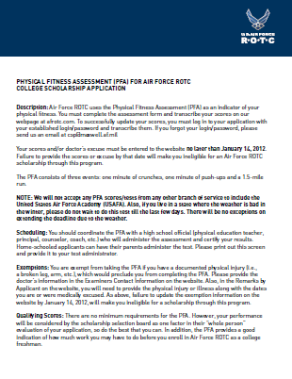
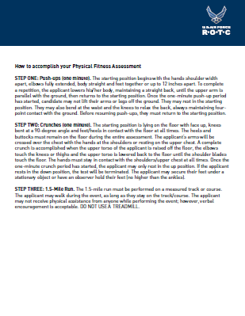
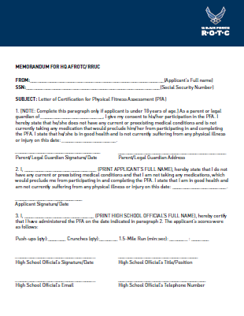
Physical Fitness Assessment
Students download form & take test w HS official
Student scans & uploads form to website
Instructions for applicant
Instructions for
test proctor
PFA score sheet

Slide 18
Interview Process
Accomplished after applicant becomes eligible
Det will receive email notification on newly assigned applicants
Det schedules and conducts interview
Det must complete interview within 30 days from the date applicant became eligible
If your cadet has not been contacted within 30 days, notify RRUC

Slide 19
HSSP - Selection Process
HQ AFROTC processes all applications electronically
Eligible applicants’ records meet selection board
Nov, Jan, Feb, Mar (March is a Reboard)
Board Members: Det Commanders
Evaluate applicants’ Leadership, Motivation, Fitness
Board Order of Merit Listing (OML)
Offers made based on OML and academic major choices
HQ AFROTC uploads all selects and non-selects on restricted website
Selects must upload Letter of Admission (LOA)
Validates acceptance into major at school of choice
Ticket to schedule DoDMERB physical exam
Serves as formal authorization to activate scholarship in fall

Slide 20
Commander’s Scholarship (CS)
Every Det has 1 CS for HSSP – with conditions
Must have at least 1180 SAT or 26 ACT to be eligible
Type varies based on academic major
Type 1 for Tech majors
Type 2 for all other majors
Det makes offer after interviewing applicant
PAS may recommend to another Det if applicant wants to attend another school

Slide 21
HSSP Offers Summary FY15 & FY16
Starting College Fall 15
8,262 Applicants
70% Selection Rate
84% Tech
4% Foreign Language
12% Non-Tech
Scholarship Types
5% Type 1
15% Type 2
80% Type 7
Average Selectee
1313 SAT
29.6 ACT
3.75 GPA
Starting College Fall 16
8,237 Applicants
75% Selection Rate
65% Tech
1% Foreign Language
34% Non-Tech
Scholarship Types
11% Type 1
16% Type 2
74% Type 7
Average Selectee
1308 SAT
30 ACT
3.76 GPA

Slide 22
AFROTC Scholarships
QUESTIONS ?

