Slide 1
NROTC SCHOLARSHIP
MARINE CORPS OPTION
(Sgt Winningham)

Slide 2
NROTC Opportunity
For those who seek to make a difference, to be challenged, to develop mind, body and spirit, for that select few we offer the opportunity to become . . .
an Officer of Marines

Slide 3
Becoming an Officer of Marines
Four Year College Programs
Naval ROTC Scholarship (NROTC)
U.S. Naval Academy (USNA)
Enrolled College Students/Graduates
Platoon Leaders Course (PLC)
Officer Candidate School (OCS)

Slide 4
Selection & Competition
Each year the Marine Corps commissions approximately 1,400 new Officers from an average of 3,000 applicants.
47% of applicants meet the challenge.

Slide 5
Purpose of the NROTC Program
The NROTC scholarship program is a exceedingly competitive program designed to select and prepare highly qualified men and women for service as Officers in the Marine Corps Reserve.

Slide 6
Benefits to the Student
Offered at more than 100 top colleges and universities nationwide
Pays for 100% of tuition, books, lab fees and subsistence
Some schools will lump rent in with tuition so it is covered by the scholarship.
$250 cash per month the 1st year, increasing each year.
Total value in excess of $180,000
Education, Training, Mentoring
Notes:
Explain what subsistence is to high school students.

Slide 7
College Life
Regular academic classes (BA/BS)
Major/Minor of choice
Additional classes include:
Leadership
Military law
Military history
Military science
Military benefits and training

Slide 8
Participating Schools
Complete List Found at:
http://www.nrotc.navy.mil/colleges_nrotc_unitsXP3.aspx
- UC Berkeley - Stanford
- Univ of San Diego - UC Davis
- MIT - UCLA
- Florida State - Virginia Tech
- USC - Pennsylvania
- Notre Dame - Oregon St
- Texas - Florida
- Harvard - Colorado
- Washington - Cornell
- Penn State - CSUSM
- SDSU - Yale
- Arizona State Univ - Tulane
- George Washington - Michigan
- Embry-Riddle - Missouri
- Purdue - Nebraska
- Northwestern - North Carolina State
- Kansas - Univ of N Carolina
- Ohio State - Duke

Slide 9
Graduation and Commissioning
Upon graduation Midshipmen are commissioned as Second Lieutenants in the Marine Corps Reserve.
Scholarship recipients have a eight-year service obligation, 4 years active and 4 years inactive, following college graduation.
Notes:
Explain what a midshipmen is.
Explain the 8-year obligation.

Slide 10
NROTC Eligibility Requirements
U.S. CITIZEN
17-23 years old (first day of college)
If in college, must have less than 30 Semester Units/45 Quarter Units by time of Board; College concurrent with High School is ok.
Pass USMC physical fitness test with a score of at least 175 (AND meet the minimum in each category)
No moral/legal disqualification (Waivers are per Officer Procurement Manual)
Apply and Gain admission to an NROTC college/university
Either one of these TESTs:
1. Minimum SAT = 1000 Must be a combination of Reading and Math Period, Most recent test and must be from the same test.
2. ACT = Composite Score of 22
3. ASVAB = 74 AFQT

Slide 11
NROTC Application Process
Complete Online Application (http://www.nrotc.navy.mil/apply.aspx)
(Must click on Marine Corps Option)
Apply to NROTC college/university
Complete application package with recruiter
Attend a Processing Day to complete package
Selection board convenes
Applicant notified of board results

Slide 12
NROTC Timeline
Early Board
17-21 October Early Board Convenes
Results released December
Main Board
28 Feb- 3 March Main Board Convenes
Results released in April
PDV/FCB Board
Convenes in March after the Main Board
Notes:
These due by dates are XO’s deadlines for the RSSs.
If an applicant completes his or her online application after 25 January but before 31 January, they will be considered a worker.

Slide 13
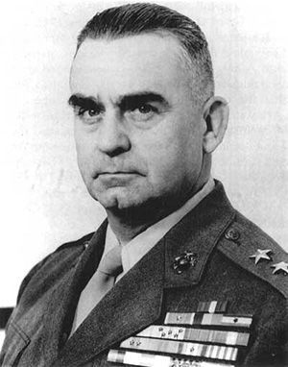
Pedro de Valle Scholarship
Pedro de Valle was a US Marine Corps Officer who became the first Hispanic to reach the rank of Lieutenant General.
Same qualifications as Main 4 Year Scholarship
Deadline for application is 31 January
The Marine Corps offers NROTC Scholarships for students who plan to attend the following Hispanic
Serving Institutes (HSIs):
California State University at San Marcos
San Diego State University
University of New Mexico
Notes:
For the PDV and FCB scholarship, it is essentially the same scholarship as the NROTC 4-year scholarship, just a different pot of money and is for select schools.
If an applicant wants to be eligible for either of these two scholarships, they must include one of the select schools in their Top 5 school choices on the online application, apply to that school, and inform their recruiter or the XO that they want to be eligible. A PDV/FCB SOU must be filled out as well.

Slide 14
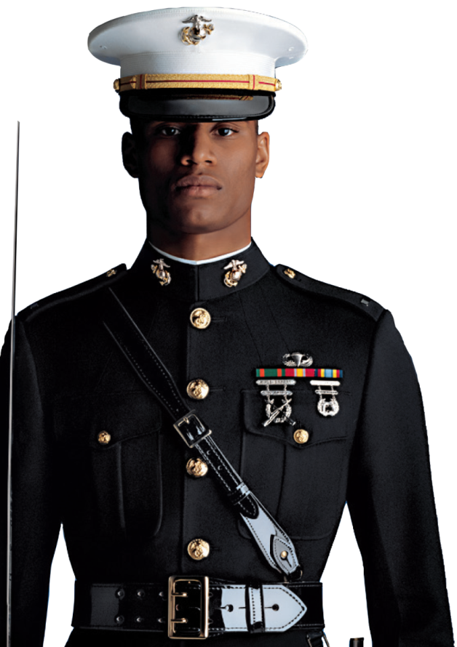
Frederick C Branch Scholarship
Frederick C Branch was the first African American Marine Corps Officer.
Same qualifications as Main 4 Year Scholarship
Deadline for application is 31 January
The Marine Corps offers NROTC Scholarships for students who plan to attend the following Historically Black Colleges or Universities (HBCUs):
Allen Univ
Clark Atlanta Univ
Dillard Univ
Florida A&M Univ
Hampton Univ
Howard Univ
Norfolk Univ
Morehouse College
Huston-Tillotson Univ
Prairie View A&M Univ
Savannah State Univ
Southern Univ and A&M College
Spelman College
Tennessee State Univ
Texas Southern Univ
Tuskegee Univ
Xavier Univ

Slide 15
QUESTIONS?

Slide 16
FY17 Mission
RS SDO:
Total: 21
Females: 3
African American: 1
Hispanic: 8
Other: 7
Air: 2
RS RVS:
Total: 21
Females: 3
African American: 1
Hispanic: 8
Other: 7
Air: 1

Slide 17
Recruiter Requirements
To receive points for an NROTC submission, a recruiter must ensure the following are completed:
Applicant completes online application.
Applicant has or is planning on applying to an NROTC eligible college.
All required paperwork that the XO designates is completed when the applicant shows up for a Processing Day. (Exceptions can be made for teacher evaluations and transcripts but must be turned in by due date.)
Applicant has a current PFT score within 60 days of the board. (Early and Main)
Applicant must attend a Processing Day.

Slide 18
Trends and Pointers
-Ensure the applicant is aware of what the program is all about BEFORE attending a Processing Day.
-Ensure applicant is aware of how to do each portion of a PFT properly.
-Ensure applicant applies to his/her top 5 school choices. ALL of them!
-New this year: after an applicant submits the online application, he/she does not need to submit a trouble ticket, they can go back into their application and change information up until 31 Jan.
-New this year: Aviation guarantee. XO will complete a very cool aviation brief and SOU with interested applicants during Processing Day.

