Slide 1
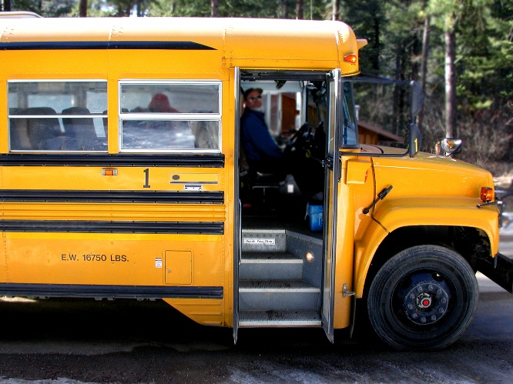
LES Handbook
(208) 686-1651
2024-2025
www.pwsd.com
Student Parent Information
Table of Contents
A list of topics this handbook is intended to address:
Principal’s Note…2
Student Records…2
Student Schedule…3
Attendance…3
Free Breakfast/Lunch…3
Non-Discrimination…3
Emergency Closures…4
Personal Belongings…4
Dispensing Medication…4
Video Surveillance…4
Health, Injury or Illness…5
Communication …5
P/T Conferences…5
Alcohol. Tobacco
Vape & Drug Policy…6
Library …6
State Testing…6
Student Insurance…6
Accommodation of Individuals w/ Disabilities…7
Volunteers…7
Web Site/Social Media…7
Dress Code…8
Staff…9
The purpose of this handbook is to serve as a summary of the rules, regulations, policies, and procedures of Lakeside Elementary School. It is not intended as a comprehensive manual, but is pre-pared for the purpose of providing essential information to students and parents, deemed essential by the admin-istration. Although it is the intent of the administration that the information in this handbook and the governing district policy and procedures, district rules and regulations, Idaho State Department of Education rules and regulations, or state or federal law, the latter will prevail over this manual.
Lakeside Elementary School
P.O. Box 130
1345 E Street
Plummer, ID 83851
(208)686-1651
Principal: Dani Boyd Office Manager: Lisa Wilson
Working together to Educate and Prepare Positive, Motivated, and Successful Citizens. 1

Slide 2
LES Handbook
(208) 686-1651
2024-2025
www.pwsd.com
Principal’s Note
The information contained in school student records shall be kept current, accurate, clear and relevant. All information maintained concerning a student receiving special education services shall be directly related to the provision of services to that child. The District may release directory information as permitted by law, but parents shall have the right to object to the release of information regarding their child. A complete copy of FERPA is available on the district webpage.
Directory information shall be limited to:
Name, Address, Gender, Grade level, Birth date and place, Parents’/guardians’ names and addresses, and Period of attendance in school.
*** COVID-19: PERMITTED DISCLOSURES: The permitted disclosure of PII to appropriate officials in connection with a health or safety emergency (§99.31(a)(10)) may include the disclosure of a positive COVID-19 test result and/or disclosure of exposure to COVID-19 by a student to a person with whom the student has had close contact and has tested positive, to public health department officials, or to other individuals who have a need to know, in order to protect the health or safety of a student or another individual.
District policies are available for parent review at www.pwsd44.com
Back
Welcome to our 2024-2025 school year at Lakeside Elementary School!
This will be my fifth year working with our tremendous students, staff and community of Plummer-Worley School District, and I am so excited for all we will accomplish together this year.
Our staff is wholly committed to meeting the needs of each individual student, and we are continuing this endeavor with renewed vigor to help every student grow, achieve and succeed.
Partnering with families and our community to ensure students reach their highest potential is vital, so please reach out to your teacher, or contact me, if you have any concerns, questions, or suggestions.
On behalf of the staff here at LES, thank you for your support and commitment to our students!
Dani Boyd, Principal
Student Records
In accordance with the Federal Educational Rights to Privacy Act (FERPA), school student records are confidential, and information from them shall not be released other than as provided by law. State and federal law grants students and parents certain rights, including the right to inspect, copy, and challenge school records.
Working together to Educate and Prepare Positive, Motivated, and Successful Citizens. 2

Slide 3
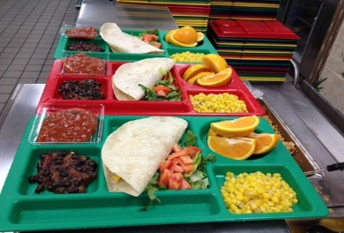
LES Handbook
(208) 686-1651
2024-2025
www.pwsd.com
Student Schedule
Elementary students are expected to maintain 90% attendance at school with minimal absences. Absences/tardies may be considered when deciding to retain or promote a student for the next school year. When school officials believe a student has been excessively absent or tardy, social services or juvenile courts may be contacted.
Back
Preschool 8:15-11:30 T-F
Kinder. - 5th Grade 7:55-3:00 M-F
Early Release dismissal–1:00 (K-5)
Breakfast is served before school.
Attendance
Regular school attendance is necessary for children to achieve academic success. It is important for children to be in school all day, every day. The school will send a letter home to parents when a child has missed 3 days of school. After a total of 6 days, a second letter will be mailed home inquiring how we might assist you in helping your child improve their attendance.
If your child is ill, please call the school office at 686-1651 between 7:30 a.m. and 8:30 a.m. to report they will be absent. Submit a doctor’s note if your child has a prolonged illness. Late students must check in at the office. Students arriving to school after 10:00 a.m. or departing from school before 1:00 p.m. will be recorded as absent a half day. All tardies and absences are recorded.
If you need to pick up your child from school, please come to the office to sign him/her out. No child will be allowed to leave the building during the school day without being signed out by the legal parent or guardian.
Free Breakfast/Lunch Program
breakfast and lunch for all students during the 2024-25 school year.
Adults are welcome to join their children for lunch but must purchase a lunch at the cost of $4.35 per meal.
The district has been granted approval through the USDA Community Eligibility Program to provide free
Non-Discrimination
The Plummer Worley Joint School District No. 44 complies with all state and federal rules and race, color, religion, national origin, age, gender, disability, marital, sexual orientation, or any other legally protected status. This holds true for all district employment, opportunities, and programs. PWSD 504 Coordinator:
Tara Lere at 208-686-1621
Working together to Educate and Prepare Positive, Motivated, and Successful Citizens. 3

Slide 4

LES Handbook
(208) 686-1651
2024-2025
www.pwsd.com
Emergency Closures
Personal Belongings
Back
Due to changing weather and road conditions, school may be delayed or canceled. A decision will typically be made by 6:00 a.m. whether we will close school for the day or be delayed 2 hours. These will pertain to both students who are bussed and walk to school.
Please make sure the school office has your updated contact information as the school has an automated telephone system to alert you of any changes or canceled days. This will also let you know of any special events to attend.
In the event of any school closure or emergency, you may receive an automated phone call notifying you of how to proceed, or you may receive an email notifying you of a situation. Please keep in mind any and all communications during an actual emergency are provided only after approval of law enforcement in charge of the emergency.
Any changes in our regular schedule will be announced on local radio and television stations, as well as Facebook. If we announce that school is delayed for 2 hours, there is a possibility that school will still be canceled if weather conditions worsen or the roads cannot be cleared. If school is delayed, breakfast will not be served at school.
Students may not bring personal belong-ings such as collectibles, radios, cameras, skateboards, iPods, headsets, toys, etc., to school, as they are frequently broken or lost. We will not be responsible for these items. Leave them home. Students are not permitted to use cell phones at school.
Dispensing Medication
Parents must fill out forms at the time
the medication is brought to the school. All prescription medication must be submitted in person by the parent/ guardian (in filled Rx labeled containers with unit dosages) to the office. The pre-scription must be current. All dosages will be administered and recorded through the office medication log.
School employees may assist in the self-administration of an over the counter drug for a pupil provided it is in compliance with written instructions, provided from home in its original container, and if the parent/guardian consents in writing. The over the counter drug
will be kept in the office in a locked box.
Video Surveillance
The Plummer/Worley School District may use video surveillance in all buildings that are school district property.
Working together to Educate and Prepare Positive, Motivated, and Successful Citizens. 5

Slide 5

LES Handbook
(208) 686-1651
2024-2025
www.pwsd.com
Health, Injury or Illness
Back
Communication
The school board recognizes that school personnel are responsible for providing first aid or emergency treatment in cases of sudden illness or injury to a student, but further medical attention is the responsibility of the parent or guardian.
The principal, or designee, shall make every reasonable effort to contact the parent so proper treatment can be arranged. In the event that the parent cannot be reached and immediate medical attention is required, the injured student may be taken directly to the hospital and receive treatment by an EMT or the physician on call. When the parent is located, he/she may then choose to continue the treatment and/or make other arrangements.
Please keep the school informed of any medical needs of your child, including allergies, medications, and injuries, so your child remains safe at school.
Please make sure that the office has your current home and work phone numbers as well as your designated person’s current home and work phone numbers so that we can reach someone at all times.
ages to the students, especially at the end of the day. If you need to call with different plans for your child, please call before 1:00 p.m.
The school office is open from 7:30 a.m. to 3:30 p.m. Monday through Friday. The best time to reach your child's teacher is from 7:45 to 7:55 a.m. or 3:00 to 3:30 p.m. A written note, voicemail, or e-mail are other effective ways to communi-cate with your child's teacher.
Student use of phones is reserved for important situations or emergen-cies and such commun-ications are done in the office. Please make all arrangements for your child’s after-school activities prior to your child leaving home in the morning and commun-icate these to the school through a note with your child.
It is extremely difficult to get last minute mess-
Parent/Teacher Conferences
LES is interested in fostering greater Parent/Teacher engagements. There are two regularly-scheduled Parent/Teacher Conferences during the school year:
November 4 & 6-7, 2024 (Evening Conf.)
March 26- 27, 2025
Working together to Educate and Prepare Positive, Motivated, and Successful Citizens. 5

Slide 6
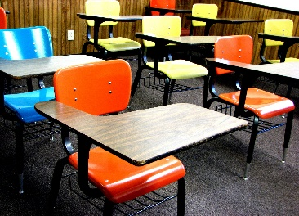
LES Handbook
(208) 686-1651
2024-2025
www.pwsd.com
Alcohol, Tobacco, Vape and Drug Policy
of the book(s). Please help your children keep current with book returns so they may continue to check out books.
Back
Lakeside Elementary and the Plummer Worley School District takes a firm stand that any use of alcohol, tobacco, vaping paraphernalia, or drugs by students is abuse. Students, while on school property, or within a “Drug Free School Zone”, or attending a school sponsored activity, who possess, distribute, sell, use or give evidence of having used tobacco, consumed alcoholic beverages, drugs, or narcotics not taken at the direction of a physician, or other controlled or dangerous substances, or are in possession of paraphernalia, shall be subject to intervention, discipline, suspension, expulsion and/or appropriate alternatives.
State Testing Schedule
The most notable of all standardized assessments in the State of Idaho is the Idaho Standards Achievement Tests (ISAT). The ISAT assesses the areas of
Reading, Mathema-tics, Science and Language Usage; The ISAT is conducted one time a year for students in Grades 3-5. LES will conduct the ISAT during the months of April & May.
The Idaho Reading Indicator (IRI) is a required State of Idaho assessment. Students in
Kindergarten through 3rd Grade take this annual assessment. The IRI is conducted twice a year. LES conducts the IRI in
September and May.
Library
All students visit the school library on a regular basis to check out books. The number of items a student may check out varies according to grade level. The main goal of the library program is to encourage the enjoyment of reading for pleasure and to gain knowledge.
Students are responsible to keep books safe and dry. Any lost or damaged book(s) will result in a fee for the replacement or repair
Student Insurance
Student accident insurance information is provided on request. Students are not covered by district insurance in the event of an accident.
Check with the school office with questions regarding this application.
Working together to Educate and Prepare Positive, Motivated, and Successful Citizens. 6

Slide 7
LES Handbook
(208) 686-1651
2024-2025
www.pwsd.com
Accommodation of Individuals with Disabilities
School Board policy and is subject to change.
State and Federal Statute
Under special circumstances, State and Federal Statue may take precedence over any rule or regulation in this handbook
Back
Individuals with disabilities shall be provided a reasonable opportunity to participate in all school-sponsored services, programs or activities on an equal basis to those without disabilities and will not be subject to illegal discrim-ination. The District will provide aux-iliary aids and services where appro-priate to afford individuals with disabilities equal opportunity to participate in or enjoy the benefits of a service, program or activity.
The District will take reasonable measures to see that each service, program or activity operated in existing facilities shall be readily accessible to, and useable by, individuals with disabilities. New construction and alterations to facilities existing before Jan. 26, 1992, will be accessible when viewed in their entirety.
Individuals with disabilities should notify the Superintendent or building principal if they have a disability which will require special assistance or services, and, if so, what services are required. This notification should occur as far in advance as possible of the school-sponsored function, program, or meeting.
This handbook is a reflection of the
Volunteers
Volunteers are an important part of our school. One can work directly with students under teacher supervision, assist the librarian, or volunteer in other approved settings. Volunteering is built around one’s schedule. Applications are available in the school office.
Web Site/Social Media
School information can be obtained at www.pwsd.com. You can find announcements, menus, calendars, and policies. Information from the secondary schools and district office are also available, along with email links for every staff member.
Like and follow us on Facebook at: www.facebook.com/Plummer-Worley Joint School District No. 44
Working together to Educate and Prepare Positive, Motivated, and Successful Citizens. 7

Slide 8
LES Handbook
(208) 686-1651
2024-2025
www.pwsd.com
Dress Code
Back
In an effort to provide an atmosphere that enhances learning, instills discipline, prevents disruption and avoids safety hazards, the district reserves the right to insist that the dress and grooming of students are within the limits of generally accepted good taste for the activity in which the student is engaged. When a student’s appearance causes undue attention, is in poor taste, or causes a disruption to the educational environment, the student may be asked to change and may be subject to disciplinary action.
To maintain a safe, positive, gang-free environment that does not disrupt or distract from the educational purpose, the following regulations have been established to supplement the policy of the Plummer-Worley School District:
Hoods or bandannas may not be worn in the school during the school day.
Pants/shorts may not be excessively baggy and/or low riding and must be worn above the hip.
Undergarments may not be visible at any time. Clothing, including jeans and leggings, which expose skin or undergarments below the shoulders or higher than three inches below fingertip length, are prohibited.
Any form of sleepwear, as determined by administration, is not appropriate or allowed at school.
Shirts must be modest, cover the tops of shoulders and midriff, and must not be excessively low in the front. No cleavage or undergarment may be showing. Prohibited items include but are not limited to: spaghetti straps, halter tops, tube tops, bro tanks, racerback shirts, cut off jerseys, and cut off t-shirts.
Shorts and skirts must be at least three inches below fingertip length.
Clothing and personal items that promote, advertise, or display profanity, vulgarity, racially or sexually offensive/suggestive expressions, firearms or weaponry, drugs or drug culture, alcohol, vaping, or tobacco products are not allowed.
Any items identified as gang related or gang "colors" will not be allowed. This includes the wearing of gang-related tattoos, tagging or marking of books and notebooks, and the use of hand gestures or signing, which signifies gang activity. Any gang related activity will be reported to the police and may result in suspension or expulsion from school.
Contacts that alter/conceal the normal appearance of the eye are prohibited.
Working together to Educate and Prepare Positive, Motivated, and Successful Citizens. 8

Slide 9
LES Handbook
(208) 686-1651
2024-2025
www.pwsd.com
Staff
Back
Inclusion Preschool
Josie Schultes
Megan Libby
Kindergarten
Arynn Gomez
Grade 1
Kylie Allen
Grade 2
Jen Giulio
Grade 3
Kara Harkness
Michelle Studer
Grade 4
Paul Gorton
Grade 5
Tony Vandever
Art
Rebecca Lewis
Music
Rebekah Hendricks
Physical Education
Caleb Harms
Reading Specialist
Caralyn Olson
Counselor
Jestine Hensley
Special Education
Laurie Flack
Heather Stockton
Megan Em
Ashley Schaefer
Speech/Language
Bethany Sailors
Occupational Therapy
Laura Longinotti
Physical Therapy
Miriam Basye
Success Center
Rachel LaCroix
Federal Programs
Corin Peone
Attendance Advocate
Boone Giulio
Principal
Dani Boyd
Office Manager
Lisa Wilson
District Nurse
Mariah Morris
Day Care
Kim Campbell
Nicole Middleton-Whitman
Custodians
Tracey Way
Zach Ozuna-Wilbur
Food Service
Ashley Anderson
Kristine Diviak
Michelle Renfrew
Bus Drivers
Suzie Brazil-Geyshick
Cathy Horlacher
Jackie Noice
Melanie Gallagher
Mel Gallagher
Les Hall
Jim Moos
Working together to Educate and Prepare Positive, Motivated, and Successful Citizens. 9

