Slide 1

Bullying
You Can Help to Put an End to It!
By Joy Martin

Slide 2
What is Bullying Any hurtful repeated action or word that involves misuse of power.
Verbal – Taunting, name-calling, put-downs, threats, intimidation, spreading rumors
Physical - Hitting, kicking, destruction of people and/or property
Relational (Emotional) – Rejecting/excluding peers
Cyber - Using cyber technology to hurt, threaten, spread rumors
Notes:
-Bullying – What sets bullying apart from other types of conflict is that there exists an imbalance of power. A person can often solve a conflict by him/herself. With bullying, the victim often needs help from another person to make it stop.
-Physical bullying – often boys
-Relational bullying – often girls
-Bullying Statistics?

Slide 3

What Are Bullies Like
Value dominance and aggression
Little empathy for others
Quick tempers
Gain satisfaction from hurting others
Want their own way
Find it difficult to see things from others’ point of view
Difficulty controlling self
Difficulty following rules
Notes:
-Bullies want power and will use others to get what they want.

Slide 4
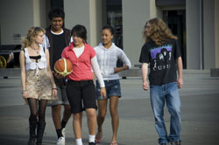
What Can The Victim Do About Bullying
Avoid the bully
Walk away
Hang out with friends
Talk it out
Distract the bully with a joke
Tell an adult

Slide 5

The Bystander The most powerful force to stop the bully
Never encourage the bully
- Joining in or laughing with the bully gives the bully more power
- Even doing nothing makes you part of the problem, not the solution
“There are no innocent bystanders!”
Take action to stop the bully
Confront the bully
-Tell the bully to stop
-Help the victim to walk away
-Get friends to help
-Befriend the victim
-Get an adult
“When peers intervene, bullying stops within 10 seconds!”
Notes:
-Bystanders are present 85% of the time bullying occurs
-Bystanders who egg on, join in, or do nothing are all just as responsible for the bullying as the bullies themselves!
-Stop – “That’s not right. Leave him alone.”
-Help walk away – “Hey Sarah, can you come here a minute? I need to ask you something.”
-Get friends to help – “Will you guys come with me to help Robert?”
-Befriend – “Maria, do you want to sit with us at lunch?”
-Get adult – “I think someone needs help.”
-Most victims are unlikely to report bullying. Bystanders can be their voice.
-Most kids feel uncomfortable witnessing bullying, but few intervene

Slide 6
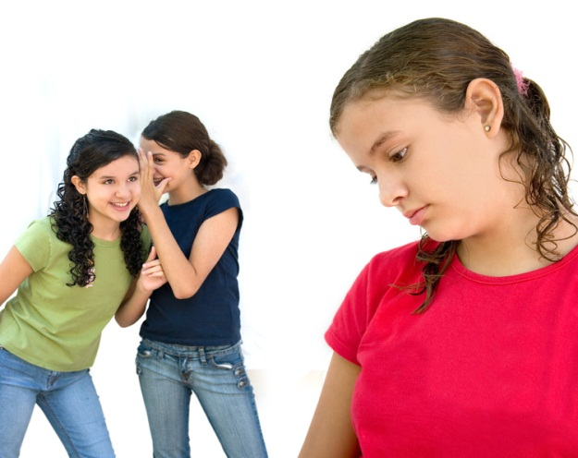
Gender Plays a Role
Both boys and girls engage in verbal bullying
Boys are more likely to bully in physical ways
Girls are more likely to bully socially (excluding, manipulating social
situations
Notes:
-Teens who are repeatedly victimized sometimes see suicide as their only escape
-The emotional scars of bullying can last a lifetime
-Students in grades 7-12 say revenge is the strongest motivation for school shootings
-86% said, ‘other kids picking on them, making fun of them, or bullying them’ can cause teenagers to turn to lethal violence in school
Statistics?

Slide 7

Cyber Bullying
Making fun of someone in a chat room
Harassing a user over an instant message
Posting derogatory messages on a user's Facebook or MySpace page
Circulating false rumors about someone on social networking websites
Publishing lewd comments or unflattering pictures of someone on a blog or the Web
Sending someone unwanted , threatening, or provocative e-mail messages
Sending unsolicited text messages or making repeated calls to someone

Slide 8

Signs Your Child May Be a Victim of Bullying
Physical
-scrapes, bruises, damaged belongings
-stomachaches, headaches
Emotional
-changes in mood- sad, irritable, temper outbursts
-loss of interest/reluctant to go to school
-socially isolated

Slide 9
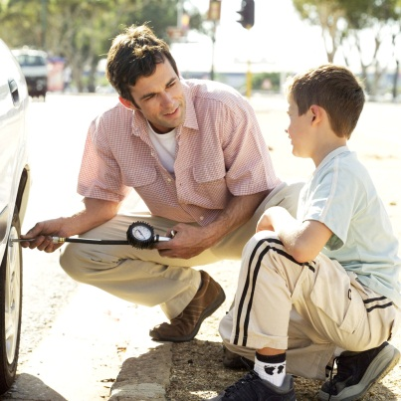
What Parents Can Do
Listen carefully
Be sympathetic & take it seriously
Be careful not to overreact or under-react
Teach your child social skills and how to be assertive, not aggressive
Encourage your child to tell teacher, school counselor, bus driver, principal
Act in your child’s behalf in contacting the school
Seek help from mental health professional if interventions not helping

Slide 10
What The School Can Do
Create a safe & positive environment
Establish clear & concise class/school rules of expected behavior
Teach children individually, in small groups, and as a class ways to handle bullying and positive conflict resolution
Work with the bully and the victim
Encourage children to report bullying
Take bullying seriously
- investigate
- carry out appropriate consequences
- follow up with parents
Encourage parental involvement

Slide 11
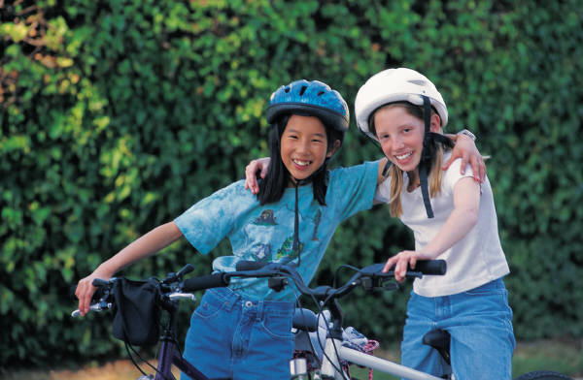

What We All Can Do Foster Resiliency in Children
Make good friendships
Practice well-being
- proper nutrition
- sleep
- exercise
- relaxation strategies
Participate in enjoyable activities
Look for the positive
As the adults in our children’s lives
- model appropriate coping strategies
- support and reassure

