Slide 1






HACIENDA LA PUENTE UNIFIED SCHOOL DISTRICT
School Site Improvement Projects
Regular Board Meeting August 22, 2024
Business Services
Notes:
Good evening Ma’dam President, Ms. Christine Salazar, Distinguish Board Members; Superintendent, Dr. Jimenez, Executive Cabinet, Colleagues, and community members.
A special greetings to our Principals, Administrators, staff member who are joining us via the virtual platform.

Slide 2

PROJECT COMPLETE LIST
2024/2025
Site | Item Description | Funding Source | Completed Date
California | Bottle Filling Station | Facilities | 08/2024
Cedarlane | Playground Asphalt | Facilities | 08/2024
Cedarlane | Portable Installation | Facilities | 08/2024
Grandview | Parking Lot Restriping | Facilities | 08/2024
Los Molinos | Bottle Filling Station | Facilities | 08/2024
Mesa Robles | Classroom Flooring | Facilities | 08/2024
Wing Lane | Playground Restriping | Facilities | 08/2024
Wing Lane | Portable Installation | Facilities | 08/2024
Districtwide | Banners | Facilities | 07/2024
Wilson High School | Little Theatre Improvement | CTE Grant | 07/2024
Changes And Progress Since Last Report - Blue

Slide 3

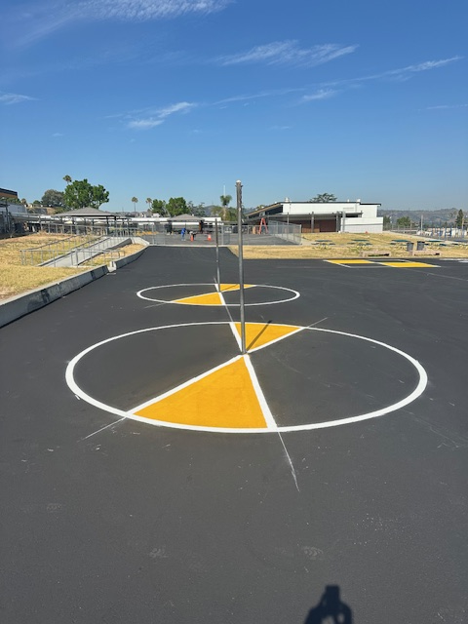
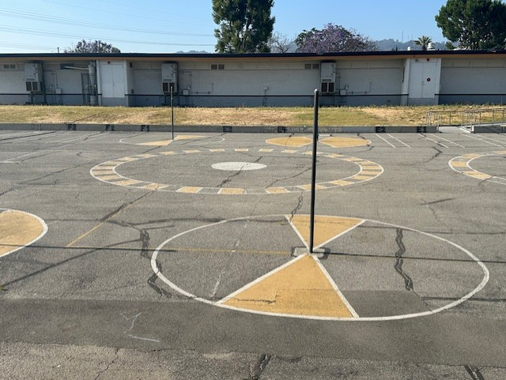
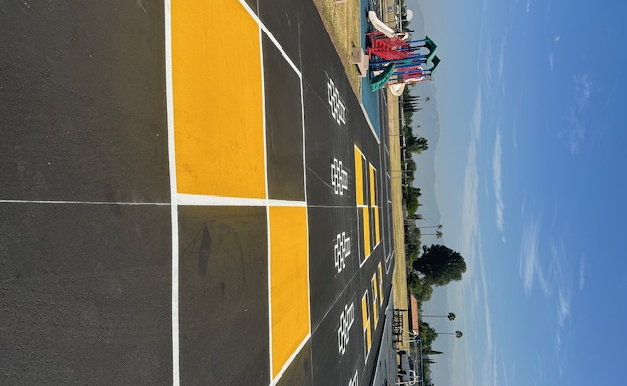
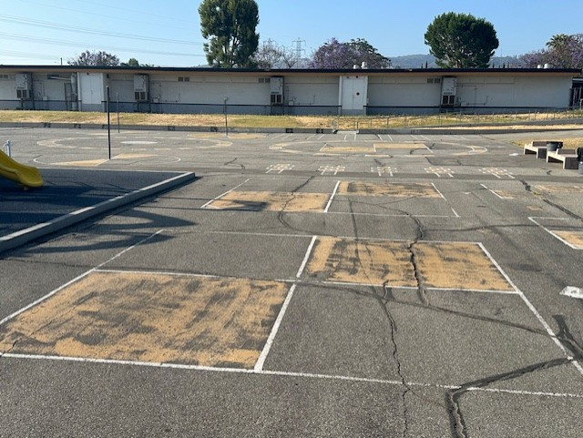
Projects Completed as of August 22, 2024
Cedarlane Academy – Playground Asphalt
BEFORE
AFTER
BEORE
AFTER

Slide 4
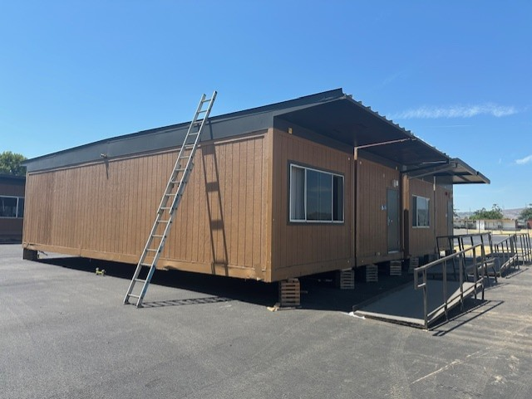
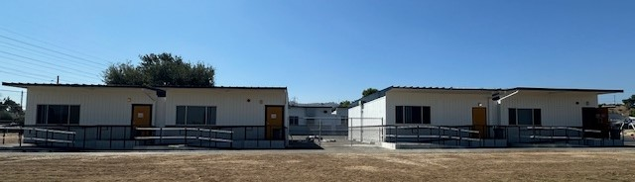
Projects Completed as of August 22, 2024
Cedarlane Academy - Portable Installation
WORK IN PROGRESS
AFTER
BEORE
AFTER

Slide 5
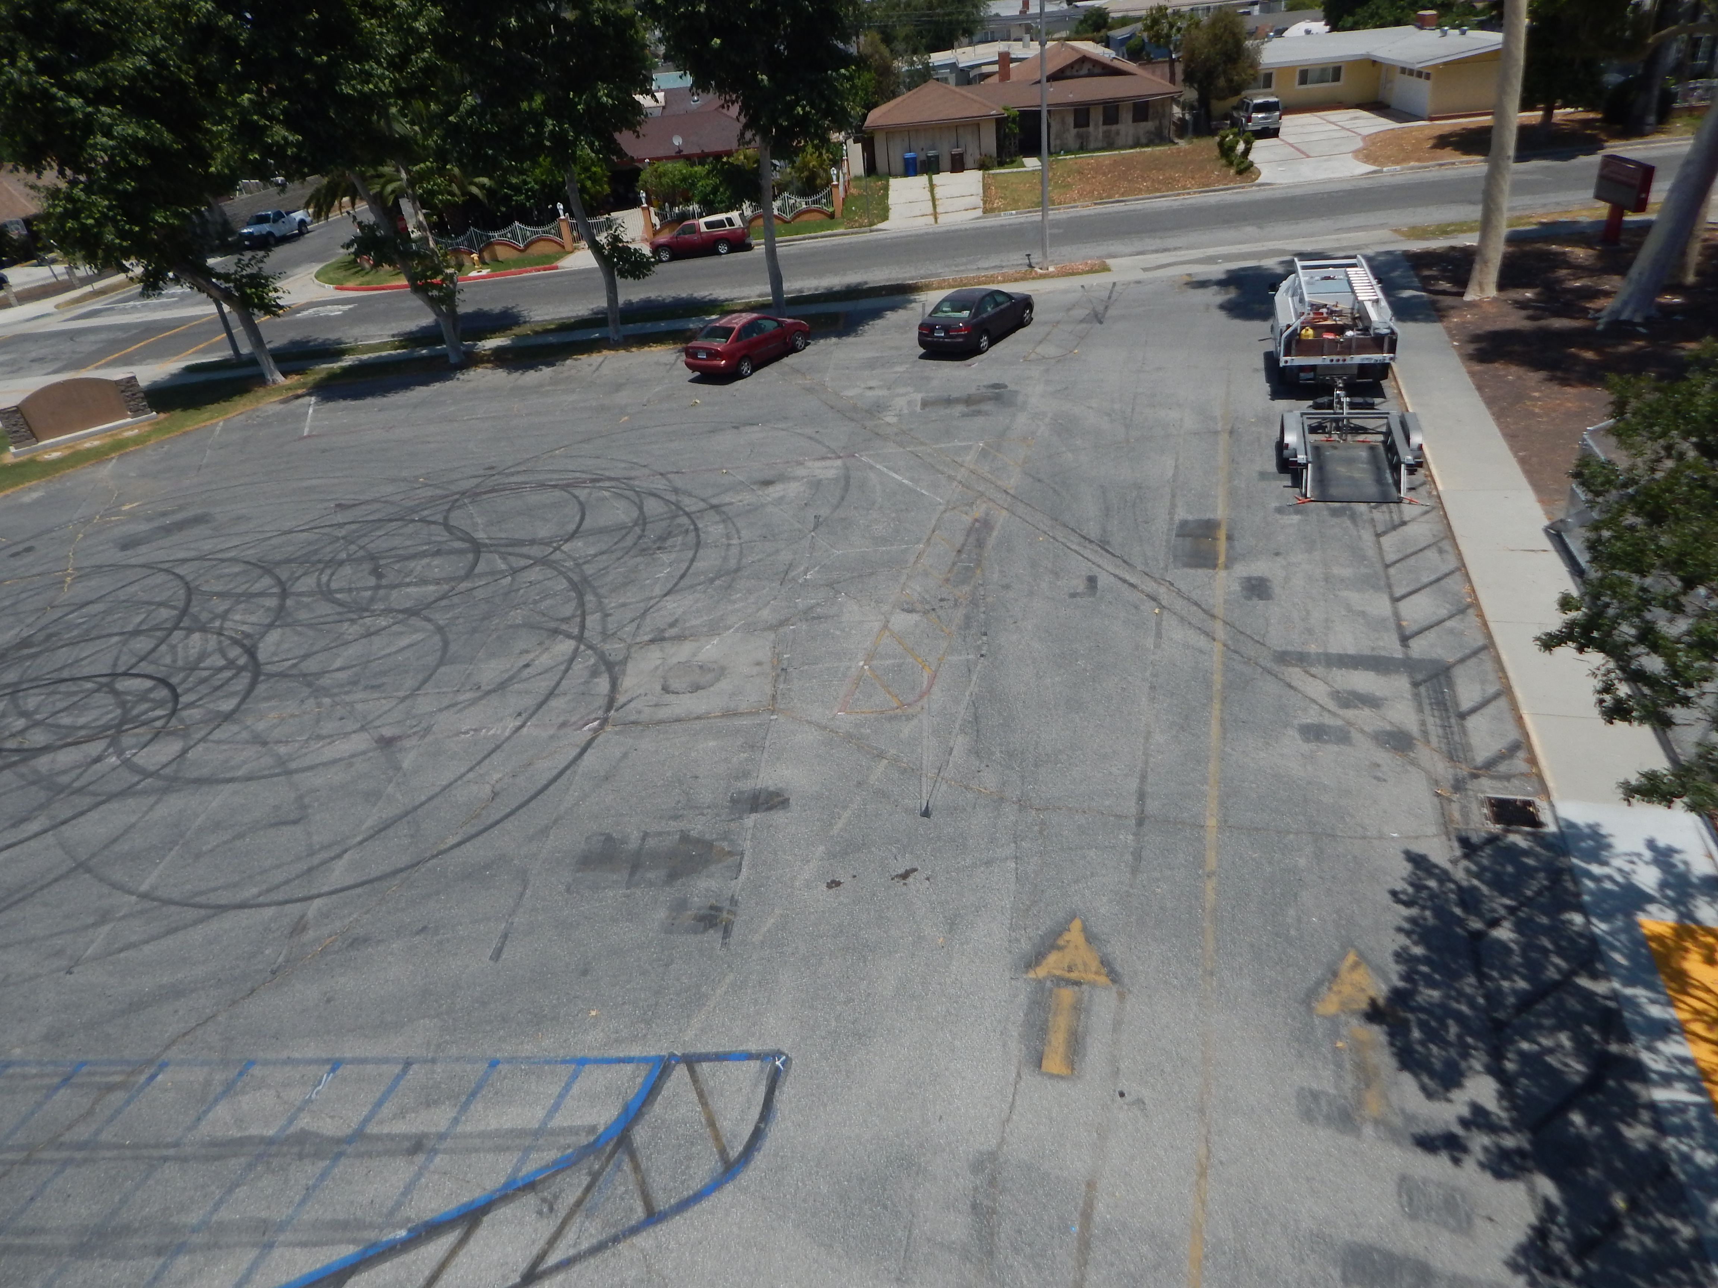
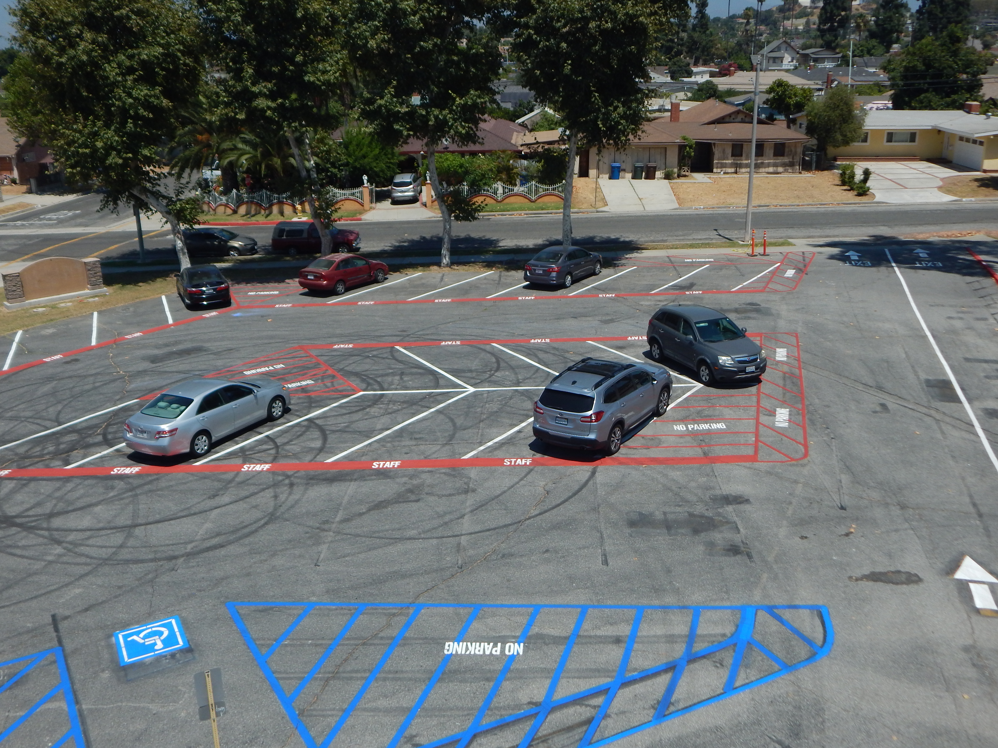
Projects Completed as of August 22, 2024
Grandview Academy – Parking Lot Restriping
BEFORE
AFTER
BEORE
AFTER

Slide 6
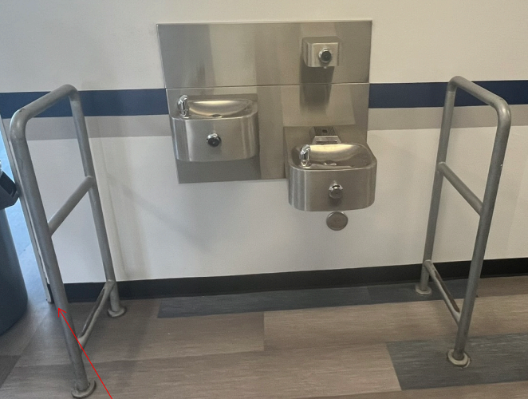
Projects Completed as of August 22, 2024 Los Molinos Elementary – Bottle Filling Station

Slide 7
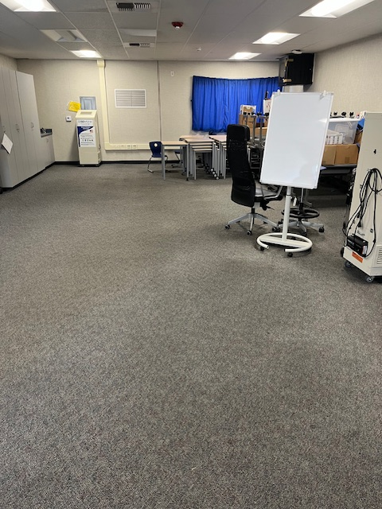
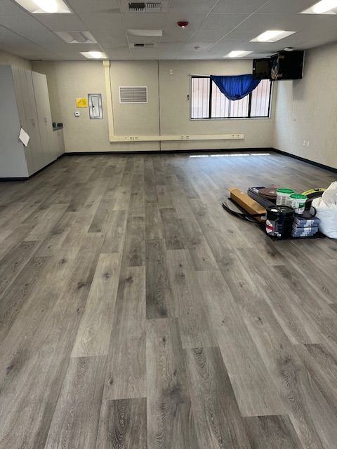
Projects Completed as of August 22, 2024
Mesa Robles Academy – Classroom Flooring
BEFORE
AFTER
BEORE
AFTER

Slide 8
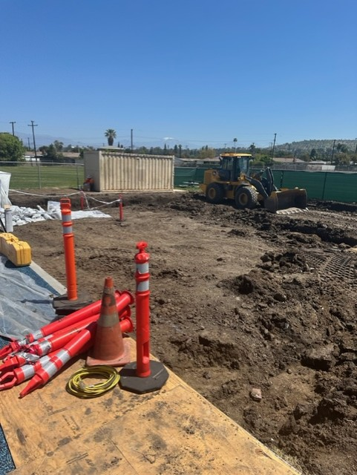
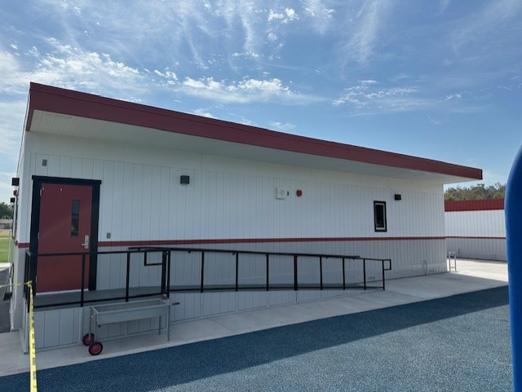
Projects Completed as of August 22, 2024 Wing Lane Elementary – Portable Installation
BEFORE
AFTER

Slide 9

Projects In Progress 2024-2025

Slide 10
Projects in Progress as of August 22, 2024
Facilities
Site | Item Description | Architect Plans | DSA Approval | Procurement | Construct | Funding Source | Target Completion Date
District Wide | HVAC System Replacement | Pending | Pending | Pending | TBD | Facilities | TBD
Kwis Elementary | Baseball Fields | Complete | Approved | Pending | TBD | Facilities | TBD
La Puente High School | Custom Shade Structure | Complete | Approved | Pending | TBD | Facilities | TBD
Los Altos High School | Gym & Locker Room HVAC (65 tons of temporary HVAC units have been installed) | Complete | Approved | Complete | In Progress | Facilities | 12/2024
Los Altos High School | Stadium Press Box & Bleachers | Pending | Pending | Pending | TBD | Facilities | TBD
Sparks Middle School | Front Office Counter | NA | NA | Pending | Pending | Facilities | TBD
Wedgeworth | K-5 Permanent School | Complete | Approved | Complete | In Progress | COPS | 06/2025
Wilson High School | Stadium Press Box & Bleachers | Complete | Pending | Pending | TBD | Facilities | TBD
Workman HS | Phase II Stadium and Baseball Field (Phase I Track & Field and Softball Field Complete) OPTION B | Complete | Approved | Approved | TBD | Facilities | TBD
Workman HS | Shade Structure, Wall, & Lighting | In Progress | Pending | Pending | TBD | Facilities | TBD
Changes And Progress Since Last Report - Blue
Notes:
Los Altos High School, expected to begin in July

Slide 11
Projects in Progress as of August 22, 2024
Facilities
Site | Item Description | Procurement | Construct | Funding Source | Target Completion Date
Baldwin Elementary Grazide Elementary Kwis Elementary La Puente High School Los Molinos Elementary Wilson High School | Roofing | Complete | In Progress | Facilities | 10/2024
Stimson Learning Center | Roofing | Complete | Pending | Facilities | TBD
Notes:
Los Altos High School, expected to begin in July

Slide 12
Projects in Progress as of August 22, 2024
Child Development
Site | Item Description | Architect Plans | DSA Approval | Procurement | Construct | Funding Source | Target Completion Date
Amar Children’s Center | Entry Security Project | Complete | Approved | Pending | Pending | Child Development | TBD
Amar Children's Center | Roofing | N/A | N/A | Pending | Pending | Child Development | TBD
Fairgrove Academy Head Start | Playground & Shade Structure | Complete | Approved | Complete | In Progress | Child Development | 09/2024
Nelson Elementary Head Start | Playground, Shade Structure, & Accessibility Path of Travel | Complete | Approved | Complete | In Progress | Child Development | 09/2024
Workman Elementary Head Start | Playground & Accessibility Path of Travel | Pending | Pending | Pending | Pending | Child Development | TBD
Changes And Progress Since Last Report - Blue

Slide 13
Projects in Progress as of August 22, 2024
Special Ed
Site | Item Description | Architect Plans | DSA Approval | Procurement | Construct | Funding Source | Target Completion Date
Lassalette Elementary | Inclusive Playground | NA | NA | Complete | In Progress | General | 09/2024
Adult Ed
Site | Item Description | Architect Plans | DSA Approval | Procurement | Construct | Funding Source | Target Completion Date
Center for the Performing Arts | Construction of NEW Performing Arts Center @ Temple Academy | Complete | Complete | Pending | TBD | Adult Ed | 08/2025
Dibble Adult | Admin Upgrade | In Progress | NA | Pending | Pending | Adult Ed | TBD
Dibble Adult | Roofing | N/A | N/A | Complete | In Progress | Adult Ed | 10/2024
Willow Adult | Marquee | Complete | NA | Pending | Pending | Adult Ed | TBD
Changes And Progress Since Last Report - Blue

Slide 14
Projects in Progress as of August 22, 2024
Nutrition Services
Site | Item Description | Architect Plans | DSA Approval | Procurement | Construct | Funding Source | Target Completion Date
Baldwin Elementary School | Kitchen Renovation - Three Compartment Sink Installation | Complete | NA | Pending | TBD | Food Services | TBD
District Office | Warehouse Freezer | Complete | NA | Pending | TBD | Food Services | TBD
Mesa Robles Middle School | Kitchen Renovation | Complete | Approved | Pending | TBD | Food Services | TBD
Wilson High School | Kitchen Modernization | Pending | Pending | Pending | TBD | Food Services | TBD
Changes And Progress Since Last Report - Blue
Notes:
Kwis Baseball – Will be Re-Bid, uncertified entry was added to scope of work into the project.
Cedarlane Portable – In design phase with PBK architecture. Soils samples being conducted.
Willow Adult School = Two Story Building continues to be under construction. It coming along very well.

Slide 15
Next Report – September 26, 2024

