Slide 1

Synergy LMS
Substitute Training
Students prepared for their future.

Slide 2


Viewing this Module
Due to the nature of the content contained within this module, we are required to secure our video demonstrations on a password-protected website.
Before starting this module, please visit www.office.com and sign in with your Office 365 Credentials:
Username: NetworkID@olatheschools.org
Password: Network Password
Return to this presentation once you are signed in. This will allow you to view the videos.
Notes:
During the Synergy portion of our time together, we will take a look at how interact within Synergy as a long term remote substitute teacher. We will explore how to sign in, take attendance, launch virtual meetings, create and grade assignments and more!

Slide 3
What is Synergy?
Also known as TeacherVUE, the Synergy LMS is a Learning Management System (LMS) in which teachers take attendance, lunch counts, assign and grade work, host class websites, launch virtual class meetings, and manage grades.

Slide 4
How are Teachers
using the Synergy LMS?
All teachers use the Synergy LMS to take attendance, capture lunch counts (Elementary), host class websites, manage grades, and for some, launch virtual class meetings.
Some teachers will also use the Synergy LMS to assign and grade work.

Slide 5
How are Students
using Synergy?
The information that you enter in the Synergy LMS, such as assignments, objectives, and grades will be viewed by students in StudentVUE.
Parents can view their student’s information in ParentVUE.

Slide 6
Synergy Agenda
Sign into Synergy as a Long-Term Sub
Take attendance
Launch Zoom Meetings
Create Assignments
Grade Assignments
Manage the class LMS Page/Class Website
View Student Workload
Communicate with Students/Families
Notes:
During the Synergy portion of our time together, we will take a look at how interact within Synergy as a long term remote substitute teacher. We will explore how to sign in, take attendance, launch virtual meetings, create and grade assignments and more!

Slide 7
Your Accounts
Microsoft
Username - NetworkID@olatheschools.org
Password - OPS Network Password
Google
Username - NetworkID@students.olatheschools.com
Password - OPS Network Password
Synergy
Username - Network Username
Password - OPS Network Password

Slide 8
Synergy
Synergy consists of three different portals:
TeacherVUE
StudentVUE
ParentVUE

Slide 9
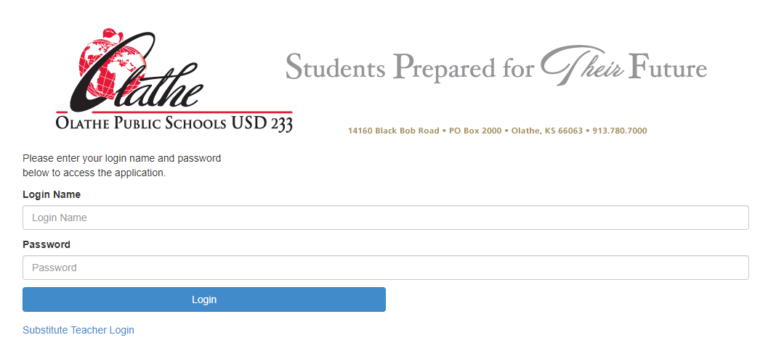
Signing into Synergy
To sign into Synergy:
Double-click on the Synergy icon on your desktop
Enter your login and password
Username: NetworkID
Password: Network Password
Notes:
Jen – Introduce topic of Signing into Synergy
Signing in as a long-term sub is slightly different than signing in as a daily sub.
Rather than clicking “Substitute Teacher Login”, we will sign in as a teacher would.
First, since Synergy is most compatible with the Google Chrome web browser, please be sure to refer to your handbook to see how install Google Chrome on your district-issued device and make it the default browser.
Now take a look at how to sign into Synergy!

Slide 10


Slide 11
Taking Attendance
Please take attendance at the beginning of each class period or day.
Even when all students are present, attendance must be taken.
Remote Subs with classes containing students from multiple buildings will need to perform the steps described in the next few slides for each building.
The video on the next slide will show you how to take attendance in Synergy.
Notes:
Most of us are probably familiar with taking attendance, so we will review taking attendance by seating chart, list, and show you how to take attendance for elementary, secondary, and teachers with students from multiple buildings.

Slide 13
Zoom Meetings in Synergy
Remote teachers recently received updated information for launching Zoom meetings from Synergy.
When meetings are launched in Synergy, students will join their meetings from StudentVUE.
Notes:
Remote teachers recently received updated information for launching Zoom meetings from Synergy.
Today, we will walk you through the steps of scheduling a Zoom meeting for students from multiple schools and launching your Zoom meetings.
When meetings are launched in Synergy, students will join their meetings from StudentVUE.

Slide 14
Launching Zoom Meetings:
One Building
Notes:
Jen - Walkthrough

Slide 16
Scheduling
Zoom Meetings:
Multiple Buildings
Notes:
For Remote Teachers with students from multiple buildings, the process for launching a Zoom meeting looks a little bit different. In this case, we will have to first schedule a meeting that all of our students can join, then launch the meeting. Please remember that these steps are different and should be followed when substitute teaching for a remote teacher that has students from multiple buildings.

Slide 17
Notes:
This elementary remote teacher has students from two different elementary schools.
To schedule a meeting that captures all of her students, we will click Video Meeting

Slide 18
Launching Scheduled Zoom Meetings:
Multiple Buildings
Notes:
Jen - Walkthrough

Slide 20
Create an Assignment
As part of your long-term assignment, your classroom teacher may ask you to create and distribute assignments using Synergy Course Content.

Slide 22
Create an Assignment
without a Grade
There will be times that you will want students to complete work/assignments and you will NOT take a grade.
The next slide will show you how to create an assignment without taking a grade.

Slide 23

Create an Assignment Without a Grade
Demonstration​

Slide 24
Copying Assignments
For your convenience, assignments can be copied from one building to another.
Please refer to pp. 38-41 of the Long-Term Substitute Handbook for detailed instructions.

Slide 25
Grade Book
Teachers and long-term substitutes may enter grades using Grade Book Main or New Grade Book. Both can be used interchangeably, however the New Grade Book contains a few more features.
The next two slides will show you how to access the New Grade Book and explore New Grade Book Features.

Slide 26

Grade an Assignment
Demonstration​

Slide 27
Managing the
LMS Page / Class Website
An LMS Page is also called the Class Website.
If you are in a Hybrid, Systemwide Online Learning, or Remote environment, you will be asked to share the class weekly objectives on the LMS Page/Class Website.
Students and Parents will view the LMS Page on the Class Websites tab in StudentVUE and ParentVUE.

Slide 28
LMS Page / Class Website
Resources
There are a number of resources to help you manage your teacher’s LMS Page. We invite you to explore these at your convenience:

Slide 30
Viewing Student Workload
When you are creating assignments for students, there is a feature in Synergy called "student workload". This feature will allow you to see the workload that students in your class have from you and other teachers so you can adjust accordingly.
The next slide will show you how to View Student Workload.

Slide 31

View Student Workload

Slide 32
Communicating with
Students and Families

Slide 33

Communicate with Students and Families
Demonstration​

Slide 34

Please Remember
Everything in this training is outlined in the handbook with step by step instructions.
We are here to support you along the way.
Let's pass it off to our trainers for ClassLink and Outlook!

Slide 35
Questions?
If you have questions about Zoom or need assistance, please contact the Help Desk at
913-780-8058
or
helpdesk@olatheschools.org
Thank you!! ☺

