Slide 1
Wichita Public Schools McKinney-Vento
Homeless Education Program

Slide 2
What is McKinney-Vento?
The McKinney-Vento law was passed in 1987 in response to homelessness under President Reagan.
The term “homeless means children and youth who lack a fixed, regular and nighttime residence.
All school districts in the United States is mandated to have a McKinney-Vento Liaison.

Slide 3
The purpose of the McKinney-Vento Act is to focus on:
School Stability
Support for Academic Success
The best interest of the child
All homeless children and youth have equal access to an education
Provide resources and services to help the student overcome obstacles and barriers

Slide 4
USD 259 School Board Policy
P1117 Education of Homeless Children and Youth
The Board of Education possess a strong commitment to ensuring that Homeless children and youth receive a meaningful opportunity to enroll in school and attend all public schools in the district. The Wichita Public Schools Office of the Homeless Liaison acts as a resource center for all school personnel facing questions related to homeless children and youth.
The McKinney-Vento Homeless Assistance Act, 42 U.S.C. 11435 et.seq., Requires that all schools in USD 259 provide homeless students with immediate access to an education.

Slide 5
Classifications of homeless under the McKinney-Vento Act
Students qualify due to economic hardship, loss of housing due to eviction or natural disaster, domestic violence and unable to work due to health reasons.
Housing situations must be temporary.

Slide 6
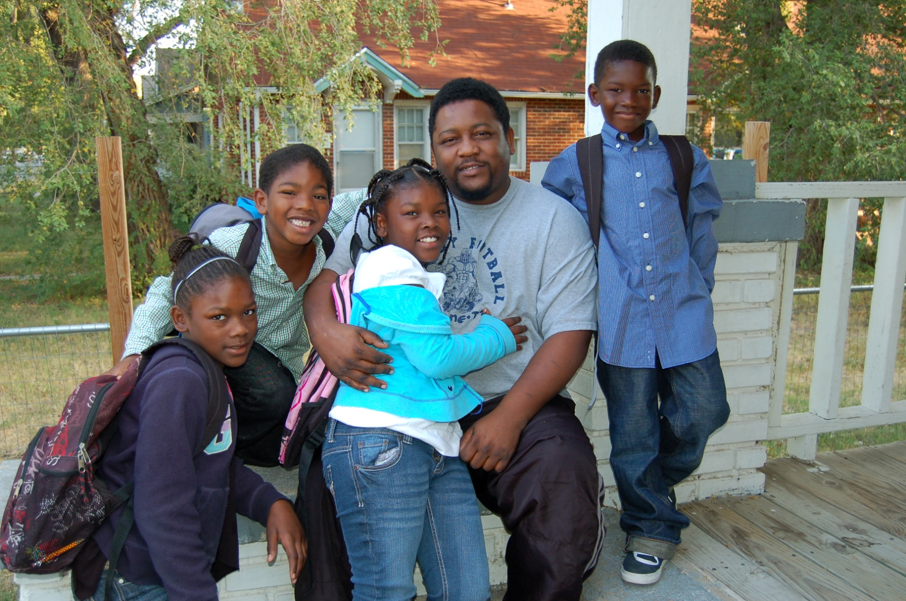
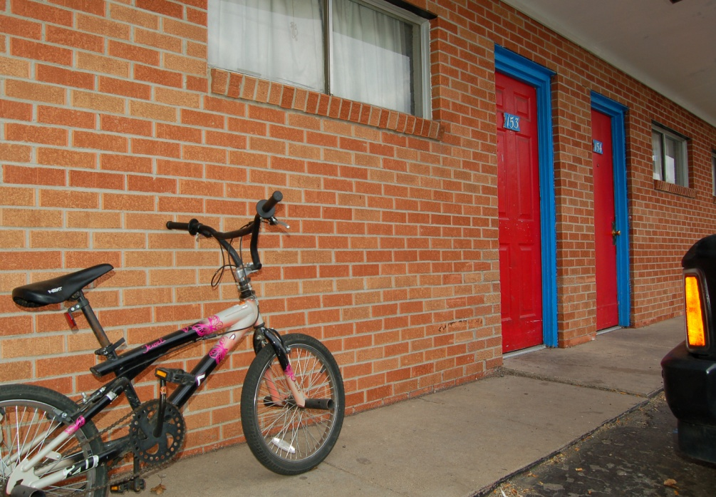
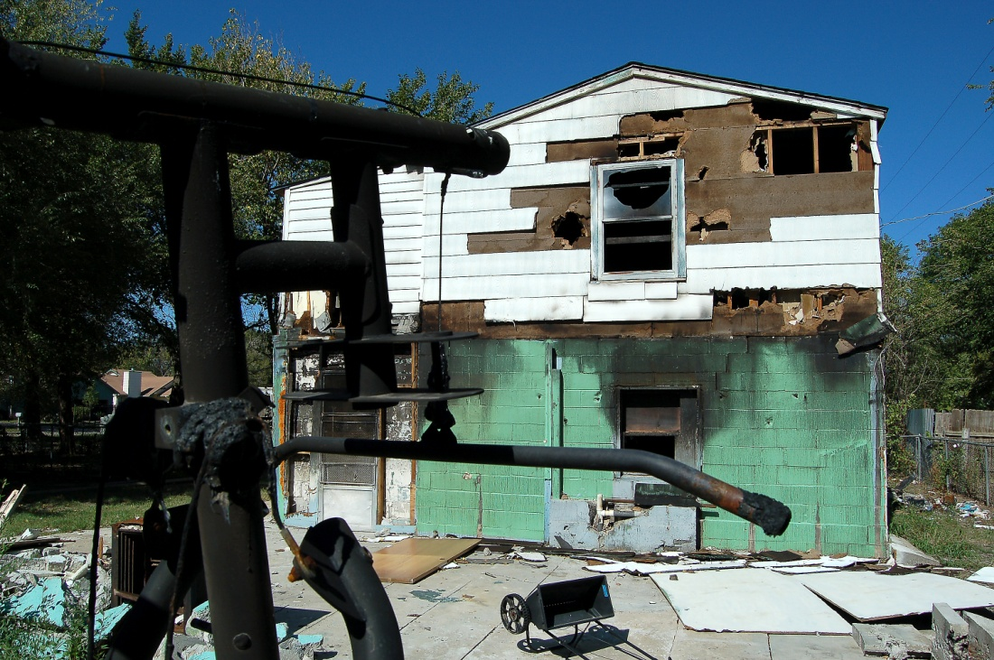
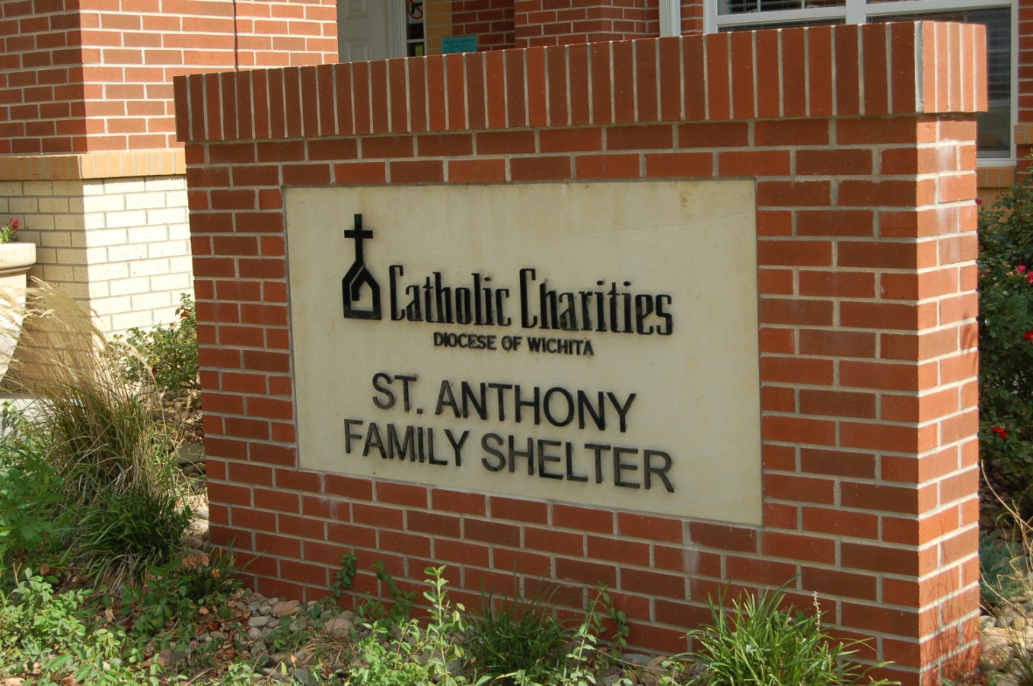
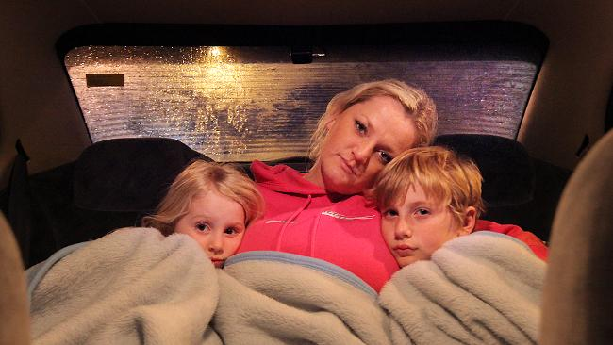
Displaced due to a fire or other natural disasters
Doubled up with family or friends
Living in a hotel or motel
Living in a car, campground or inadequate housing dwelling
Unaccompanied youth without parent or guardian support
Living in a shelter, transitional housing, drug rehab center

Slide 7
Identifying Students in Homeless Situations
Children and Youth who are homeless are difficult to identify for many reasons and often go unnoticed by school personnel. Students and parents are often embarrassed about the situation. Many fear of having their children taken away from them if they are homeless. Using the term “Families in Transition” helps eliminate embarrassment.

Slide 8
Identifying Students in Transitions
Every student must fill out an enrollment residency questionnaire form when they are enrolling in school. The form is then sent to our office where we will process it and determine if they qualify for our program. Students may also be identified throughout the school year. If a staff person feels that a student may qualify for our program they can refer that student to their school McKinney-Vento designee or Social Worker.
Students are assigned to a family support worker. Students are in the program for the academic school year even if they move into permanent housing.
They must requalify every school year.

Slide 9
Unaccompanied Youth
Unaccompanied youth have no parent or guardian support. Living on their own, often couch surfing going from place to place. They may lack safe and stable housing, lack of support from a caring adult and lack of basic needs. They have a right to immediate enrollment without proof of guardianship and have an equal access to an education. The McKinney-Vento liaison may act on behalf of the unaccompanied youth.

Slide 10
McKinney-Vento Forms can be accessed on the USD 259 Website
Go to USD 259 Website
Sign In
Go to Departments
McKinney-Vento Homeless
Click on forms

Slide 11
Services Provided to Children and Youth
The McKinney-Vento program helps the student overcome the obstacles and barriers to an education so that they can be successful in school.
All students in the McKinney-Vento program receive services, resources and referrals.
Students receive Immediate nutrition services
Student may receive transportation if they live more than 2.5 miles from school.
Fees are temporarily waived until confirmed. Once confirmed all fees will be waived. Parents are responsible for fees if they do not qualify.
McKinney-Vento provides school supplies, uniforms, hygiene and other supplies and resources needed for school.
Cap and gown is also provided by the program.

Slide 12
Recognizing Signs of Students in Transition
While these are considered common signs, please recognize that
they are only for general guidance.
Erratic attendance and tardiness and not being picked up on time
Hygiene issues/lack of cleanliness
Hungry (may hoard food)
Fatigue (falling asleep during school)
Change of behavior
Gets nervous when it’s time to go home
Clinging to possessions
Statements made by parent, guardian or the child

Slide 13
For more information or assistance with a student please contact the McKinney-Vento Liaison.
Cynthia Martinez
cmartinez@usd259.net
316-9734670 office
316-210-3309 cell
Website: https://www.usd259.org/Domain/637
Face Book: USD 259 McKinney-Vento Homeless Education Program
Instagram: Mckinney_Vento_USD259

