Slide 1
Title IX Training
Sharon Rye
Director of Employee Relations, Title IX and ADA
(316) 973-4616
srye@usd259.net

Slide 2
Agenda:
Title IX and the definition of sexual harassment
The Title IX complaint process
Resources for Title IX complainants and respondents
The three roles in the Title IX complaint process:
Title IX Coordinator
Investigator
Decision-maker
Appeal process
Recordkeeping
Retaliation Prohibited

Slide 3
What is Title IX?
Federal law that discrimination on the basis of sex in education programs and activities.
Discrimination on the basis of sex includes sexual harassment and dating violence.
The Title IX regulations were recently amended to change the definition of sexual harassment and the process for addressing Title IX complaints.

Slide 4
Definition of Sexual Harassment
Sexual harassment shall include conduct on the basis of sex involving one or more of the following:
A district employee conditioning the provision of an aid, benefit, or service of the district on an individual’s participation in unwelcomed sexual conduct;
Unwelcome conduct determined by a reasonable person to be so severe, pervasive, and objectively offensive that it effectively denies a person equal access to the district’s educational program or activity; or
Sexual assault, dating violence, domestic violence, or stalking.

Slide 5
Education Program and Activities
Includes “locations, events, or circumstances over which the recipient exercised substantial control over both the respondent and the context in which the sexual harassment occurs….”
Consider factors such as whether the district funded, promoted, or sponsored the event or circumstance where the alleged harassment occurred.
No single factor is determinative.
“In the United States”
Notes:
Clothing expressing support for “Black Lives Matter,” “All Lives Matter,” “Blue Lives Matter,” and “MAGA,” or other such messages should NOT be prohibited.
If apparel is likely to generate ill-will based upon race, ethnicity, religion or gender, are prohibited. P 1119 prohibits clothing that denotes, “KKK,” “White Supremacy,” “Black Power,” “Confederate flags or articles,” “Neo-Nazi” or any hate group (except in purely educational settings for purely educational purposes. This list is non-exclusive. The same standard applies to all District employees.

Slide 6
Notes:
To assure proper delivery of the curriculum, teachers should confine classroom discussions to matters relevant and necessary to teaching the particular subject matter.

Slide 7
No Conflict of Interest or Bias
The Title IX Coordinator, Investigator, and Decision-Maker must be free of conflicts of interest and bias.
Impartial, no prejudgment of the allegation.
What is Conflict of Interest or Bias?
Applying sex stereotypes as a factor;
Harboring a bias for or against an individual complainant or respondent;
Considering an individual’s status as a complainant or a respondent as a negative or a positive.

Slide 8
Examples of Conflict of Interest or Bias
All complaints of sexual assault by a female against a male are true and the complainant should be believed over the respondent.
Stereotypical notions of male and female behavior.
Reliance on statistical evidence to support credibility of one party over the other.
Prior relationship with a party that materially affects ability to remain impartial.
Viewing an academically successful student as more likely to be telling the truth than a struggling student.
Viewing a witness of your race as more credible than a witness of a different race.

Slide 9
Title IX Coordinator

Slide 10
Report of Sexual Harassment
District must respond when any employee has “actual knowledge” of sexual harassment.
Actual knowledge:
Notice of sexual harassment, including claims of sexual harassment.
Could include witnessing the conduct, hearing about the conduct from someone else, or receiving a written report about the conduct.
Other school employees report claims to Title IX Coordinator.

Slide 11
Formal Complaint
At the time of the filing of a formal complaint, the complainant must be participating in or attempting to participate in the education program or activity of the District where the formal complaint is filed.
A formal complaint may be filed with the Title IX Coordinator in person, by mail, or email, or by any other means that results in the Title IX Coordinator receiving the report.
A formal complaint contains the physical or digital signature, or otherwise indicates that the complainant is the person filing the formal complaint (unless signed by the Title IX Coordinator).

Slide 12
Formal Complaint
The form for students making a formal Title IX complaint is available at: https://www.usd259.org/domain/138
The form for staff making a formal Title IX complaint is available at: https://www.cognitoforms.com/USD259WichitaPublicSchools1/SexualHarassmentIncidentReportEmployees
Title IX Coordinator will make an initial determination of whether, if everything in the complaint is true, the conduct alleged would constitute Title IX sexual harassment.
If not, then we can follow our procedures for the handling of other complaints.

Slide 13
Supportive Measures
Supportive measures must be offered as soon as the District has notice of a possible Title IX issue, and to the Respondent after a complaint is filed.
Avoid burden: Supportive measures must be non-punitive, non-disciplinary, and not unreasonably burdensome to the other party.
Individualized: Supportive measures must ensure equal educational access, protect safety, and/or deter sexual harassment.
Examples: Counseling, adjustment of class schedule, extending deadlines, campus escort, increased security and monitoring, and/or mutual restrictions on contact between the parties.

Slide 14
Informal Resolution Option
If an informal resolution is desired, the parties are to be provided written notice disclosing:
The allegations
The requirements of the informal resolution process (including the circumstances under which it precludes the parties from resuming a formal complaint arising from the same allegations)
That at any time prior to agreeing on a resolution, any party has the right to withdraw from the formal resolution process and resume the grievance process with respect to the formal complaint, and
Any consequences resulting from participating in the informal resolution process, including any records that will be maintained or could be shared.
Process cannot be used where an employee is alleged to have sexually harassed a student.

Slide 15
Advisor of Choice
The Complainant and the Respondent have the same opportunity to have “others present” during any complaint proceeding.
May be a parent, family member, attorney, or other person.
The advisor may be present for any meeting or interview and may inspect and review any evidence obtained.
The District can regulate the extent to which the advisor may participate in the proceedings, so long as the restrictions apply equally to all parties.

Slide 16
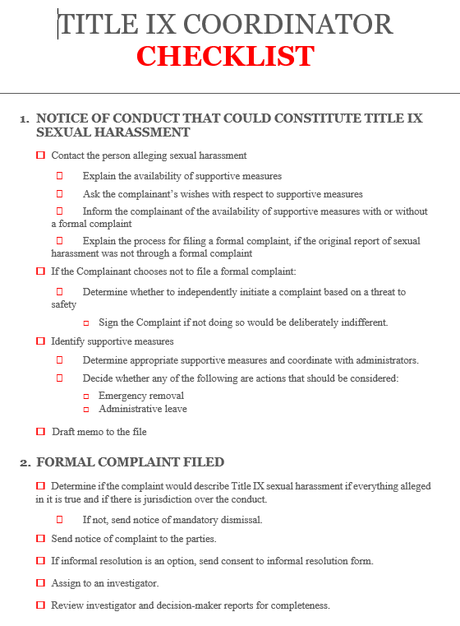
Title IX Coordinator Checklist

Slide 17
Title IX Coordinator Resources (available on OneNote)
Memo to File of Actions Taken
Written Notice of Allegations
Notice of Mandatory Dismissal
Notice of Discretionary Dismissal
Request for Appeal
Consent to Informal Resolution
Withdrawal from Informal Resolution

Slide 18
Title IX Investigator

Slide 20
Investigation Tips
Ask open-ended questions.
Remain impartial, but build rapport and try to create a comfortable environment for those you interview.
Use impartial language, such as referring to the “complainant” and “respondent” or “student A” and “student B” rather that the “victim” and the “harasser”
Remember that all evidence has to be shared with both parties.
Funnel method:
Ask general questions based on the elements of the offence.
Then ask specific questions based on known facts, documentary evidence, and other interviews.

Slide 22
Relevance and Evidence
Look to initial complaint to develop questions.
Provide written notice for all interviews and sufficient time for the party to prepare to participate.
Consider all information that supports either parties’ position, or in contradiction to them.
Try to focus the investigation on the complaint, but if additional issues arise, provide parties with the required notice.
Be cautious of any evidence related to the sexual predisposition or sexual history of the complainant.

Slide 23
Sexual Predisposition of Complainant
Questions and evidence about the complainant’s sexual predisposition or prior sexual history are not relevant.
Exceptions:
Such questions and evidence are offered to prove that someone other than the respondent committed the conduct alleged by the complainant OR
If the questions and evidence concern specific incidents of the complainant’s prior sexual behavior with respect to the respondent and are offered to prove consent.

Slide 24
Additional Allegations?
If additional allegations are raised during the investigation, the District has the obligation to inform the subject of the allegations.
DO NOT investigate new allegations until the requisite notice has been provided to the subject of the allegations by the Title IX Coordinator.

Slide 25
Direct Threat Concerns
If at any point in the investigation you have concerns that a person may pose a direct threat to the physical safety of any student or other individual at school, report the concern to the Title IX Coordinator, or to security if the threat is imminent.

Slide 26
Investigative Report
The investigator must prepare a Preliminary Investigative Report that fairly summarizes relevant evidence and share the report with the parties and their advisors for review and response.
The parties and their advisors must be provided with any evidence obtained as part of the investigation that is directly related to the allegations raised in the complaint.
The parties will then have at least ten days to review and respond to the Preliminary Investigative Report in writing.
Consider and incorporate new information and responses into the Final Investigative Report. The parties will then have 10 days to submit a response to the Final Investigative Report.
Notes:
The right, however, is not unlimited. During student’s personal time, an example of a violation is a threat. Absent extreme circumstances, an oral admonition against such conduct should be the first consideration.

Slide 27
Title IX Investigator Checklist

Slide 28
Title IX Investigator Resources (available on OneNote)
Notice of Title IX Investigative Interview (for the parties)
Notice of Title IX Investigative Interview (for non-party witnesses)
Preliminary Investigation Report Cover Letter
Final Investigation Report Cover Letter
Confidential Investigation Report template + example
Confidential Investigation Report template

Slide 29
Title IX Decision-Maker

Slide 30
Decision-Maker Responsibilities
Upon receiving the investigator’s report, the decision-maker must afford each party the opportunity to submit written, relevant questions that the parties want asked of any party or witness, provide each party with the answers, and allow for additional, follow-up questions.
Explain any decision to exclude questions as not relevant.
The decision-maker must then make a determination regarding responsibility and provide it in writing to the parties simultaneously.
Notes:
Employees should always remain conscious that what they do or say while off duty can negatively reflect upon themselves as employees and upon the District’s ability to fulfill its educational mission.

Slide 31
Decision-Maker Responsibilities
Use preponderance of the evidence, (“more likely than not”) standard.
The written determination of responsibility must include findings of fact, conclusions about whether the alleged conduct occurred, the rationale for the result as to each allegation, any discipline imposed on the respondent, and whether supportive measures will be provided to the complainant.
If it is determined that sexual harassment has occurred, disciplinary procedures are triggered.
The decision becomes final on the date that the parties receive the results of an appeal, if any appeal is filed, or on the date that the opportunity for an appeal expires.
Notes:
These guidelines should serve as context in considering each situation on its individual facts.

Slide 32
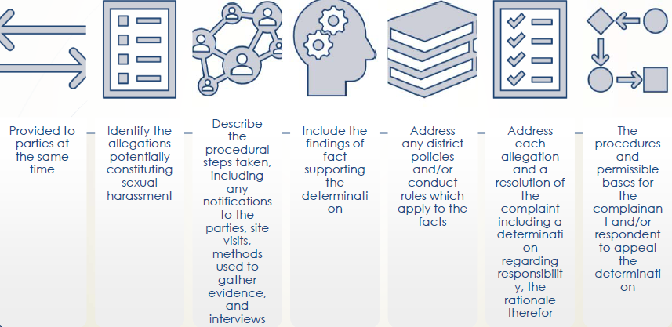
Written Determination of Responsibility

Slide 33
Title IX Decision- Maker Checklist

Slide 34
Title IX Decision-Maker Resources (available on OneNote)
Notice of Title IX Written Questions
Notice of Title IX Written Questions Excluded
Letter attaching Title IX Written Questions (also used for follow-up questions)
Notice of Answers to Title IX Written Questions/ Notice of Follow-Up Questions
Letter attaching answers to Follow-Up Questions
Written Determination of Responsibility template + example
Written Determination of Responsibility template

Slide 35
Appeals

Slide 36
Appeal Process
Both parties have the opportunity to appeal the determination of responsibility or the dismissal of a formal complaint.
Appeals should be submitted in writing within ten days of the determination of responsibility.
Bases for appeal:
Procedural irregularity that affected the outcome;
New evidence that was not reasonably available and could have affected the outcome; or
Conflict of interest or bias generally or specifically by the Title IX Coordinator, investigator, and/or decision-maker that affected the outcome.

Slide 37
Appeal Process
The Superintendent or designee will appoint an Appeal Adjudicator. The Appeal Adjudicator cannot be the investigator, decision-maker, or Title IX Coordinator from the initial determination.
The Appeal Adjudicator will forward the appeal to the other party, who will have five calendar days to submit a written statement in support of or against the appeal.
Supportive measures will remain in place, but there will be no corrective or preventative measures implemented prior to the end of the appeal process.

Slide 38
Written Determination of Appeal
Within ten days of the deadline for the submission of a statement by the non-appealing party, the Appeal Adjudicator will issue a written statement of appeal.
The Written Determination of Appeal must be provided to all parties at the same time.
No further appeals are allowed.

Slide 39
Recordkeeping and Retaliation

Slide 40
Recordkeeping
The District must maintain records for at least seven years, including:
Each Title IX sexual harassment formal complaint.
Investigation records.
Record of actions taken (including supportive measures).
If no supportive measures were provided, documentation of why this was not clearly unreasonable in light of known circumstances.
Determination regarding responsibility.
Audio recordings or transcripts, if any.
Any discipline imposed on the Respondent.
Any remedies provided to the Complainant.
Measures taken to restore/preserve access to education.
Any appeal and the result of the appeal.
All training materials.

Slide 41
Retaliation Prohibited
Retaliation against someone for making a complaint, participating in a Title IX investigation, or refusing to participate is prohibited.
Complaints of retaliation may be filed according to the formal complaint investigation procedures.
Disciplining someone for making a false statement in bad faith is not retaliation.

Slide 42
Thank you! Sharon Rye, Director of Employee Relations and Title IX (973-4616)

