Slide 2
Turn in those reading logs each week!
We need your minutes!

Slide 3
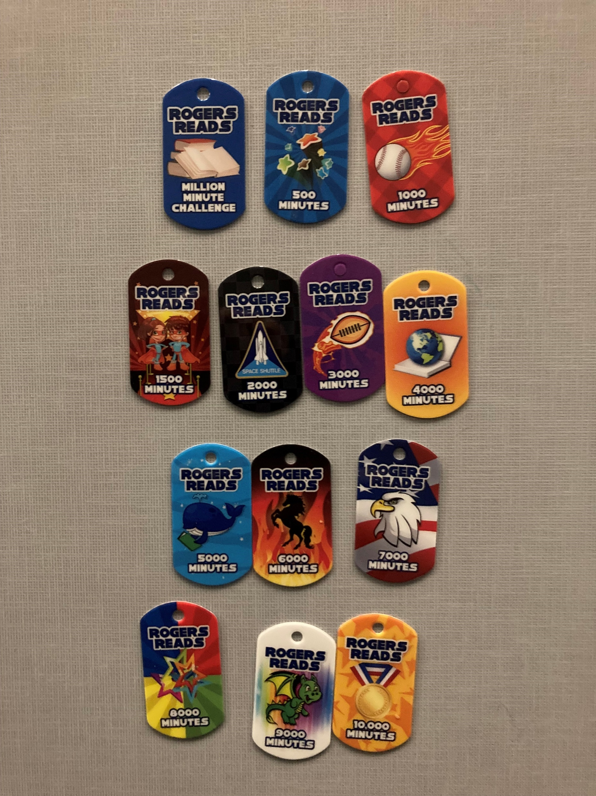
Earn your brag tags!!

Slide 4
We are at 4% of our goal! Keep reading, so we can reach a million!

Slide 5
Hispanic Heritage Celebration

Slide 6
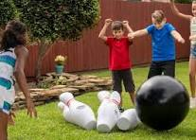
Back to School Bash September 26th

Slide 7
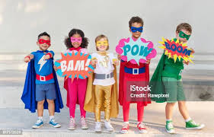
Super Hero Day September 27, 2024

Slide 8
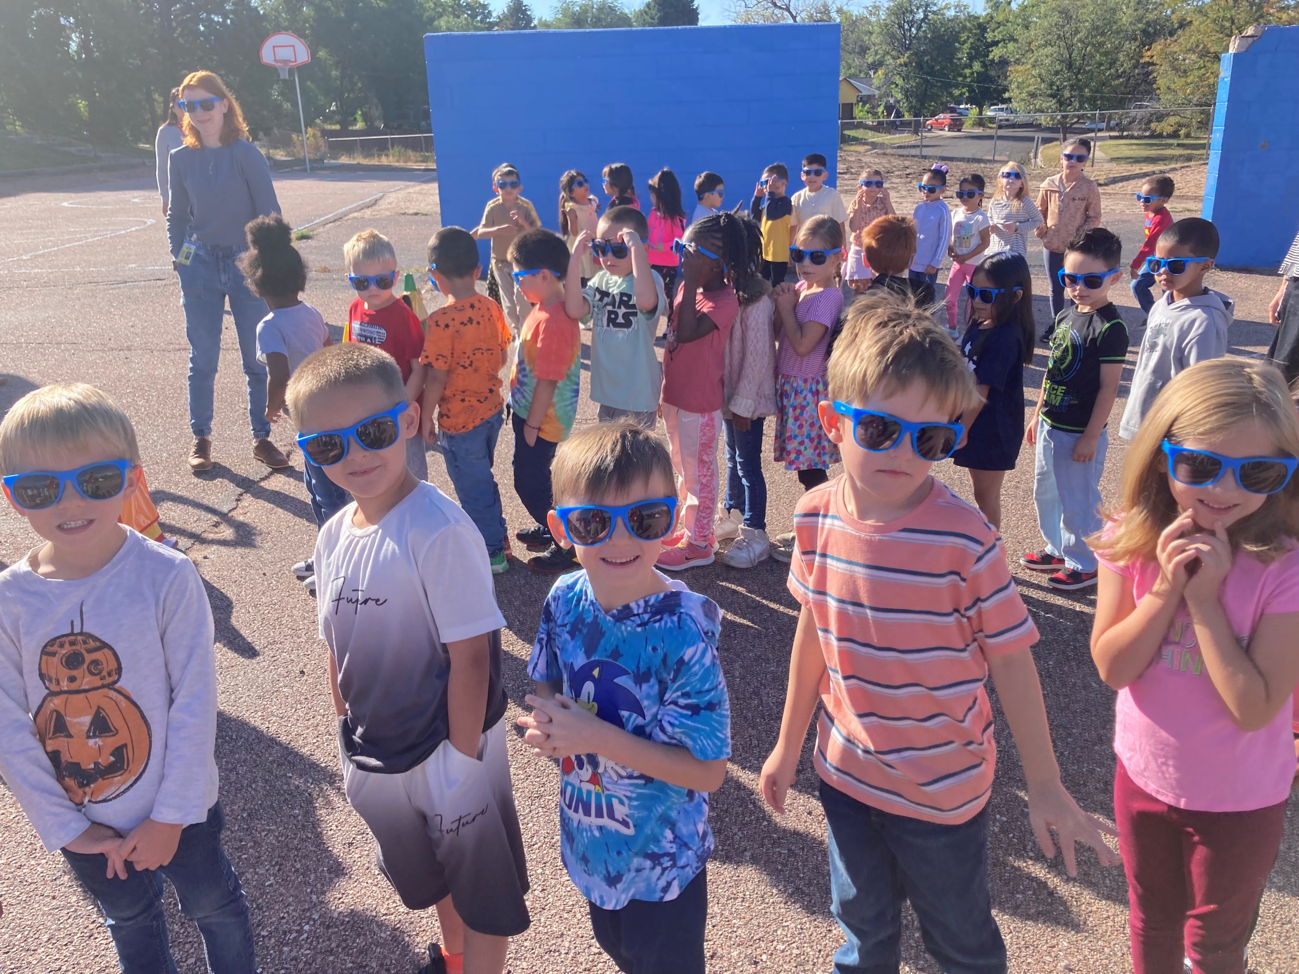
Count Day Fun Run October 1, 2024 -Be here to help our school and get in on the fun!

Slide 9
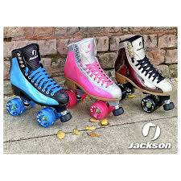
Skate City Rogers Family Night October 2, 2024 5pm-7pm

Slide 10
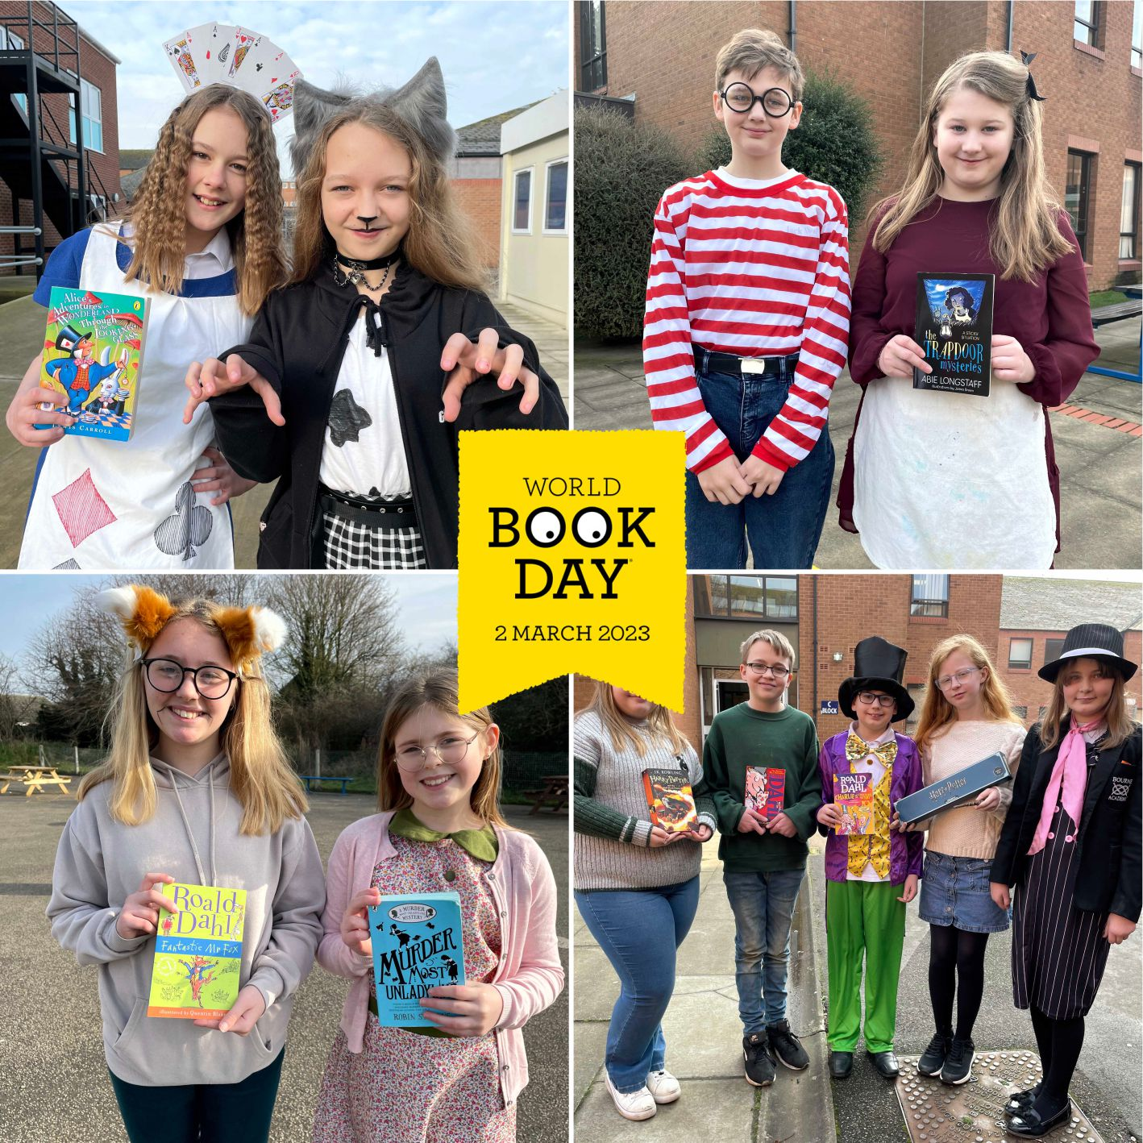
Rogers Spirit Day October 4, 2024 Dress as your favorite Book Character

