Slide 1
Booster Club / PTO
Best Practices
August 27, 2024

Slide 2
Agenda
Purpose of Booster Clubs and PTOs
Guidelines
Shall and Shall Nots
Internal Controls
Bylaws
Financial Reporting
Resources
Evaluation
Notes:
Discuss the agenda items are best practices for your organizations. We work together to meet a common goal described in the next slides.

Slide 3
Purpose of Booster Clubs and PTOs
Support the District Strategic Plan, District Scorecard, District Improvement Plan, and Campus Improvement Plan.
Booster Clubs and PTOs play an important role in helping all Boerne ISD students be successful.
Donated funds are supplemental to the District.
Booster Clubs and PTOs are separate organizations from the district. The District is not responsible for the compliance of the organization.
Notes:
Boosters and PTO play an integral role in supporting the District’s goals with supplemental financial support and volunteer work.

Slide 4
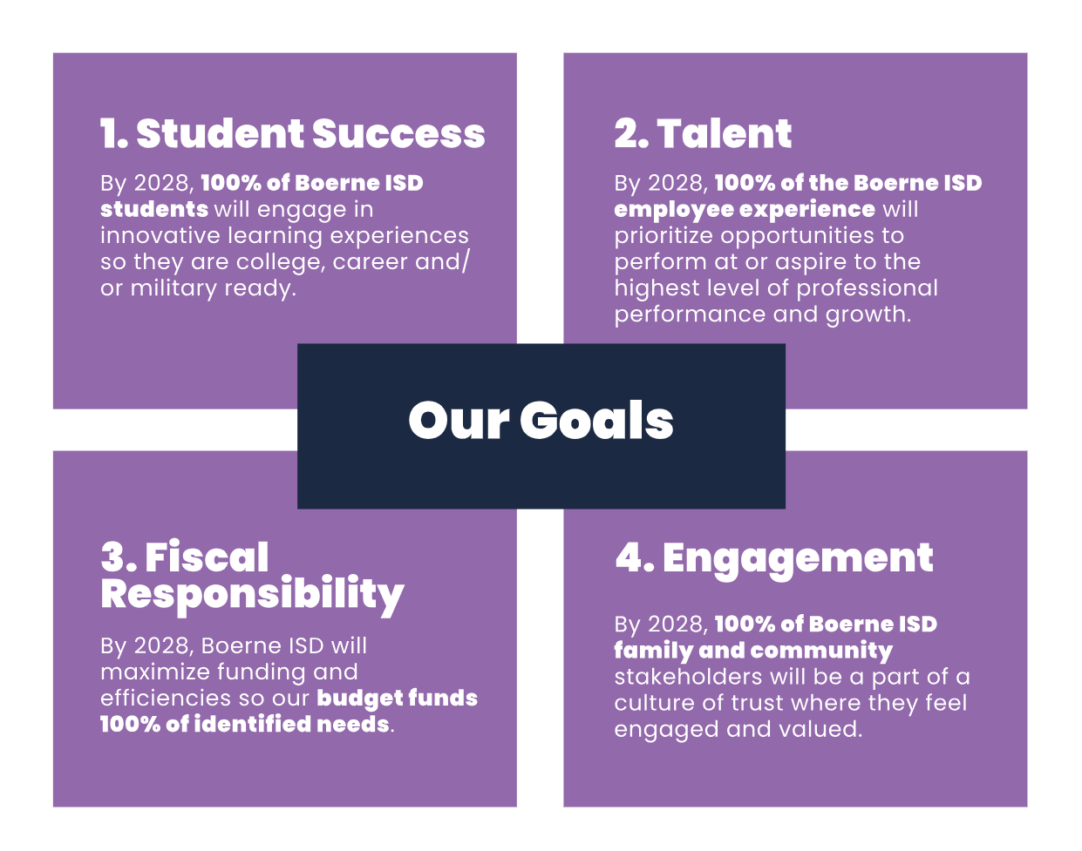
District Scorecard
Notes:
Here you see our major objectives as approved and monitored by our Board of Directors.

Slide 5
What can we support?
Appropriate | Not Appropriate
Innovative Program Furniture | Classroom Furniture Replacement
Innovative Technology | Technology Replacement
Innovative Materials | Core Subject Curriculum
Marquee / Memorial Benches | Building Maintenance and Repairs
Faculty Gatherings / Celebrations | Alcoholic Beverages
Gift Cards | Cash
Notes:
This is the general idea of support we see as appropriate or not. There will be exceptions and differences between the many organizations across the district.
Today’s goal is not to provide a manual you can take home and see if every purchase you make is approved in it, but rather gain an understanding of where we need support and how your organization can help.
Technology Example of something cool but needs to be run by the principal. Latest and greatest iMac G3! The principal will work with the appropriate departments such as Finance and Technology to make sure there are no barriers that should be addressed prior to purchase.
Is the district about to purchase similar devices across to maintain a uniform technology set in the classroom?
Is tech staff able to support the device. If not, how do we plan on financing these and other fees in the future?
Innovative?
Questions…

Slide 6
BISD Guidelines
Guidelines are a tool designed to help set the stage on how to be a successful organization.
Provides resources and training to ensure all Support Organization members and officers understand the limited relationship between the School District and the Organization.
Working document which can be updated or revised at any time for the betterment of all support organizations.

Slide 7
Organizations shall:
Be voluntary and serve as a support organization ONLY
Encourage involvement from parents and community stakeholders
Use school facilities with approval from the District
Obtain Principal approval of all fundraisers
Submit a copy of financial report to the Business Office 30 days after end of fiscal year
Submit officer information to the District
Submit annual budget to Principal by beginning of school year
Publish meetings – there are no closed meetings which would exclude members
Have adequate insurance / bonding
Pay all taxes and debts incurred by the organization
Comply with administrative regulations, board policies, UIL, and regulatory agencies
Have an awareness of sensitive procurement areas (ex. - copyrighted logos)
Follow pathways to obtain these items that do not conflict with District agreements. (Eddie Ashley!)
Notes:
Note the change in reporting requirements. Discuss relationships with principals, sponsors, or other admin.

Slide 8
Organizations shall not:
Be involved in decision or policy making activities for student groups
Give a sponsor/coach a gift or cash in excess of $500
Give a member any gift without the approval of club membership
Directly employ, contract, supplement or in any way compensate workers for work performed
Sign contracts or pay expenses directly for student travel
Use Boerne ISD employer ID number or sales tax-exempt status
Use Boerne ISD in the name of the Booster Club or PTO
Give cash to any school employee to use at their discretion
Attempt to influence the Sponsor, Principals, or others to be a lobbying group concerning District personnel matters
Allow more than one member of a family to serve as an officer at the same time
Eliminate students from participating in activities
Collect student fees
Notes:
Technology Example of something cool but needs to be run by the principal. The principal will work with the appropriate departments such as Finance and Technology to make sure there are no barriers that should be addressed prior to purchase.
Is tech staff able to support the device. If not, how do we plan on financing these and other fees in the future?

Slide 9
Internal Controls
Notes:
The next few slides will go over general bylaws and reporting that should be provided during meetings to maintain transparency.
Report frequency may be determined by your organization.

Slide 10
Notes:
The three items listed here set a likely scenario for fraud. We may only be able to control the opportunity section.

Slide 11
BYLAWS:
Initially submit a copy of bylaws to the district
Address the organizational structure
Address the methods used to elect officers
Contain the rules of membership
Include how meetings will be publicized and conducted
Address the organization’s fiscal year
DO NOT allow one person to hold multiple offices
Address the dissolution of a booster club
Notes:
We start with the backbone or your organization. These may need to be reviewed from time to time if they have been in place for years.

Slide 12
FINANCIAL RECORDS:
Banking Information (who is changing signature at bank?)
Cash Receipts (two people count money)
Federal / State Reporting: 1099 requirements, sales tax, 990 tax return
Bank Reconciliation (not the same person writing checks/signing checks)
Financial Reporting (board approval)
Insurance Requirements (bond)
End of Season Audit (before turned over to new treasurer)
Record Retention (where are the records kept and how long)
Notes:
Key things are creating clear separations of duties.
While this can be challenging and make simple things more time consuming it will greatly reduce the ‘Opportunity’.
Dual signature authority, separation of bank recs, and regular transparent reporting are all great practices.

Slide 13
Financial Reporting
Statement of Financial Position
Equivalent to a Balance Sheet
Statement of Activities
Equivalent to an Income Statement
Statement of Cash Flows
Equivalent to a standard Statement of Cash Flows

Slide 14
Statement of Financial Position
Assets
Cash
Investments
Accounts Receivable
Furniture, Equipment
Liabilities
Accounts Payable
Net Assets (equity)
Equity
Reserved Endowments

Slide 15
Statement of Activities
Revenues
Donations (restricted / unrestricted)
Letter to donor
Membership Dues
Interest on Investments
Fundraisers
In-kind (fair value)
Expenditures
Salaries
Supplies
Services
Utilities
Fundraisers

Slide 16
Statement of Cash Flows
Sources and Uses of Cash
Operating Activities
Investing Activities
Financing Activities
Other Activities
Notes:
Check registers for purchases

Slide 17
BISD WEBSITE RESOURCES:
BISD Booster Club / PTO Registration and Approval Form
Booster Club / Parent Teacher Organization Guidelines
District Board Policy GE (Local)
Fundraiser Application and Authorization
Financial Activity Overview
Donation Reporting Form
BISD Facility Request Application Form

Slide 18
Helpful Websites
National Booster Club Website (Insurance and Bonding)
http://www.boosterclubs.org/
Protect Your Nonprofit
https://protectyournonprofit.com/helpful-websites-for-ptos-and-booster-clubs/
National PTO
http://www.pto.org/index.html
Parent Booster USA
https://parentbooster.org/
Comptroller of Public Accounts
https://comptroller.texas.gov/programs/unclaimed/

Slide 19
Meeting Review:
Purpose of Booster Clubs and PTOs
Guidelines
Shall and ShaIl Nots
Internal Controls
Bylaws
Financial Reporting
Resources
Evaluation
Notes:
Take questions.

Slide 20
Wesley Scott
Chief Financial Officer
Wesley.Scott@BoerneISD.net
(830)357-2028
America Jones
Administrative Assistant
America.Jones@BoerneISD.net
(830)357-2029
Eddie Ashley
Purchasing Director
Eddie.Ashley@BoerneISD.net
(830)357-2026
Joceline Baumgardner
Director of Business Services
Joceline.Baumgardner@BoerneISD.net
(830)357-2024
Ana Webb
Assistant Director of Business Services
Ana.Webb@BoerneISD.net
(830)357-2021

