Slide 1
2024
College Orientation
Part II

Slide 2
Agenda
11:00 - 11:45
Student Scavenger Hunt
Parent Information Session, Q&A
10:00 - 10:45
Introduction and Important Information
Student Expectations and Policies
10:45 - 11:00
MVCC Academic Advisors
Schedule and Degree Information
11:45 - 12:00
Final Questions

Slide 3
Introduction and Important Information

Slide 4
P-TECH Reminders
4-6 year program, earning an associate degree separate from completing high school courses
High school diploma requirements must come first
Home districts hold onto high school diploma until completion of associate degree
Parents do not have access to students’ professors or grade portal at MVCC
Member of 3 communities: P-TECH, MVCC, and home school district
P-TECH paying for books, tuition, and fees
At the college level, students must take ownership of their education
Notes:
Shift - Student in charge of their education. Independence and honesty.

Slide 5
P-TECH Pathways at MVCC
Mechanical Engineering Technology
Electrical Engineering Technology
Computer Applications Programming
Computer Science- Cybersecurity
Computer Science
Civil Engineering Technology
Business Administration
Human Services
Remotely Piloted Aircraft Systems
Semiconductor Manufacturing Technology
Computer Aided Drafting
Engineering Science

Slide 6
Important Contact Information
P-TECH Cell Phone:
315.796.5355
Instructors: Emails and office locations will be in Brightspace, in their syllabus, and located in the Staff Directory.
Ms. Garrett
Email: sgarrett@oneida-boces.org
Mrs. Colantuoni
Email: kcolantuoni@oneida-boces.org
Mrs. French
Email: jfrench@oneida-boces.org
Ms. Macrina
Email: bmacrina@oneida-boces.org
Mrs. Foote
Email: kfoote@oneida-boces.org
Mr. Fagan
Email: mfagan@oneida-boces.org
Mrs. Warner
Email: cwarner@oneida-boces.org
Stephanie Lai
Email: SLai@mvcc.edu

Slide 7
Stephanie Lai: P-TECH Academic Advisor
Shane McGovern, Brandon Horrender, Sarah Lam
MVCC Support Team

Slide 8
Daily Schedule
Classes are held at the MVCC Utica campus (exception of RPAS pathway)
Full-time college students will report directly to MVCC by 8:30 am daily and remain on campus until 2:00
CTE students report to OHM BOCES in the morning and MVCC in the afternoon (check in no later than 11:30)
ALL students will check-in upon arrival by scanning their MVCC IDs
Students must be on campus during school day Monday-Friday
Students should not be leaving campus
It is illegal for minors to work during school hours
Tutoring, studying and homework when not in classes
Notes:
Trust!!! Privilege not a right to be on the MVCC campus.

Slide 9
Attendance
Students are required to follow the college schedule and are not excused from classes during high school breaks
During college breaks, students may be expected to take additional classes or report to BOCES
Excused absences (doctors appointments, school sports, etc.), late arrivals, or early departures must be approved and insufficient attendance can result in students being pulled back to BOCES campus.
*Students must check with professors for official excused absences from class
Notes:
P-TECH gets attendance report but does not follow students to class. Do the right thing!

Slide 10
Safety and Security
Students must remain on campus during school day
Students must have college ID on them at all times
Department of Public Safety is a resource for students
Academic Building, room 106 (315)731-5777
P-TECH will provide a roster of students on campus each semester
Student should loop P-TECH administration into any issue involving Campus Safety
Mass notifications will go to telephone number on student MyMV account
Can add additional numbers
ParentSquare & StudentSquare will be used for notifications as well
Stop by there today!
Get your college ID, Register your car

Slide 11
Transportation and Lunches
Transportation
College students must register their vehicle at MVCC to receive a parking pass
Transportation is available for juniors and seniors
Students must get their own transportation on district days off
Look at the MVCC schedule and school district calendar before the start of the semester to figure out transportation
Lunch
A bagged lunch is provided each day for students to pick up at the C3 pantry
Students can also choose to purchase food in the cafeteria at MVCC with their own funds
Student should have completed lunch & transportation survey

Slide 12
Textbooks and Chromebooks
Textbooks
OHM BOCES will purchase textbooks for students
Student responsible for reimbursing OHM BOCES if book is lost/destroyed to prevent a hold on their account
P-TECH purchases “required textbooks” only
Additional materials for classes are the responsibility of student
Ms. Garrett will notify students by email about the books they will need for the semester a week before classes start
Students may need to pick up books from both BOCES and the MVCC bookstore
The email will specify the location of your books
Chromebooks and laptops
Students are able to use their P-TECH issued chromebooks
Computer labs and loaners are also available if needed

Slide 13
Extracurricular Activities
High School
Students can still be involved in their home district’s extra-curricular activities through their senior year
Students must communicate with their professors if attendance will be impacted
Be aware of possible scheduling conflicts
MVCC
Students at MVCC have the ability to join clubs, intramural sports and student organizations
Academics come first!
Students cannot participate in college sports
Notes:
P-TECH students have started their own clubs on campus, VP and President of Phi Theta Kappa

Slide 14
Online Platforms
Students will frequently access Brightspace, MyMV, and their MVCC email for information regarding grades and classes.
Brightspace
Online learning platform (similar to Buzz)
MyMV
Information about grades/transcripts, schedules, and cancelled classes
MVCC email
Students should be checking their MVCC email and P-TECH email daily
Must use MVCC email to communicate with professors

Slide 15
Login Information
Email: first initial last name date of birth @student.mvcc.edu
ex. sgarrett25@student.mvcc.edu
Check the top of your schedule for your email
Username for MyMV and Brightspace is your email
Ex. sgarrett25
Password for email, MyMV, and Brightspace is the last four of your M#
Your M# is located at the top of your schedule
Please try these after the orientation and notify us if there are any issues.

Slide 16
Schedules

Slide 17
Schedules
Scheduled into MVCC courses - Try our best to schedule between 8:00am and 2:30pm for 11th and 12th grade students - Exceptions discussed with students
Expectations outside of class:
Mandatory tutoring in Learning Commons
All students are required to attend at least one tutoring session per course by the midterm.
Required check-in meetings with Ms. Garrett and Ms. Colantuoni
20 minute weekly individual meetings in the P-TECH office Payne Hall 316
Weekly whole group advisory sessions with other P-TECH students
Utilize professors’ office hours

Slide 18
Schedules
Schedules are being handed out today
Chance of changes before classes start
Individual meetings with Ms. Garrett and Ms. Colantuoni are determined AFTER students are registered for courses and may not be finalized until the week before classes begin
Any questions or concerns regarding schedules can be directed to Ms. Garrett

Slide 19
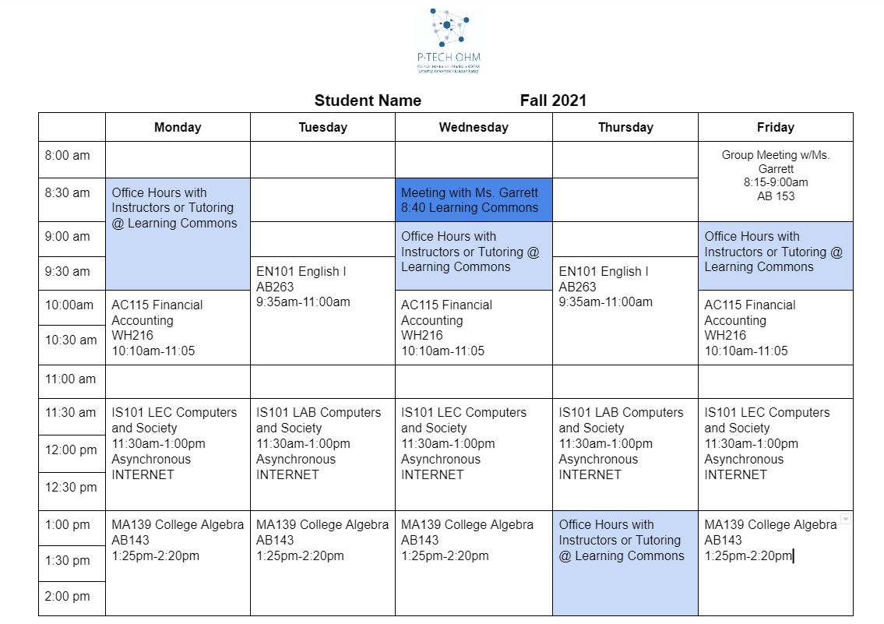

Slide 20
Student Scavenger Hunt
Report back here at 11:45

Slide 21
Parent Information Session

Slide 22
Academics
Students will be taking classes from MVCC instructors and beginning coursework specific to their degree pathway
College level rigor with expectation of students being proactive in seeking help
Students should be reaching out to their instructors
Students are responsible for monitoring their performance and should be sharing this information with their parents. Parents will not have independent access to their students’ coursework or grades
If a student is not performing satisfactory in a course and/or has poor attendance, instructors will automatically drop that student without conversation.

Slide 23
Fall Semester 2024
Dual Credits Courses
EN101 English 1: Composition
3 college credits, .5 high school English 12
EN102 English 2: Literature
3 college credits, .5 high school English 12 credit
BM101 Survey Economics*
3 college credits, .5 high school Economics
PS101 American National Government
2 college credits, .5 high school Government
PE course used for Physical Education requirement
These courses are needed for NY high school graduation - High school comes first!
Individualized Scheduling
Half-day CTE Students
At OHM BOCES in the morning, MVCC in the afternoon
Full-day BOCES students
Career Tech at OHM BOCES in the morning and online college or dual credit courses in the afternoon
EN 101, EN 102, PE 172, MA115
OR
P-TECH classes in the morning and online college courses in the afternoon at OHM BOCES
BM101, PE172, PY101

Slide 24
Academics
Midterm grades are submitted halfway through the semester
Students can check midterm grades in their MyMV account
Midterm grades will also be mailed home
Final grades will be sent home at the end of each semester
Included in high school 5-week report - Mailed home and shared with home district
Student schedules will be adjusted based on course performance
Supports are in place to help students succeed
Low performance and failing grades may result in change of programming

Slide 25
College Coaches
Ms. Garrett: sgarrett@oneida-boces.org
Mrs. Colantuoni: kcolantuoni@oneida-boces.org
P-TECH Cell Phone:
315.796.5355
Ms. Garrett and Mrs. Colantuoni are students’ primary contact in regards to anything college related. This includes but is not limited to:
Schedules
Books
Academic support
Coaching
Organization
Studying
Completion plans

Slide 26
Important Dates
First Day of Instruction
Last Day of Instruction
October 16th
December
August 26th
December
Finals
Midterms
Check the Academic Calendar for more dates.

Slide 27
Degree Completion

Slide 28
Anticipated Completion Timeline - Varies by Pathway
Students have individualized schedules and will take 6-18 credits each semester
Full-time seniors at MVCC
Associate degrees by May 2026
High school requirements by June 2025
Full-time juniors
Associate degrees by May 2026
High school requirements by June 2026
CTE seniors
Associate degrees by May 2027
High school requirements by June 2025
Students have up to 6 years within the P-TECH program to complete their
associate degree

Slide 29
Student Supports

Slide 30
Check-in Meetings
There will be mandatory weekly meetings, one individual meeting and one group session with Ms. Garrett/Mrs. Colantuoni
Individualized scheduled meetings
Held at the same time each week
Discuss how you are doing and any individual concerns; this is a great opportunity for students to ask questions specific to them
Group check-ins/College Seminar 2.0
Once a week
Reviewing time management, following deadlines, accessing resources, etc.
Ms. Garrett and Ms. Colantuoni can refer/arrange additional support when
needed
Ms. Macrina & Ms. Foote will provide additional support

Slide 31
Free Tutoring
The Learning Center provides free tutoring services for any MVCC student interested in receiving help outside of class
Tutoring is provided 7 days/week in the Learning Commons AND online
There is a Math Lab and a Writing Lab in addition to content specific tutoring
Students are required to attend at least one tutoring session per course by the midterm
Students may be required to attend on a more regular basis, as determined by Ms. Garrett and Mrs. Colantuoni

Slide 32
Learning Center Benefits
Academic support in the Learning Center is provided by experienced peer and professional tutors.
All peer tutors are recommended by their instructors and have extensive knowledge of the subject they tutor, and the ability to convey that knowledge to their peers.
Professional tutors have strong backgrounds in their subject area at the undergraduate or graduate level. Most of the professional tutors have taught, or are currently teaching, the subject they tutor.
Students that accel in their classes should talk with professors about becoming tutors; we have several P-TECH students working as tutors.

Slide 33
Parent Q&A

Slide 34
Scheduling Tutoring
Students are encouraged to make an appointment, but walk-ins are welcome as well.
A complete tutoring schedule is available on the Learning Center’s website: https://www.mvcc.edu/learning-commons/tutor-appointments/tutor-schedule.php.
Students do not need a referral to use these services. To make a tutoring appointment, visit: https://www.mvcc.edu/learning-commons/tutor-appointments/.

Slide 35
Career Planning
Career Center
Exploratory tools and resources, Career advisors, Job searches, Resume help, Interview prep
Career and job fairs
Internships and job shadows
Opportunities shared by professors and MVCC
P-TECH opportunities: you need to check your emails and answer your phone!
Offered over school breaks and summer
NYPA, Trenton Technology, Indium Corporation paid internships
Companies want P-TECH graduates!
~45% graduates entering the workforce
Wolfspeed and Indium Corporation

Slide 36
Transfer
Holistic Student Support Office
Help you explore transfer options
Research transfer requirements and the timeline for transferring
Transfer and college fairs
Ms. Macrina
Consult with professors
Ask your professors where students have transferred to in the past
It is never too early to start thinking about transfer options!

Slide 37
Helpful Information

Slide 38
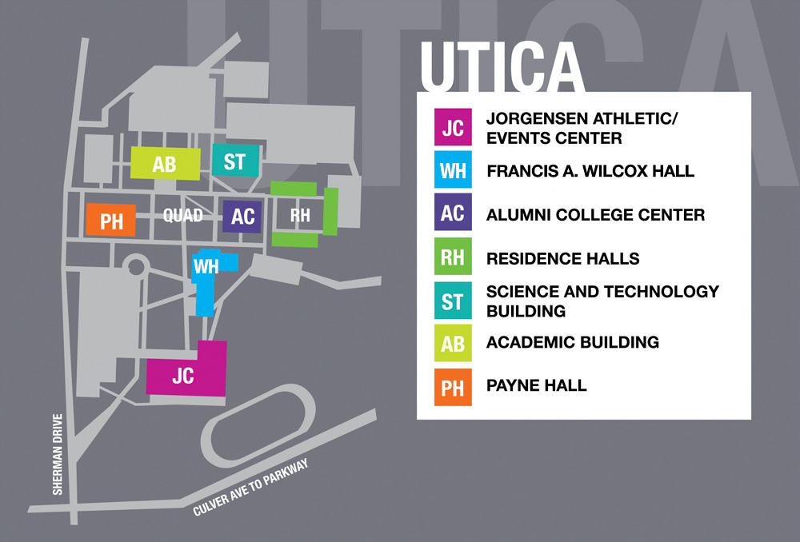
Important Places to Utilize
P-TECH Office Payne Hall 316
C3 Program (lunch pick up)
Library
Student Service Center
Counseling
Career Services
Office of Accessibility (academic needs and any other needed accommodations like breaking a leg)
Learning Commons
Attendance Check In/Out
Health Office

Slide 39
Helpful Pages on MVCC Website
Final Exam Schedule
Information Technology
Library
Academic Calendar
Learning Commons
Current Student Page
Student Success Guide
Counseling Center
Faculty and Staff Directory

Slide 40
The College Mindset
Be Proactive & Ask Questions
Stay Organized
Accept Help
Be Honest with Yourself & Us
Communicate, Communicate, Communicate!
Keys to Success
Notes:
Semesters only 15 weeks long.

Slide 41
Questions?

Slide 42
2024 Student Contract and
Code of Conduct
2024 P-TECH OHM Student Contract
Student and Parent Commitment
Classroom Behavior
Student Handbook
MVCC Code of Conduct & Policies
Notes:
Semesters only 15 weeks long.

