Slide 1
The Journey
Freshman to Senior Year...and Beyond
September 19, 2024

Slide 2
Counseling Team
Lisa McMorrow | 12th: A-F; Sa – Sp 11th: A-F 10th: A-F; S
Deanna Larson | 12th: G-L; St - Sz 11th: G-L; Sa – Sm 10th: G-L; T
Cal Beneze | 12th: M-R; T-Z 11th: M-R; So – Z 10th: M-R; V-Z
Katie Kunitzer | 9th: A - H
Michele Meyer | 9th: I - Z
Lindsay Cusano | Administrative Assistant
STRENGTHENING STUDENTS mind, body, and soul

Slide 3
Christian Service
Graduation Requirement
120 hours minimum
Log hours via MobileServe
Service to Place of Worship – Evangelization
Service to the Community
Christian Service to the Poor and Marginalized
Service to NDP
For even the son of man came not to be served but to serve others and to give His life as a ransom for many.
Matthew 20:28

Slide 4
Extracurricular Activities
QUALITY over Quantity
Sports
Arts (Drama, Choir, Jazz Ensemble)
Clubs
Jobs
Internships
**Highlight leadership experience(s)
i.e.: House Leadership position(s), Captain on a sports team

Slide 5
Grades Things to keep in mind...
Freshman grades DO appear on official transcripts
Encourage your student(s) to:
Meet with their teacher
Explore tutoring (if possible/available)
Extra practice on their own
Parents can access their student's grades through Canvas.

Slide 6
Honors Classes The details...
More rigorous courses (increased workload, increased depth)
Extra weight to GPA (+0.5 point)
Required grades to place into Honors classes (reference both semester grades to determine placement)
Honors to Honors = B (83%)
Standard to Honors = A (93%)

Slide 7
Advanced Placement (AP) Classes The details...
AP = Most rigorous courses
Extra weight to GPA (+1.0 point)
AP exams take place in May
College credit is awarded if a student earns a 4 or 5 on the AP exam
Required grades to place into AP classes
AP to AP = B (83%)
Honors to AP = B+ (87%)
*Regular to AP = A (93%)
*Check with instructor

Slide 8
Dual Enrollment (DE) Classes Available beginning sophomore year.
More rigorous courses (increased workload, increased depth)
Honors level DE courses earn extra weight to GPA (+0.5 point)
ALL Dual Enrollment (DE) classes earn college credit if students earn a "C" or better
We offer our DE classes through Scottsdale Community College and University of Arizona
College credit earned is accepted by in-state (and many out-of-state) colleges

Slide 9
Graduating with Distinction
Summa Cum Laude (4.00)
Magna Cum Laude (3.85)
Both require 32 (30 academic) credits to graduate
Remaining two (2) credits from Christian Service
Both require 4th level of a world language

Slide 11
Standardized Testing Journey
11th Grade
PSAT
Practice ACT
SAT
ACT
AP
10th Grade​
PSAT​
Practice ACT​
AP
------------------------------------------------------------------------------
12th Grade​
SAT
ACT
AP

Slide 12
PSAT
October 30, 2024: Sophomores & Juniors take the PSAT at NDP (Required)
Designed to measure the ability to understand and process elements of reading, writing, and mathematics
Determines National Merit scholarship eligibility for juniors
When your students receive their test results, they can connect with Khan Academy to get free personalized study recommendations

Slide 13
Practice ACT, SAT, and ACT
Taken in the spring: Sophomores & Juniors
collegeboard.org for all SAT-related information
act.org for all ACT-related information
More colleges are becoming test optional
Free test prep resources:
dictionary.com
Khan Academy
act.org

Slide 14
Factors Influencing College Admission
Grades (GPA)
Strength of Curriculum
Test Scores (ACT or SAT)
Extracurricular Involvement
College Essays
Letters of Recommendation
Institutional Need

Slide 15
Institutional Need?
Year-specific individual institutional needs
Special talents (arts/athletics)
Geographic considerations (does the school "need" students from a certain school/city/state?)
Demographic considerations (does the school "need" students of certain demographics?)

Slide 16
Financial Aid
Scholarships
Grants
Work-Study
Loans

Slide 17
Scholarships
Individual Scholarships
Based on academic achievement, leadership qualities, community service work, special talents, acceptance to a specific program, or combination of all
SOME scholarship websites we recommend...
Fastweb.com
Goingmerry.com
Chegg.com
Raise.me
Tallo.com

Slide 18
Athletic Scholarships
- Athletic Scholarships ARE NOT for 4 years - they are renewable each academic year, and may be increased, renewed, reduced, or withdrawn.
- Athletic Scholarships can be awarded in a variety of amounts – full, to partial, to books, etc.
- Excelling academically will make you eligible for even more scholarships.
- NCAA – Div. I & II: www.eligibilitycenter.org
- NAIA Eligibility Center: www.playnaia.org

Slide 19
GRANTS Free Money!
Federal (Government)
Need-based
FAFSA required
Institution (College/University)
Need-based
FAFSA required
CSS required (Only for institutional grants)

Slide 20
Decisions, Decisions...
Attend NDP College Visits
Attend College Fair Events
Visit College Campuses
Research Colleges
SCOIR
Major Clarity

Slide 21
SCOIR
A Quick Overview
College and career readiness software provider
Offers access to information regarding colleges and universities across the United States
Manages recommendation letters, surveys, and transcripts
All freshman students will receive access information in class. Parents will receive access to their student's SCOIR profile during the school year.
www.SCOIR.com to create or access account

Slide 23
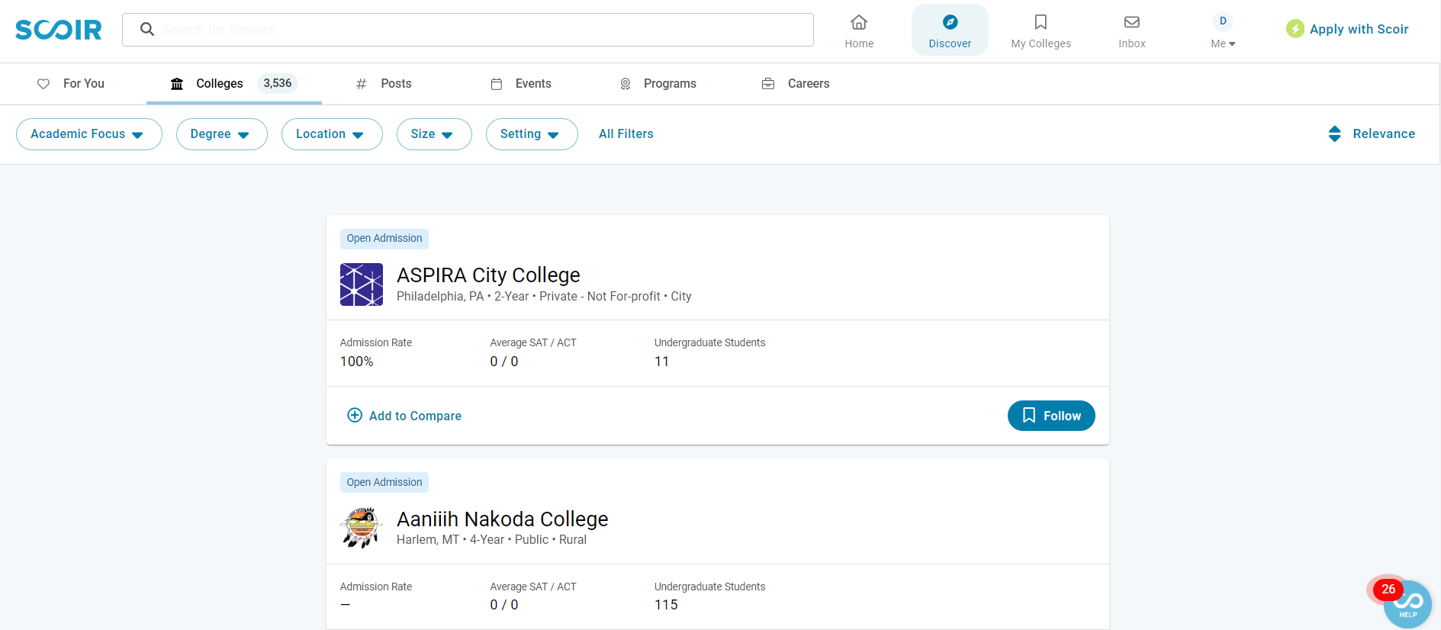
SCOIR
Offers Many Useful Resources
Start a Search by College or University Name
Get Detailed Specific College or
University Information
Create Favorite Colleges and Universities List

Slide 24
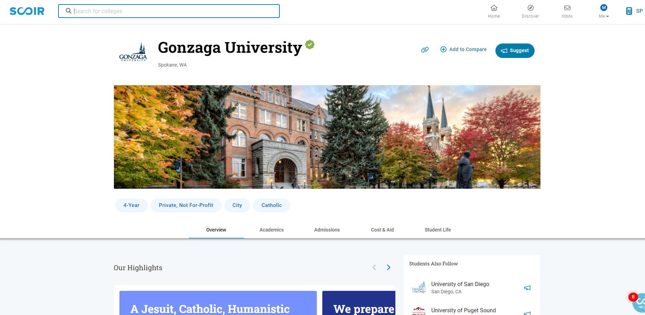
SCOIR
Discover feature
You can use the Discover feature to click on each college to find more detailed information. This includes acceptance rate, cost, virtual tours, average SAT/ACT scores, student life, makeup of the student body, retention rates, top majors, and proximity to transportation.

Slide 25
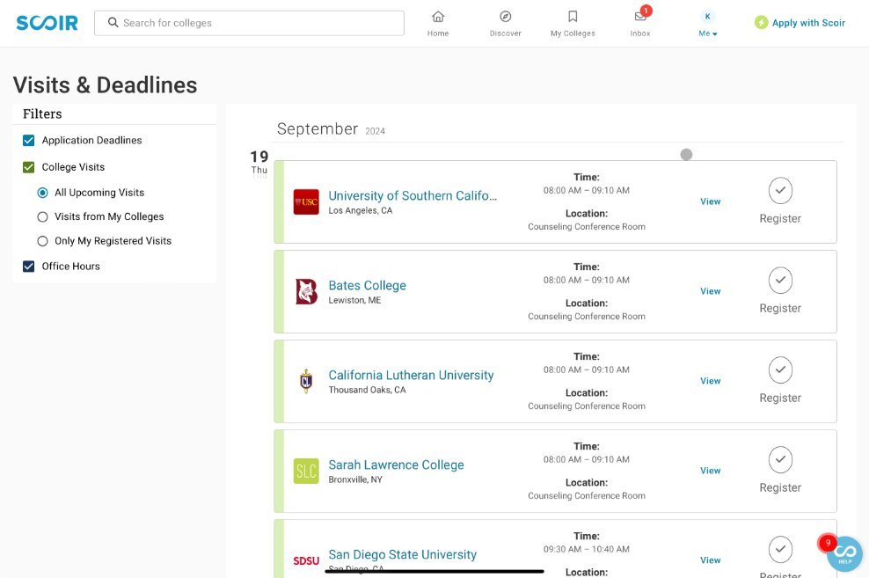
SCOIR
College Visits – How to Sign-up
from the Home Page
select ME, select Visits & Deadlines
select Register

Slide 26
SCOIR
Activities & Achievements
Students Should Start Compiling
Their List of Activities and Achievements Freshman Year

Slide 27
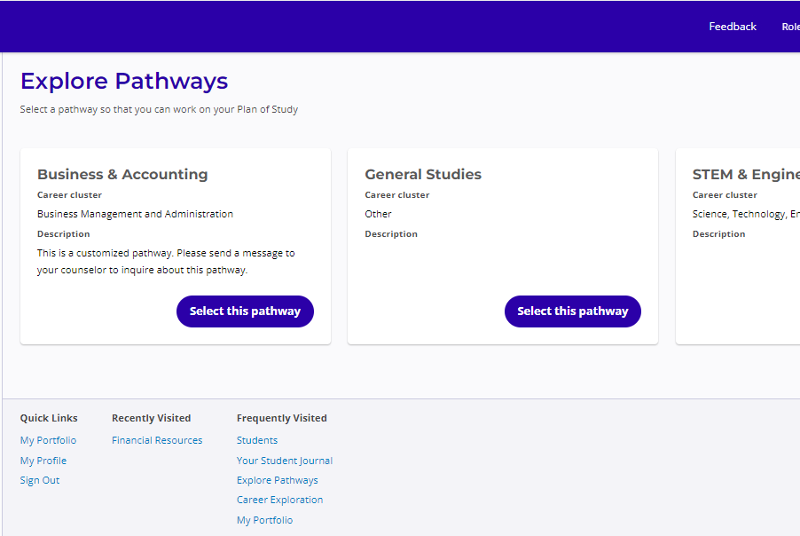
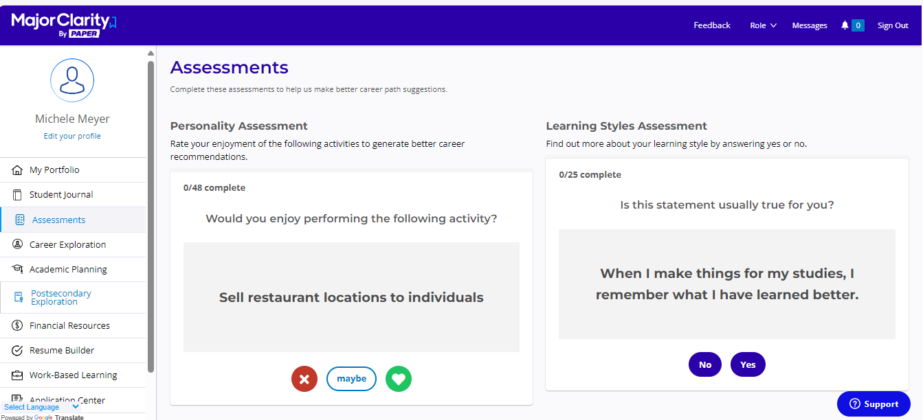
MajorClarity
MajorClarity is an additional career planning platform along with SCOIR.
Students will be able to take assessments, get matched up with careers, learn in-depth information about different career fields, and much more!
All students are automatically registered and can login with their current NDP credentials.

Slide 28
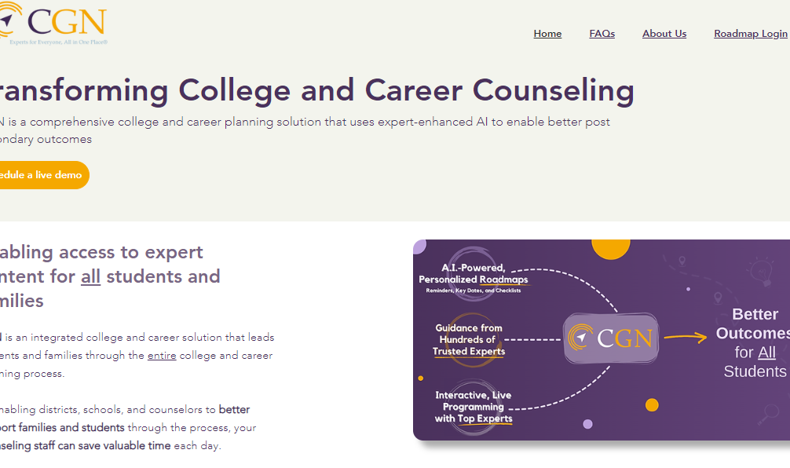
College Guidance Network (CGN)
College Guidance Network (CGN) helps
students and parents create a roadmap for
applying to college.
They also host live events, videos, webinars,
and much more, covering all facets of the
college search and application process!

Slide 29
Thank you!
Any questions?

