Slide 1


2024-2025 Proposed Final Budget
May 28, 2024
Dr. Marcia Stokes, SFO
Notes:
Good Evening. I am Dr. Marcia Stokes, Chief Financial Officer for the Harrisburg School District. This evening I will be reviewing the 2024-2025 Proposed Final Budget. I would encourage you to follow along in the detailed Budget Pamphlet. I will be referencing the budget pamphlet throughout this presentation. It is the Harrisburg School District’s mission to Empower Academic Achievers and Lifelong learners. This budget presentation is intended to outline the financial investment in achieving our mission.

Slide 2
Agenda
Budget Development Process
Budget Overview
Proposed Expenditures
  By Function and by Object
Anticipated Revenues
  Local, State, and Federal
24-25 Proposed ESSER Expenditures
Notes:
This evening I will be reviewing the process we underwent to develop the product that I will be presenting this evening. I will be reviewing the entire budget-both revenues and expenditures. I will also summarize the changes since the preliminary budget was presented last month. In addition, I will be reviewing the ESSER funded initiatives planned for the 24-25 school year. All ESSER Funds must be obligated by September 30, 2024.

Slide 3
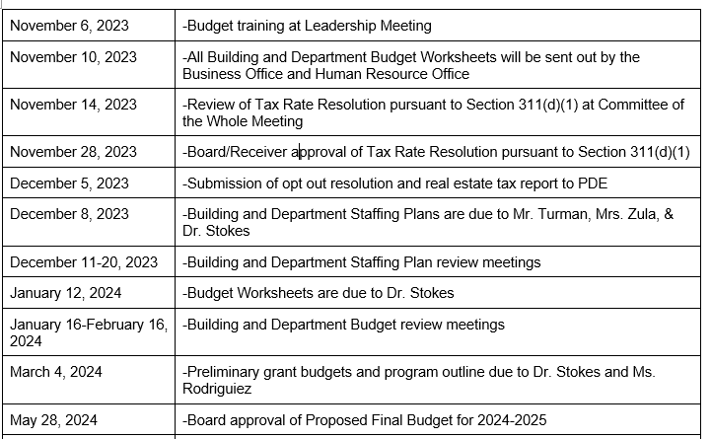
Budget Development Process
Notes:
The 24-25 proposed final budget was developed using the zero-based budgeting method. Under this approach, all principals and department leaders were given budget worksheets that required them to make their budget allocation requests from zero. In addition, we added in a significant staffing review process this year, that include the evaluation of every position in the district to determine the personnel needs for next year. There has been a substantial amount of input from many Harrisburg team members throughout this extensive processes. The Cabinet team has spent months reviewing budget requests and positions requests. This year’s budget development had some significant challenges including trying to capture all the changes associated with the district’s reconfiguration including all the personnel changes and the end of ESSER funding. In addition, the unknown of the Commonwealth budget and what we can anticipate in our state subsidies. I will highlight the assumptions we are making around state subsidies later in this presentation.

Slide 4
Budget Overview
Notes:
In the budget pamphlet, you will find this budget summary on page 5. Throughout the presentation, I will be providing the data on the current year budget and the 24-25 proposed budget, however you have 5 years of data available in the budget pamphlet. All information presented will be in accordance with the PA Chart of Accounts, which outlines how each school district must classify every dollar that goes in or out of the district each year. As you can see, there is a large decrease from the current budget to the proposed final budget of $11,115,054 or 5.25%. This decrease is directly related to the end of the federal ESSER grant funds. We will be reviewing this in more detail shortly.

Slide 5
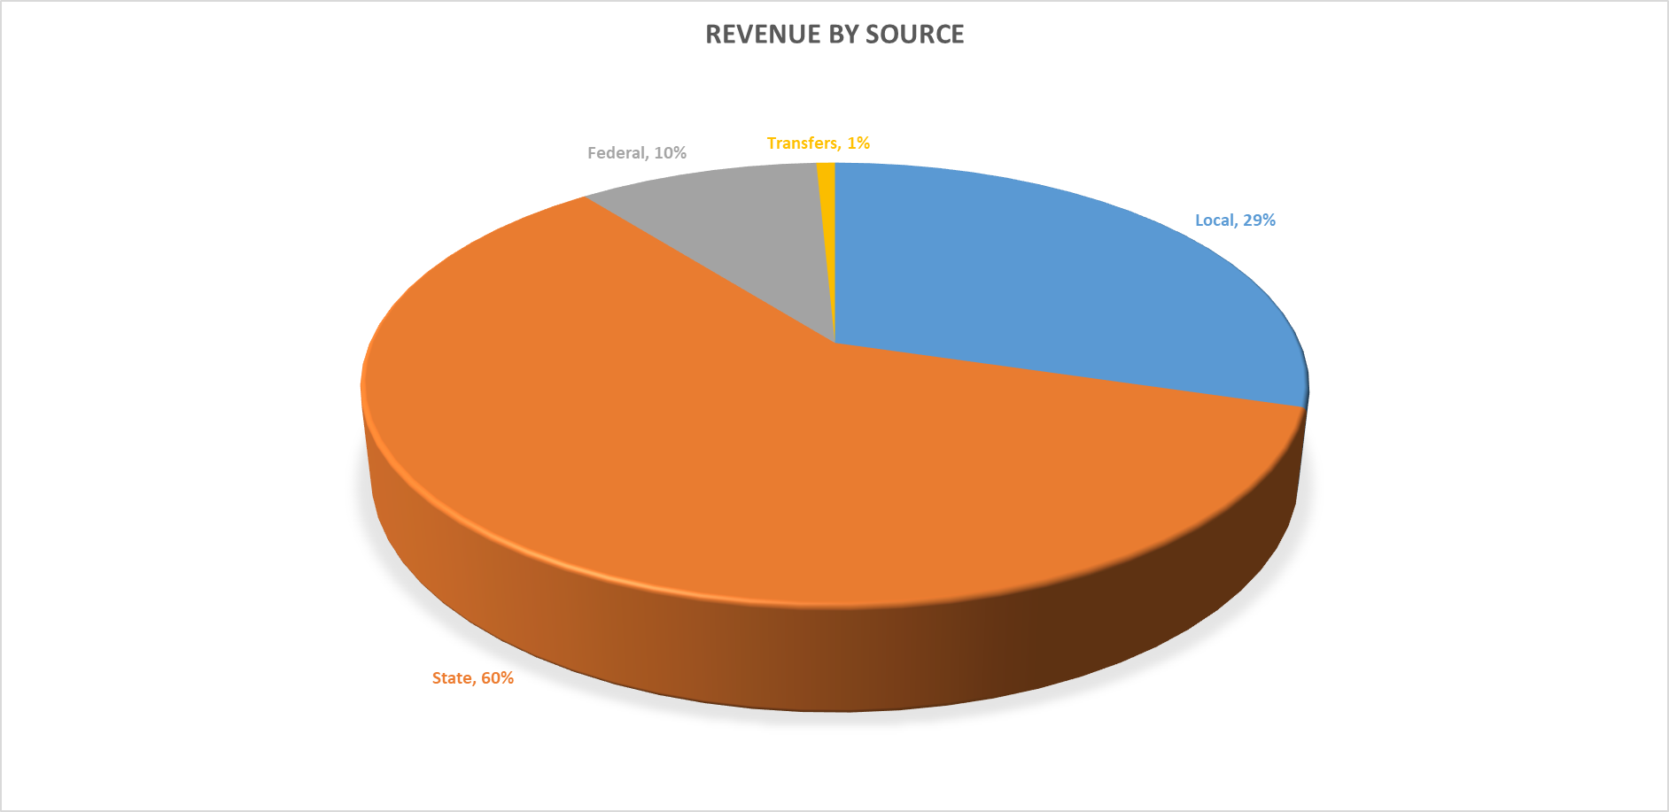
Revenues
Notes:
This slide demonstrates the breakdown of the district’s revenue sources. The majority, 60%, of our revenues from the Commonwealth in the forms of various subsidies. For 24-25, we are estimating 10% of our revenue to come from federal sources , 29% from local sources, and 1% from an interfund transfer in.

Slide 6
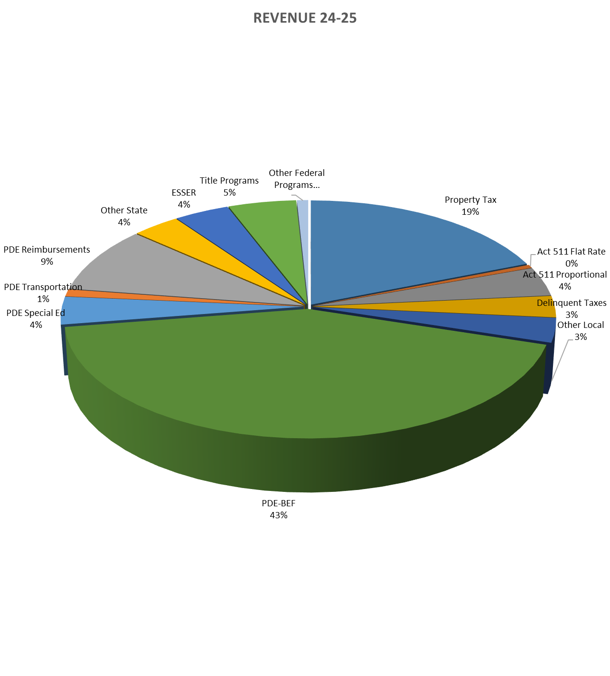
2024-25 Estimated Revenues
Notes:
This graph is found on page 6 of the budget pamphlet. It provides a breakdown of local, state, and federal revenues. As you can see by the graph, our largest revenue source is Basic Education Funding at 43%. Since the State Budget is not approved yet, we are estimating our BEF and SEF at 50% of the Governor’s proposed budget allocations. . You will see that our second largest source of revenue is property taxes at 19% followed by PDE Reimbursements at 9%. PDE Reimbursement include our subsidy on our debt payments, social security payments and PSERS payments.

Slide 7
Revenues-Local
Notes:
This slide outlines the estimated local revenues and is found on page 8 of the budget pamphlet. For a description on what is included in each of the various revenue lines, please refer to details starting on page 11. Local revenues are estimated at $62,714,512, representing a $1,260,596 , or a 2.01% increase. You will see the largest increase is in in investment earning due to the high interest rate market. The real property tax increase represents a 0 mill increase. The decrease in real estate taxes is because of a decrease in the District’s overall assessed values. Additional details on the proposed real property tax increase is forthcoming.

Slide 8
Property Taxes
Proposed Mill Increase 0%
  Mill rate remains at 30.78
Property Tax Relief funds of $4,101,390 (State Revenue)
Increase in the amount of the Homestead Exemption for qualified taxpayers due to a lesser number of qualified properties (5,541 for 24-25 vs. 5,561 for 23-24) and an increase in the Property Tax Relief funds.
Notes:
The Amended Recovery Plan recommends the district evaluate the need to raise taxes annually. The 24-25 Act 1 index for the District is 8.1%. The proposed final budget reflects a property tax increase of 0%. The increase in Property Tax Relief funds received in 24-25 represents and increase of approximately $600,000. This will result in an increase in the Homestead exemption amount for eligible properties , thus reducing the taxes due for qualifying taxpayers.

Slide 9
Homestead Exemption
2023-2024
2024-2025
  Qualified for Homestead exemption 5,561
  Estimated Exemption Amount $20,496
  Estimated Value of Exemption $631
  Qualified for Homestead exemption 5,541
  Estimated Exemption Amount $24,140
  Estimated Value of Exemption $743
Notes:
The increase in Property Tax Relief funding will provide an estimated exemption amount of $24,140 creating an exemption value of approximately $743. The $4.1 million on Property Tax Relief funds will be divided among the 5,541 property owners who qualified for the Homestead exemption. This will result in a tax bill reduction amount of approximately $743.

Slide 10
Example Tax Bill Comparison
Notes:
This slide provide an example of the impact of the increase of property tax relief funds will have to the homeowners who qualify for the Homestead exemption. The median assessed value of a property in the District that qualifies for the homestead exemption is $54,600. That median assessed value is what has been used for this example. As you can see, the Homestead Exclusion Amount (the amount excluded from taxes) is much higher 2024-25 than in 2023-24. This increase in the exclusion reduces the amount subject to the tax rate. As such, the tax bill on this example property would be $112 less in 2024-25 than in 2023-24.

Slide 11
Mill Rate History
Notes:
This slide show the mill rates and increases for the past 10 years. The average mill increase over the past 10 years has been .29 mills. The increases in 2018-19 and 2019-20 were to the Act 1 Index. The proposed 2024-2025 increase 0% is 8.1% less than the Act 1 index.

Slide 12
Assessment Growth History
Notes:
Nearly 50 percent of the properties located within the school district are exempt from real property taxes. As you can see by this chart, assessment growth over the past 15 years has been relatively flat at an average of .01% increase per year. The taxable assessed value for 24-25 has decreased by $5.4 million or .34%. Our taxable assessed value for 24-25 is nearly the same as it was in 2014.

Slide 13
Revenues-State
Notes:
State revenues can be found on page 9 of the budget pamphlet. As mentioned early, the district relies heavily on state revenue sources. We are estimating a 9.29% increase in state revenues with the majority of this increase in the 7111 Basic Education Funding line. This is based on the district receiving 50% of the increase proposed in the Governor’s budget. We will continue to watch the state budget process closely in hopes that it will adopted prior to the adoption of our budget on June 27th. You will see the increase in Property Tax relief funds in the 7340 account line.

Slide 14
Revenues-Federal
Notes:
9.8% of the 24-25 estimated revenues will be coming from Federal sources. The $20,827,115 of federal revenues represents a decrease of 123.57% over the current year. The large decrease is reflective of the end of the ESSER funding on 9/30/2024. You can see the dramatic changes in federal revenues over the past 5 years on page 10 of the budget pamphlet.

Slide 15
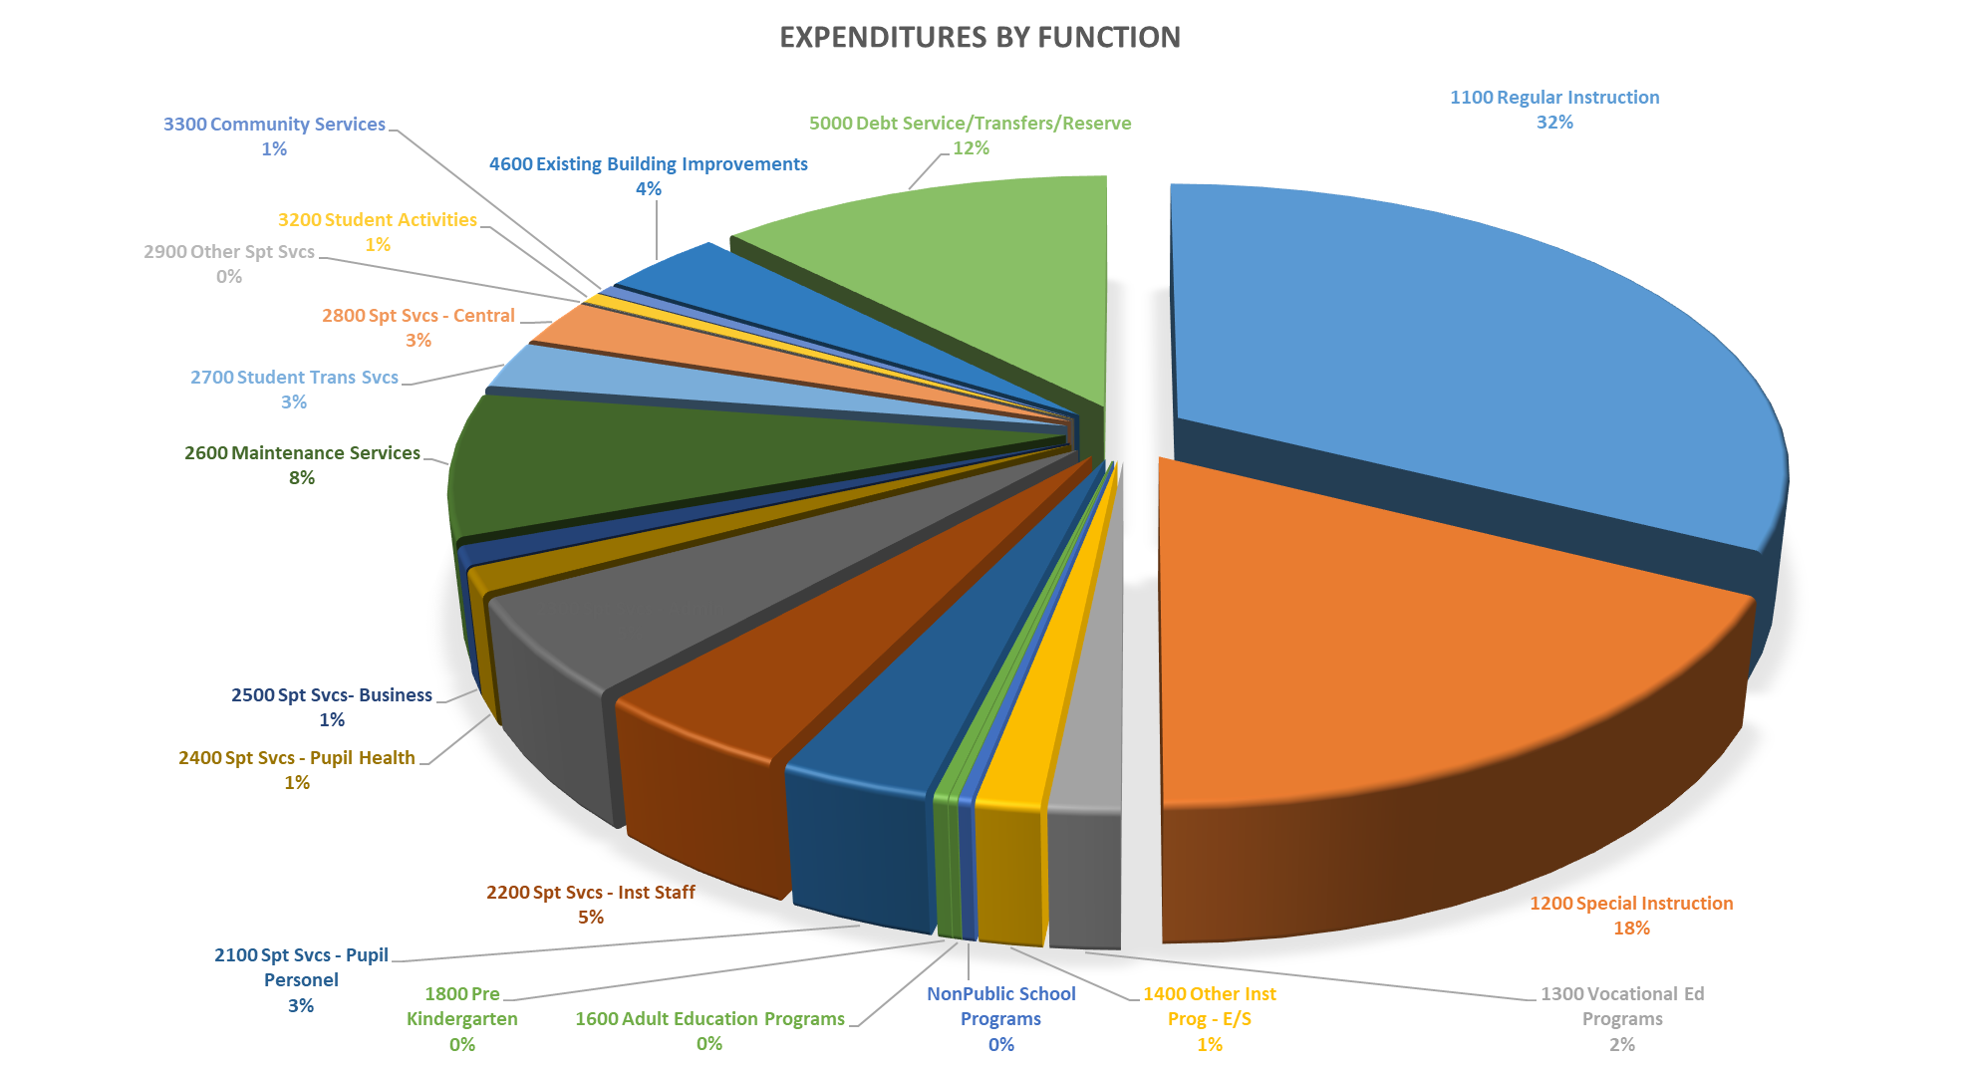
Expenditures
-Function
Notes:
I will now take you through the $211,714,679 in proposed expenditures. The expenditure details start on page 15 of the budget pamphlet. This graph reflects the expenditures by functional area. As expected, our largest functional area for expenditures is the Regular Instructional Program at $68.7 million or 32%. This is followed by our Special Education Programs at $37.2 million or 18%. The 3rd largest functional area for expenditures is Debt Service and Transfers at $26.2 million or 12%.

Slide 16
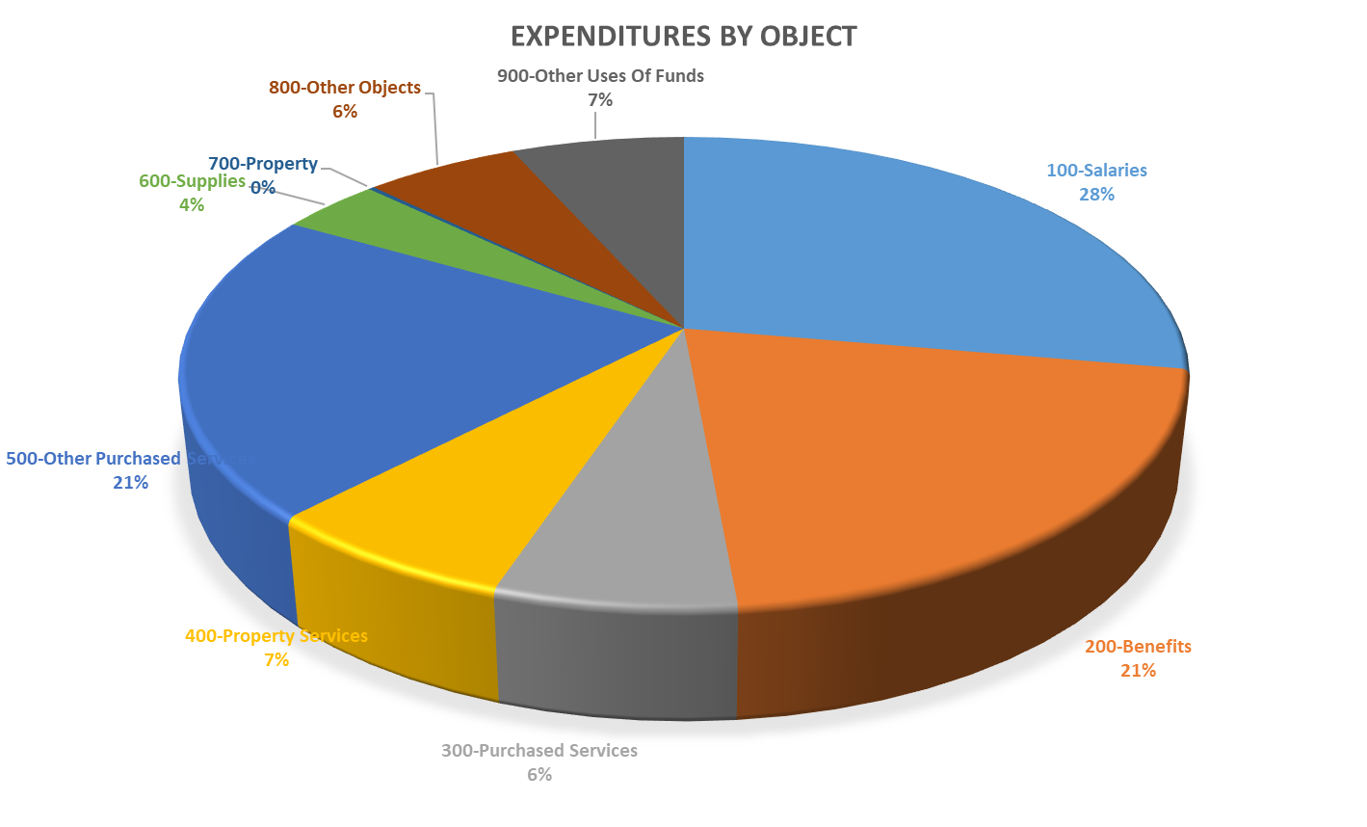
Expenditures
-Object
Notes:
This slide breaks down the proposed expenditures by the object code. Explanations on what types of expenses are include in the various object codes can be found on page 14 of the budget pamphlet. Salaries and benefits make up the largest portion of our expenditures at 49% or $102.8 million. The 2nd largest expenditure is in the 500 codes. This is due largely by the tuition paid to charter schools of $29.1 million. Property services make up the 3rd largest expenditures in 23-24 due to the renovation on Steele Elementary School and the HVAC equipment replacements funded by ESSER.

Slide 17
Expenditures-Instruction
Notes:
In the instructional area, found on pages 15 through 17 of the budget pamphlet, you will find the costs for regular education program, special education programs, the Dauphin County Technical School tuition payments, summer school, alternative education programs, nonpublic school contributions, HACC sponsorship, and our PreK program costs. You will notice that the cost of charter school tuition is showing in the 500 other purchased services code. We are estimating our charter school tuition expense to be $29.1 million in 24-25.

Slide 18
Expenditures-Support Services
Notes:
The detail on the support services portion of the budget can be found on pages 18 through 22 of the budget pamphlet. Included in the support service areas are guidance counseling, social work, psychological services, technology, library, staff development, administration, nursing, business services, operations and maintenance, student transportation, and human resources.

Slide 19
Expenditures-Operation of Non-Instructional Services
Notes:
In the 3000 section of the expenditure budget, found on pages 22 & 23 of the budget pamphlet. This includes our athletic programs at the middle school and high school level, extracurricular clubs and activities as well as family and community engagement.

Slide 20
Expenditures-Facilities Acquisition, Construction, & Improvement Services
Notes:
In the 4000 section on the budget, found on page 23 of the budget pamphlet. This reflects the costs associated with the Steele Elementary renovation not occurring in the current year as well as replacement of HVAC equipment throughout the district paid for by ESSER funding.

Slide 21
Expenditures-Other Expenditures & Financing Uses
Notes:
The 5000 section of the budget can be found on pages 24 of the budget pamphlet. This section includes debt service payments, transfers to other funds, and budgetary reserve. The district will make $19.2 million in principal and interest payments on the debt during the 24-25 school year. This will generate subsidy of $2.2 million from the state and $404 thousand from the federal government. After these payment, the district will have an outstanding principal balance of $172 million. A budgetary reserve in the amount of 2.16% of the budget is included for operating contingencies. In addition, a budgeted transfer to the Capital Reserve Fund of $2.5 million is included.

Slide 22
Revenues Assumptions
Property Taxes-0 Mill increase
Basic Education Funding-50% of the Governor’s proposed budget
Special Education Funding-50% of the Governor’s proposed budget
Additional rental income-1010 N. 7th Street Leases
Investment earnings-rates remain close to current rates
Grants: COPS Grant, STOP grant, Title Grants, CSI Grant, Stronger Communities Grant, ESSER III, ARP ESSER Learning Loss
Notes:
We recently were notified that we will be receiving the 21st century grant to help support afterschool and summer programs starting in the Fall of 2024. We do not know our allocation at this time, but hope to be able to have that in time to make adjustments before the final budget adoption. It is highly unlikely that the State will adopt an on-time budget, so we will likely have to adopt our budget based on estimates for BEF and SEF.

Slide 23
ESSER Funding
2024-2025 Budget: $8,540,300
One time source of funding-9/30/2024
  ESSER III
  ARP ESSER Set Asides-Learning Loss
Notes:
As shown in the federal revenue section, we are budgeting for $8.5 in ESSER funding during the 24-25 school year. All ESSER expenditures must be obligated by 9/30/24. We then have 90 days to expend those obligations. A late liquidation period can be applied for, if needed.

Slide 24
2024-2025 ESSER Funded Expenditures
ESSER III $8,000,000
ESSER Set Aside: $540,300
Salaries & Benefits for ESSER Administrator
HVAC equipment replacements
Steele Elementary renovation
Phase II and Phase III of the Curriculum Audit
UnboundEd Standards Training
Academic supplies
Teacher salaries and benefits for curriculum work
Notes:
This slide outlines the planned uses of the ESSER III and ESSER Set Aside grant funds during the 2024-25 school year. With the obligation date of 9/30/24 for all ESSER funds, the 24-25 expenditures are limited to the completion of the Steele Elementary renovation project and the HVAC projects for Camp Curtin and Hamilton as well as the 2nd and 3rd phase of the curriculum audit and the Unbound Ed staff training in August. ESSER III also includes Dr. Thompson’s salary and benefits for a partial year.

Slide 25


Empowering Academic Achievers and Lifelong Learners
2024-2025 Budget Adoption
June 27, 2024
Notes:
As stated at the beginning of this presentation, I outlined that the mission of the Harrisburg School District is to Empower Academic Achievers and Lifelong learners. I hope this 2024-25 proposed budget presentation explained the financial investment we are making in achieving our mission. The adoption of the 2024-25 budget and setting of the tax rate is planned for June 27, 2024. Please note that this is a Thursday. Copies of this presentation, the budget pamphlet and the budget in the official form of the PDE 2028 will all be available on the district website.

