Slide 1
Composer Overview
Dallas ISD

Slide 2
Agenda
01
Navigating your site
02
Editing Interior Pages
03
Managing Resources and Galleries
04
Posts
05
Calendars
Notes:
To replace photos inside the shapes, right click on the image > Replace Image

Slide 3
Navigating Your Site

Slide 4
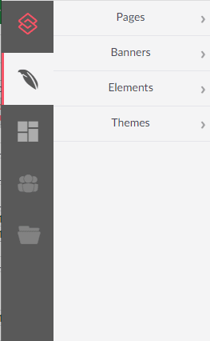
Composer
The editor used to build pages
How we refer to the entire content management system
Pages: Add and edit content to your site
Note: Options will vary according to your user permissions.

Slide 5
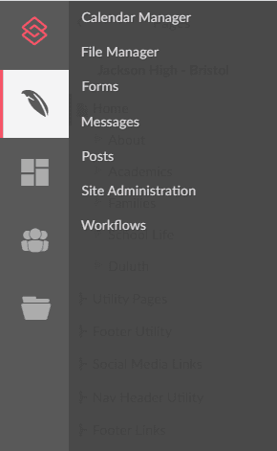
Modules
Smaller pieces of software designed to do one task really well
Uses elements within Composer to display content on your pages dynamically
Note: Options will vary according to your user permissions.

Slide 6
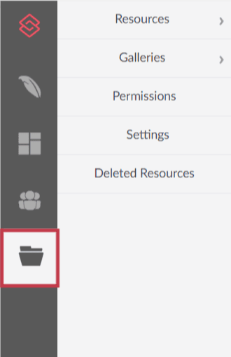
Resources
Resources: The filing cabinet for files and media
A folder structure for organizing files
Galleries: Groupings of resources for display
Contains home page slider images

Slide 7
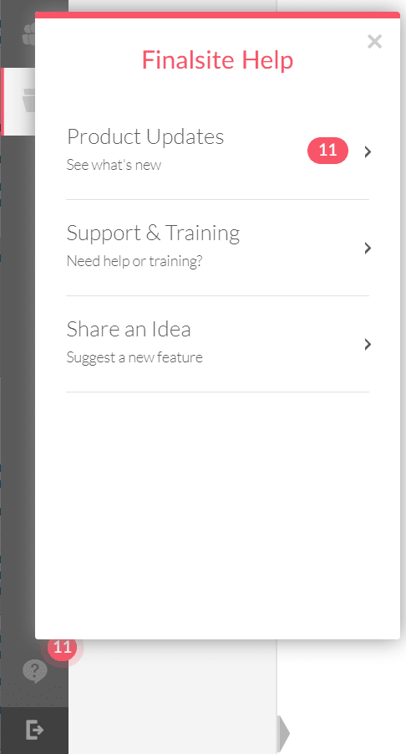
Help & Support
Full Help & Support menu
(Shortcuts were on the desktop)
Logout button
Note: Options will vary according to your user permissions.

Slide 8
Basic Composer Navigation

Slide 9
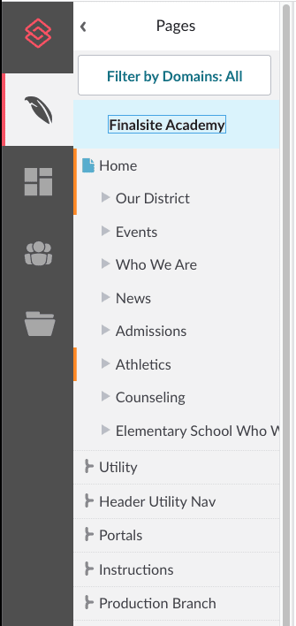
Page navigation
At the top of your Pages panel, you’ll find your domain - your school’s site. The first section beneath the domain is your site’s main content pages. Below your main pages are branches, folders that allow you to organize site content without impacting the site’s structure.
Branches are used for links/buttons in the header and footer, portals, instructions, and production notes, but they are also great for storing your practice or test pages separate from live pages.

Slide 10
Reference Branches
Production
Style Guide page Contains what each element should look like with your site’s theme.
Contains the elements which are utilizing custom classes.
Contains elements which can be copied and pasted onto other parts of your site.
Instructions
This section walks through how to update the content of your site, including the home page and headers and footers.
This section also includes information about image sizes and preferred styles of cropping for each type of element.
Notes:
Class of 2022 Top Ten

Slide 11
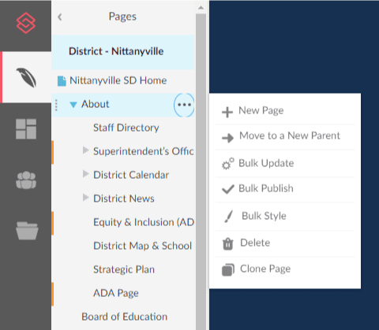
Managing Pages
Pages are updated by using the three dot menu to
Add new page
Move to a new parent
Delete
Clone
Or change the page name in the Page Settings (more on this later)
Note: If you don’t have this menu, you may not have permissions to perform these actions.

Slide 12
Composer - Page Basics

Slide 13
Page Settings
Select the gear icon to access the page settings.

Slide 14
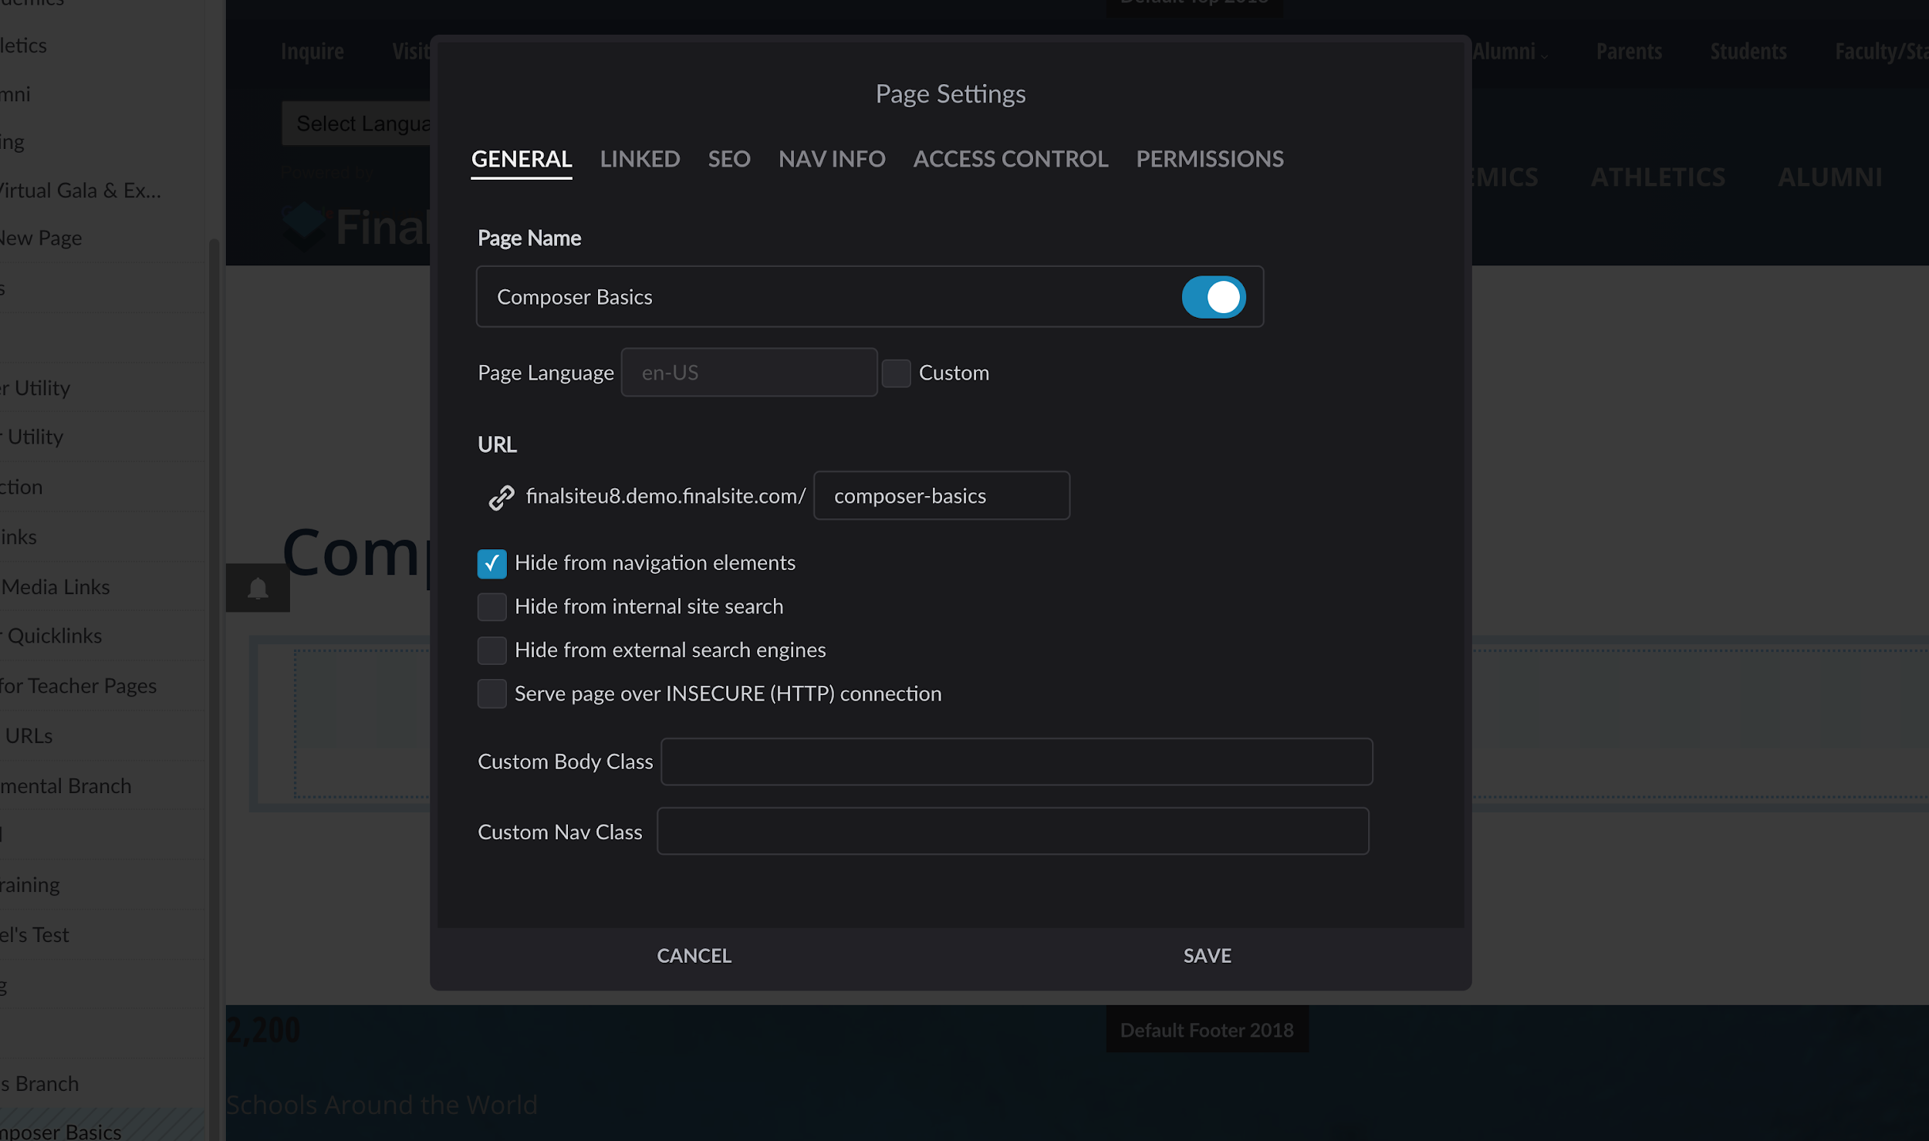
Page Settings
General
Set page name, choose to hide or show this page title
Adjust URL as needed
Hide from navigation
Hide from searches
Custom styling added by your Finalsite designers or the CSS savvy
Hidden pages have gray lines through the page name.

Slide 15
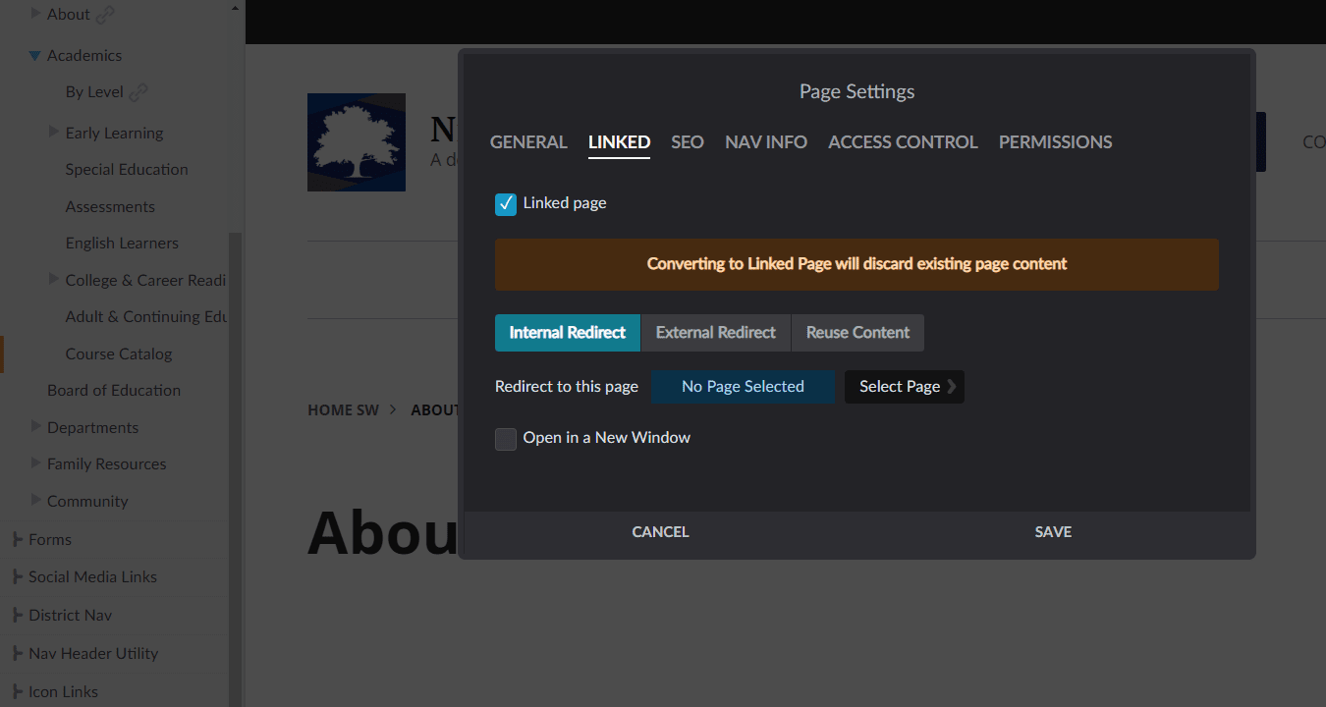
Page Settings
Linked
Internal Redirect
Select another Composer page
External Redirect
Insert a URL
Reuse Content
Pull content from one page to display on another page
You’ll see a link icon next to the name of any pages that have been linked to another page.

Slide 16
Additional page options
Use this button to view
TIER TWO
1 2 3 4 5 6 7
TIER TWO
Page History: Log of edit/publish history
Clone: Make a clone of the page
Delete: Remove the page
Unpublish: Remove the page from the public-facing website only
5. Move: Move the page under a new parent
6. Add: Add a new page below this page
7. Restore: Revert to last published version
Tier 1 Features, plus
Feature Name
Feature Name
Feature Name
Tier 1 Features, plus
Feature Name
Feature Name
Feature Name

Slide 17
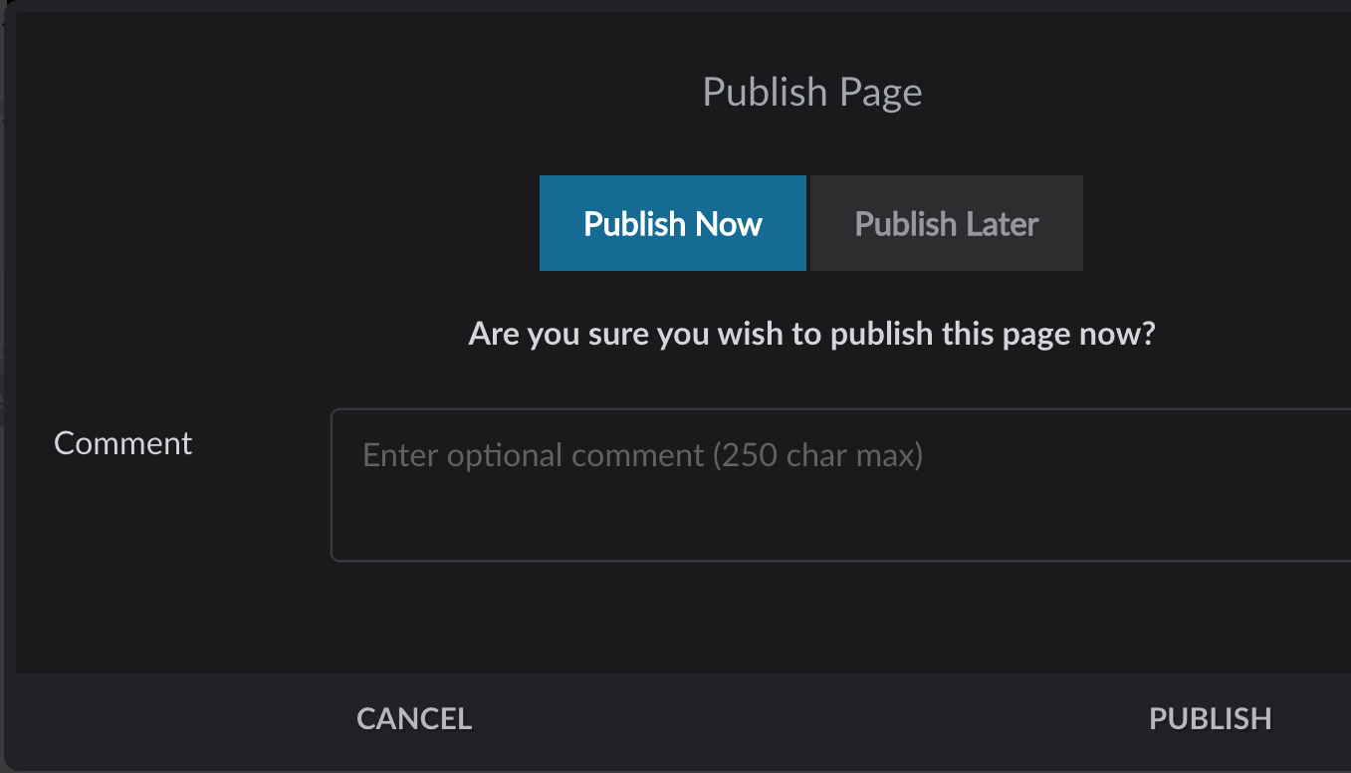
Publish button
Publish Now: Page is live immediately
Publish Later: Choose a date and time for the page to be published
Comment: Make an admin-only note about why you are publishing
Know your page statuses:
Green = Published Yellow = New
Orange = Draft Light blue = Scheduled

Slide 18
View options
View the published version of this page
View this page on multiple screen sizes!
Note: Looking for a preview? Turn off Compose mode!

Slide 19
Composer - Editing Interior Pages

Slide 20
Compose mode
The Compose toggle enables page editing, adding new or editing existing content.
Changes from gray to blue when you can edit
If you don’t see a Compose toggle, you don’t have permission to edit this page.
Pages are built with “elements.”
With Compose mode ON, you can also edit your page’s layout, banners, and theme in Page Layout & Appearance.

Slide 21
What are elements?
Elements are the fundamental building blocks of your Composer website.
Some elements add static, page-specific content.
Others add dynamic content from modules like Calendar Manager, Posts, etc.
Use elements to create a unique layout and organize content.

Slide 22
Element actions
Hover over an element to:
Add a new element to the page
Move the element on the page
Copy the element to paste elsewhere
Access the element settings
Delete the element

Slide 23
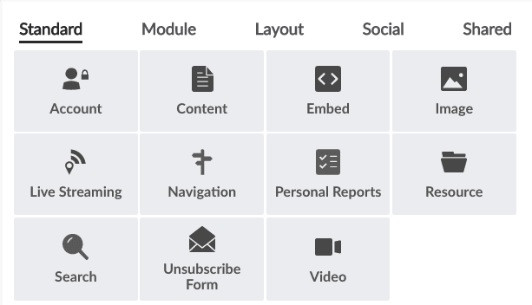
Standard elements
Content: Text, photos, etc.
Image/Resource/Video: Resources content
Navigation: Tree of site pages for menus

Slide 24
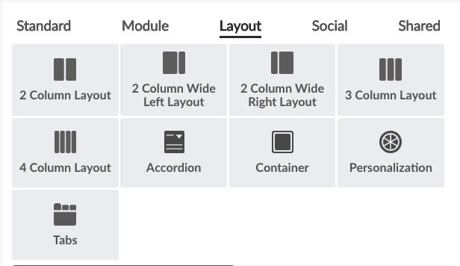
Layout elements
In addition to the full-page layouts in the Page Layouts & Appearance menu, Layout elements further customize the arrangement of elements on your pages.
Easily switch between column layout elements by hovering over the element and clicking the layout icon.
For pages with lots of content, consider using Accordions or Tabs to condense and organize.

Slide 25
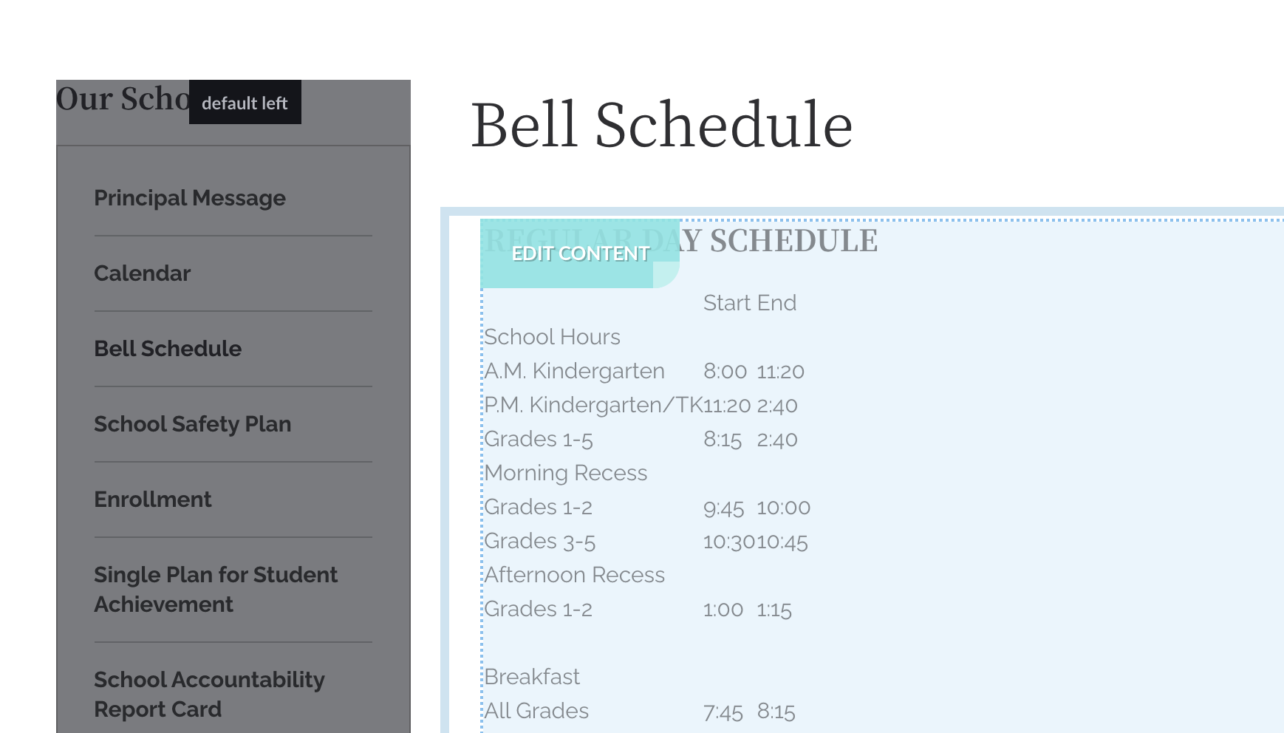
Content element
The most basic element is called the Content element. Content elements can be used to add text, images, embeds, links, and more to your page.
In Compose mode, hover over the element until you see “Edit Content.”
Click anywhere inside to access the content editor.

Slide 26
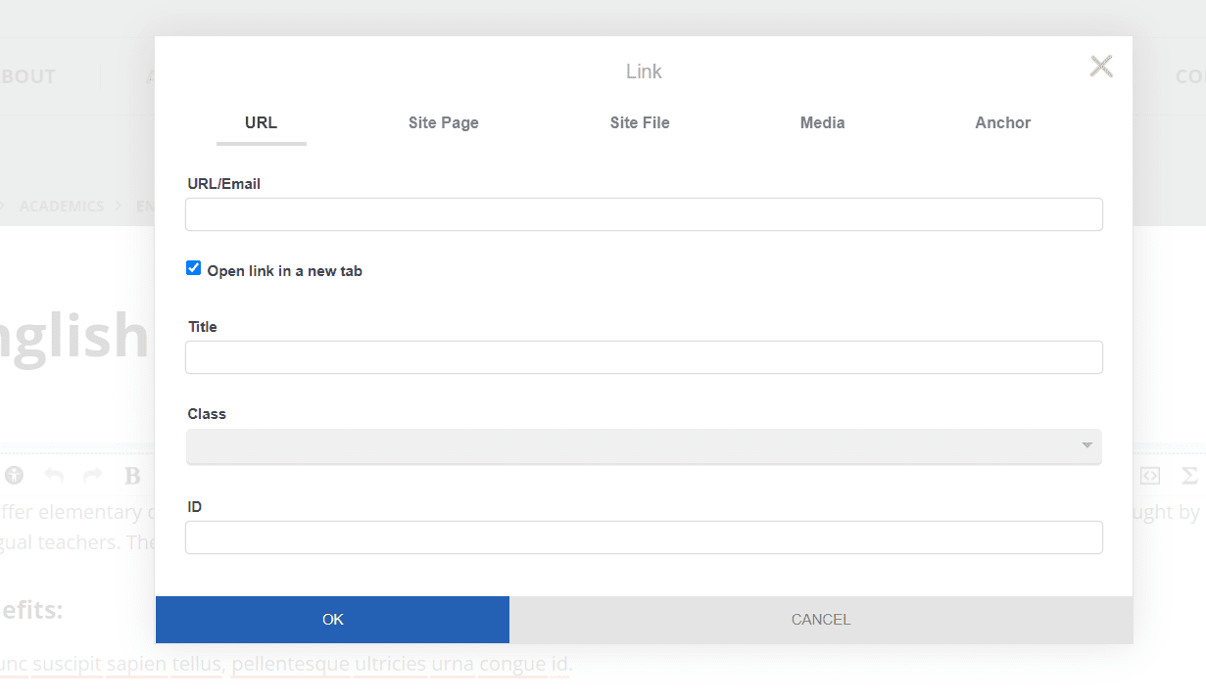
Add a link
Content Elements - Buttons
URL
Add a direct URL to another site
Site Page
Browse Composer to link to another page
Site File
Browse Resources to link to a file/image

Slide 27
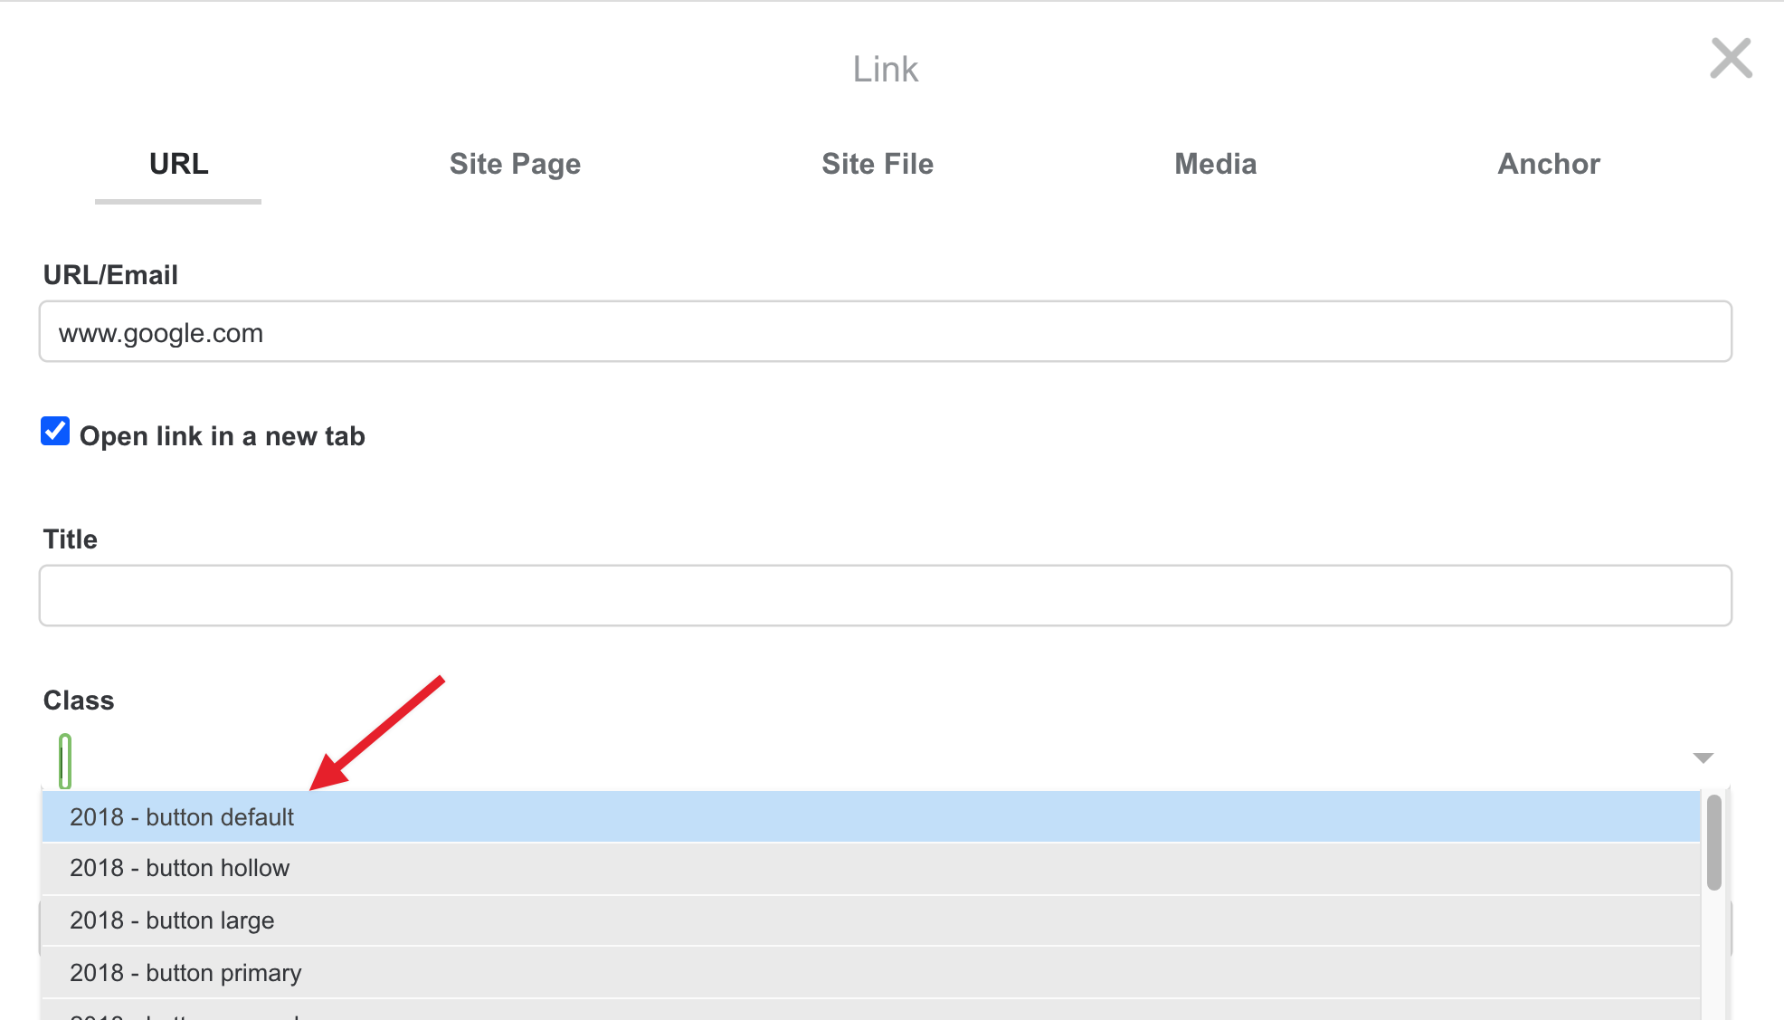
Add a button
Content Elements - Buttons
Select the text
Click “Add Link”
Add the appropriate link
Use the “Class” field to select the styling
Note: Even though it is possible to use the Styles menu in the editor and apply a button style that way, we recommend this method for best results.

Slide 28
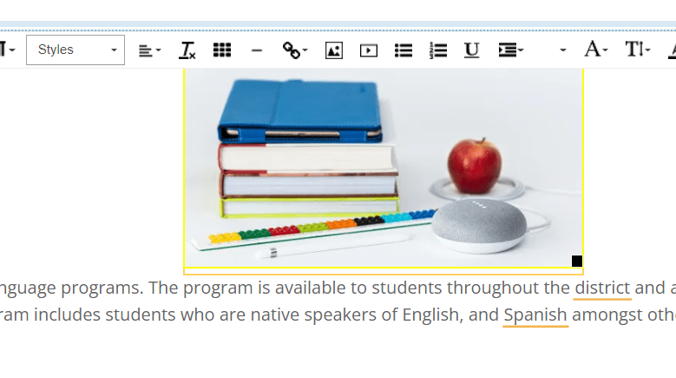
Add an Image
Content Elements - Buttons
Insert image from Resources
Can resize in the content element
Apply alignment to wrap text around the image

Slide 29
Tips for editing content
Use the Accessibility Checker like a spell checker to help stay in compliance.
Paste plain text with formatting removed for best results. Use Cmd (or Ctrl) + Shift + V
Remember: Headers are for structure, not styling.
Use the styles in the dropdown instead of making your own. These were created for you to make your site look awesome!
Notes:
A speaker note in response to "But it clears out links.." While yes, it does, it behooves you to use the "Site Page" linking option so that links do not break over time.

Slide 30
Resources

Slide 31
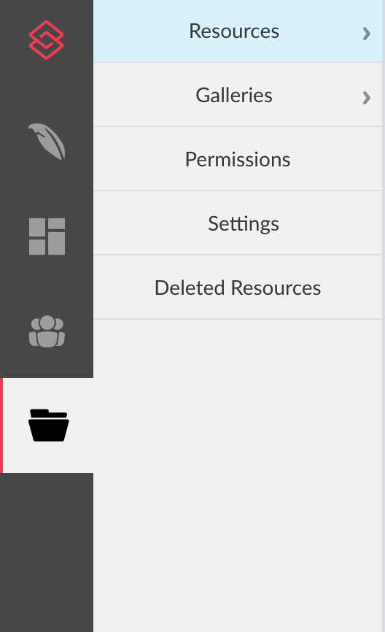
Resources sections
Resources: The filing cabinet for files and media
Images, videos, files, PDFs
Galleries: Groupings of resources for display
Home page slideshow
Event pictures
List of files such as Board meeting minutes, or handbook policies

Slide 32
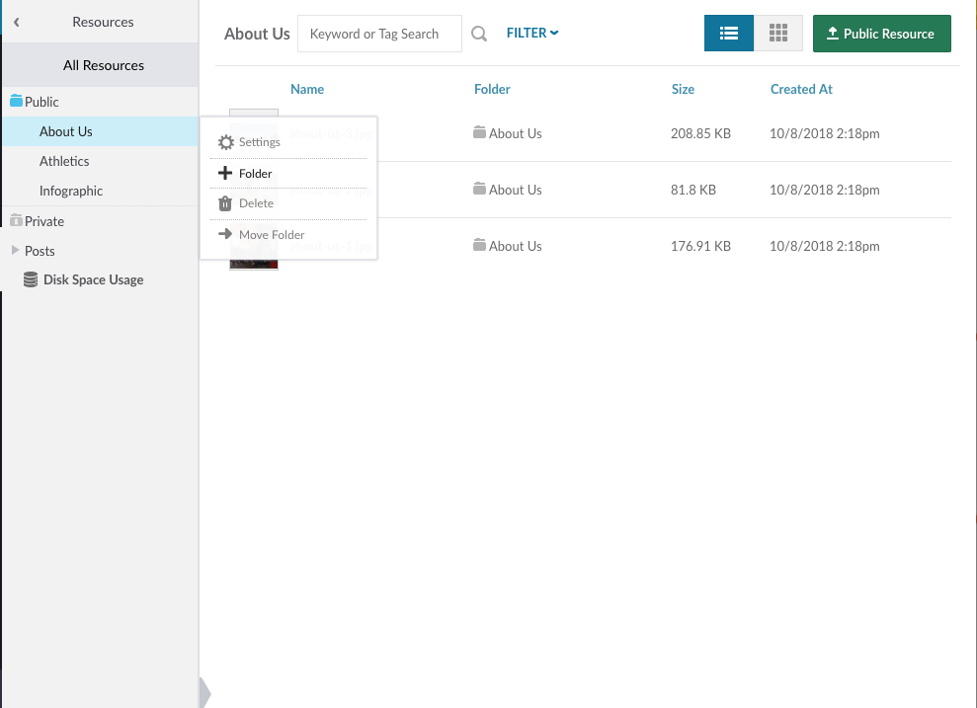
Resources
Folders can be nested (indefinitely).
Permissions can be set on individual folders.
Create a folder structure that mimics your page structure
Upload using
A resource can only exist in one folder at a time.

Slide 33
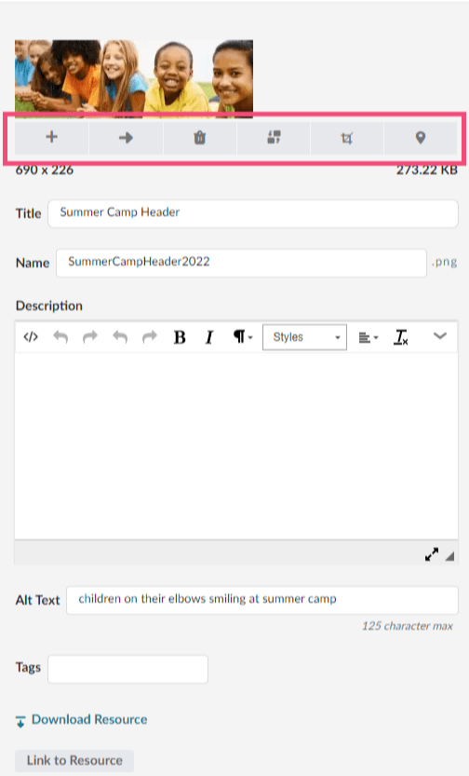
Image Tools
1 2 3 4 5 6
Add to Gallery - add file to an existing gallery
Move to Folder - move file to an existing folder
Delete Resource - moves file to Deleted Resources (30 days)
Replace Resource - replaces the file in all instances where it is displayed on the site
Edit Image - only cropping available; use image ratios
Where Used - see where the file is used throughout the site

Slide 34
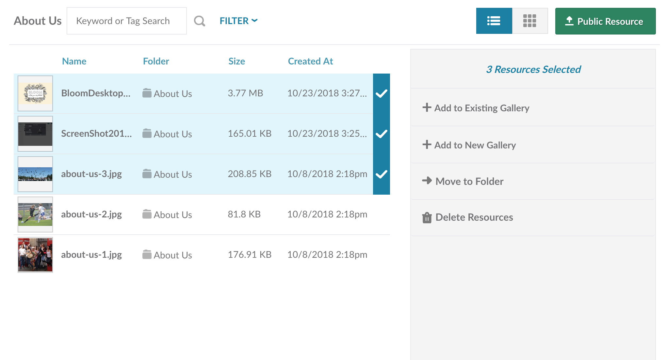
Bulk actions
Hover over the resource and select the blue checkmark to the right of the resource.
Once you select one, you will have the option to move the items between folders or between galleries or delete resources.

Slide 35
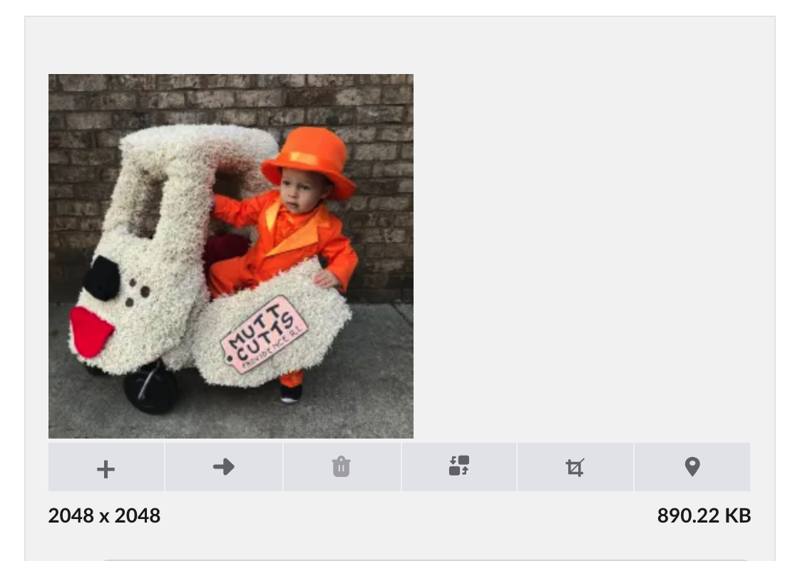
Best Practice: File Sizes
File size limits in Resources are based on the file type.
Image files/PDFs can be up to 100 MB.
Video files can be up to 3.51 GB.
All other files can be up to 3.91 GB.
Pro Tip: Refer to your Instructions page for specific dimensions for your site

Slide 36
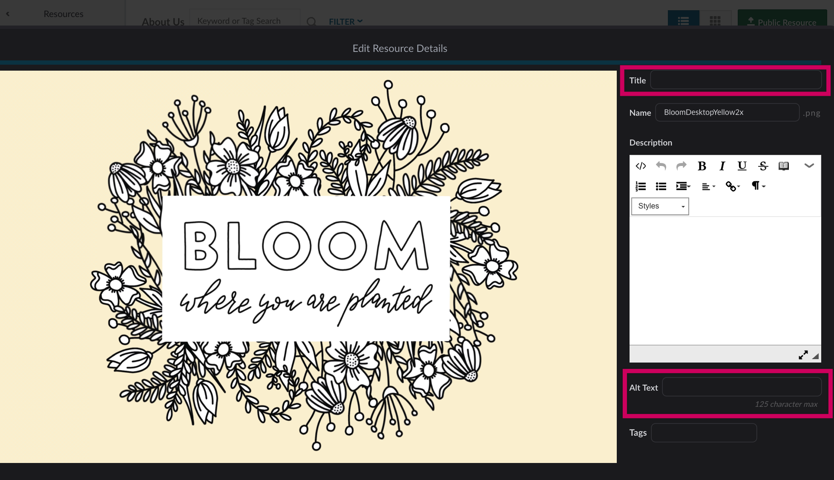
Upload skills
Add a Short Title. If no title is added, and the title is set to display, the file name shows. Underscores and all.
Add Alt Text. Make sure to skip adding “Image of” and just describe the image as well and briefly as possible.
Descriptions are optional, but if you have one, it’s best to put it in on upload rather than add it later.
Note: Titles and Descriptions may be styled to display on your home page slider.

Slide 37
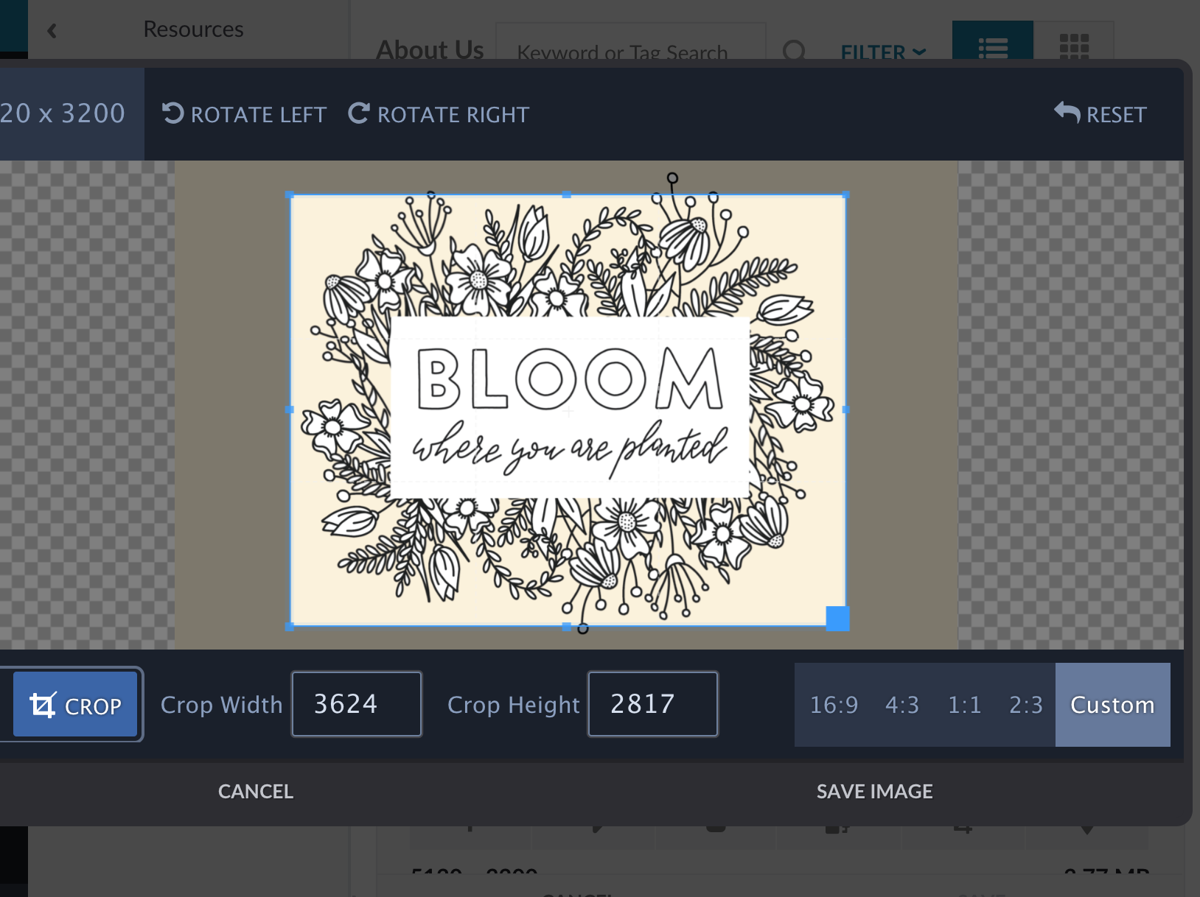
Optimization
Resources will automatically optimize your videos and images.
Cropping is now more important than optimizing. Crop your images with the focus in the center of the screen and with a high-quality image. You can edit any image directly in Resources with the crop icon.
The system will compress the image and display items with layout-specific sizing.
Note: You cannot resize images in Resources.

Slide 38
Galleries

Slide 39
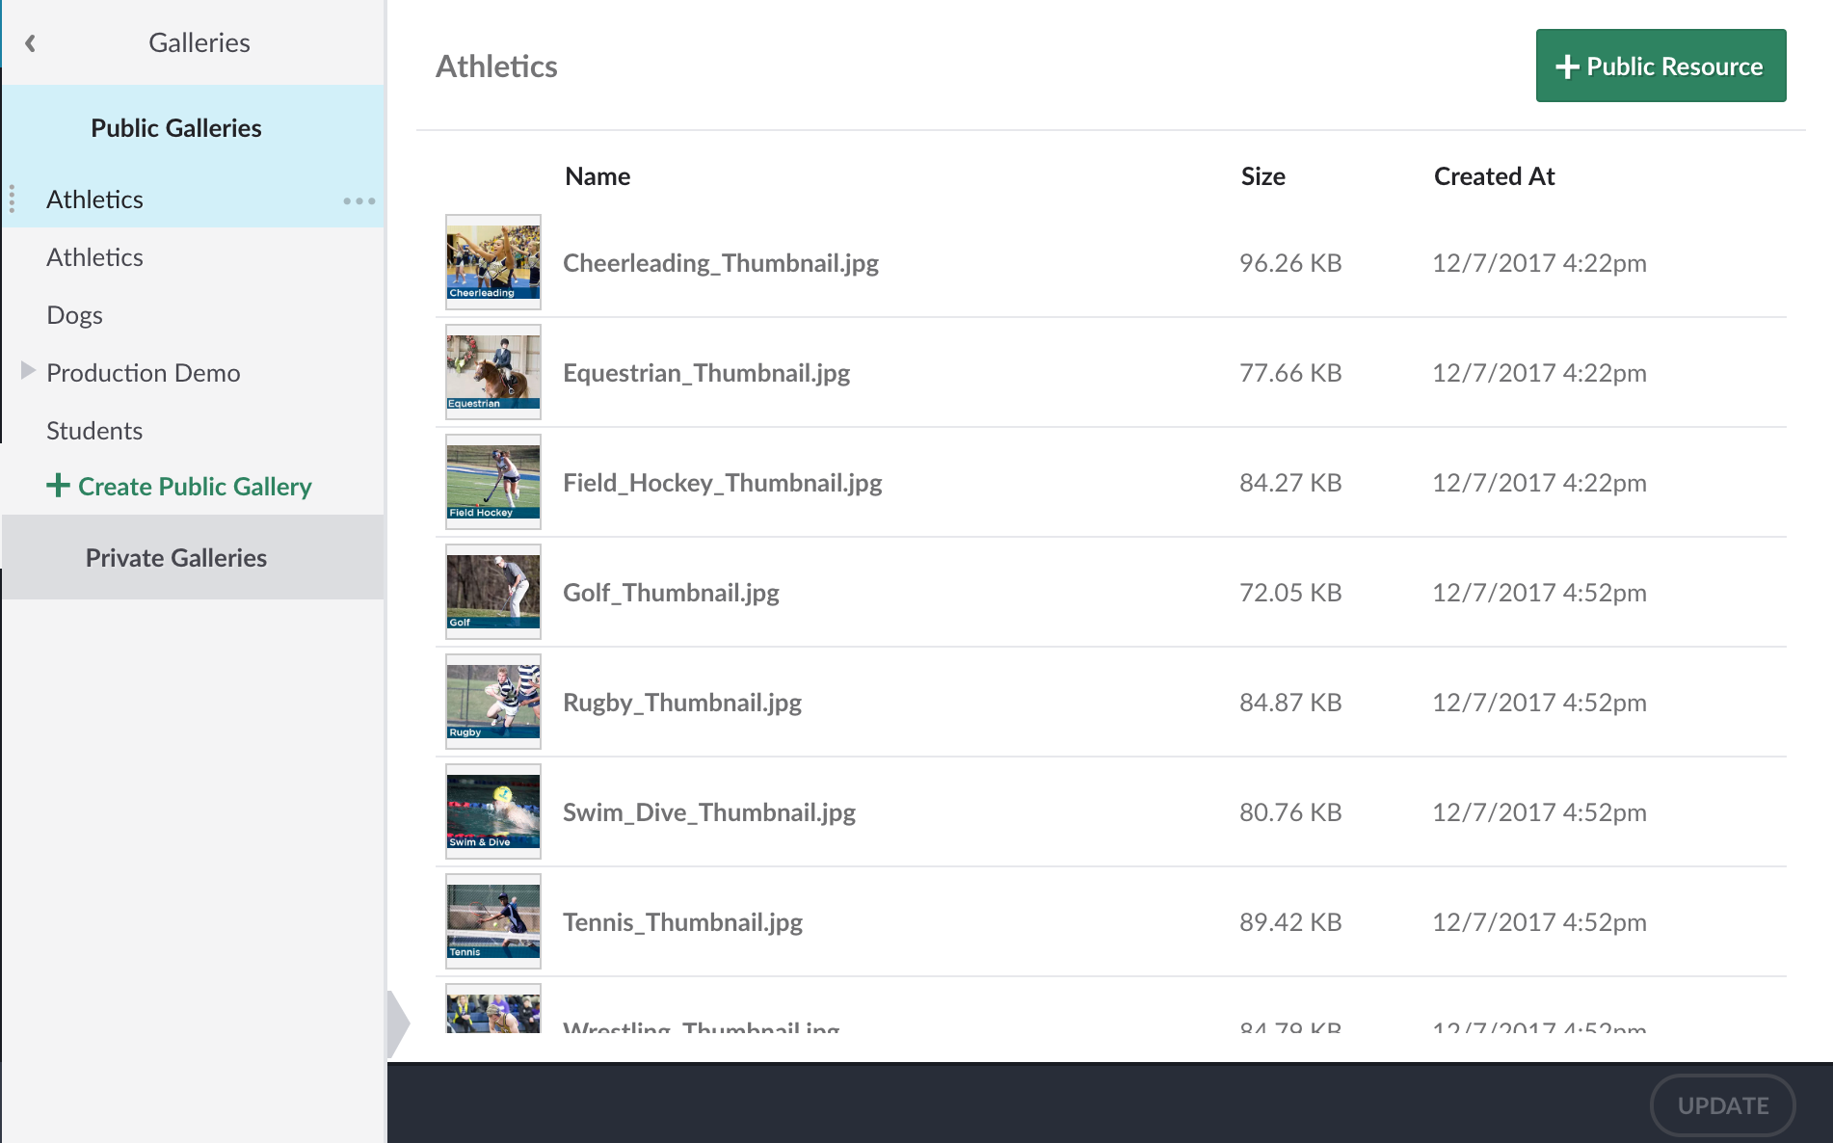
Galleries
Grouping your resources is easy with galleries. Use galleries to create:
Slideshows
File display groups
Photo galleries
Anything you can think of!
A resource can exist in multiple galleries.

Slide 40
Managing Galleries
Add to gallery
Remove from Gallery
Hover over files to rearrange order
1
3
2

Slide 41
Displaying resources on your site

Slide 42
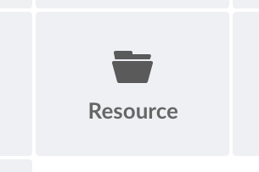
Resource element
Quickly make lists, slideshows, or photo galleries by grouping together your resources in a quick gallery and using the Resource element to display these.
The List and Grid formats can show resources only, galleries only, or both.
If you configure this element to show only galleries, you can link it to another Resource element to display the individual resources in that gallery.
In Grid format, you can display resources inline or as thumbnail links that open in a lightbox or element.
Use the Audio, Image, Video, Document, and Other buttons to filter the resource types displayed.
Use for: Photo slideshows, lists of documents, and any other times you want to display files as a group

Slide 43
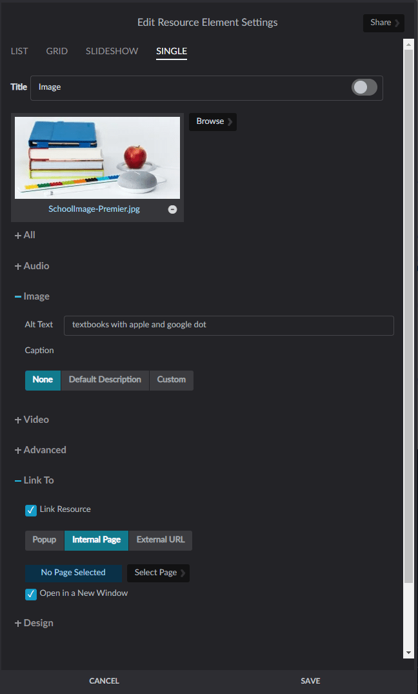
Add images with a Resource element:
Fills the space of the element (cannot be resized)
Provides other options in the element settings such as displaying captions and linking to a URL, page, or file

Slide 44
Posts Module

Slide 45
What can you do with Posts?

Slide 46
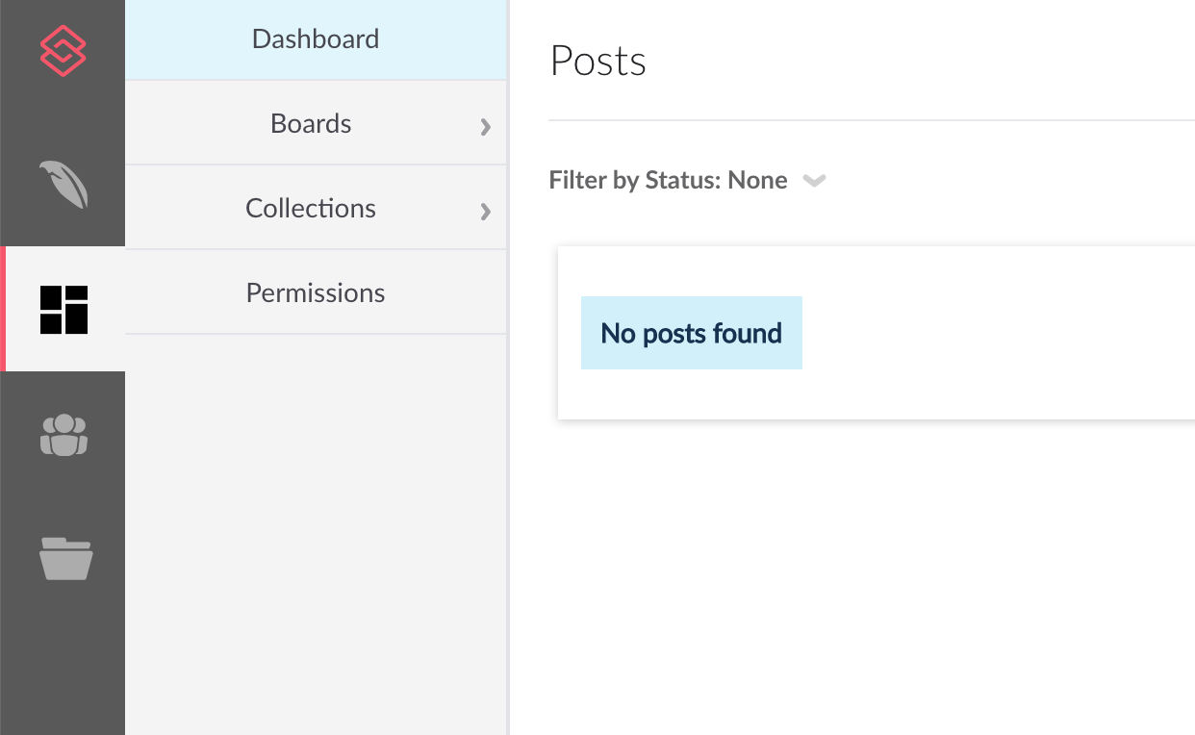
Organization of Posts
Dashboard
Boards: Contain Posts of a specific subject, such as District News
Folders: Collection of Boards, back end organization only
Collections: Add Posts from any Board to a collection and organize in any order.

Slide 47
Examples of board structures
Folder
District
District News
Employment
Transportation
NRH Elementary
NRHES News
NRH Middle
NRHMS News
NRH High
NRHHS News
All School
All School News
Employment
Transportation
Lower School
LS News
Middle School
MS News
Upper School
US News
Athletics
FS Academy
All School News
Employment
Transportation
Athletics
Fine Arts
Admissions
Folders allow you to define locations (for mobile app).
Assign permissions to manage posts by Boards.
Admins only see the folders and boards that they have access to.
Boards

Slide 48
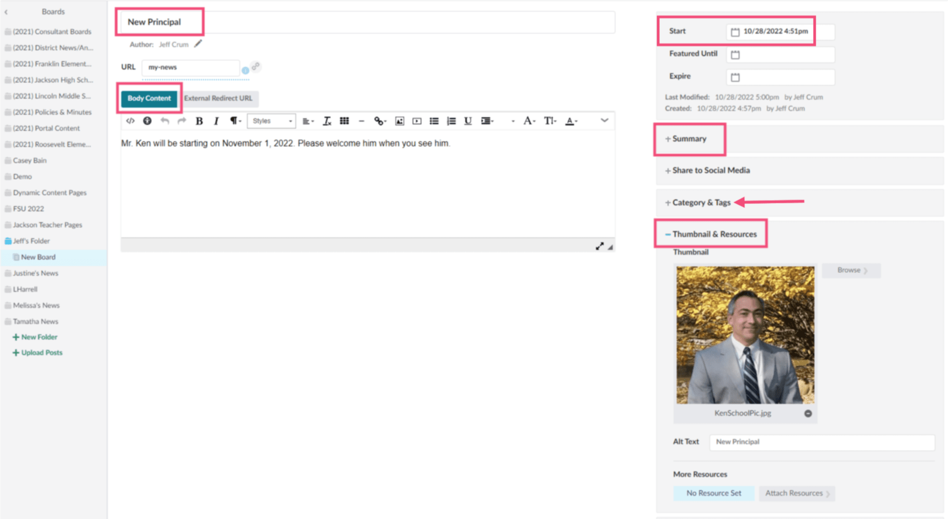
Elements of a Post
Click on a board
Click on an existing post
Locate the following:
Title
Body Content
Summary
Thumbnail
Start date

Slide 49
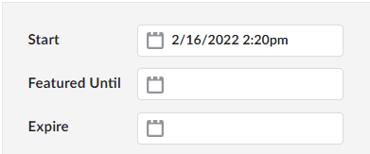
Create a Post
Select on a board
Click Create Post
Complete all post details
Title, body, summary, thumbnail
Tags (if used)
Save > Do you want to publish immediately?
Yes - a start date/time will be entered and the post will publish
No - the post stays in draft mode until you schedule the start date/time
Featured Until: the post remains at the top of the news list until this date, then it will fall in order with all posts (Note: This may be how posts appear as a “Featured News Story”)
Expire: the post will be removed from the page, but will remain in posts

Slide 50
Categories and Tags
Categories
A grouping of related posts on one board
Categorize posts
Specific to one board
Tags
Broad topics
Shared across all boards
Filter which posts display in an element

Slide 51
Posts Best Practices
Do
separate different subject types of content by Board
Don’t
over complicate things!
Do
utilize Post Tools to allow visitors to filter only on the content they wish to see.
Do
have your posts open in a page rather than pop-up
Don’t
use long Board or Post Titles to keep the post URL short as possible
Do
clone a post instead of creating from scratch

Slide 52
Calendars
Managing events

Slide 53
Event Source
Events are managed in Calendars in one of two ways:
Standard
Events are manually entered into calendars
Can be imported with a datasheet
All edits are managed here
Site admins need access
Live
Events are synced from an ics feed (such as Google Calendar)
All edits are managed in the original source
ICS file must be less than 3 MB
Site admins don’t need access

Slide 54
Display events on your site

Slide 55
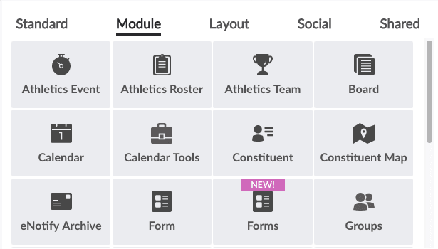
Calendar elements
Calendar: Displays full calendars in list, grid, slideshow, or single view
Calendar Tools: Displays a legend, search feature, or mini grid

Slide 56
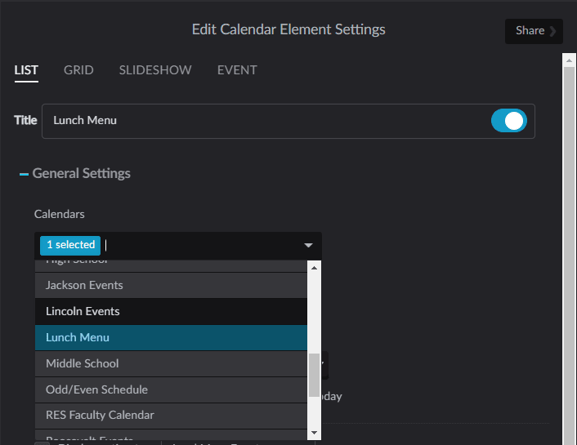
Events / Calendar
Which calendar(s) are displaying?
Use the element settings to learn which calendar(s) are displaying.
Go to Modules > Calendars
Open the Calendar and edit
Note: The calendar may be a live calendar synced to a Google calendar feed. In this case, it would only be edited in Google.
Learn more about Calendar Manager

Slide 57
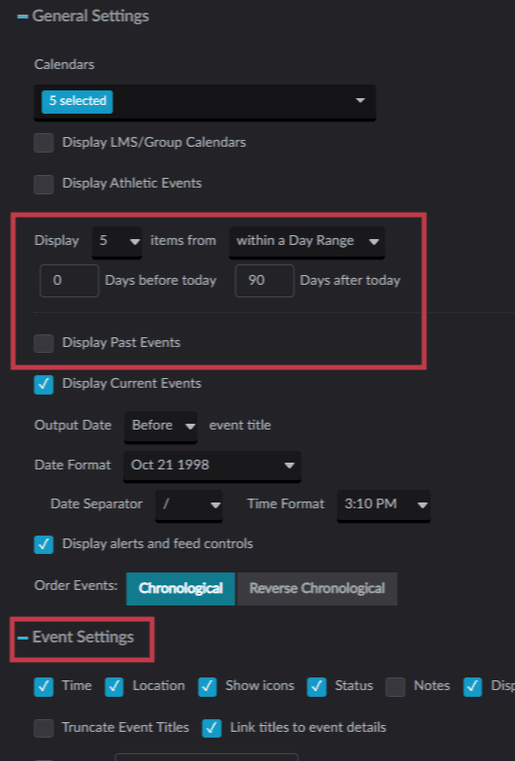
Calendar Element Settings
General Settings
Display 0 days before today
Uncheck Display Past Events
Event Settings
Check what you what displayed

