Slide 2
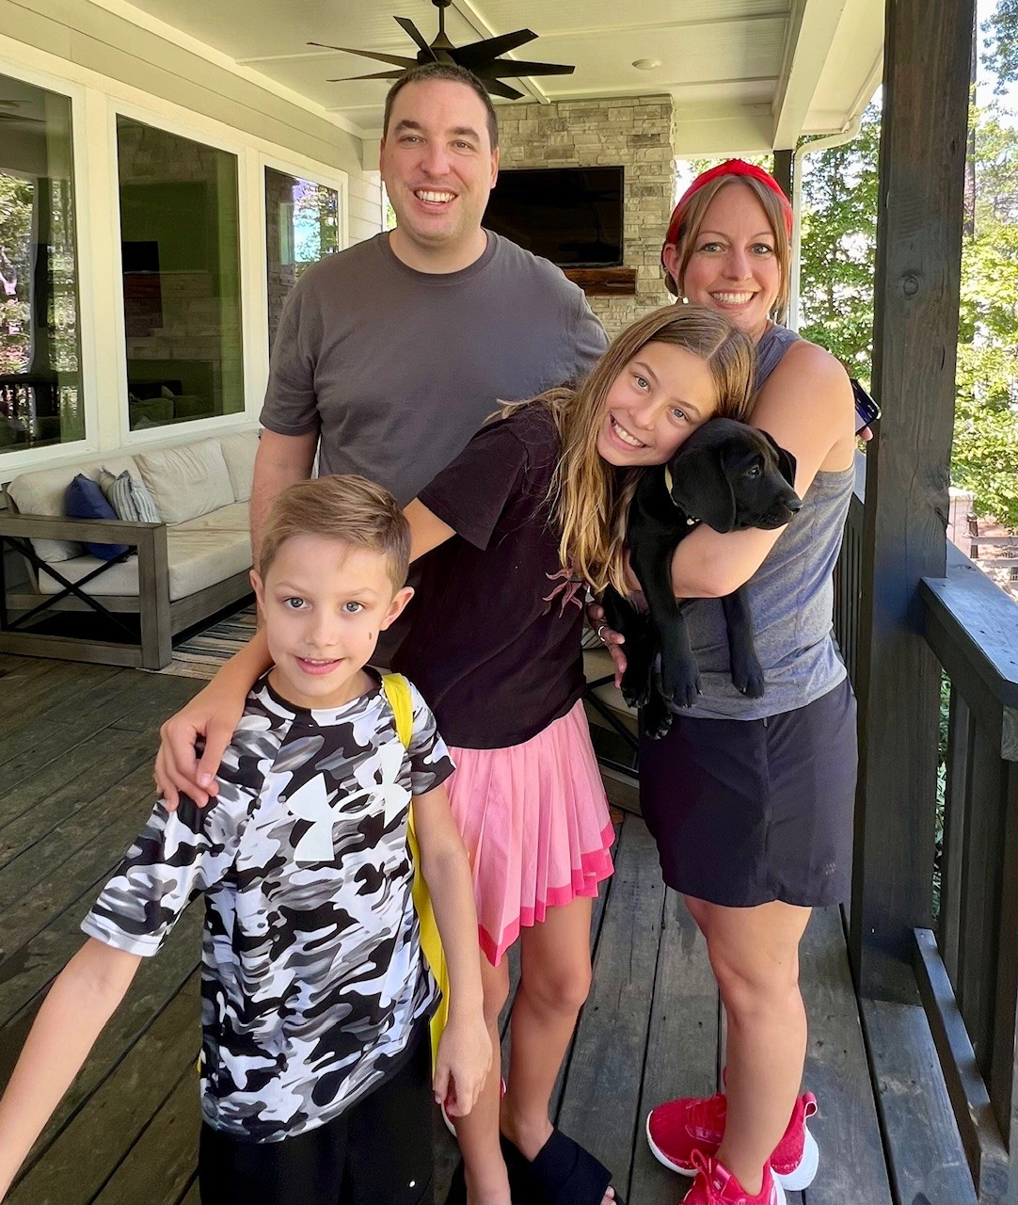
Shannon Leeds
Graduated from Cedarville University with a Bachelors in Early Childhood Education (Birth-grade 3) and Special Education (age 3- age 21)
10th year teaching PreK, 2nd year at AES
I have two children: Lillian (12 years old) and Lucas (7 years old) and a new puppy Luna

Slide 3
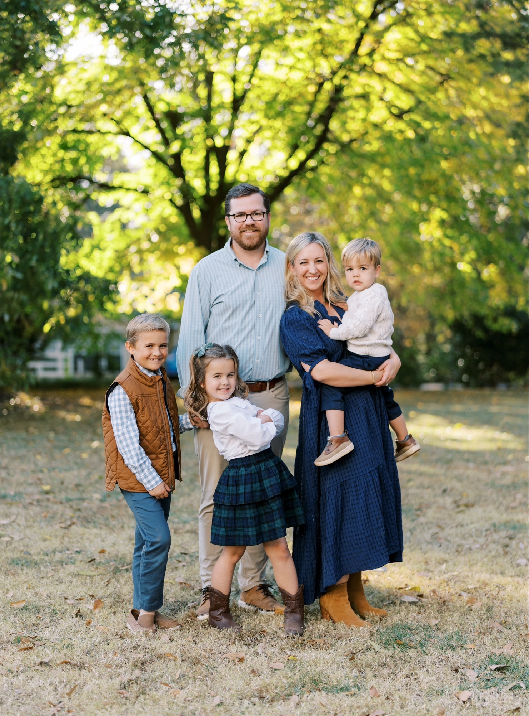
Lindsey Messina
Live in Alpharetta with my husband, Brendan, and our 3 kids: James (3rd grade), Mary (Kindergarten), and Patrick (3 years old)
Master's in teaching from Georgia College and State University.
Taught middle school English for 13 years.
Loving my first year in elementary school with PreK!

Slide 4
Frog Street Curriculum:
My School & Me
Family & Friends (Pets and Neighborhood)
Giants (Big/Little, Nature’s Giants, Giants Made by People, Make Believe Giants)
Choices (Healthy Choices, Healthy Habits, Problem Solving)
Holidays Around the World
Stories and Rhymes (Nursery Rhyme, Traditional Tales, Fairy Tales, Folktales, Fables)
I Build! I Create! (Construction, Tools and Machines)
Things That Move (Muscles/Dance, Travel, Transportation, Mysterious Movers (coasters, wind, bees)
Animals (Farm, Zoo, Bugs)
Changes (Life cycles, Weather, Seasons, Sun/Moon)

Slide 5
Heggerty
Phonological Awareness and Phonemic Awareness
Kid Lips
Explicit Alphabet and Phonics Instruction
Social Emotional
Feeling Buddies
Second Step

Slide 6
GELDS: Georgia Early Learning Development Standards
STRAND: Self-Regulation Standard
SED3: The child will demonstrate self-control.
- SED3.4a Independently follows rules and routines.
SED3.4b Regulates own emotions and behaviors and seeks out adult support when needed.
SED3.4c Regulates a range of impulses.
SED3.4d Manages transitions and adapts to changes in schedules and routines independently.

Slide 7
STRAND: Early Reading Standard
CLL5: The child will acquire meaning from a variety of materials read to him/her.
CLL5.4a Prior to reading, uses prior knowledge, story title, and pictures to make predictions about story content.
CLL5.4b Retells familiar stories.
CLL5.4c Discusses books or stories read aloud and can identify characters and setting in a story.
CLL5.4d Makes real-world connections between stories and real-life experiences.
CLL5.4e Develops an alternate ending for a story

Slide 10
Grits with Grandparents (Sept)
Eagle Dash (Sept)
Red Ribbon Week (Oct)
Ga Pre-K Week
Winter and End of Year Party
Bingo
Family Dance
Kids Heart Challenge
Field Day (in May)
Eagle Fest (May)
Spirit Nights (throughout the year)

Slide 11
WSO Narrative summaries are completed at the end of each semester. Summaries include information about your child’s progress in each content area.
For students with IEPs, those meetings will be held according to dates listed in individual IEPs
We would like everyone to sign into Classlink/Teams to make sure we are prepared for virtual conferences and possible virtual teaching days.

Slide 12
*Please make sure to label personal supplies!!
Backpack
One small towel
A complete change of clothes (shirt, shorts, underwear, socks, and shoes)
A lunchbox (if bringing lunch from home)
Water Bottle (label with name)
Folders for communication
You can register online as a volunteer.

Slide 13
We plan activities for every day of every week that are carefully chosen for the children in the class. If your child is absent, they are missing important small groups and activities.
Attendance information is on the FCS website under “Students and Families”.
We have a Pre-K specific attendance policy that we will have you sign as well.

Slide 16
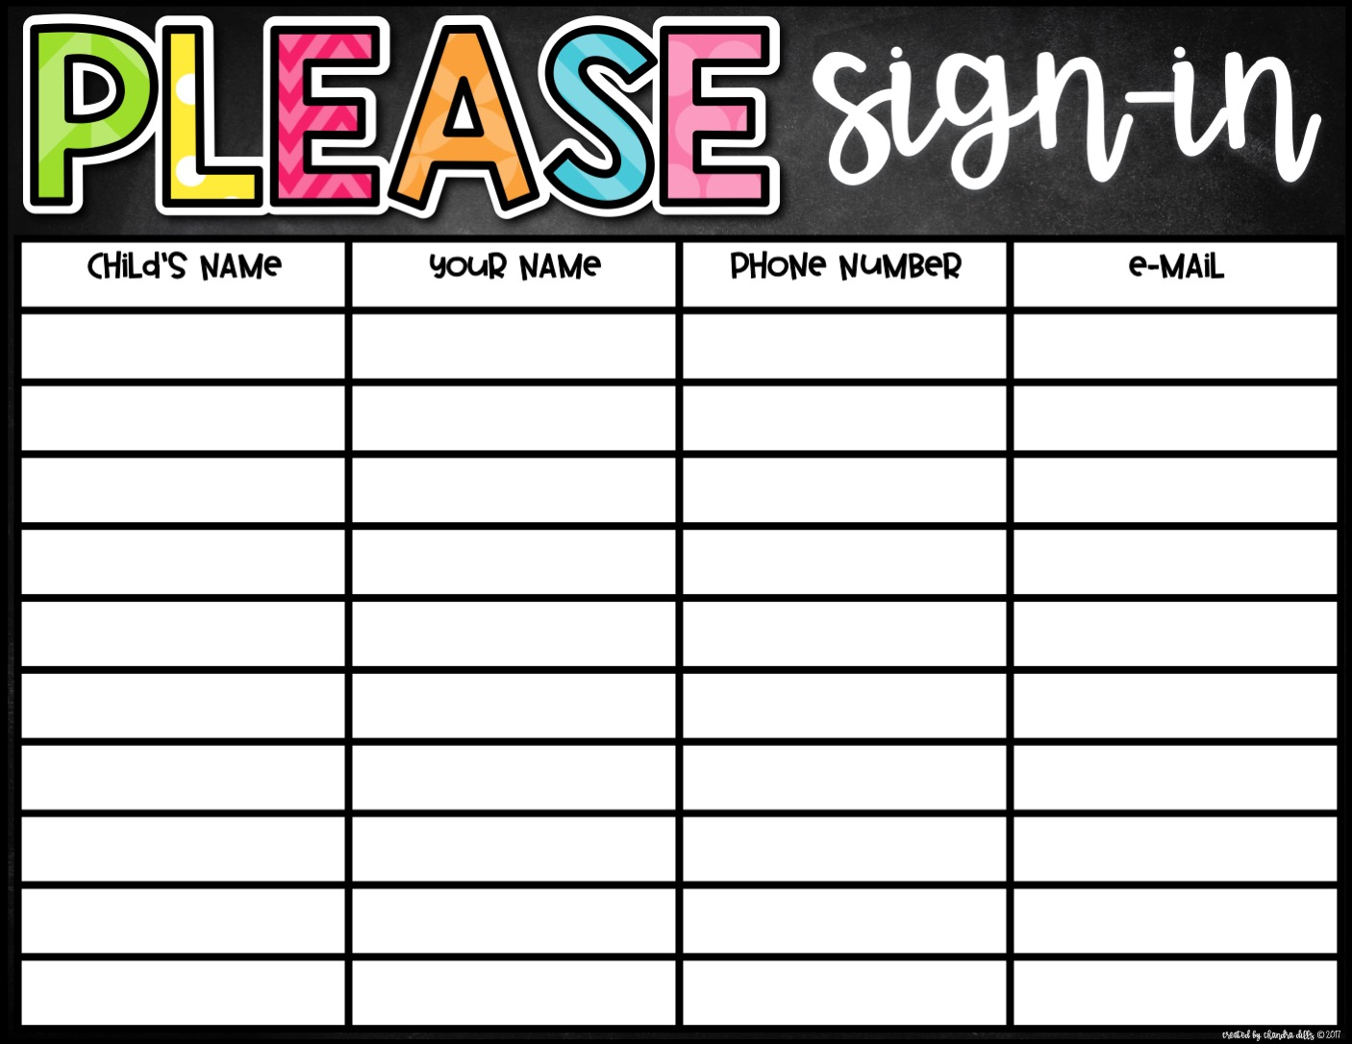

Slide 17
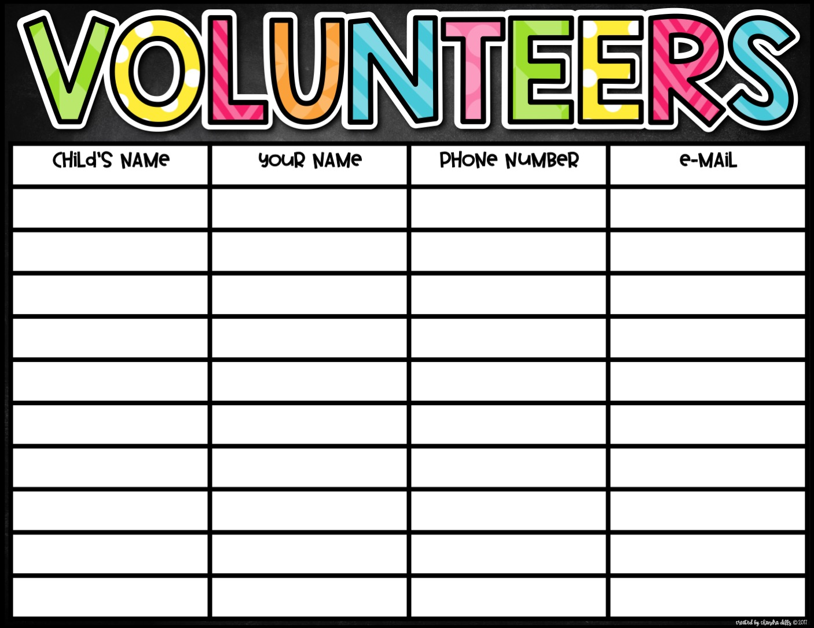

Slide 18
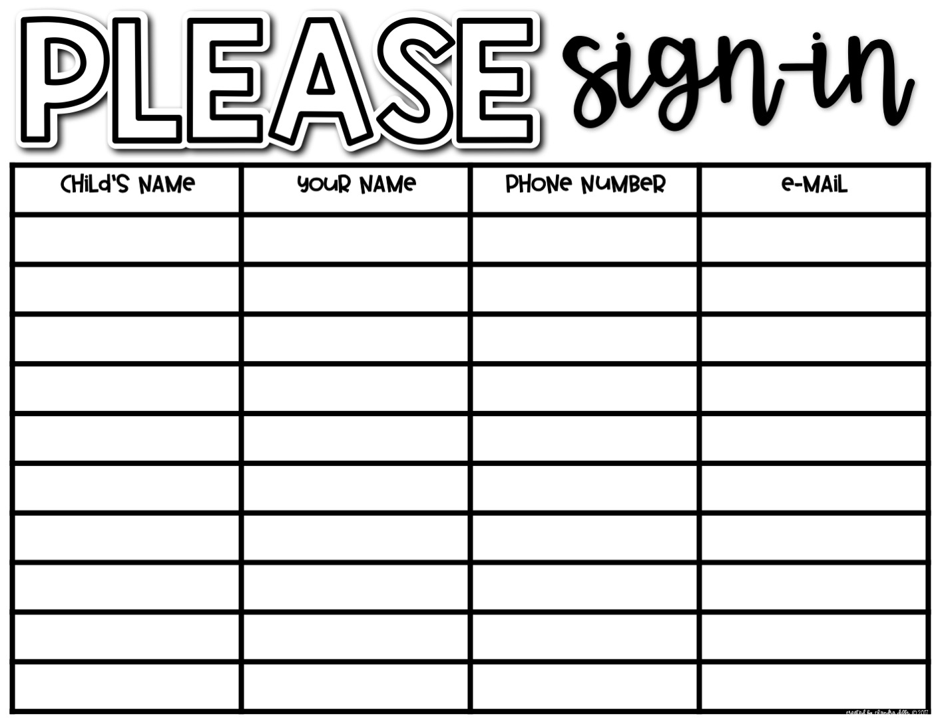

Slide 19
