Slide 2
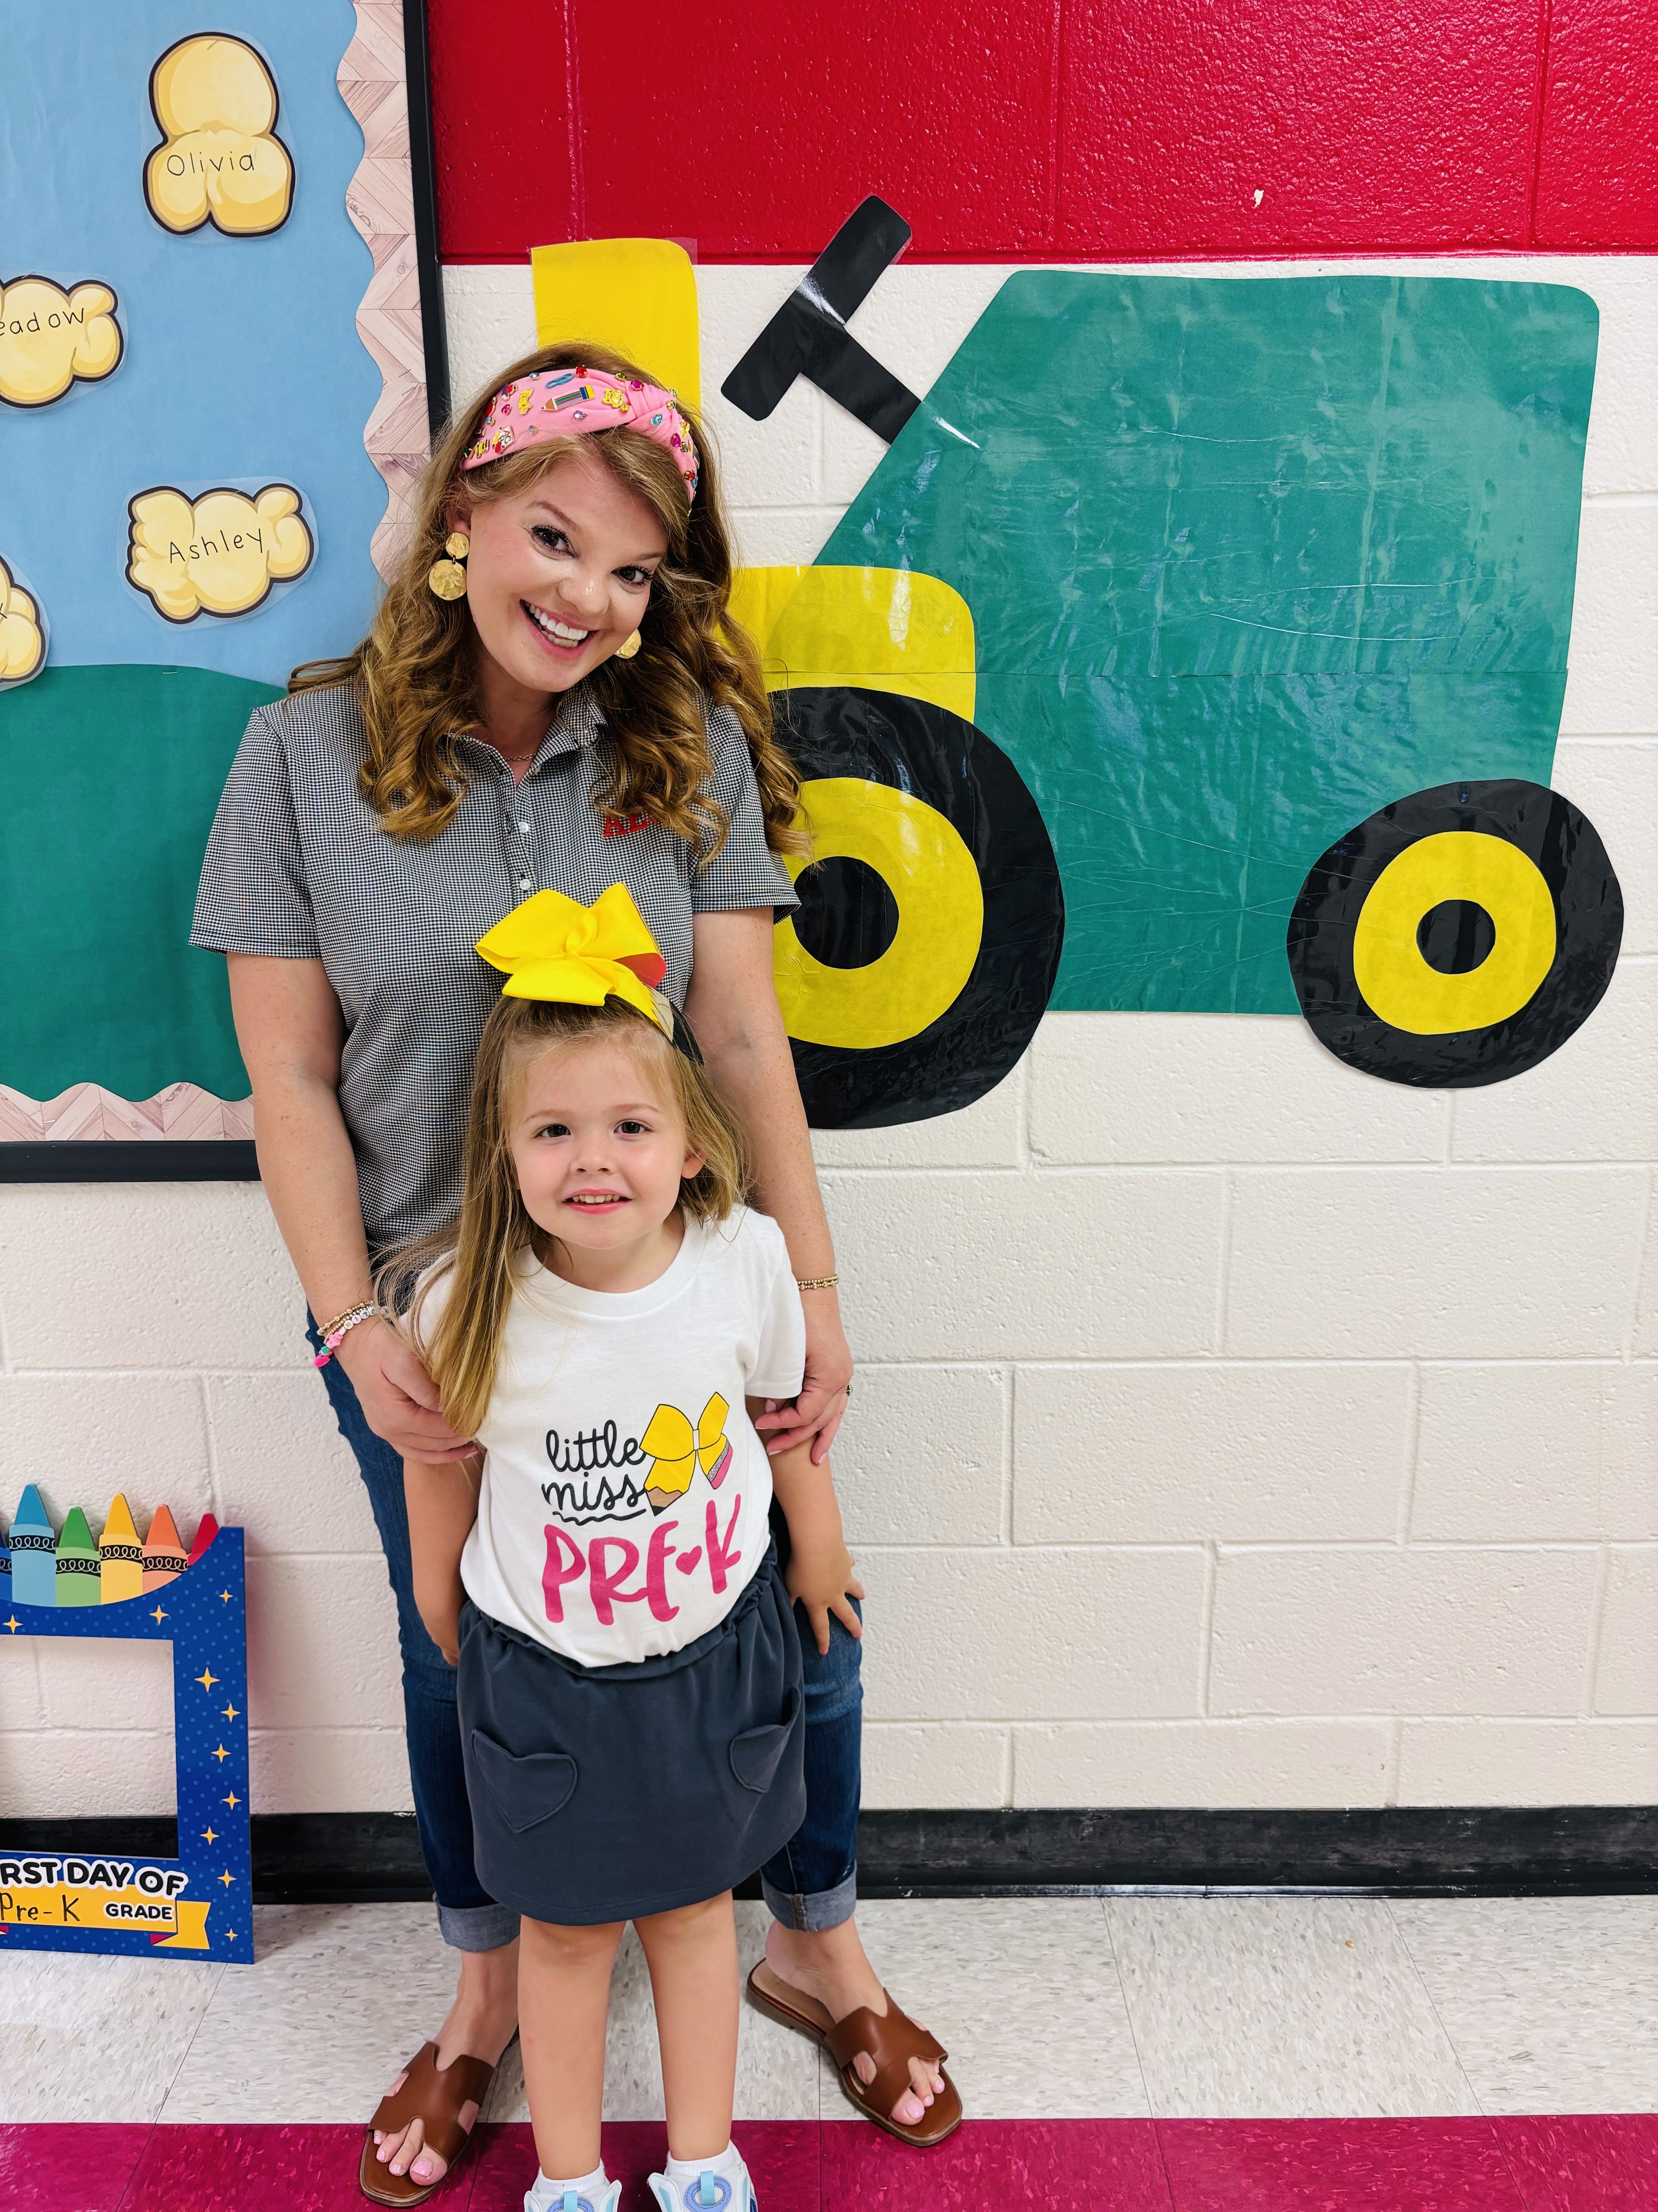
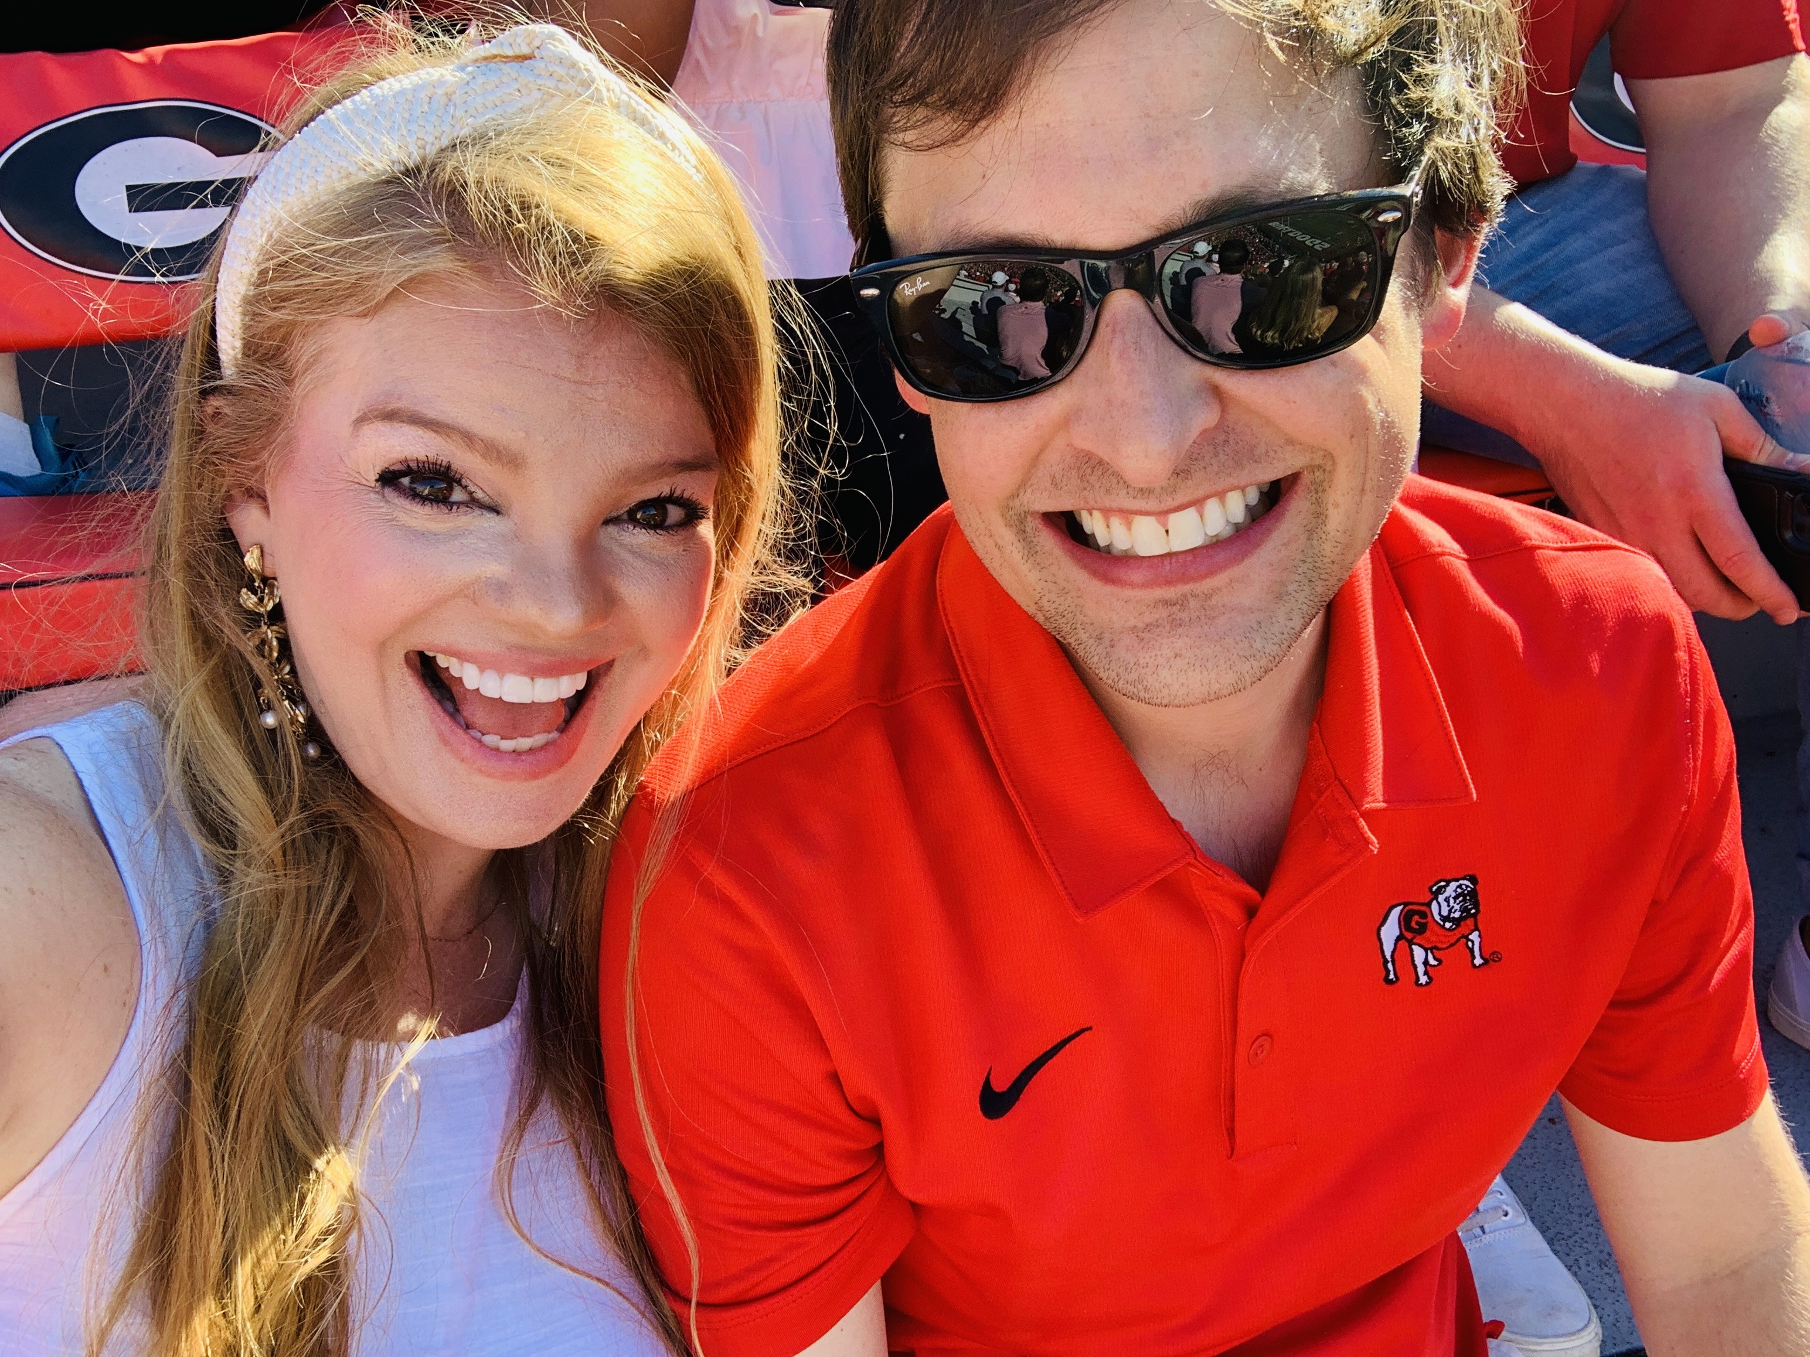
Christine Brazeal
-14th year teaching
-Taught Pre-K and Preschool Special Education
-Certified in Pre-K through 5th General Education and Special Education
-From Suwanee and lives in East Cobb

Slide 3
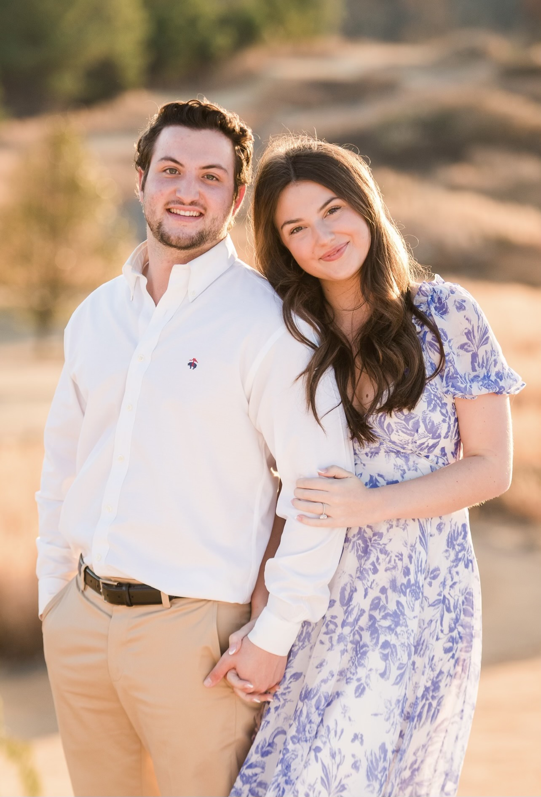
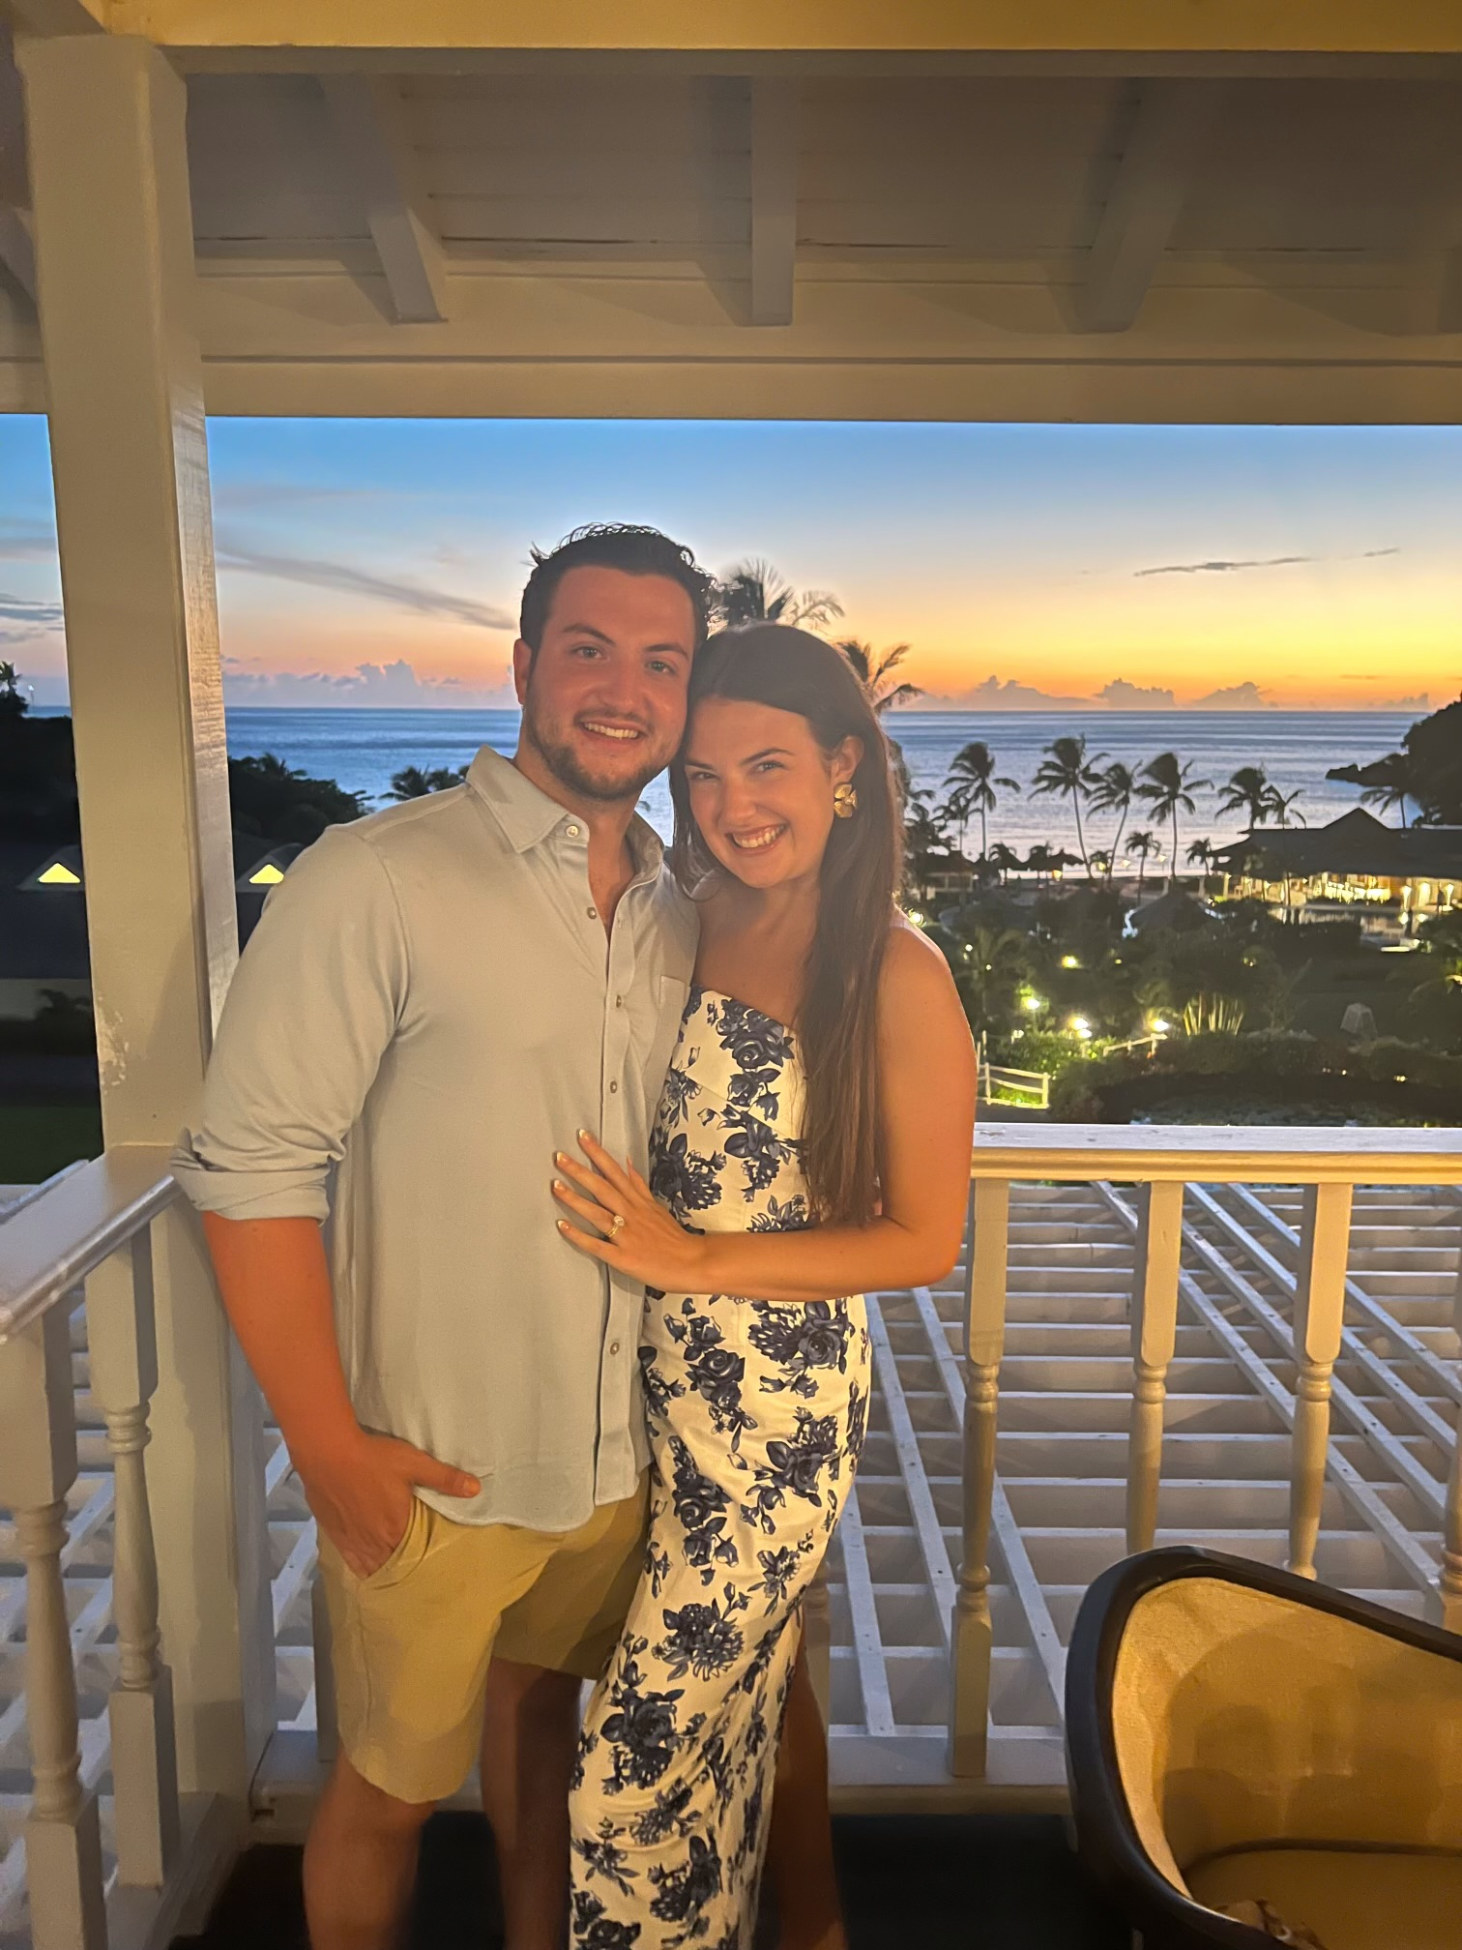
Sydney Birozes
-Pre-K Paraprofessional
-Attending Georgia College and State University for a Masters in Early Childhood Education.
-From Cumming and lives in Alpharetta

Slide 4
Frog Street Curriculum-Complete curriculum
Heggerty-Explicit Phonological Awareness Instruction
Kid Lips Instruction-Alphabet and phonics instruction
Learning Without Tears-Handwriting instruction
Feeling Buddies and Second Step-Social Emotional instruction

Slide 5
Frog Street Curriculum:
My School & Me
Family & Friends (Pets and Neighborhood)
Giants (Big/Little, Nature’s Giants, Giants Made by People, Make Believe Giants)
Choices (Healthy Choices, Healthy Habits, Problem Solving)
Holidays Around the World
Stories and Rhymes (Nursery Rhyme, Traditional Tales, Fairy Tales, Folktales, Fables)
I Build! I Create! (Construction, Tools and Machines)
Things That Move (Muscles/Dance, Travel, Transportation, Mysterious Movers (coasters, wind, bees)
Animals (Farm, Zoo, Bugs)
Changes (Life cycles, Weather, Seasons, Sun/Moon)

Slide 6
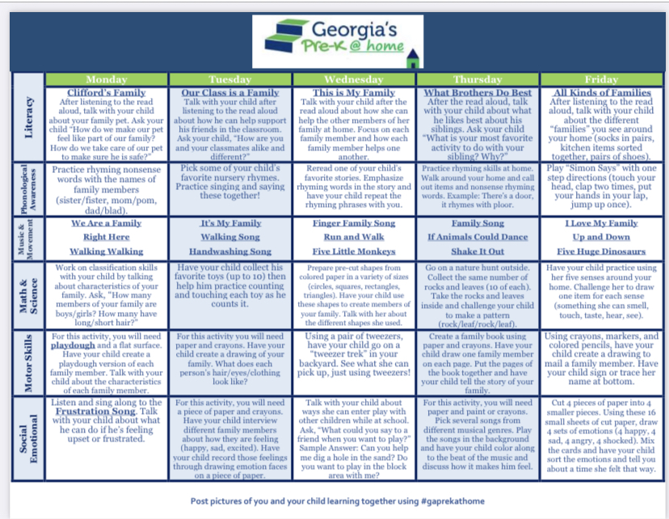
Georgia Pre-K at Home:
https://www.decal.ga.gov/documents/attachments/PreKAtHome/PreKAtHomeDailyActivities_Families.pdf

Slide 7
GELDS: Georgia Early Learning Development Standards
https://gelds.decal.ga.gov/GELDS

Slide 8
Time: | Activity:
7:10-40 | Arrival/Fine Motor Table Activities: AES Announcements
7:40-7:45 | Clean-up/Select Commitment
7:45-8:05 | Morning Meeting: (Unite, Disengage the Stress Response, Connect, Commit, Morning Message, Social Emotional)
8:05-8:10 | Music and Movement
8:10-8:25 | Phonological Awareness
8:25-8:35 | Story 1
8:30-8:45 | Large Group Literacy
8:45-9:00 | Snack
9:00-9:30 | Small Group
9:30-10:20 | Centers
10:20-10:25 | Clean Up
10:25-10:55 | Specials
10:55-11:05 | Restroom
11:05-11:19 | Story 2
11:19-11:49 | Lunch
11:49-12:20 | Recess
12:20-12:30 | Social Emotional Learning
12:30-1:30 | Rest
1:30-1:45 | Math Group
1:45-2:00 | Closing Circle
2:00-2:15 | Pack Up
2:15-2:20 | Line Up for Dismissal
7:10-7:55 | Arrival/Table Toys: Falcon Talk (7:40-7:50)
7:55-8:20 | Morning Meeting: Morning song, review good choices, attendance, calendar review, weather report, morning message
8:20-8:40 | Bathroom/Music & Movement
8:40-9:10 | Small groups
9:10-9:25 | Story time
9:25-9:55 | Outside
9:55-10:10 | Bathroom/snack
10:10-10:25 | Large group literacy
Specials Schedule:
M-Music
T-Morning Recess
W-PE
TH-Library
F-Art

Slide 9
Programs: Conscious Discipline
Positive Behavior Supports:
-Class wide “Kindness Hearts” We work toward a goal to earn a class wide treat!
-“Bucket Filler” SOAR Bucks: school wide token economy.
-Kindness Tree: Decorated Kindness Heart leaves.
Classroom Language:
-Red/Green Choices
-Be a Bucket Filler
-”5 Things Ready”

Slide 10
Pre-K Classroom Commitments:
Kind Words
Helping Hands
Listening Ears
Big Voice

Slide 11
Fun Friday
Mystery Readers
Grits with Grandpararents
Eagle Dash
Ga Pre-K Week
Thanksgiving Luncheon
Winter and End of Year Party
Bingo Night
Movie Night
Eagle Fest (in May)
Field Day (in May)
Spirit Nights

Slide 12
WSO Narrative summaries are completed at the end of each semester. Summaries include information about your child’s progress in each content area.
These conferences will happen twice a year:
-December
-May

Slide 13
*Please make sure to label personal items.
Backpack
One small blanket and/or one small stuffed animal for rest time
A complete change of clothes (shirt, shorts, underwear, socks, and shoes)
A lunchbox (if bringing lunch from home)
Separate labeled snack
Water Bottle (label with name)
Folders for communication

Slide 14
We plan activities for every day of every week that are carefully chosen for the children in the class. If your child is absent, they are missing important small groups and activities.
Attendance information is on the FCS website under “Students and Families”.
We have a Pre-K specific attendance policy.

Slide 17
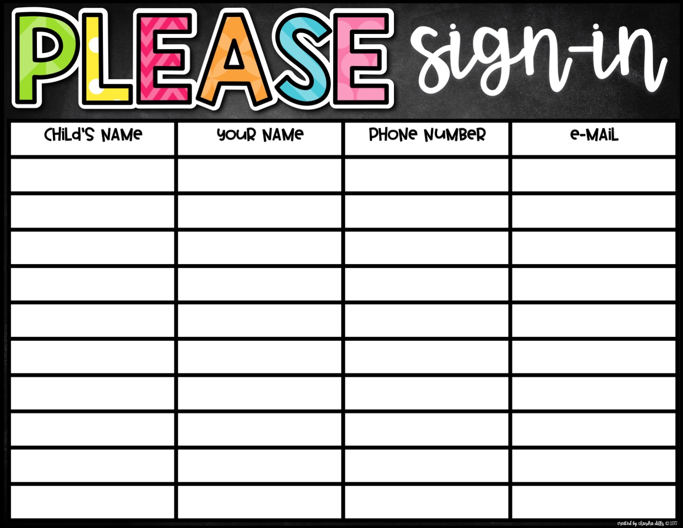

Slide 18
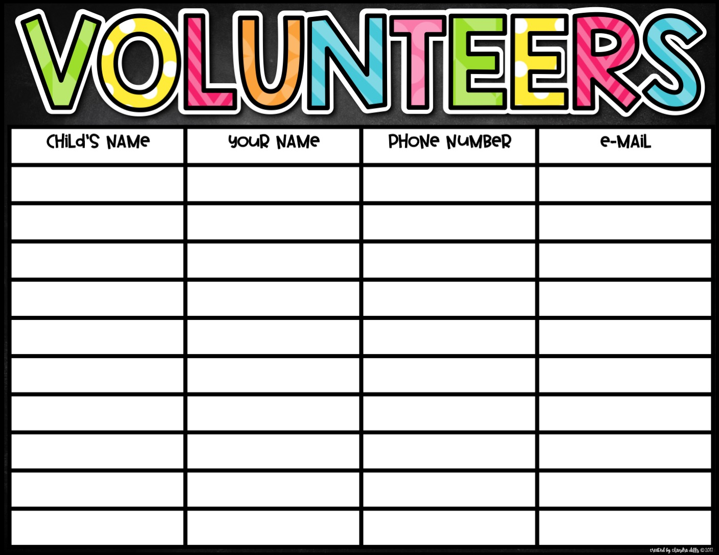

Slide 19
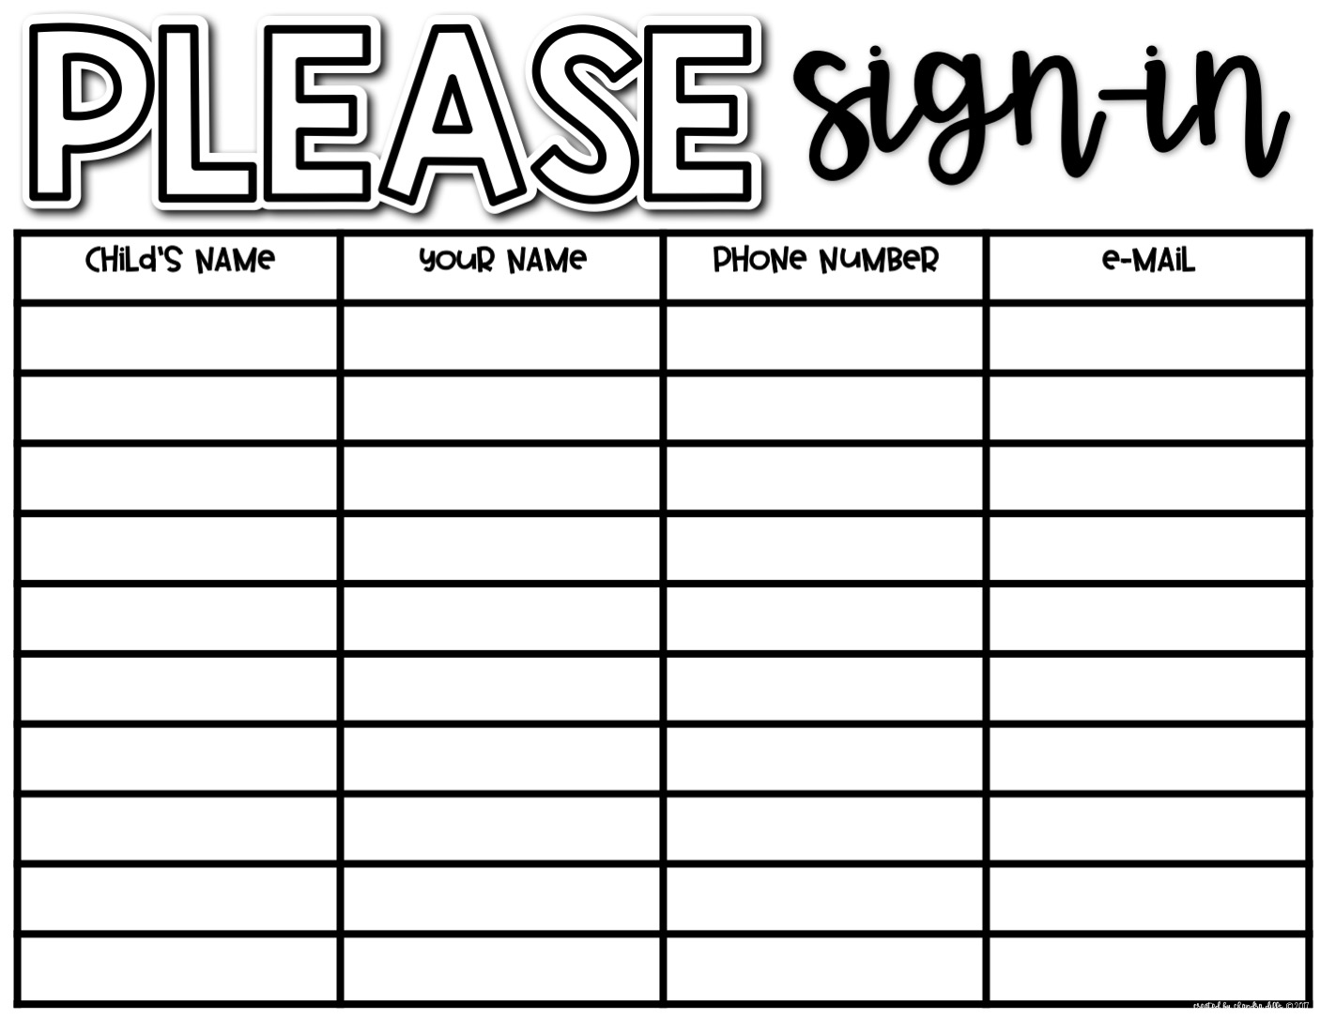

Slide 20
