Slide 2
Welcome
Introductions
About NHE
Safety
Communication

Slide 3
Attendance
Our school day starts at 7:35 AM. Children cannot be dropped off at the school before 7:10 AM. If your child is not in his/her classroom by 7:35 AM, you must come into the office and sign him/her in. The school day ends at 2:15. This is a very early start for students, so please make every effort to set and maintain an early bedtime for your child. This will help him/her to obtain maximum benefits of school. Daily attendance is also very important to your child’s success in school.

Slide 4
Absences
When your child becomes ill at home before leaving for school, please keep him/her at home. If your child is absent from school, please send an excuse to NHEattendance@henry.k12.ga.us or a handwritten note (only accept 5 for the year) with your child when he/she returns to school. The absence is marked as unexcused until a note is received. Please include the following on the written excuse: ∙ Child’s name
∙ Date of absence(s)
∙ Reason for absence(s)
∙ Parent/guardian signature

Slide 5
Early Dismissal
If you must pick your child up early, sign him /her out in the office. You must have your ID in order to sign a student out. An office staff member will call your child to the office. Only people listed on your child’s emergency form will be allowed to check your child out of school. Except for emergencies, please do not check your child out between 2:00 - 2:15 without prior notice.

Slide 6
Sickness
If your child becomes ill at school, the teacher will send your child to the clinic aide.
It is imperative that you provide the name and telephone number of at least 2 people on the emergency forms to be contacted locally in case you cannot be reached by the school.
*If your child is sent home with a fever, he/she may not return to school until he/she has been fever free for 24 hours without taking any kind of medication. Please also note that if your child has been vomiting or had diarrhea, it needs to be 24 hours without these symptoms in order to return to school.

Slide 7
Medication
If your child needs to take medication at school, you must do the following:
1. Please obtain a medication form in the office.
2. Bring in the medicine in the ORIGINAL container. Do not send it in with the child.
3. Label the medicine with your child’s name and teacher’s name.
The school does not keep any medicine on hand for student use except what is sent by the parent.

Slide 8
Conferences
Your child’s teacher is available for conferences by appointment. If you would like to schedule a conference, notify the teacher to set one up. When your child’s teacher requests a conference with you, please reply immediately. There will be two conferences planned throughout the year.

Slide 9
Guidance and Counseling Services
Our school counselor visits each classroom monthly with activities designed to help children develop their social and emotional skills. The counselor is also available for parent consultations, teacher consultations, and counseling with our children.

Slide 10
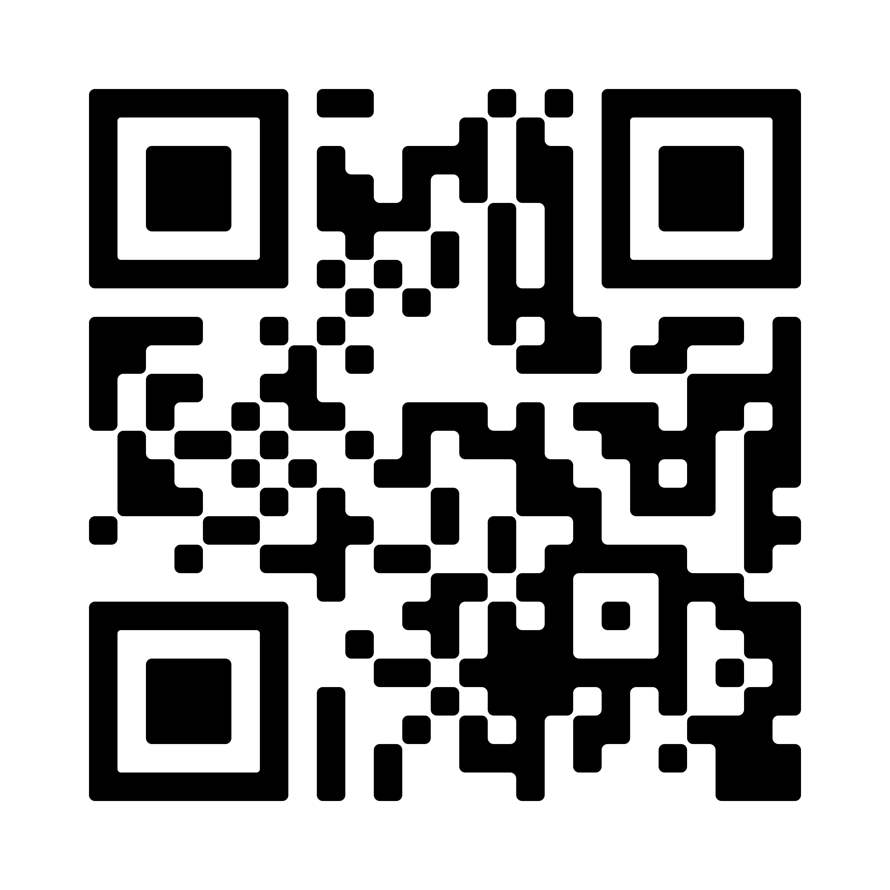
After-School
There is an After School Program available from 2:15 - 6:00 pm each day. Registration can be done online.
https://www.henry.k12.ga.us/Page/17411

Slide 11
Birthdays
If you would like, you may provide a small treat (non-edible) or you may purchase ice cream from the lunchroom for the whole class on your child’s birthday.
Cupcakes/food items may not be sent in due to allergies.

Slide 12
Meals
A breakfast program will be offered to your child starting at 7:10. The cafeteria will close promptly at 7:30 each day so if you want your child to have breakfast, please make sure they are here on time. Bus riders and car riders will report directly to the cafeteria for breakfast if they are eating here.
Prices for student meals: Breakfast $1.40 Lunch $2.65 Milk $.50

Slide 13
Meals
Your child may bring his/her lunch from home or our cafeteria staff will offer a nutritional lunch. Check the monthly lunch menus on our school’s web page for student choices. If a student has not brought any lunch money or a lunch from home, he or she will not be denied the opportunity to eat lunch. Under such circumstances, students may be allowed to charge lunch. The cafeteria manager will notify parents of lunch charges which have not been paid. Full or reduced price students are allowed up to $17.75 in charges at the Elementary level. In the event any student has reached the maximum charge limit, the student will be offered an alternate meal. The alternate meal will include a sandwich, fresh fruit, and milk.

Slide 14
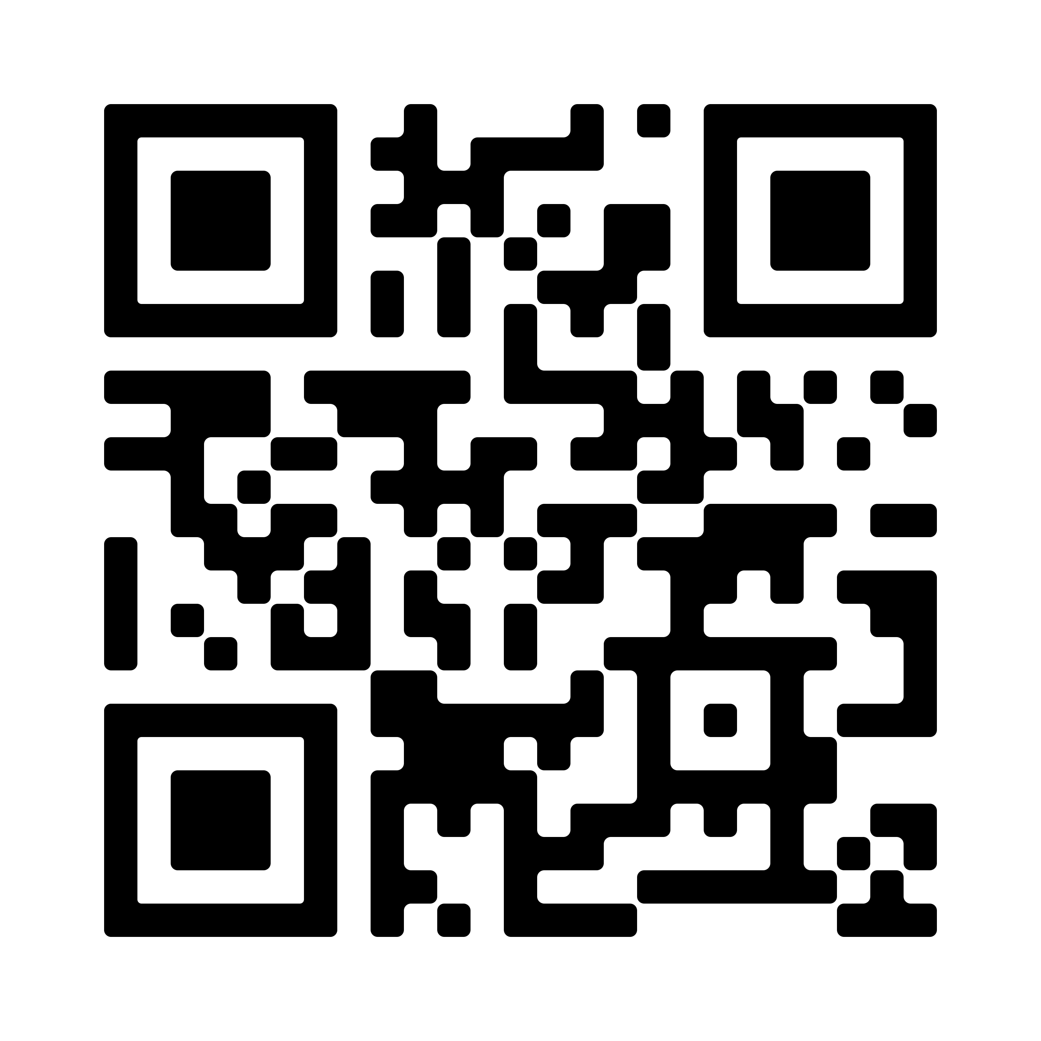
Meals
How do I pay for school lunch?
Henry County Schools uses online payment system LINQ Connect to accept payments for school lunch. Additionally, the application for free and reduced meals for 2024-2025 is available in the Infinite Campus Parent Portal.
https://www.henry.k12.ga.us/Page/203

Slide 15
NHE Cafe
The NHE Café is a classroom where families eat lunch with their child. The Café will open to NHE families the week of September 9th.
Kindergarten, First Grade, and Third Grade days: Monday & Wednesday
Second Grade, Fourth Grade, and Fifth Grade: Tuesday & Thursday
Other students are not able to sit with you and your child. Only people listed on the yellow card will be allowed to eat with your child.

Slide 16
Dress Code
Pants may not have holes above the knee. Patches or leggings must cover skin if above the knee.
Shorts, skirts, culottes, split skirts or dresses must rest midthigh in length and this includes with leggings or shorts underneath.
Leggings are acceptable as pants but the accompanied shirt (tunic) must completely cover the child’s bottom.
All pants (including skinny jeans) and skirts shall be worn at the waist at all times.
Hats or caps should not be worn during the school day. If a student wears a hoodie, the hood may not be worn over the student’s head during the school day.

Slide 17
Dress Code
Tank, tube, and halter-tops, including spaghetti straps and low-cut shirts, are not permitted. Sleeveless shirts are permitted as long as they are three fingers in width on the shoulder. Please be mindful with V-neck shirts and low-cut shirts.
Shirts should not be transparent. If a shirt is transparent, students must wear a tank top or camisole underneath so that undergarments are not visible.
Flip-flops and slides are not allowed on the playground equipment as it is a safety issue.
Hair color and/or styles that create a disruption of the educational environment, present a health or safety concern, or interfere with the learning of others will not be permitted.

Slide 18
Dress Code
Crocs are allowed when in sport mode. Sport mode allows the band to make the shoe become a sandal and they stay on students' feet. Flip flops and slides are not allowed on playground equipment as they pose a safety risk.

Slide 19
Communication Binder
ClassDojo
ClassDojo is a way for us to communicate with you. Information for signing up will be sent home. Please make sure to join our class. You will receive information regarding things happening in our school and classroom. Please check this site each day.

Slide 20
Communication Binder
Communication Binder
Each student will have a communication binder. Please make sure your child has a 1” binder with a clear pocket on the front and a clear pencil pouch inserted in the front of the binder. This binder needs to be returned to school daily. This will be the way to send in all notes and monies for your child. Along with their behavior calendar. It will be sent home daily in your child’s backpack. Please make sure to check this binder nightly for any information sent home from school.

Slide 21
Newsletter
A newsletter will be posted each Monday explaining what we have been doing in our classrooms and upcoming events. Please take time to read all the information sent home. All student work will be sent home on Monday in a communication folder. The newsletter will be posted on the teacher’s website and sent through Dojo. Check your teacher’s website periodically for any information pertaining to your child’s classroom.

Slide 22
Assessments
The Georgia Kindergarten Inventory of Developing Skills (GKIDS) is administered throughout the school year to all Kindergarten students in Georgia to help determine readiness for first grade. The test will be given to students on an individual basis throughout the year. The information on your child’s GKIDS results, reading benchmarks, and classroom performance will be used in determining your child’s readiness for first grade.

Slide 23
Curriculum
We believe that Kindergarten should provide age appropriate activities that challenge students with various learning styles. Our developmental program involves hands-on experiences, which create a fun way to learn the basic skills. Unit topics are used throughout the year to link all subject areas. Please check out the website for the kindergarten standards:
https://www.georgiastandards.org/Georgia-Standards/Pages/default.aspx

Slide 24
Contagious Diseases
If your child has pink eye or any other contagious disease such as the flu and/or is running a fever (100 degrees), vomiting or experiencing diarrhea, he/ she should stay at home as long as needed.
Please note that your child must be symptom free for 24 hours without medication to return to school.
Please send an excuse for your child’s absence when he/she returns.

Slide 25
Snacks
Due to the long Kindergarten day, we will have a snack time each day. Please send in a healthy snack for your child. Since snack time, is not separate from instructional time, please send in something individually wrapped or in small baggy for them to grab quick and eat. Only water in water bottles are allowed at snack time.

Slide 26
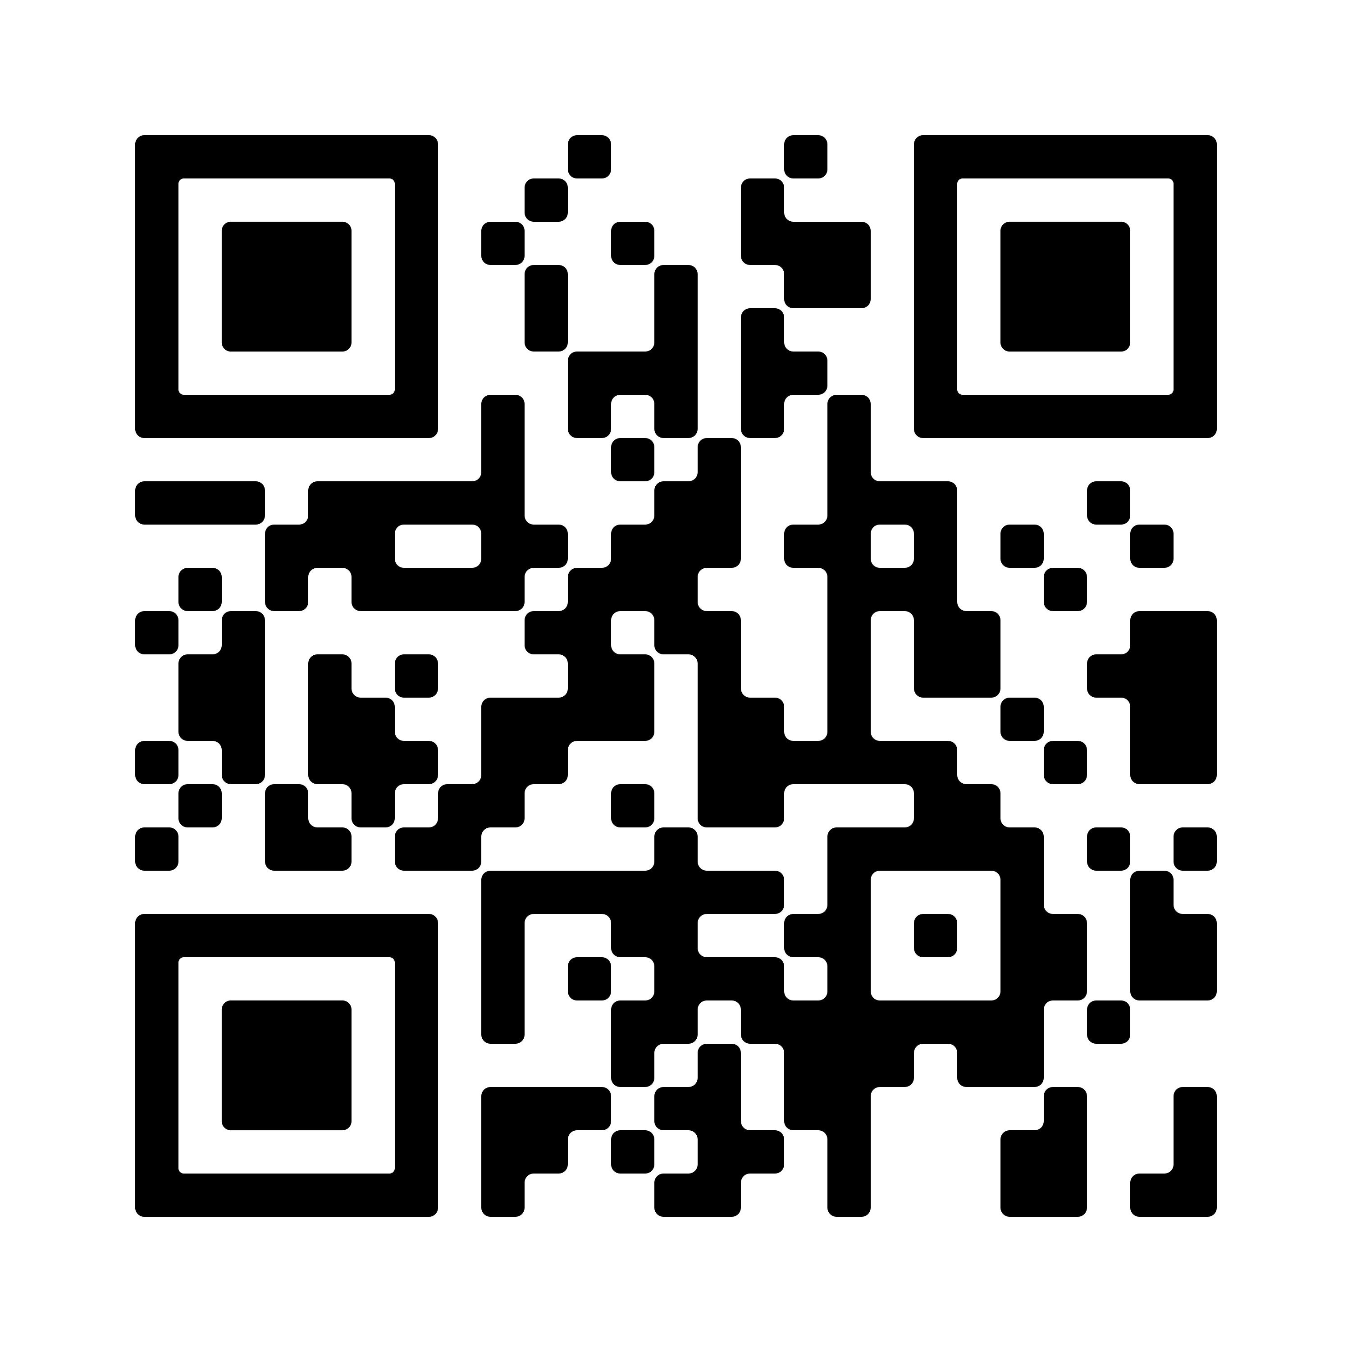
Bus Information
If your child is going to ride the bus to and from school, check with transportation at (770) 957-2025 or go on the web at https://www.henry.k12.ga.us/domain/40 to get the correct bus assignment.
Any change in transportation must come in the form of a signed note which is to be sent to your child’s teacher. Your child will be sent home his/her regular way without a note.

Slide 27
Field Trips
Educational field trips will be scheduled throughout the year. Parents are encouraged to go along to help supervise the children. All chaperones must submit a background check prior to going with the class. Chaperones will not be allowed to attend if he/she does not have an approved background check. Background checks take weeks to get approved. Field trip information and donation requests will be sent home prior to each trip.

Slide 28
Behavior
Be Respectful, Be Responsible, and Be Ready to Learn!
Each kindergarten classroom has a behavior management plan. Your child’s teacher will share her plan with you regarding expected behavior. Your child’s behavior will be shared each day with you through ClassDojo or in their binder on their behavior calendar. Please check your child’s binder and initial each night. Points will be awarded daily in ClassDojo for a total of 10 available per day.

Slide 29
Kindergarten Teachers
& Paraprofessionals
Jessi Smith-Adele Barfield
Olivia Otis-Hannah Martin
Tina Buchanan -Rosealyn Woodall
Amie Lewis-Melissa Smith
Liz Colson/Kathy Rosser-Kim Wilson

Slide 30
Thank you!
We are looking forward to a wonderful year in Kindergarten!
We look forward to seeing everyone at Open House tomorrow from 4-6pm!

