Slide 1
Visiting the Zoo
Carlyne Anderson

Slide 2
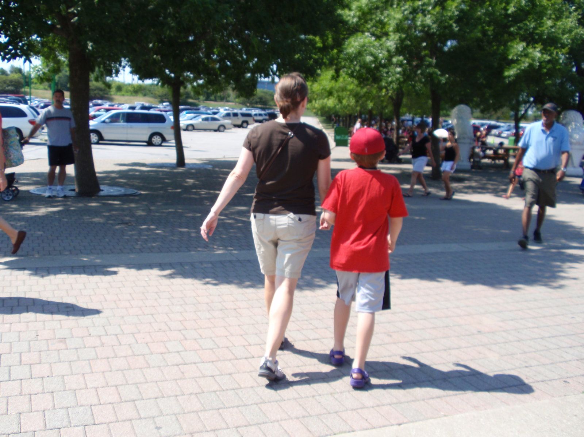
Going to the zoo!
Our favorite family outing is …

Slide 3
Our Favorite Zoo Animals

