Slide 1

Ms. Carla Johnson’s Fifth Grade Open House 2020-2021
Reading
ELA/Language
Social Studies

Slide 2

#StarkStrong
Selfless
Teamwork
Respectful
Opportunity
Noble
Growth
EAGLES never give up!

Slide 3


Our FUTURE is LIMITLESS!
We don’t just look at the
stars above…..WE ARE ONE!

Slide 4

DATES FOR OPEN HOUSE:
August 11TH (TUES.)
K & 5TH grades: 5:30-7:30
August 12th (WED.)
PS/Pre-K grades: 3:00-5:00
2nd & 3rd grades: 5:30-7:30
August 13th (THURS.)
1st & 4th grades: 5:30-7:30

Slide 5

Introduction
In 5th grade, we will continue to have a 2-person team. I will be your Reading/ELA and Social Studies teacher. Mrs. Tingle will be your Math and Science teacher. You will stay in my homeroom all day. Mrs. Tingle and I will swap classrooms to teach the other class.
Enjoy your last days of summer and
Remember… We are Stark Strong!
Sincerely,
Ms. Johnson

Slide 6
5th Grade Supply List
This year, more than ever, it is important that all students have their own school supplies. No communal supplies or sharing of supplies will be allowed due to Covid-19 restrictions!
1 pair of headphones/ear buds, glue sticks, pencils (NO LEAD PENCILS), scissors, cap erasers, colored pencils/crayons/markers, highlighters, supply
Pouch (NO PLASTIC BOXES), 2-3 packs of notebook paper, 8 marble composition notebooks (Yes, we will use them all)
Wish list
Tissues, baby wipes, gallon/snack/quart baggies, Clorox wipes,
individually wrapped candy like Starbursts, Smarties, etc…

Slide 7

Behavior
Mrs. Tingle and I keep a Behavior Clip Board. Should a student receive 3 behavior marks, that teacher with complete a Behavior STEP or Infraction.
Examples of Behavior Marks:
Disrupting others or instruction
Hands on others
Touching others belongings
Harassing others

Slide 8

Johnson’s Virtual Schedule
8:30 - 9:00 Live Lesson
9:00 - 10:00 Question & Answer Session
10:00 - 11:00 Planning
11:00 - 12:00 Lunch
12:00 - 1:00 Academic Support
1:00 - 1:30 Live Lesson
1:30 - 2:30 Question & Answer Session
2:30 – 4:00 Conferencing/Grading/Organize Tasks

Slide 9
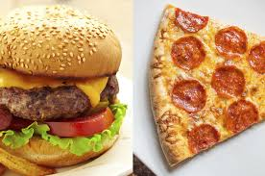
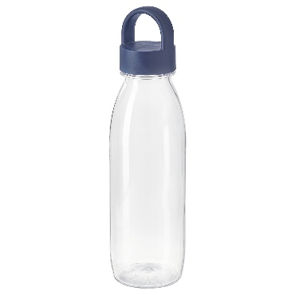
Lunch Expectations
Lunch will be in our homeroom class this year! Just like breakfast, you will eat in the classroom and a trash can will be provided in the hallway for your trash and food. We NEVER throw our food in the trash cans in our classroom!
A mandatory lunch count will be collected first thing in the morning and submitted during SPECIALS. If you are late for school, first choice will be counted as your lunch choice. Our lunches will be delivered to our classroom. You get what you ordered! No exceptions! You are also encouraged to have a clear water bottle with you at all times. The water fountains will not be in use!

Slide 10

Classroom Procedures
Enter the room with everything you need!
*Do you have your supplies?
Pencils? Notebooks? Agenda?
Read the board and begin working!
*Finish your morning work?
Read silently or finish incomplete work
(journals or writing assignments)

Slide 11
Dismissal
At the end of the day, Mrs. Tingle and I will swap back to our classrooms for dismissal!
One teacher will take all bus riders to the buses, while the other teacher will dismiss car riders. This year, car riders will be dismissed from your homeroom classroom, NOT from the front of the school. Since will we have to watch for name on the active board, you will be expected to be:
SEATED FLAT ON YOUR BOTTOM FOR SAFETY
IN YOUR ASSIGNED AREA ONLY
QUIET and RESPECTFUL

