Slide 1
Word Processing Features
Business and Technology
Using Microsoft Word

Slide 2
Creating Tables
Table – an arrangement of text or numbers in rows and columns
Row – horizontal placement of cells in a table
Column – vertical stack of cells in a table
Cell – intersection of a column and a row
Gridlines – outline of rows and columns

Slide 3
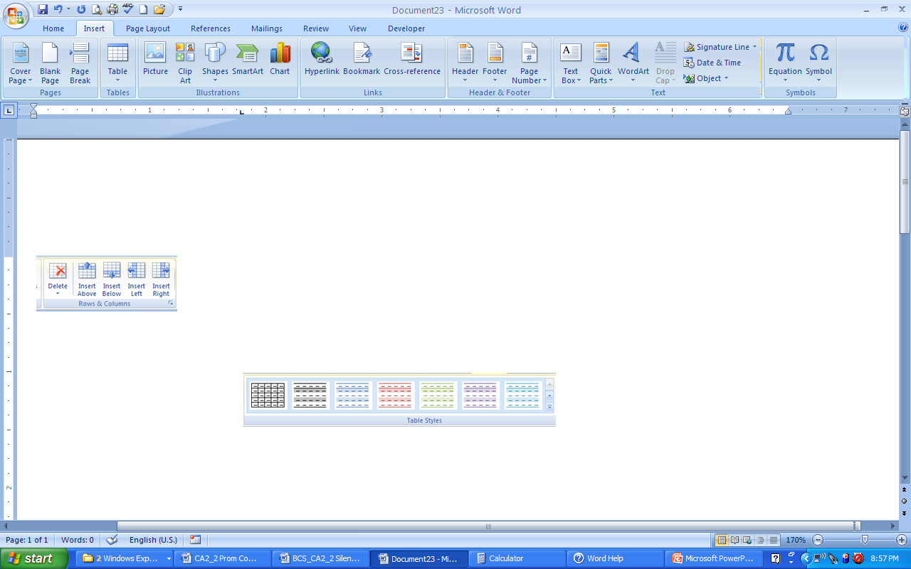
Steps to Create a Table
Click the Insert Tab
Click the Table button
  Choose the columns and rows using the grid or
  Choose Insert Table and insert the # of columns and rows

Slide 4
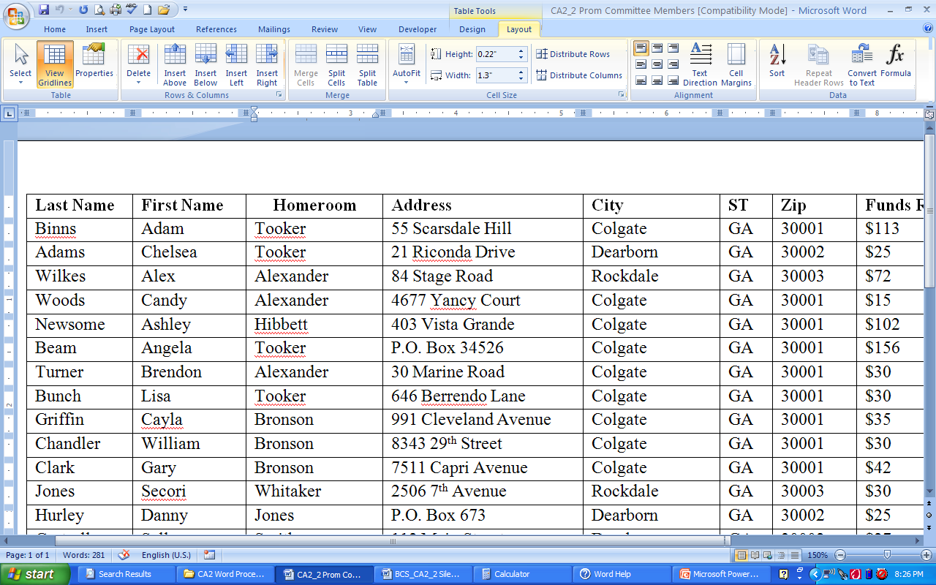
Sorting Data in Tables
Choose the Sort button on the Layout Tab
Make sure Header Row is selected
Can sort by up to three different columns
  Ascending Sort – sorts from A to Z or smallest to largest
  Descending Sort – sorts from Z to A or largest to smallest

Slide 5
Table Rows and Columns
Inserting Rows and Columns
  On the Layout Tab
  To insert rows use the Insert Above/Insert Below buttons
Deleting Rows and Columns
  On the Layout Tab
  To delete rows/columns use the Delete button

Slide 6
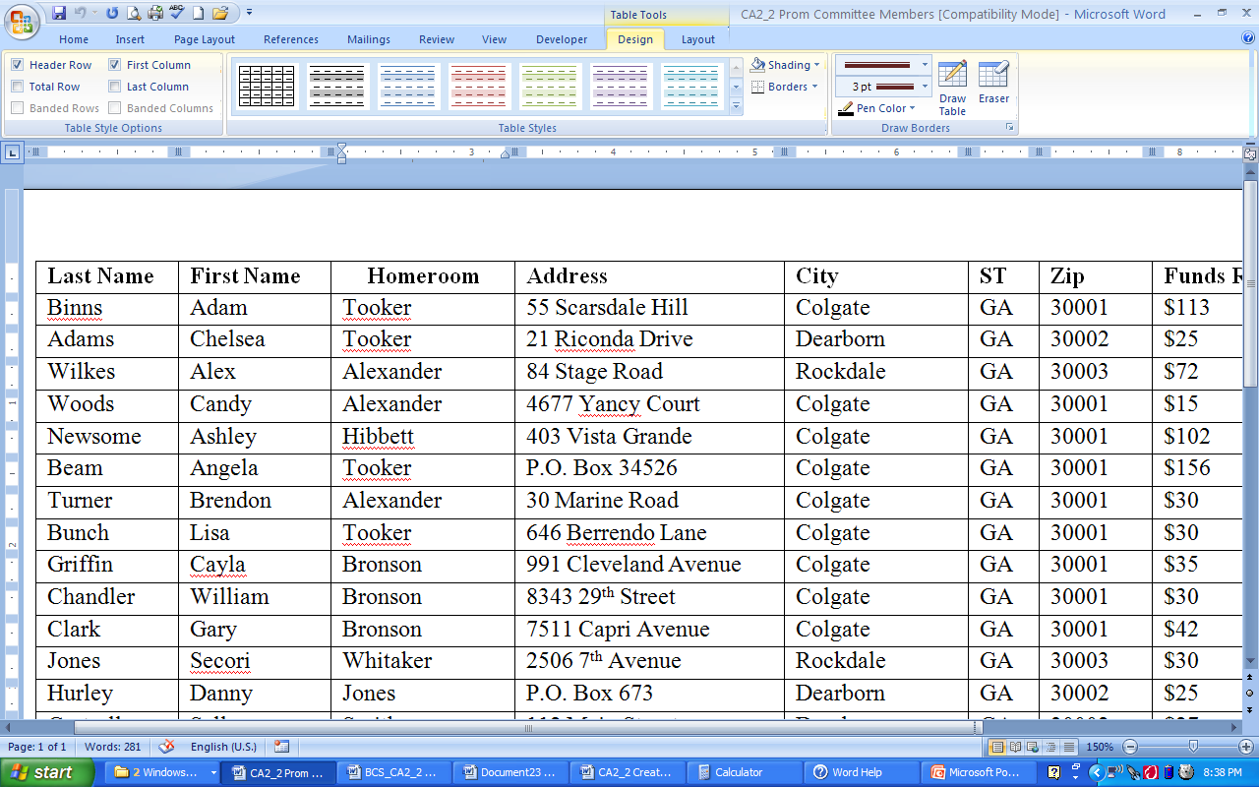
Advanced Table Features
Split cells
  Select columns/rows to split
  Click Split cells to separate
Merge cells
  Select the columns/rows to merge
  Click Merge cells to join cells
Formulas
  Located on the Layout tab
  Allows you to create formulas in a table
Table Styles
  Set of formatting options for tables

Slide 7
Templates
Templates are predesigned files that you can use to create a new file.
Using Templates
  Click the Office Button and New
  Three choices
    Installed Templates
    My Templates
    New from existing

Slide 8
Creating Templates
After designing your document:
  Click the Office Button
  Save as
  Change Save as Type to Word Template
  Save your file to your destination folder
To use again:
  Click the Office button and New
  New from Existing
  Select your template and Create New

Slide 9
Macros
A bunch of commands grouped together as a single command to accomplish a task automatically
Used to automate tasks
To use - Go to Office Button
  Click Word Options
  Popular
  Show Developer Tab in the Ribbon

Slide 10
Mail Merge Features
Data source – contains the records or fields used in another document
  Field – Single characteristic that appears in columns
  Record – complete set of data appears in rows

Slide 11
More Mail Merge Features
Main Document – contains the information that does not change in a mail merge
Form Letter –Contains merge fields to indicate where to print data from the data source
Merge Field – placeholder in the main document to be replaced with data in a data source

Slide 12
Onscreen Forms
Similar to templates
On the Office button, choose New
In the Microsoft Office Online Section, choose Forms
Some categories:
  Academic
  Business
  Community

Slide 13
Thesaurus
A built-in reference for finding synonyms for words in a document
  Right-click on a word and choose synonym
Or
  Use the Thesaurus tool on the Review Tab in the Proofing section

Slide 14
Spelling and Grammar Check
Spell Check
Grammar Check
A feature used to locate and correct spelling errors
Indicated on screen by underlined misspelled words in red, wavy underlines and misused words in blue, wavy underlines
A feature used to locate and correct grammar errors
Indicated on screen by green, wavy underline

Slide 15
Hyphenation
Allows Word to break lines between syllables of words
Three choices
  None
  Automatic
  Manual
On Page Layout Tab in the Page Setup section

Slide 16
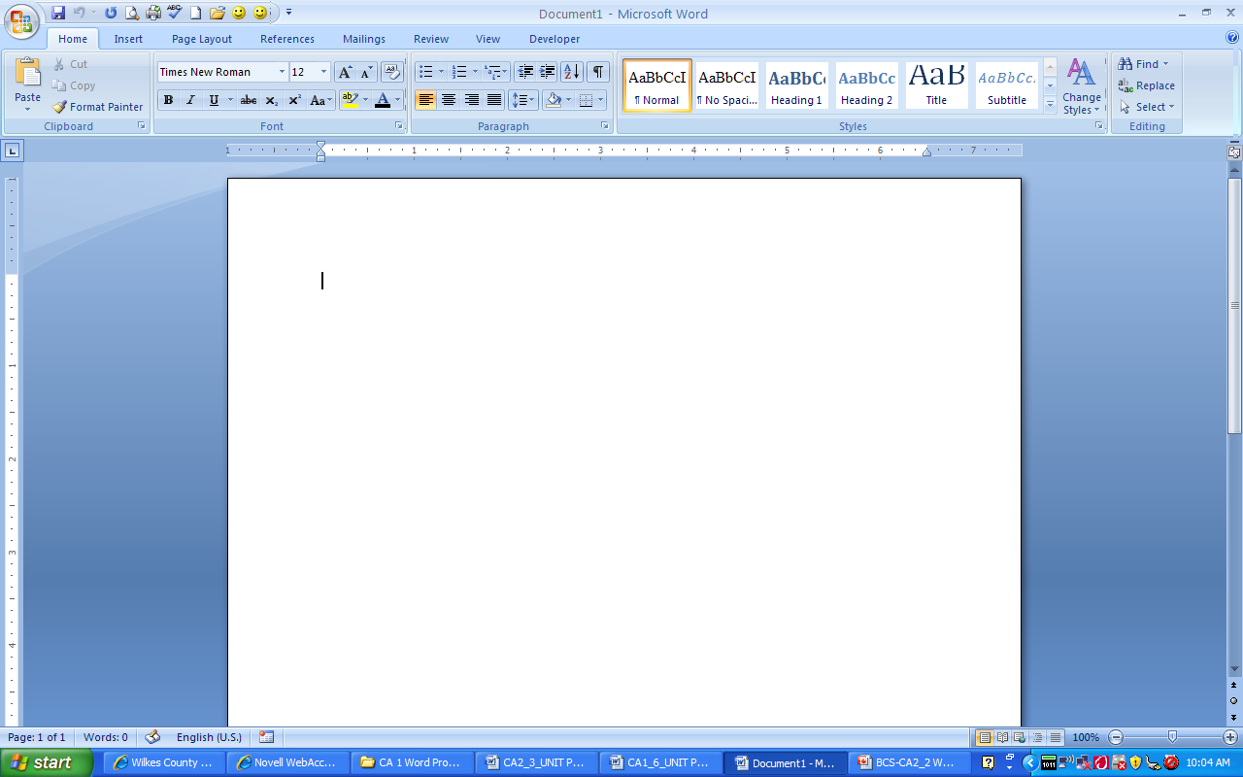
Find and Replace
Find – command that lets you specify how to locate data in a file
Replace – command that lets you search for data and replace it with other data
On Home Tab in Editing Section

Slide 17
Source
Microsoft Office 2007: Introductory Course. William Robert. Pasewark , et al. - Course Technology - Boston, Mass. - 2008

