Slide 1
Word Processing Fundamentals
Vocabulary

Slide 2
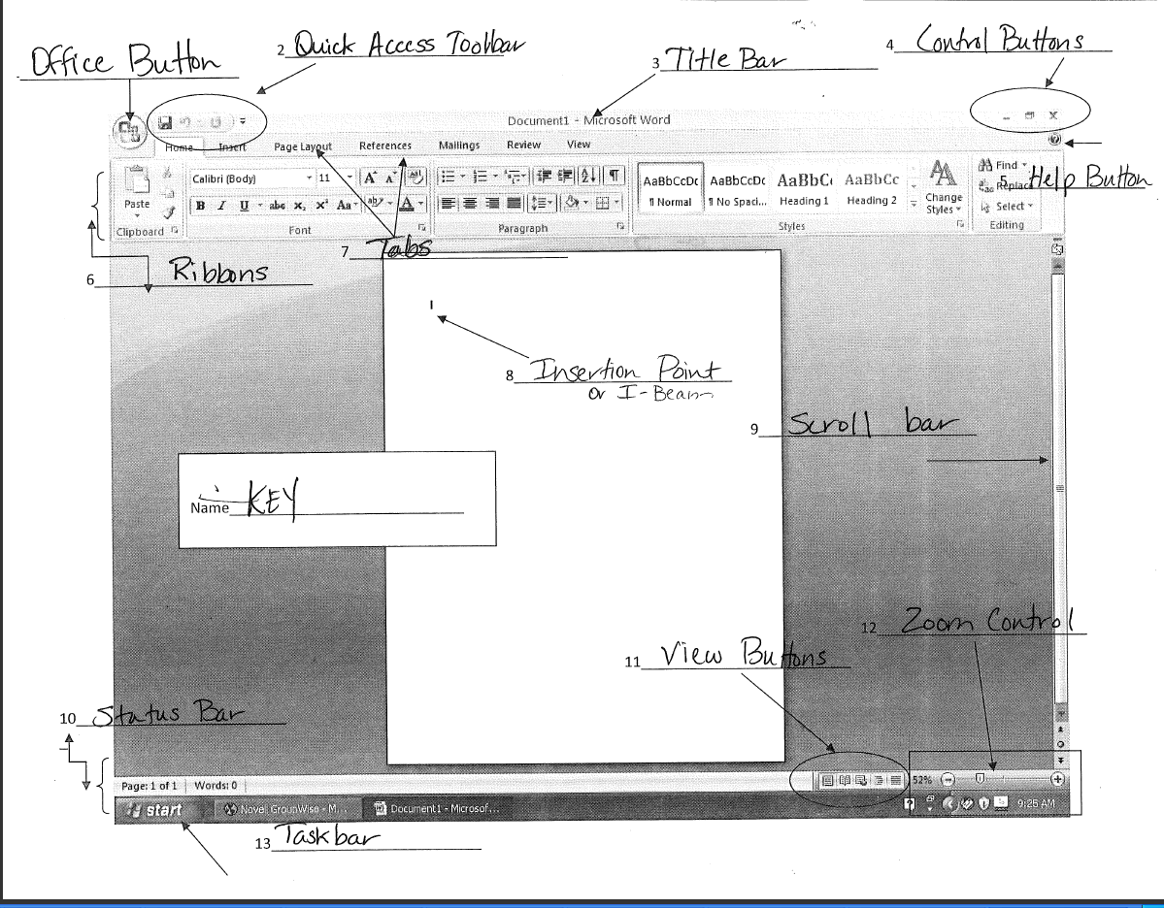
PARTS OF THE WORD 2007 SCREEN

Slide 3
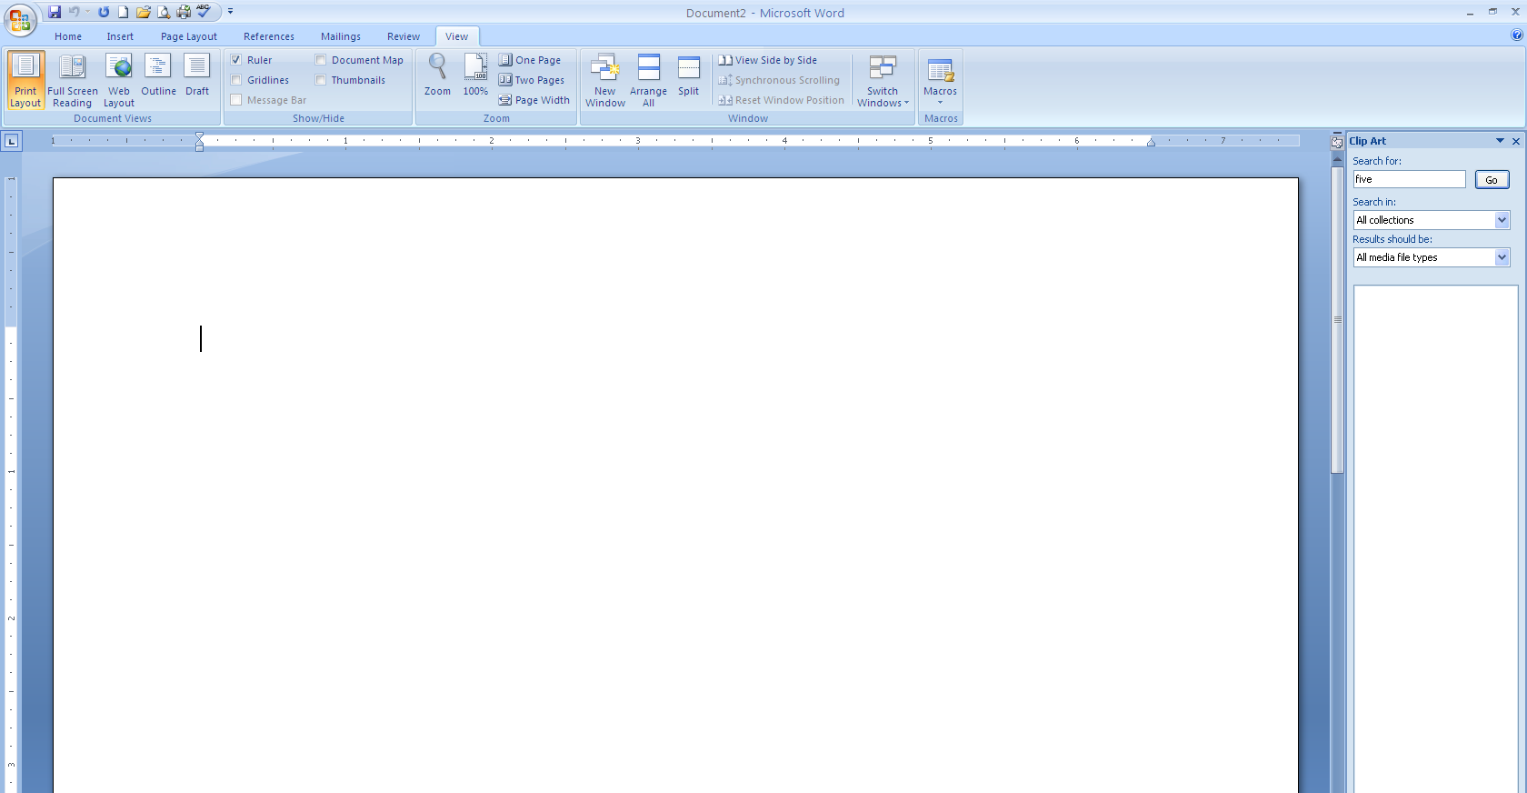
Task Pane
A window along the side of the program window that contains options and commands
Task pane

Slide 4
Getting Started….
The design of text. Example: Times New Roman, Georgia, Arial, etc.
Font
Automatically formats and fixes your manuscript, generates correct headers, footers, footnotes, page layouts, etc.
Wizard
A predesigned file that you can use to create a new file. Ex: letters, memos, etc. Click on the Office button & New to get to templates
Template
Portrait – default orientation – when the page is longer than it is wide
Landscape – when the page is wider than it is long.
Page Orientation

Slide 5
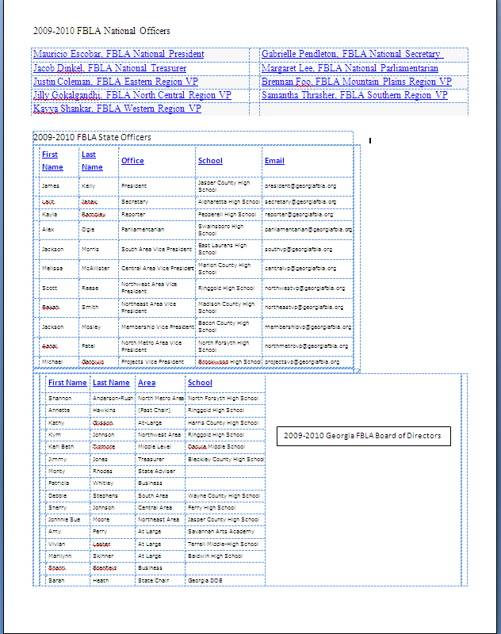
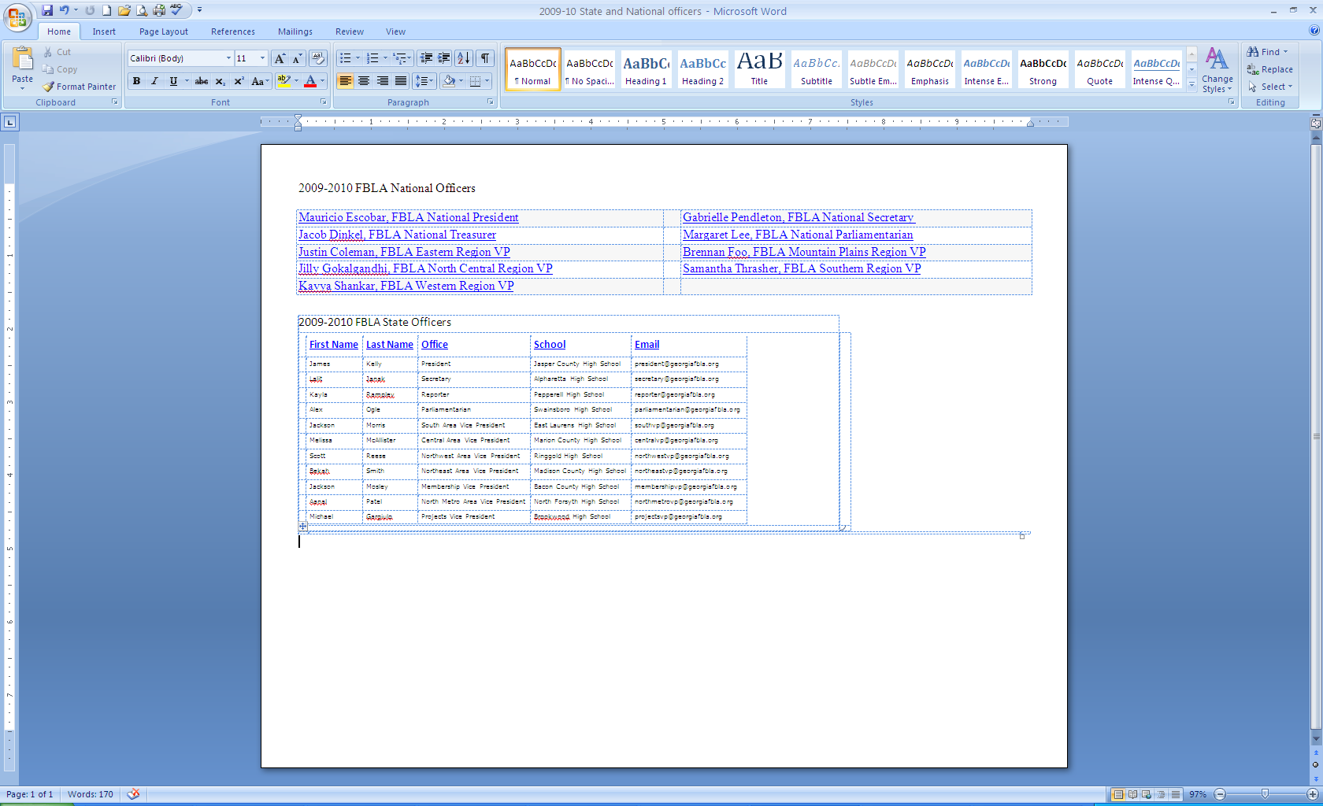
Page Orientation
Portrait Orientation
Landscape Orientation

Slide 6
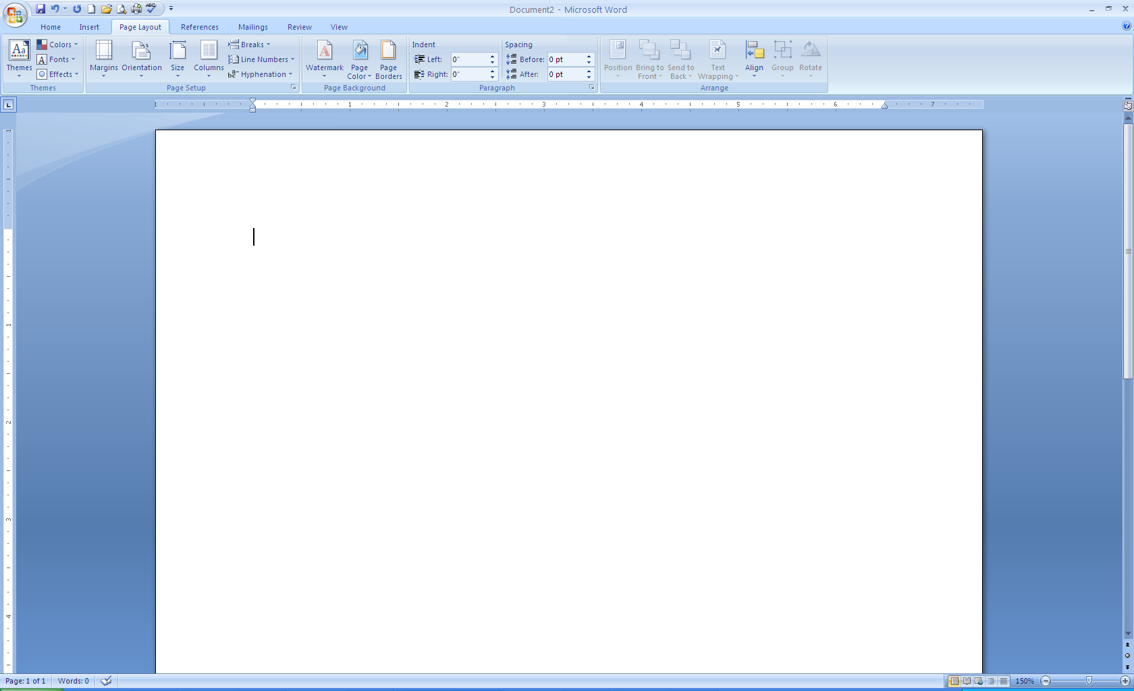
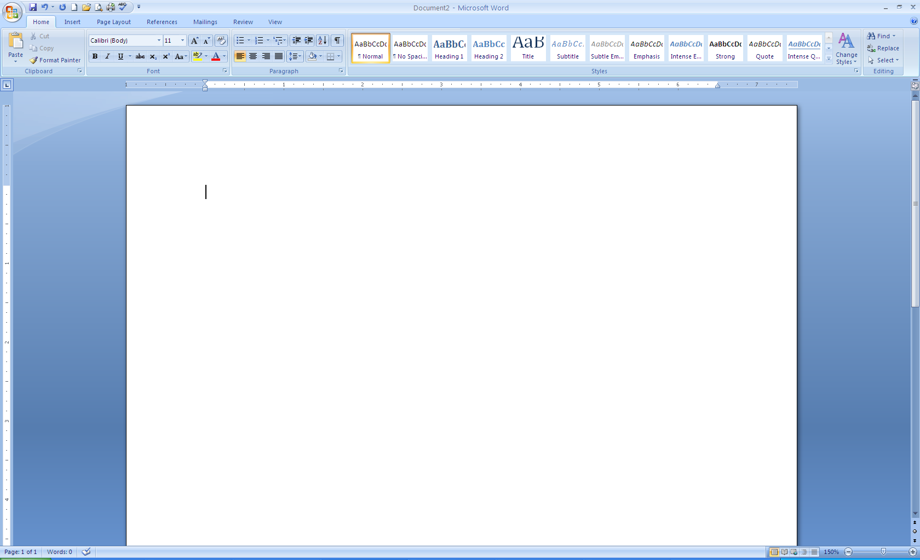
Margins and Indentation
Margins
  Blank spaces around the top, bottom, and sides of a page
  Found on the Page Layout Tab in the Page Setup section
Indentations
  The space between text and the margins
  Set indentation in the paragraph section
  of the Page Layout tab OR
  You can use the ruler to indent
1st Line Indent
Hanging Indent
Right Indent
Left Indent

Slide 7
Types of Indentation
First Line Indent
  Only the first line of text in the paragraph is indented
Hanging Indent
  When the first line of text is not indented but all of the following lines in the paragraph are
Left Indent
  When all lines of the paragraph are indented from the left margin
Right Indent
  When all lines of the paragraph are
  indented from the right margin

Slide 8
Editing Documents

Slide 9
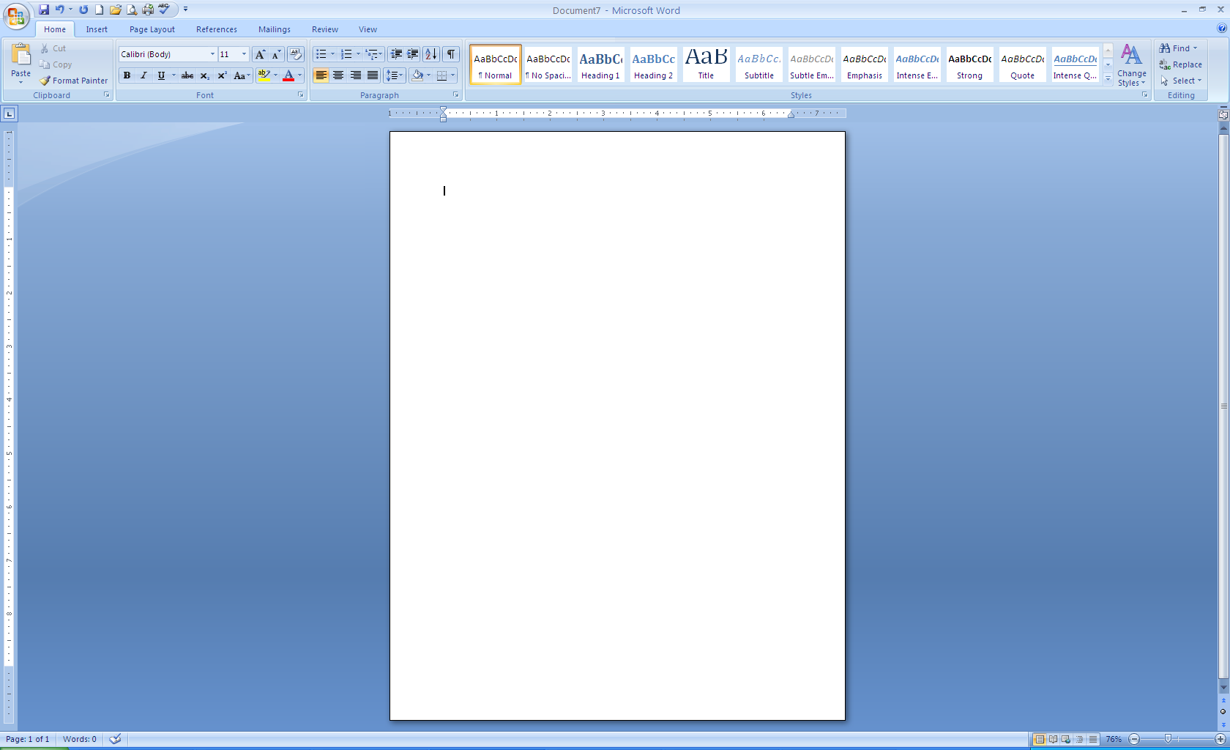
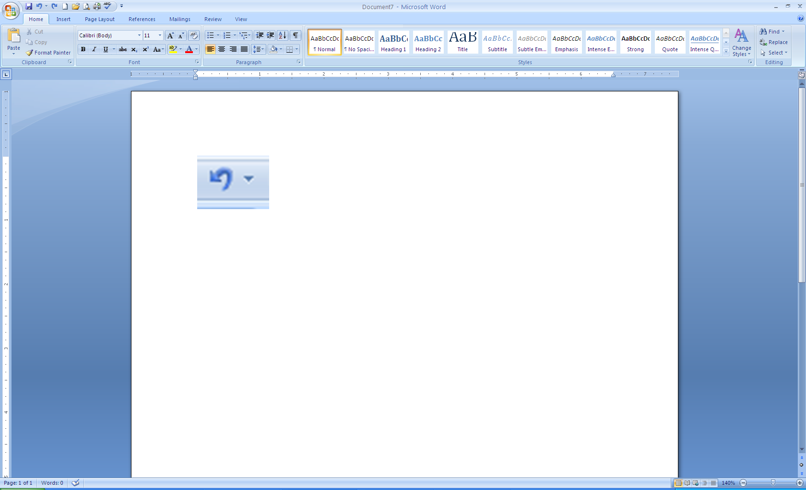
Undo – Redo – Repeat
Undo Command
REDO Command
Command useful when reversing a recent action.
In Office 2007, on the Quick Access Toolbar
Command used to reverse an action that you undid.
Can add to your Quick Access Toolbar
Repeat Command
Command used to repeat the most recent action.
Can add to your Quick Access Toolbar

Slide 10
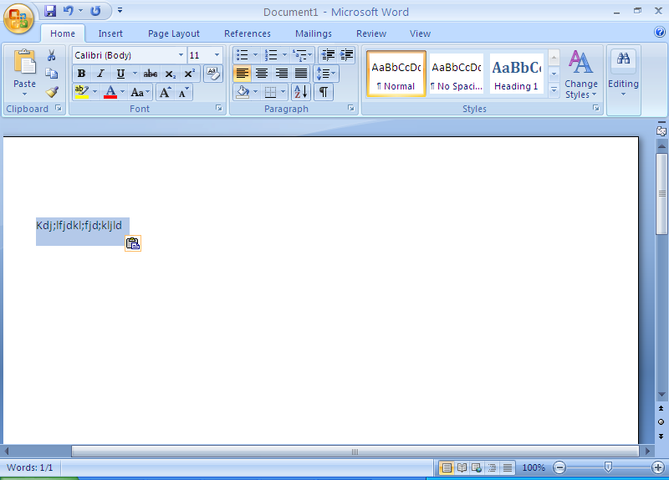
Cut – Copy – Paste Commands
Cut Command
Paste Command
To remove selected text and place it on the Office Clipboard
To copy an item stored on the Office Clipboard to a location in a file.
Copy Command
Paste Special Command
To place a copy of selected text on the Office Clipboard
Inserts the contents of the clipboard so that you can edit it in that Microsoft Office program’s format.
*In Office 2007, each command can be found on the Home Tab in the Clipboard Section

Slide 11
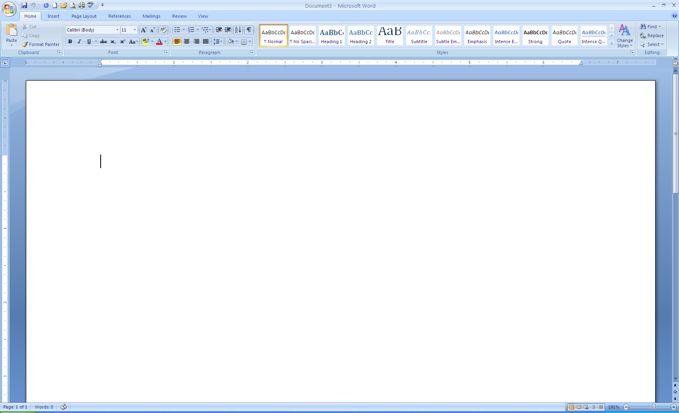
Format Painter
A feature that copies format attributes such as
  Colors
  Borders
  Fill effects
These features can be applied to other objects or text
Select the text or object and
  Click once to copy once
  Click twice to copy more than once
  Then, paint over the text or object you want the
  attribute to be painted to

Slide 12
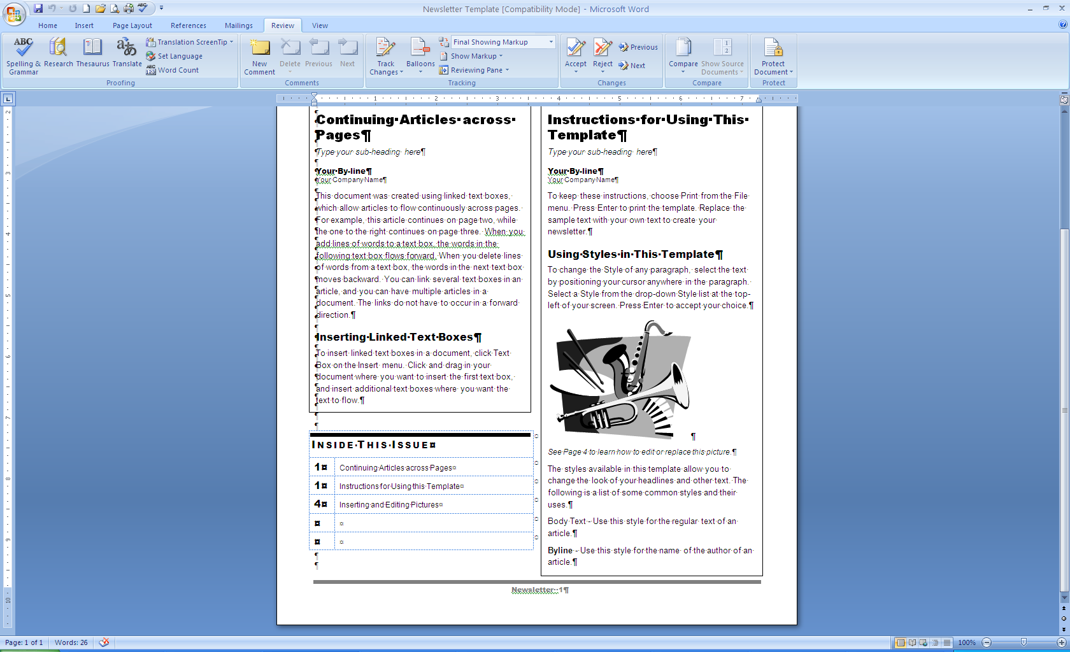
Helpful Word Features
Thesaurus
Spell Checker
Grammar Checker
A built-in reference for finding synonyms for words in a document
Right-click on a word and choose synonym
Or
Use the Thesaurus tool on the Review Tab in the Proofing section
A feature used to locate and correct spelling errors
Use the Spelling and Grammar tool on the Review Tab in the Proofing section
Or
Add the Spelling Button to the Quick Access Toolbar
Indicated on screen by underlined misspelled words in red, wavy underlines and misused words in blue, wavy underlines
A feature used to locate and correct spelling errors
Use the Spelling and Grammar tool on the Review Tab in the Proofing section
Indicated on screen by green, wavy underline

Slide 13
Enhancing documents

Slide 14

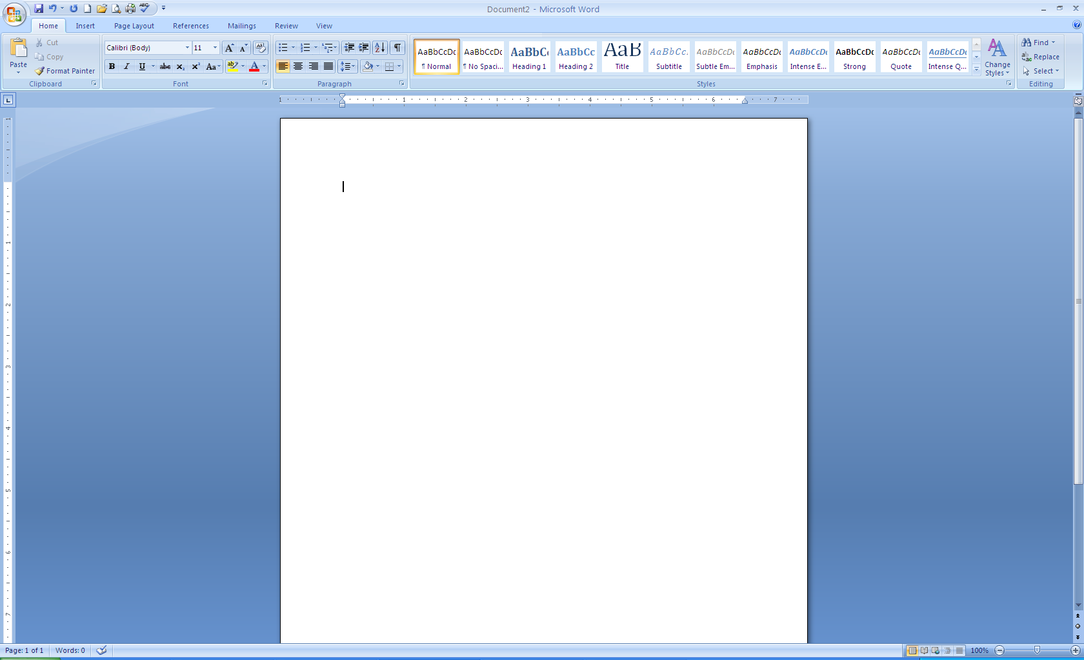
Borders
Paragraph Borders
  Used to draw the reader’s attention to the paragraph
  Found on the Home Tab in the paragraph section
Page Borders
  Borders around an entire page including Art borders
  Found on the Page Layout Tab in the Page Background section

Slide 15
Shading
Paragraph Shading
  Used to draw the reader’s attention to the paragraph by adding color to the background
  Found on the Home Tab in the paragraph section
Page Shading/Color
  Add shading to the background of a page
  Found on the Page Layout Tab in the Page Background section

Slide 16
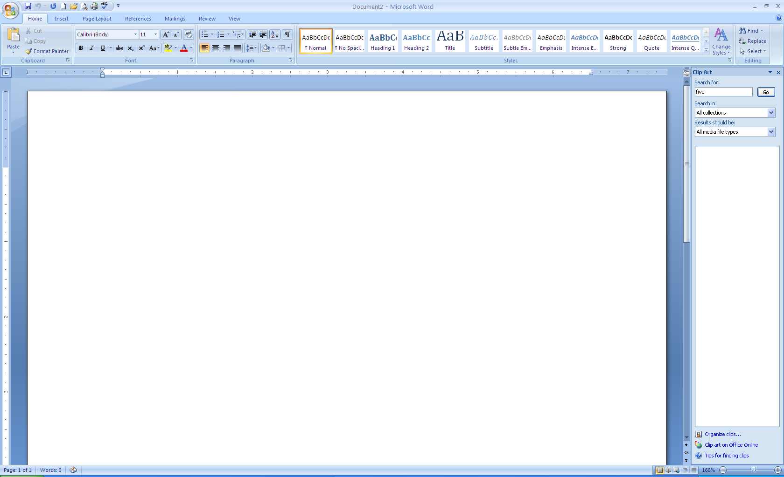
Bullets and Numbering
Bullets
Enumeration (Numbering)
Any small character that appears before an item in a list
Use the Bullets button in the Paragraph section of the Home Tab
Add numbers, letters, Roman Numerals, etc. to a list
Use the Numbering button in the Paragraph section of the Home Tab

Slide 17
Tabs and Columns
Tabs and columns can also be used to organize your text
Tab stops
Columns
An indicator in a paragraph that marks the place where the insertion point will stop when you press the Tab key.
The default tab stops are set at every ½ inch
Text can be formatted into multiple columns:
  One, two, or three of equal width
Useful in creating newsletters
Found on the Page Layout Tab in the Page Setup section

Slide 18
Setting Tabs
Use the Ruler to set tabs.
A Left Tab stop sets the start position of text that will then run to the right as you type.
A Center Tab stop sets the position of the middle of the text. The text centers on this position as you type.
A Right Tab stop sets the right end of the text. As you type, the text moves to the left.
A Decimal Tab stop aligns numbers around a decimal point. Independent of the number of digits, the decimal point will be in the same position.
A Bar Tab stop doesn't position text. It inserts a
vertical bar at the tab position.

Slide 19
Working with Documents
Widow
Orphan
Hyphenation
First line of a paragraph at the bottom of the page
This should be avoided!
Can be avoided when automatic page breaks are inserted
Last line of a paragraph at the top of a page
This should also be avoided!
Allows Word to break lines between syllables of words
Three choices
  None
  Automatic
  Manual

Slide 20
Plagiarism and Fair Use
According to www.plagiarism.org, we know the following about plagiarism and “fair use” laws
Plagiarism
Fair Use Laws
These are rough guidelines for deciding the amount and extent work can be “borrowed”
Turning in someone else's work as your own
Copying words or ideas from someone else without giving credit
Failing to put a quotation in quotation marks
Giving incorrect information about the source of a quotation
Changing words but copying the sentence structure of a source without giving credit
Copying so many words or ideas from a source that it makes up the majority of your work, whether you give credit or not

Slide 21
AVOID PLAGIARISM!
When creating any word processing document, you should never copy someone else’s work as your own
Plan your document by writing information in your own words first!
Then, create a Works Cited page or a
source page
www.easybib.com is a great source
when citing information

Slide 22
Sources
Plagiarism.org. Web. 10 May 2010. <http://www.plagiarism.org>.
Microsoft Office 2007: Introductory Course. William Robert. Pasewark , et al. - Course Technology - Boston, Mass. - 2008

