Slide 1
Academic Partnership Night 2024-2025 K Team: Ms. Dahunsi, Ms. Dawkins, and Mrs. Burns

Slide 2
Resources
Georgia Standards of Excellence
www.georgiastandards.org
AES Website for ClassLink
https://www.fultonschools.org/alpharettaes
Family Handbook
Please read pages 7& 8 very closely

Slide 3
Schedule
7:50-9:50 Reading
9:50-10:20 AES Time
10:20-10:45 Writing
10:45-11:00 Recess
11:00-11:45 Specials
11:48-12:22 Lunch
12:25-1:25 Math
1:30-1:45 Recess
1:45-2:20 SS/Science/ SSS
Notes:
Snack

Slide 4
Reading Block
Heggerty Lesson – Phonological Awareness
95 Core Phonics – Phonics Instruction
Wonders Lesson – Reading Comprehension skills/vocabulary
Rotations
Read to Self, iPads, Independent Work, Para Table, Teacher Table, ELA Word Building

Slide 5
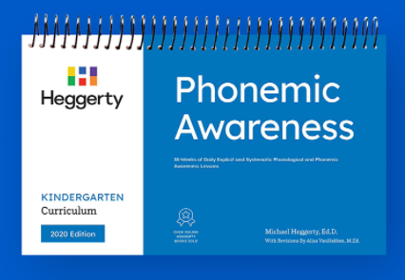
Kindergarten ELA Resources
Explicit, targeted instruction based on foundational reading and comprehension.
Students will build background knowledge, experience shared reading, whole-group lessons, small group work, as well as phonics and word work.
Notes:
Durden 2 min. Identify the 3 resources and their purposes. Give the Goldilocks analogy for how we selected them.

Slide 6
95 Core Phonics Weekly Routine
Reading
Writing
Letter-Sound
Correspondences
High Frequency Words (HFW)
Concepts of Print
Phonological Awareness
Letter Formation
Learning Objective
Notes:
Carter-10 minutes
Concepts of Print are found in Lessons 1-4. Students are introduced to academic language such as author, illustrator, cover and title
PA-daily 2 minute warm up or wrap up.
Letter-Sound Correspondence-students use pointer finger to trace a letter on laminated letter-sound strip that contains either 3 or 4 pairs of lowercase and uppercase letters and associated keywords.
Letter Formation-students practice handwriting of lowercase and uppercase letters through explicit teaching through teaching modeling with stroke talk. Letter practice is found in workbook . The program uses a ball and stick font that is aligned with the Zaner-Bloser Handwriting approach.
Reading-Once 3 consonants and the first short vowel (a), teachers provide explicit instruction on blending words beginning in lessons 5 and 6. WD do and I Do of reading at the end of lesson 6.Reading noun phrases starts in lesson 7 and reading sentences starts in lesson 8. Afterwards, students are reading short stories soon after that.
Writing-Students begin writing a letter for a picture’s initial sound in lesson 2. Writing words begins in lesson 5, writing phrases in lesson 7, and writing sentences in lesson 13.
High Frequency Words- 3-5 HFWs are based on the Dolch pre-primer and primer lists. Teacher finger stretch the sounds and show and discuss the spelling of each new word as well as use it in a phrase or sentence.

Slide 7
Math
Unit 1 Numerical Reasoning: Numbers within 10
Unit 2 Geometric & Spatial Reasoning: 2-D shapes
Unit 3 Numerical Reasoning: How many? Numbers up to 20
Unit 4 Numerical Reasoning: Using numbers using numbers within 20
Unit 5 Numerical Reasoning: Addition & Subtraction
Unit 6 Geometric & Spatial Reasoning: 3-D shapes
Unit 7 Measurement & Data Reasoning
Workbooks will be sent home to supplement instruction.
Notes:
Explain Rotations
Explain different grade levels

Slide 8
Science
Physical Properties
Motion
Day and Night
Rocks, Soil
Living and Non-Living
Similarities/Differences in Organisms
Workbook to support instruction.
Notes:
Hands on activities to teach standards

Slide 9
Social Studies
Where We Live
Observing Labor Day
Observing Columbus Day
Observing Veterans Day
Observing Thanksgiving
Day/ Christmas Day
Observing MLK Jr. Day
Observing Presidents Day
Celebrating Our Nation
Personal Finance
Workbook to support instruction.
Notes:
Labor Day

Slide 10
Technology in the Classroom
iPADS
Interactive White Board
iReady
Notes:
iRead-Comprehensive online program for phonics and reading skills.

Slide 11
AES Time
AES Time is a 30-minute block of time for enrichment and intervention based on student needs. It will change throughout the year.

Slide 12
Grading
Major (45%) - Two majors every 9 weeks, will assess 7-9 standards. Students may recover only one major per 9 weeks.
Minor (40%) – Three minors every 9 weeks, will assess one standard or learning target (quiz, project, performance assessment)
Practice (15%) – Three practice every 9 weeks, (small group work, classwork with teacher feedback provided)
Report cards every 18 weeks and Progress report at 9 weeks and 27 weeks
Grading Scale
EM 90-100 Exceeding Mastery
M 80-89 Mastery
AM 70-79 Approaching Mastery
NYM 69< Not Yet Mastered
NG No Grade

Slide 14
Communication/Discipline
Email
S.O.A. R. (Safe, Ownership, Attentive, Responsible) Matrix/ SOAR points/S.O.A.R. reminder
Kindergarten Weekly Newsletter (smore)
Daily Red Folder

Slide 15
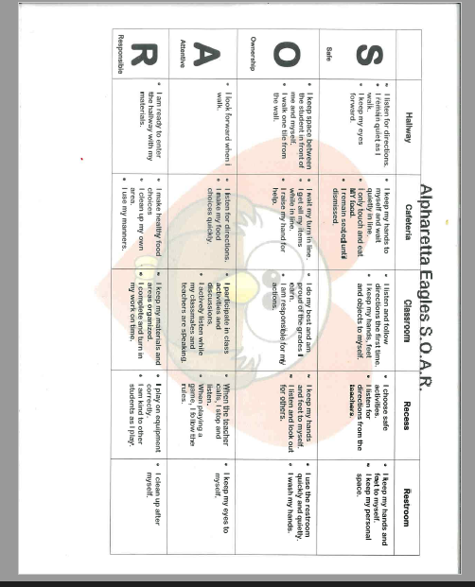

Slide 16
Thank you for coming tonight! We are looking forward to a great year with your students!

