Slide 1
Welcome to
Fourth Grade Academic Partnership Night
Teachers:
Mrs. Keys, Mrs. Nelson,
Mrs. Urquhart, and Ms. Klaus

Slide 2
Got Questions?
Need Answers?
AES Website for ClassLink
https://www.fultonschools.org/alpharettaes
Curriculum Hub
https://safari.fultonschools.org/PORTAL
24-25 AES Family Handbook

Slide 3
Our Schedule
7:10-7:40 Arrival
7:50-8:35 Specials
8:40-9:10 AES Time
9:10-10:40 Reading
10:40-11:20 Writing
11:15-11:45 Recess
11:49-12:23 Lunch
12:25-1:00 Science/SS
1:00-2:15 Math
2:20 Dismissal

Slide 4
AES Time
A 30-minute block of time for enrichment and intervention based on student needs.
It will change throughout the year.

Slide 5
Reading
Vocabulary – Vocabulary Surge
Reading Skills/Strategies - Wonders
Reading Comprehension - Wonders
Reading block structure:
Whole group mini lessons
Small group work
Vocabulary

Slide 6
Writing
Research shows that reading and writing strengthen one another.
We will focus writing instruction on the following areas:
writing foundations
quality writing for multiple purposes
the writing process
writing to enhance reading

Slide 7
Math
Place Value, Addition and Subtraction of Whole Numbers
Patterning and Algebraic Reasoning
Reasoning About Multiplication and Division
Reasoning with Shapes
Investigating Fractions
Investigating Fractions and Decimals
Building Conceptual Understanding of Angles and Measurement
Culminating Capstone Unit

Slide 8
Science
Water and Weather
Solar System
Light and Sound
Force and Motion
Ecosystems and Energy

Slide 9
Social Studies
American Revolution
The New Nation
Westward Expansion
The Civil War
Reconstruction
Personal Finance

Slide 10
Technology
Programs: iReady, Xtra Math
These programs should be accessed through ClassLink.
https://launchpad.classlink.com/fcs

Slide 11
Grading Scale
A | 90-100
B | 80-89
C | 70-79
F | 69 <
Report Cards – every 18 weeks
Progress Reports – every 4 ½ weeks

Slide 12
Grading Policy
Major (45%) – 2 every 9 weeks (multiple standards)
Minor (40%) – 3 every 9 weeks (one standard, quiz, project, performance assessment)
Practice (15%) – 3 every 9 weeks (small group, classwork)

Slide 13
Homework
(10 - 20 minutes per day total)
Reading: 15 minutes nightly; can be done independently or with support.
Math: fact flash cards to practice fluency
iReady Math and iReady Reading

Slide 14
Joining Us for Lunch?
Lunch visitors:
Here at AES, you can eat lunch with your child(ren). We ask that you do the following:
Come during your child’s lunch time
If you are early, please wait outside the cafeteria doors
Sit with your child at the visitor’s table (near stage) or you can take them out to the courtyard
Please do not take a friend to eat lunch with you

Slide 15
Code of Conduct
The new Fulton County Schools Student Code of Conduct & Discipline Handbook (2024-25) will be ready to start receiving parent/guardian signatures starting on August 5, 2024. Click here to access the Code of Conduct. Students age 10 years and older and all parents/guardians who have a student attending Fulton County Schools should sign. Click here for instruction on how to sign.

Slide 16
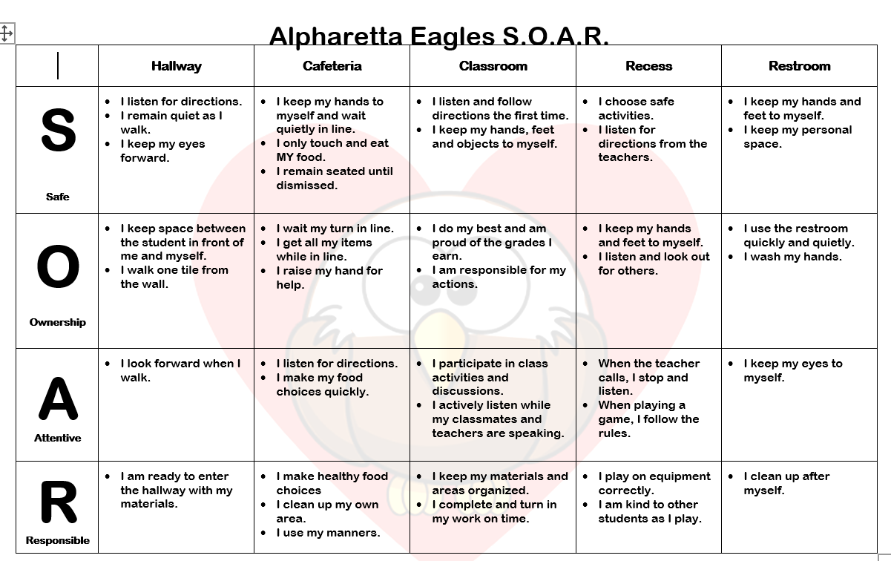
Positive Behavior Intervention System
Alpharetta Elementary’s S.O.A.R. Program

Slide 17
Communication
Red folders
E-Newsletter
Friday Papers
Eagle Wings
Email:
keys@fultonschools.org
nelsona2@fultonschools.org
urquhart@fultonschools.org
hulshizerd@fultonschools.org

Slide 18
Thank you for joining us tonight!
We look forward to a great year with your child.

