Slide 1
Welcome to
First Grade Academic Partnership Night
Teachers:
Mrs. Andolino, Mrs. Dinges,
Ms. James, Ms. Jacobs, and Mrs. Shettle

Slide 2
Our Schedule
7:10-7:40 Arrival
7:40-8:15 AES Time
8:15-10:20 Reading
10:20-10:50 Recess
10:50-11:20 Lunch
11:20-11:45 Writing
11:50-12:35 Specials
12:35-1:50 Math
1:50-2:15 Science/SS
2:20 Dismissal

Slide 3
AES Time
A 30-minute block of time for enrichment and intervention based on student needs.
It will change throughout the year.
Students in TAG will go every day during AES Time.
Notes:
AES Time is a 30-minute block of time for enrichment and intervention based on student needs. It will change throughout the year. TAG is Monday.

Slide 4
Reading
Phonemic Awareness - Heggerty
Phonics – 95 Phonics Core Program
Reading Skills/Strategies - Wonders
Reading Comprehension - Wonders
Reading block structure:
whole group mini lessons
small group work
phonics
word work
Notes:
Explicit, targeted instruction based on foundational reading and comprehension. Students will build background knowledge, experience shared reading, whole-group minilessons, small group work, as well as phonics and word work. An easy way to remember the difference between phonics and phonemic awareness is that phonics is visual while phonemic awareness is auditory

Slide 5
Writing
Research shows that reading and writing strengthen one another.
We will focus writing instruction on the following areas:
writing foundations
quality writing for multiple purposes
the writing process
writing to enhance reading
Notes:
We look for spelling to be close to what the word sounds like, sentence structure, word order, and a clear thought. At the end of each unit, they will publish a piece of writing based on the theme in that unit. We are currently working on a unit about “What makes you special.”

Slide 6
Math
Number and Operations in Base Ten (Counting to 120/Addition and Subtraction/Using 120 Chart)
Operations and Algebraic Thinking (Addition and Subtraction up to 20)
Measurement and Data (Length/Time/Data)
Geometry (2D and 3D Shapes/Fractions)
Notes:
These are the 1st Grade Standards. We do have Continuous Achievement in Math. We meet the children where they are academically.

Slide 7
Math

Slide 8
Science
Weather
Light and Sound
Magnetism
Needs of Living Things (Plants/Animals)
Notes:
We sometimes have projects with these units. (Sound)

Slide 9
Social Studies
Our Earth, Our Home
Benjamin Franklin
Lewis and Clark/Sacagawea
Thomas Jefferson
George Washington Carver
Ruby Bridges
Theodore Roosevelt
Personal Finance
Notes:
We have a workbook/notebook that we use for Social Studies. There may be projects due in these subjects.

Slide 10
Technology
Programs: iReady (30-45 mins per week in reading and math), Tumblebooks
These programs should be accessed through ClassLink.
https://launchpad.classlink.com/fcs

Slide 11
Grading Scale
EM | 90-100 | Exceeding Mastery
M | 80-89 | Mastery
AM | 70-79 | Approaching Mastery
NYM | 69 < | Not Yet Mastered
NG |  | No Grade
Report Cards – every 18 weeks
Progress Reports – every 4 ½ weeks

Slide 12
Grading Policy
Major (45%) – 2 every 9 weeks (multiple standards)
Minor (40%) – 3 every 9 weeks (one standard, quiz, project, performance assessment)
Practice (15%) – 3 every 9 weeks (small group, classwork)

Slide 13
Grading Policy

Slide 14
How can parents help?
(10 - 20 minutes per day total)
Reading: 15 minutes nightly; can be done independently or with support.
Math: fact flash cards to practice fluency for addition/subtraction
iReady Math and iReady Reading
Special Projects may be assigned throughout the year
Notes:
Read nightly a variety of ways: aloud, independently, shared reading, taking turns, listen to reading

Slide 15
Joining us for Lunch?
Lunch visitors:
Here at AES, you are able to eat lunch with your child(ren). We ask that you do the following:
Come during your child’s lunch time
If you are early, please wait outside the cafeteria doors
Sit with your child at the visitor’s table (near stage) or you can take them out to the courtyard
Please do not take a friend to eat lunch with you
Notes:
Read nightly a variety of ways: aloud, independently, shared reading, taking turns, listen to reading

Slide 16
Code of Conduct
The new Fulton County Schools Student Code of Conduct & Discipline Handbook (2024-25) is ready to start receiving parent/guardian signatures. Click here to access the Code of Conduct. Students age 10 years and older and all parents/guardians who have a student attending Fulton County Schools should sign. Click here for instruction on how to sign.
Notes:
Read nightly a variety of ways: aloud, independently, shared reading, taking turns, listen to reading

Slide 17
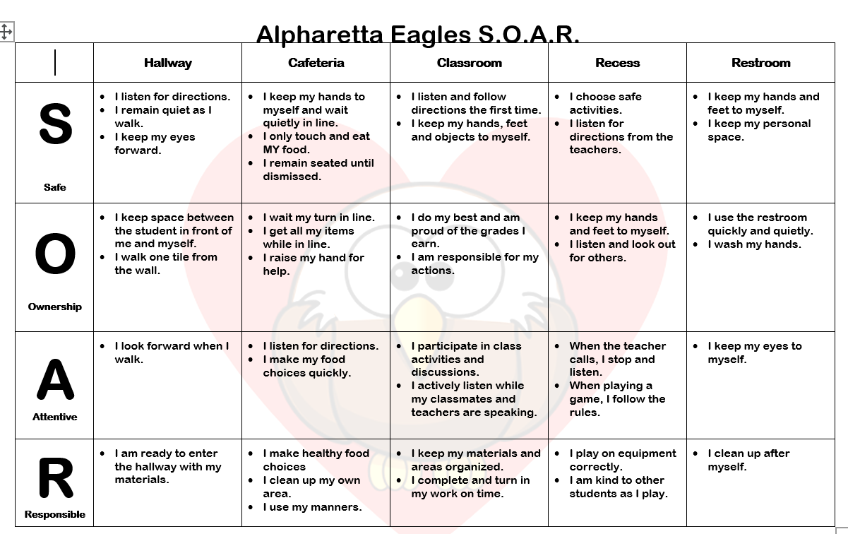
Positive Behavior Intervention System
Alpharetta Elementary’s S.O.A.R. Program
Notes:
SOAR points; Bi-Weekly Progress Report; SOAR Reminder; 3 SOAR reminders in a month is an office referral

Slide 18
NEW!
Family Handbook
AES Family Handbook 24-25.pdf
Highlights to look for:
-Birthday policy
-Attendance/tardy policy
-Communication
Notes:
BIRTHDAY CELEBRATIONS
Due to the number of students with food allergies and our focus on health and wellness, our birthday
celebration policy is as follows. Parents are welcome to send in one small nonedible birthday item Tstudent’s birthday. Please
note that the following items are prohibited on school campus: party bags, balloons, flowers, and party
invitations.
After 5 unexcused absences, our school social worker will reach out to parents. A letter from the AES social worker will be sent home once your child accumulates five or more days of unexcused absences or tardies. A social worker referral is automatically made once your child has accumulated more than five days of unexcused absences or tardies
Communication- AES Website, Eagles Wings, Weekly Newsletter, Email....

Slide 19
Communication
Daily folders
E-Newsletter
Bi-weekly Papers
Eagle Wings
Email:
Andolino@fultonschools.org
Dingesm@fultonschools.org
Jacobsko@fultonschools.org
jamesm2@fultonschools.org
shettle@fultonschools.org
Notes:
Daily folder – Check it, TRANSPORTATION (Call office) and EXCUSES Friday Folder - Sent home 2nd and 4th Friday, sign cover sheet and return.

Slide 20
Got Questions?
Need Answers?
AES Website for ClassLink
https://www.fultonschools.org/alpharettaes
Curriculum Hub
https://safari.fultonschools.org/PORTAL
Notes:
The Curriculum Hub provides a variety of resources to assist parents in supporting their student's learning in the areas of English Language Arts/Reading, Mathematics, Science and Social Studies including:

Slide 21
Thank you for joining us tonight!
We look forward to a great year with your child.

