Slide 1
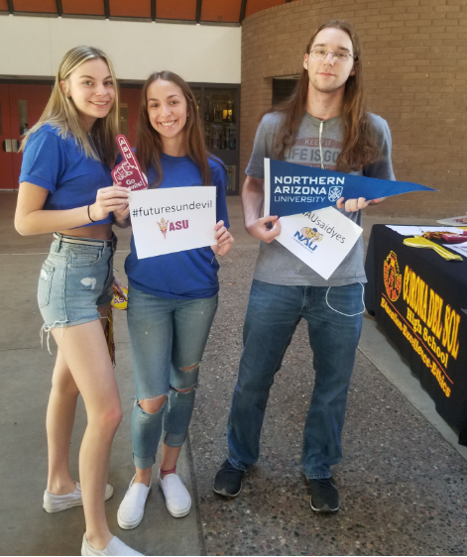
WELCOME CLASS OF 2021!

Slide 2
Today you will learn…
Senior Year/Graduation Information
In-State College/University Requirements
Post High School Options
College Entrance Testing
Post Secondary Campus Visits

Slide 3
Who is my counselor?
Susan Woods, Counseling Secretary 752-8776
Jennifer Morgan, A - CAM
Michelle Kozimor, CAN – FIN
Jaimie Schulz, FIR – JA
Michelle Deignan, JE – MA
Pam Kane, MC – PI
Dawn Milovich, PL – STE
Rosemary Cortez, STI - Z
Notes:
3

Slide 4
Graduation Requirements for Class of 2021
Curriculum Area TUHSD In-state Universities
English 4 credits 4 credits
Math 4 credits 4 credits
Laboratory Science 3 credits 3 credits (1.0 full credit in each subject you take)
Social Studies 3 credits 2 credits
CTE/FA 2 credit 1 Career Technical Ed OR Fine Art credit
World Language 0 credit 2 credits
(Two years of the same language)
Physical Education 1 credit 0 credit
Health .50 credit 0 credit
Required Core Courses 17.5 credit 16 credits
Elective Courses 5.5 credits 4 credits
TOTAL REQUIRED CREDITS 23 CREDITS 20 Credits
And Must Pass Civics Test to Graduate

Slide 5
It’s Your Transcript Yes, you are responsible to make sure it is correct
9th – 11th – correct school, classes, grades, and credits
ANY summer school grades and credit
Term credits vs. Cumulative credit (should be @ least 18)
Failed, Incomplete, Repeated courses
GPA: Standard and Weighted
Class Rank - when does this happen?
Requesting Official Transcript--Naviance (we show you how in the video posted in Schoology)
Unofficial can be viewed in StudentVue - Documents

Slide 6
How To Locate/View Your TRANSCRIPT
Log into StudentVue
Click on “Documents” the last tab on the left hand side
Clink on the hyperlink for the most recent transcript

Slide 7
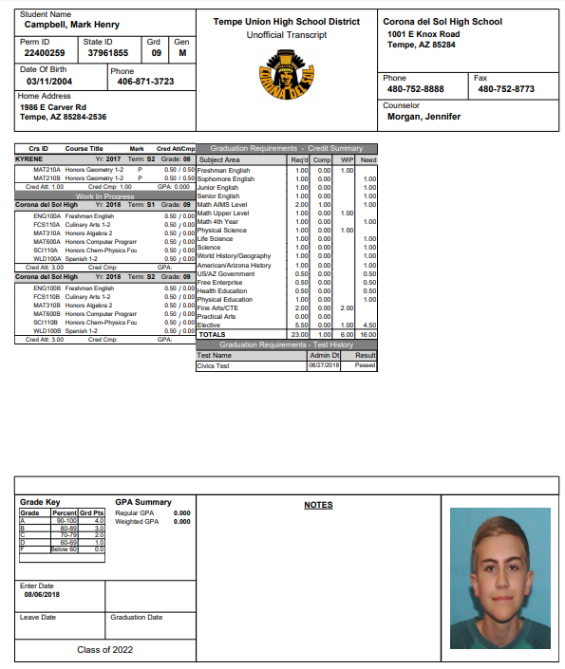
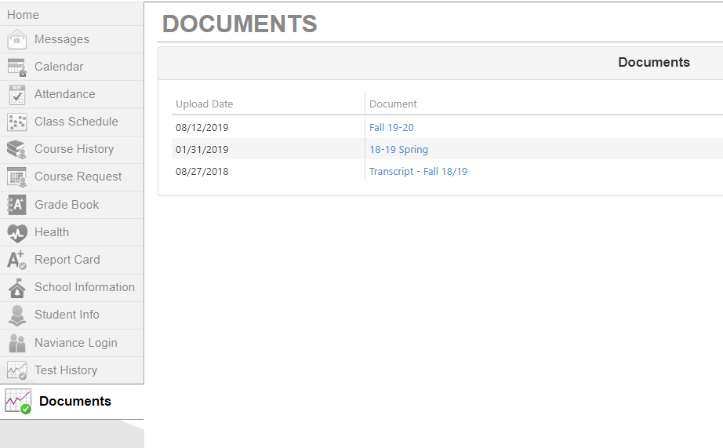
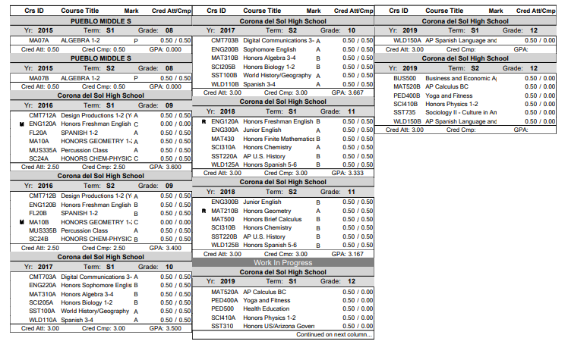
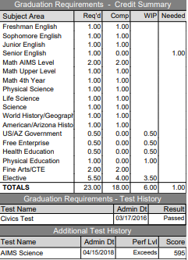
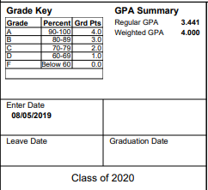
How to access your OWN transcript in StudentVue

Slide 8
What if I am missing a class?
Plan should be in place NOW and In your schedule
If NOT: Communicate with your Counselor ASAP
Tempe Union Online (TUO) is your opportunity for credit recovery. Talk to your counselor if you are off track for graduation so we can help!

Slide 9
Letters Of Recommendation
Required for some universities and scholarships, make sure to READ the requirements! Follow the Process.
99% of the time, this will be done in Naviance. We show you in how to do this in the video in Schoology.
Early communication with the counselor and/or teacher is REQUIRED
Proactive (some programs require letters before fall break e.g. Common App, Flinn, Military Academy)
Allow your recommender at least 2 weeks to complete the letter. Letters will not be written over breaks or holidays, and does not count as the two week notice.

Slide 10
Life after Corona
Attend Community College | Attend a Trade/Technical School
Enlist with Military | Attend a University
Work | Other (Mission, Gap Year)

Slide 11
Community College (2 Year college)
Wide range of occupational and/or educational programs
Gen. Ed. at CC then transfer, great option if you want/need to restart your GPA
Certificate programs & AS/AA degrees
Many vocational programs
Presidents’ Honors Program (unweighted 3.25 overall GPA covers tuition for two years)!

Slide 12
Community College Possibilities
Rio Salado CC
Dental Assisting
Energy Systems Technology
Early Childhood Administration
Language Studies
STEM Education for K -12
Chandler Gilbert CC
Aircraft Construction Technology
Aircraft Maintenance
Aviation
Equine Science
Golf Course Operations
Media Arts: Dig. Imaging
Early Childhood Programs
Mesa CC
Construction Drafting
Para-Medicine
Police Academy Preparation
Nursing
Firefighting
Scottsdale CC
Culinary Arts
Radiography
Yoga Teaching Certification
Speech-Language Pathology
Broadcasting
Gateway CC
Court Reporting
Automotive Technology (Partnership w/ Nissan & Toyota)
Hydrologic Studies
Nursing
Respiratory Therapist
Medical Radiographer
Central Arizona College
Dietetic Education
Heavy Diesel
Massage Therapy
Welding
John Deere Program
Check with your college of choice for program availability

Slide 13
Community Colleges
Open Admissions Policy
Apply in 2nd semester of Senior Year
at
Maricopa Colleges
www.my.maricopa.edu
Or
Central Arizona College
www.centralaz/edu

Slide 14
Trade & Technical Schools
Vary in size, entry requirements, cost and quality
Research
Visit the school, attend career fairs
Speak with students and employers in the field
EVIT adult programs (some might be free)!

Slide 15
Military Bound
Explore career options available through each branch by registering for the ASVAB – date TBD
Military representatives are available on campus, listen to announcements or see Mrs. Baker
Remember, both students and parents need to be involved in the process
This is a great option to have college paid for now or in the future!

Slide 16
College Admissions (In-State)
Admission applications have opened for ASU, NAU and UA
In-state University requirements:
Have a 3.0 un-weighted Core* GPA or better in the 16 core courses, OR
22 on the ACT, OR
1120 on the SAT OR
Top 25% of your graduating class
No deficiencies in core courses (no “F”’s, and a 2.0 GPA in the core subject)
Some majors will have higher admission requirements, or extra steps (audition/portfolios)
All of these universities allow self-reporting. Enter your transcript in the application for a faster admission decision!
You must pay the application fee (waivers are now built into the applications) for the university to process an admission decision.
There is a *

Slide 17
In-State University Programs
Most honor programs have higher admission requirements:
ASU separate application priority (11/1)
NAU separate application priority (before 2/1)
UA separate application (11/3)
With each application, be sure to include all additional items the school may need such as essays, letters of recommendation, activities resume, etc.
**Attend TUHSD Virtual Tri-University College Week
September 8th – September 12th

Slide 18
In-State University Honors Info, FAFSA, Scholarship, and more
The Tri-University Fair will share information about:
Arizona State University, Northern Arizona University and the University of Arizona Honors Colleges
The college admission process
Scholarships and financial aid
Information about each university and any changes due to COVID-19

Slide 19
College Admissions (Out-of-State)
Know when/how to apply
The internet is a wonderful thing!
So are NAVIANCE, REMIND, and District Info Nights
Highly selective schools have earlier deadlines (Early Action, Early Decision)
Please - HAVE AN IN-STATE BACKUP PLAN!!
**Attend Virtual Visits listed in Naviance. These are updated daily, and because they are virtual, we have more visits planned now than ever before!
Notes:
CA – remind if using this to apply we will have an Ac Lab they need to sign up for

Slide 20
Private & Out of State Colleges WUE
WUE (pronounced “woo-wee”) is the Western Undergraduate Exchange, a program of the Western Interstate Commission for Higher Education (WICHE). Through WUE, students in western states may enroll in more than 140 two-year and four-year college institutions at a reduced tuition level: 150 percent of the institution's regular resident tuition.
Several School in the following states participate:
Alaska, Arizona, California, Colorado, Hawaii, Idaho,
Montana, Nevada, New Mexico, North Dakota, Oregon,
South Dakota, Utah, Washington, and Wyoming.
Notes:
Do we need this?

Slide 21
Free Application for Federal Student Aid or the FAFSA
Get your FSA ID now at https://fsaid.ed.gov/npas/index.htm
Complete the FAFSA AFTER October 1st. Update annually. https://studentaid.ed.gov/sa/fafsa
Parent Financial Aid Nights will be offered virtually this year – dates TBD
Get help completing the FAFSA with College Connect or during College Goal FAFSA. Dates will be announced.

Slide 22
Scholarships
Naviance Scholarship pages – you must do the work of searching and applying!
Our in-state schools each have a scholarship portal that opens to you once you have been admitted.
Remind– Text @tuhsdmoney to 81010
Apply early and apply often! This is your JOB during 12th grade. The money won’t find you!
Notes:
Check on remind

Slide 23
College Entrance Exams
Universities - SAT or ACT may be used for merit awards and/or admission – this is changing for MANY schools due to COVID. Our in-state universities will not require a test score for merit based aid for Fall 2021. Check out their websites for more info.
You must register at least a month before the test date $30 late fee
SAT $49.50, w/essay $64.50
ACT $52, w/writing $68
Send test scores when you register for free! Can send to 4 colleges at no charge. If you wait, you will PAY.
Additional Math Placement Tests may be given by universities
Community College Placement Test
May use your GPA, reading and/or math placement tests

Slide 24
A Few Things to Remember
Do not PAY anyone to help you with scholarships, FAFSA or college applications
Transcripts are ordered through Naviance and you must make the request if your school requires one as part of the application
Post-secondary planning is a Process not an Event. You and your parent should be talking to reps, visiting schools (virtually), and researching
Visit colleges anywhere, anytime with virtual features and connect with their admissions rep with 1:1 Zoom meetings
Continue to apply for admission and scholarships!!!

Slide 25
Important Dates
Tri-University Week Sept. 8th – 12th
National College Fairs Sept. 13th, Oct. 12th, Oct. 18th, Nov. 8th – times vary. Register for any/all days.
Financial Aid Nights—TBD
1st semester ends – Dec. 17th/ May 19th
All alternate credits must be submitted by MAY 7th
Graduation - May 20th

Slide 26
Make Senior Year Count
Attendance matters
Stay active and involved
Pass your classes
Apply for scholarships early and often
Check your student email and learn Naviance
HAVE FUN AND MAKE GOOD CHOICES IN LIFE AND ON SOCIAL MEDIA!
Notes:
26

Slide 27
Your turn…
Make an appointment by emailing your counselor
Jennifer Morgan, A - CAM
Michelle Kozimor, CAN – FIN
Jaimie Schulz, FIR – JA
Michelle Deignan, JE – MA
Pam Kane, MC – PI
Dawn Milovich, PL – STE
Rosemary Cortez, STI - Z

