Slide 1
Date: May 8, 2024 Time: 4:30 PM School Location: Parent Center
North Metro Academy
24.25 TITLE I PLANNING MEETING
Notes:
REVISED 2/2/24
Please note that you will see a few symbols throughout the ppt. These are visual cues for your families in order to guide them in knowing their roles in jointly developing your school’s Title I Plan for the upcoming year**. The Title I Planning Meeting must be held between March 1 and May 1.
Symbols Key:
Red Hand: “Stop: Time for Review”
Two People with talking bubble: “Turn and Talk”
Pencil and Paper: “Written Input Needed”

Slide 2
Welcome
Introductions
Purpose of meeting:
All families and community members share in the decision-making process. We need your input!
At your school | At the GCPS district level
Local School Plan for Improvement (LSPI) | District Improvement Plan (DIP)
The Plan…Promise… | District Family and Community Engagement Plan
Title I Budget | District Title I Budget
Notes:
Parents, family members, members of the community, and school staff join the Title I Planning meeting once a year in the Spring to review and provide input and jointly develop the following documents:
Local School Plan for Improvement (LSPI) goals, Title I Family Engagement Plan and Promise, and Title I Budget allocation for our school.
District Improvement Plan (DIP), District Family and Community Engagement Plan, and the District’s Title I Budget.
We seek your input as we plan the implementation of the Title I program for the upcoming year.

Slide 3
Title I Overview
Is the largest federal assistance program for schools.
Provides support to students who are at risk of not meeting the State’s academic standards.
Determines funding by the number of students receiving free or reduced-price lunch.
Supports parents/families by offering activities and training opportunities to increase engagement in their children’s education.
Notes:
Title I is the largest federal assistance program for schools.
Provides support to students who are most at risk of not meeting state academic standards.
Supports parents by offering workshops and training opportunities to increase involvement in their children’s education.
GCPS receives Title I funds from the US Department of Education (USED) via the Georgia Department of Education (GaDOE) to provide additional resources to assist with the education of our children.

Slide 4
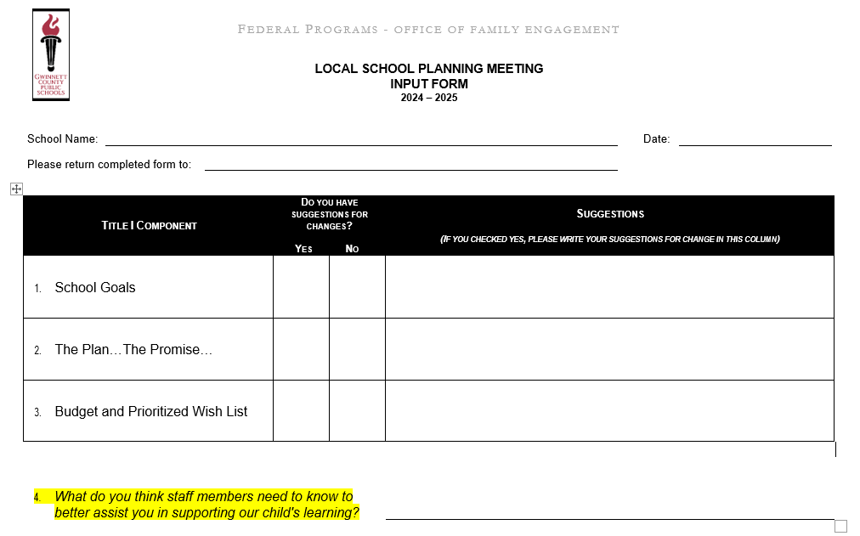
Local School Input Form
Notes:
Please provide printed or electronic copy of the Local School Input Form to each participant. Remind participants to record their input on this form.

Slide 5
DATA AND SCHOOL GOALS
Notes:
Review the following local school data and school goals in this section.
Parent Perception Survey Results Data
School Profile Data
Student Performance Data
LSPI goals and action steps
Consider providing printed copies of the data to the participants at the meeting.

Slide 6
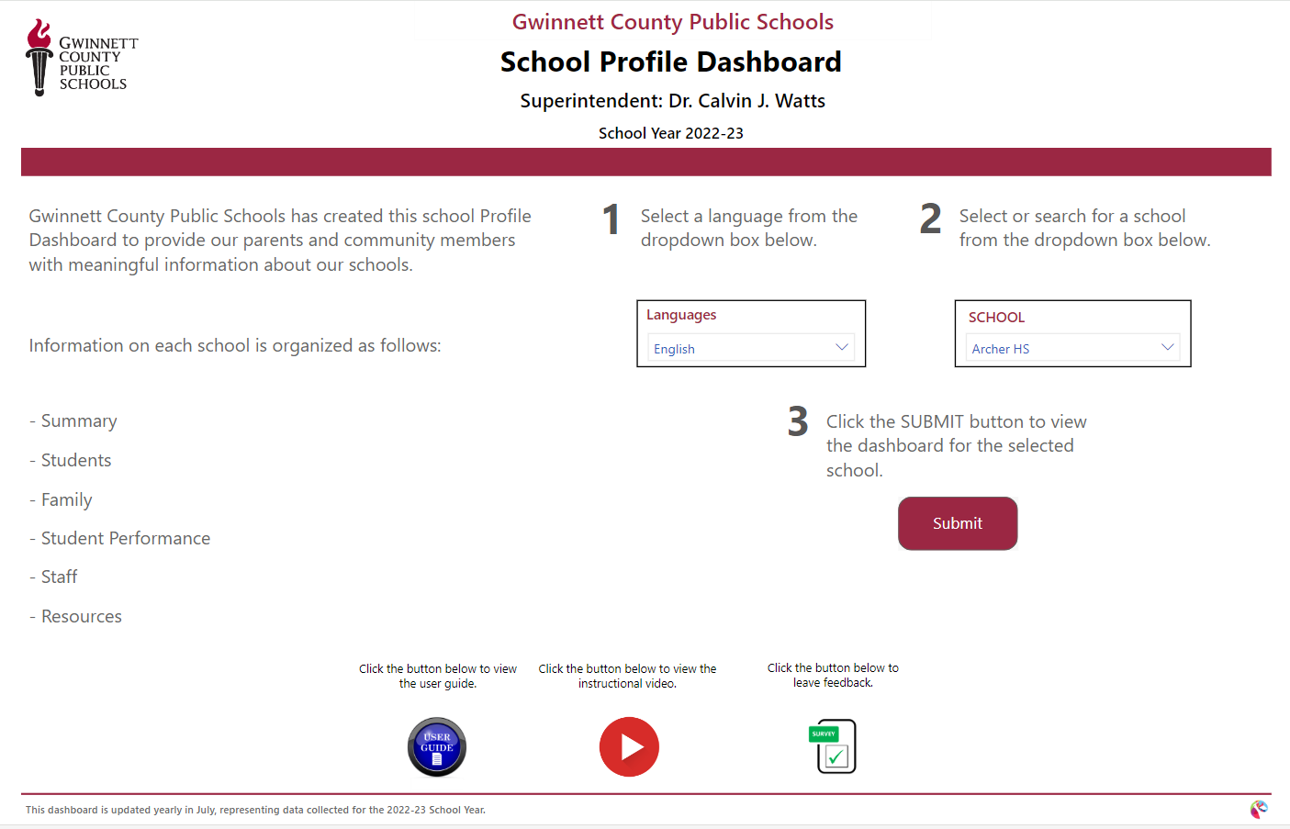
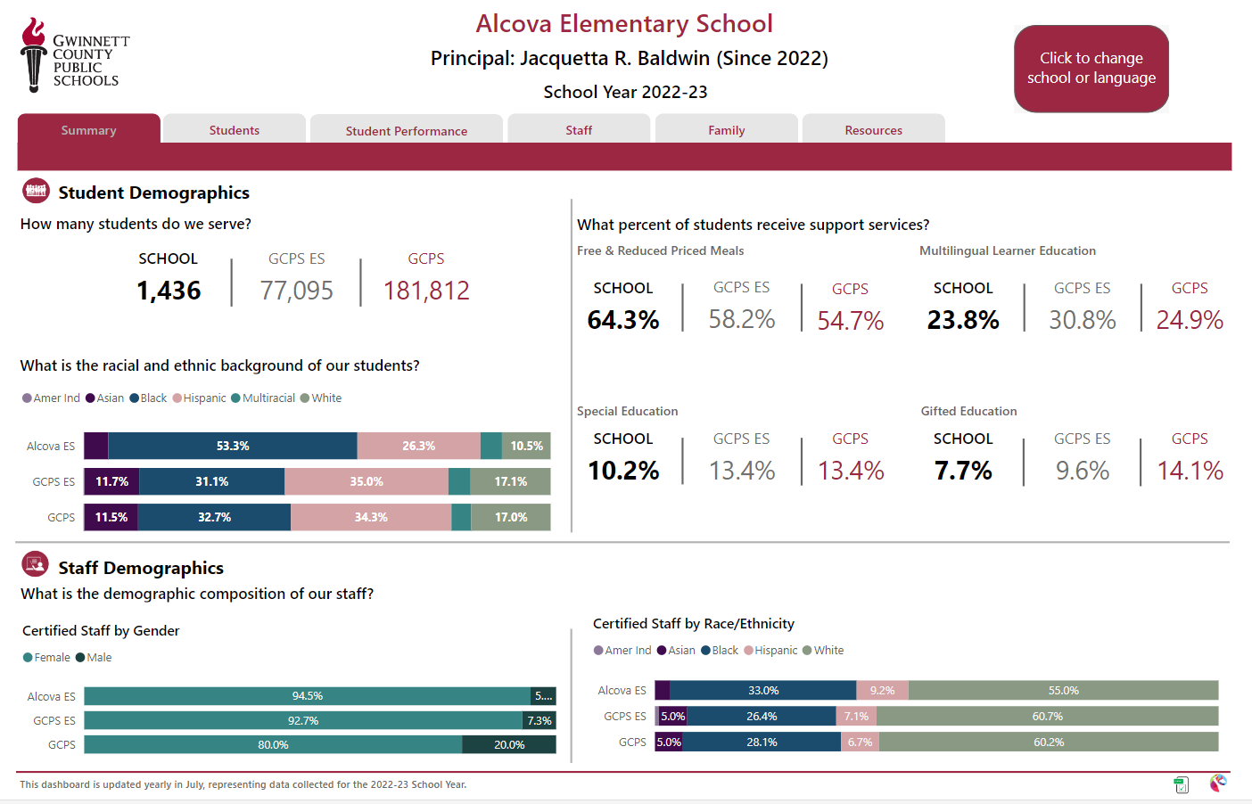
School Profile Dashboard Data
Notes:
APTI: Review the School Profile Dashboard Data available on the GCPS website GCPS School Profiles and LSPI . Note there is a User Guide and an instructional video available. If possible, provide parents with a printed copy of the “School Profile Dashboard” data report in the language of their preference. Review your “School Profile Dashboard” data with participants in family-friendly language. Provide any additional data you would like to share with your families. Be mindful that the goal is to share an overview, not to have a deep data dive with parents.

Slide 7
What does the data tell us? “Say Something” Protocol
Review the data and use the “Say Something” sentence starters outlined below to share statements regarding the data. What parts of the data catch your attention?
Something I noticed…
Something I wonder about…
Something that puzzles me …
Something I’m reminded of when I review the data …
Something I would like to talk more about …
Notes:
“Say Something” Protocol:
Invite families/parents to review the data independently or with a partner.
Invite families/parents to use different sentence starters outlined on this slide (Something I…).
Invite families/parents to turn and talk and then share with the group statements regarding the data using the sentence starter (Something I…).
Capture their thoughts/comments in the minutes template.

Slide 8
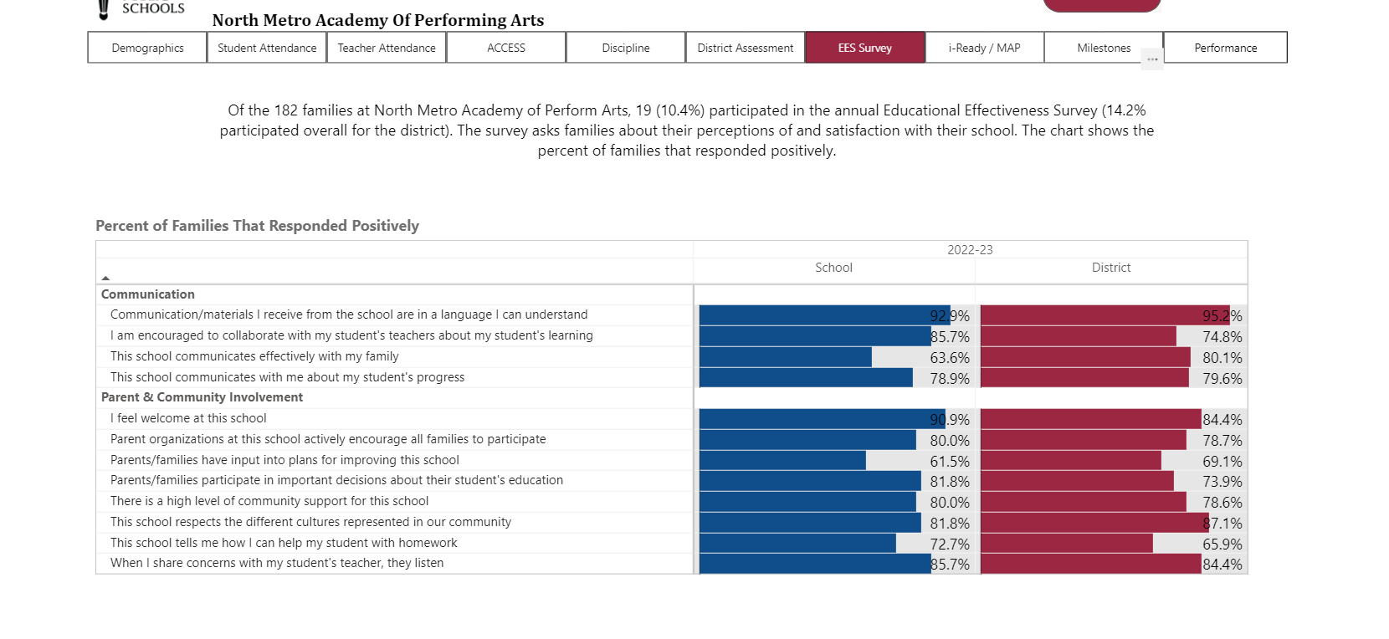
Educational Effectiveness Survey (EES) – 2022-23 Family Perceptions Results Data
Notes:
Share the Family Perceptions Educational Effectiveness Survey Results and review results with the families. Provide printed copies to families if possible.

Slide 9
Educational Effectiveness Survey (EES) Results Data
Turn and Talk:
What do you notice?
What were the results of the 2022-23 year’s survey?
How can we use this information?
Notes:
Review Parent/Family Educational Effectiveness Survey Results. Invite parents to turn and talk, and then share aloud what they noticed on this report.

Slide 10
Local School Plan for Improvement (LSPI)- What are our School’s Goals and How do we plan to accomplish our goals ?
Strategic Priority & Goal Focus #1: Empathy
Empathy: Staff and student wellbeing- Promote student and staff wellbeing through prioritizing self-care, physical and mental health, and social emotional learning
NMAPA is committed to a positive school environment in which we support student and staff wellbeing. We believe in creating a positive learning environment for our students; where the students feel safe and can be fully engaged in the learning activities. We also believe that it is imperative to provide teachers and staff with the support to create a positive learning environment and ensure their well-being by prioritizing mental and physical health.
Notes:
Insert your Goal written in a family-friendly language.
Insert Action Steps to accomplish your school goal in family-friendly language.
Ask participants to provide input about the goals using the Local School Planning Meeting Input Form > School Goals.

Slide 11
Local School Plan for Improvement (LSPI)- What are our School’s Goals and How do we plan to accomplish our goals ?
Strategic Priority & Goal Focus #2: Equity
Equity: Multi-tiered system of supports- Implement a comprehensive framework to fully operationalize a multi-tiered system of supports to address academic and non-academic student needs and remove barriers to success.
NMAPA believes that it is essential to support all students. NMAPA will correctly identify students’ needs and provide them with the necessary skills and support to ensure that they are successful in their academic and non-academic classes by removing all barriers to success. NMAPA believes in providing teachers with the time to participate in professional learning opportunities to support the implementation of tiered supports.
Notes:
Insert your Goal written in a family-friendly language.
Insert Action Steps to accomplish your school goal in family-friendly language.
Ask participants to provide input about the goals using the Local School Planning Meeting Input Form > School Goals.

Slide 12
Local School Plan for Improvement (LSPI)- What are our School’s Goals and How do we plan to accomplish our goals ?
Strategic Priority & Goal Focus #3: Effectiveness
Type your school action steps here. Effectiveness: Results-Based Evaluation System NMAPA believes in having high standards and expectations for all students and staff to ensure student success.
Notes:
Insert your Goal written in a family-friendly language.
Insert Action Steps to accomplish your school goal in family-friendly language.
Ask participants to provide input about the goals using the Local School Planning Meeting Input Form > School Goals.

Slide 13
Local School Plan for Improvement (LSPI)- What are our School Goals and How do we plan to accomplish our goals ?
Strategic Priority & Goal Focus #4: Excellence
Excellence: Preferred education destination- Be the first choice of students and families for excellent schools and the employer of choice for educators and staff to fulfill careers. NMAPA is an elementary theme school in GCPS and a school choice. We are seeking to be the premier educational destination for all elementary students and the employer of choice for educators and staff to fulfill their careers.
Families, please add your comments/suggestions to the Local School Planning Meeting Input Form under the section labeled School Goals.
Notes:
Insert your Goal written in a family-friendly language.
Insert Action Steps to accomplish your school goal in family-friendly language.
Ask participants to provide input about the goals using the Local School Planning Meeting Input Form > School Goals.

Slide 14
Family and Community Engagement Documents
Notes:
School-Family Plan: Establishes the school’s expectations for parent/family engagement; Describes how the school will implement a number of specific meaningful family engagement activities designed to increase student academic achievement; and it serves as an agreement that parents, students and teachers develop together explaining how they will partner to ensure that students meet State and district academic standards. Tied to a school goal. Focus on specific academic skill(s) in the targeted content area(s). Connects the school, parent, and student responsibilities to the academic skill.
School-Family Promise: Serve as an agreement that parents, students, and teachers develop together explaining how they will partner to ensure that students meet State and district academic standards. Tied to a school goal. Focus on specific academic skill(s) in the targeted content area(s). Connects the school, parent and student responsibilities to the academic skill.

Slide 15
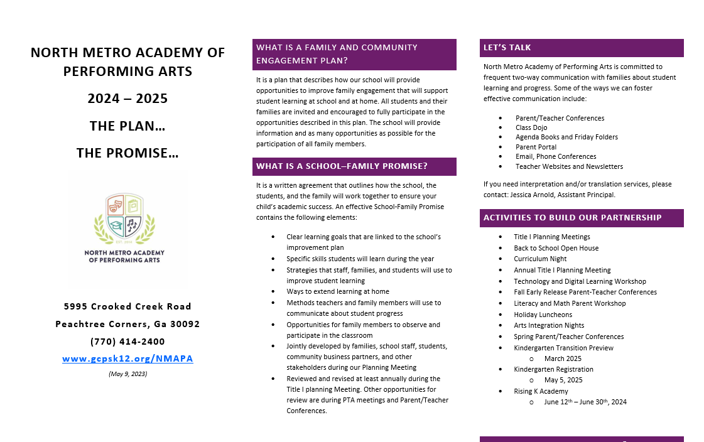
Title I School-Family Plan…The Promise…
Review The School-Family Plan…The Promise… document with families and gather written input for revisions.
Please add your comments/suggestions to the Local School Planning Meeting Input Form under the section labeled The Plan… The Promise.
Notes:
Provide printed copies and review your current Plan…Promise or a draft copy of next year’s School-Family Plan…Promise. Ask participants to provide input and suggestions for revision on the Local School Planning Meeting Input Form > The Plan… The Promise.

Slide 16
Budget

Slide 17
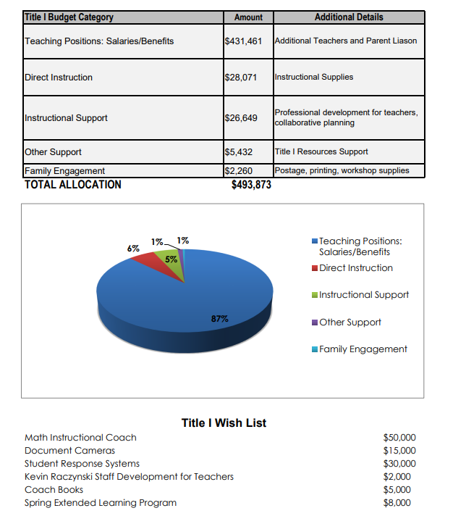
Our School’s Title I Budget and Prioritized Wish List
Families, please add your comments/suggestions to the Local School Planning Meeting Input Form under the section labeled Budget and Prioritized Wish List
Notes:
Insert your school’s Title I initial budget allocation family-friendly template on this slide. Also, provide printed copy of your school’s initial Title I Budget Allocation to your families. Review the allocation for each category and discuss the Title I Wish List. Ask participants to provide input by adding their comments/suggestions into the Local School Planning Meeting Input Form > Budget and Prioritized Wish List.

Slide 18
Staff Training

Slide 19
Building School Staff Capacity - We Need Your Input
Families, what do you think staff members need to know to better assist you in supporting your child’s learning?
Families, please add your comments/suggestions to the Local School Planning Meeting Input Form
Notes:
Parents input here and other opportunities throughout the year help to inform your school’s building staff capacity trainings.

Slide 20
GCPS District Input

Slide 21
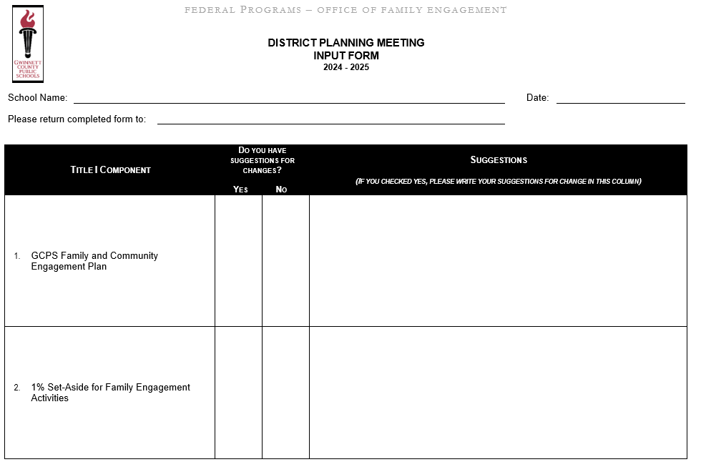
GCPS District Input Form
Notes:
Provide a printed or electronic copy of the GCPS District Input Form to all participants. Please have participants take out this form and have it ready to record their input.

Slide 22
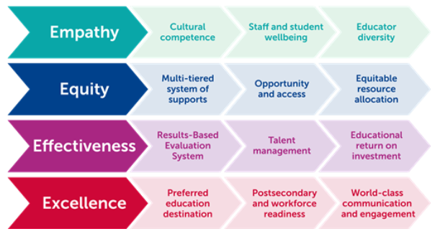
GCPS Blueprint for the Future
Notes:
GCPS Our Blueprint for the Future: Building the Bridge from Empathy to Excellence
https://www.gcpsk12.org/about-us/our-blueprint-for-the-future
The following sections contain the Blueprint strategic planning details. It is organized by the four strategic priorities: empathy, equity, effectiveness, and excellence. Each strategic priority includes three goals, with objectives and district key performance indicators (KPI). KPIs are the way we will measure success for each goal. We initially considered a broad set of potential measures and settled on the final metrics after gathering stakeholder feedback. The 2022 data will be the baseline year for this five-year strategic plan, and each KPI will have annual targets set from 2023 - 2027.
These strategic priorities, goals, and objectives will be the basis of departments and divisions’ operational management plans (OMP). The Blueprint defines the “what” in terms of high-level goals and objectives. The OMPs will detail the “how,” including specific initiatives and action steps that align with this strategic plan. The final plan adopted by the Board in July 2022 includes available baseline data and annual targets for the approved set of KPIs associated with each goal. (Some KPIs will use baseline data collected during the 2022-2023 fiscal year.) District administration will provide regular updates during Board work sessions, sharing the operational progress of individual departments and/or divisions towards the strategic plan priorities, goals, and objectives.
GCPS administration will provide annual reports to share its accomplishments and results compared to yearly targets set for final KPIs in the Blueprint. And the Board has the authority to refine or revise the plan after adoption if they choose to do so.

Slide 23
GCPS Blueprint for the Future – Strategic Plan Summary 2023-2027
Strategic Priority #1: Empathy
Empathy, the ability to understand the feelings of another person and place yourself in their position, is the entry point towards creating a culture where staff and students feel a sense of belonging and safety.
Goal 1.A—Cultural competence.
Increase the cultural competence and proficiency of our organization and individual staff members to improve service delivery, strengthen programs, and enhance engagement across the full spectrum of our diverse community.
Goal 1.B—Staff and student wellbeing.
Promote student and staff wellbeing through prioritizing self-care, physical and mental health, and social emotional learning.
Goal 1.C—Educator diversity.
Develop robust pipelines and support systems to recruit and retain an educator workforce that reflects the diversity of our students and community.
Notes:
.

Slide 24
GCPS Blueprint for the Future – Strategic Plan Summary 2023-2027
Strategic Priority #2: Equity
Board Policy BAAE - Educational Equity charged district administration to “design or redesign systemic programs and initiatives to address and reduce educational inequity, providing students and staff with targeted supports and enrichment that increase opportunities to succeed.”
Goal 2.A—Multi-tiered system of supports.
Implement a comprehensive framework to fully operationalize a multi-tiered system of supports to address academic and non-academic student needs and remove barriers to success.
Goal 2.B—Opportunity and access.
Expand student opportunities to engage in and access high-quality, rigorous, and culturally relevant curriculum, advanced coursework (e.g., Advanced Placement and dual enrollment), and enrichment activities (e.g., the arts, gifted, STEM, career technical education).
Goal 2.C—Equitable resource allocation.
Overhaul resource allocation systems and processes to ensure that each school’s instructional, social emotional, and behavior supports match the unique student and community needs.
Notes:
.

Slide 25
GCPS Blueprint for the Future – Strategic Plan Summary 2023-2027
Strategic Priority #3: Effectiveness
Every system is perfectly designed to get the results that it gets. – W. Edwards Deming This well-known adage is so simple yet profound. In this new era, the district’s challenge is to sustain the legacy of excellent performance while responding to the diverse needs of a growing community.
Goal 3.A—Results-Based Evaluation System.
Redefine the inputs, behaviors, and outcomes that determine the standards for student success as measured by the Results-Based Evaluation System (RBES) to support school improvement and student growth.
Goal 3.B—Talent management.
Transform human resources function into a strategic talent management organization that supports educators and staff to achieve district goals.
Goal 3.C—Educational return on investment.
Measure and report educational return on investment to inform budget and resource allocation decisions and drive continuous improvement.
Notes:
.

Slide 26
GCPS Blueprint for the Future – Strategic Plan Summary 2023-2027
Strategic Priority #4: Excellence
Excellence is not optional. To achieve the GCPS mission and vision, excellence is the standard. This strategic priority continues a long-standing ethos in the district to be a world-class organization in service to students and families.
Goal 4.A—Preferred education destination.
Be the first choice of students and families for excellent schools and the employer of choice for educators and staff to fulfill their careers.
Goal 4.B—Post-secondary and workforce readiness.
Prepare each and every student for postsecondary and workforce readiness so that they have multiple pathways to success based on their demonstrated knowledge, skills, abilities, and interests.
Goal 4.C—World-class communication and engagement.
Demonstrate world-class communication and engagement through modeling the value GCPS leadership places on transparent, two-way communication to build stakeholder trust and confidence.
Notes:
.

Slide 27
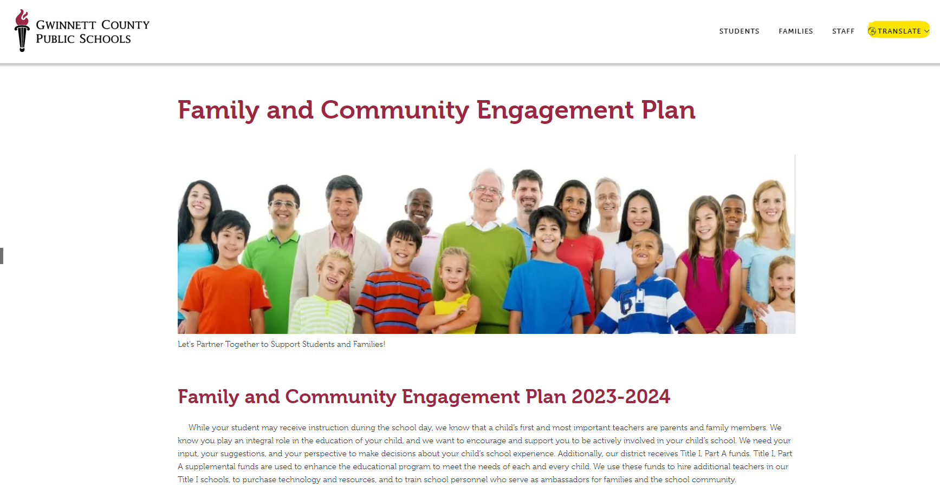
GCPS Family and Community Engagement Plan
GCPS Family and Community Engagement Plan Video (English)
GCPS Family and Community Engagement Plan Video (Spanish)
GCPS Family and Community Engagement Plan (Written Document)
Notes:
Play the GCPS Family and Community Engagement Plan Video. English and Spanish video links available on the slide.
Explain to the participants they can access the GCPS Family and Community Engagement Plan document on the GCPS website: https://www.gcpsk12.org/about-us/divisions-and-teams/school-improvement-and-operations/federal-programs/family-and-community-engagement-plan
Families can translate the FACE Plan written document into the language of their choice by using the Translate feature available on the GCPS website.

Slide 28
GCPS District Input Form
Notes:
Please have participants take out this form and record their input:
GCPS Family and Community Engagement Plan
1% Set Aside for FE Activities

Slide 29
GCPS Family and Community Engagement Plan
Work with families, parents, teachers, school staff and community members to develop a Family and Community Engagement Plan.
Office of Federal Programs provides support to all Title I schools.
Survey families for content and effectiveness of Family and Community Engagement Plan.
Collaborate with federal, state and local programs.
Building Capacity of Parents
Building Capacity of School Staff
Families, please add your comments/suggestions to the District Planning Meeting Input Form
Notes:
After reviewing information about the GCPS Family Engagement Plan, invite families to provide input and capture it on the District Planning Meeting Input Form > GCPS Family and Community Engagement Plan.
GCPS Family and Community Engagement Plan is jointly Developed = Work with families, parents, teachers, school staff and community members to develop a Family and Community Engagement Plan.
Monthly Board Meetings
Local School Councils
Parent Advisory Committee (PAC) Meetings
Local School Title I Planning Meeting
Technical Assistance = Office of Federal Programs provides support to all Title I schools.
Ongoing guidance
Regular monitoring
Annual Evaluation = Survey families for content and effectiveness of Family and Community Engagement Plan.
EES Survey
Results are used to make improvements in our schools
Coordination of Services = Collaborate with federal, state and local programs.
Work with public pre-school programs to promote kindergarten transition.
Offer Play 2 Learn in all GCPS elementary schools to promote school readiness.
All Title I schools provide entry transition workshops.
High schools assist students with exit transition.
Partnership with Gwinnett Tech for adult ESL and GED classes.
Building Capacity of Parents = To assist families in supporting their child’s learning, we provide:
Family Engagement Centers with a designated Parent Instructional Coordinator and/or Parent Outreach Liaison
Resources for check out
Information about curriculum, assessments, promotion and graduation requirements, progress monitoring
Workshops on use of technology and academic strategies to support student learning
Opportunities for parents to participate in decision making
Support to families as students transition from one level to the next
Academic Parent Teacher Teams (APTT) at some GCPS schools.
Building Capacity of School Staff = All schools must provide training for the faculty and staff to ensure more effective partnerships with parents. Parents assist in this training by providing input throughout the year. Topics include:
Working with parents as equal partners, building relationships, and effectively communicating with our families
The value and contributions of parents
Implementing the family engagement program at each school

Slide 30
1% Family Engagement Set-aside
Title I Family Engagement Budget:
1% of the GCPS Title I budget supports family engagement and is equally divided to all Title I schools to partially fund a Parent Instructional Coordinator and/or a Parent Outreach Liaison and/or to fund family engagement at schools.
Other suggestions?
Families, please add your comments/suggestions to the District Planning Meeting Input Form
Notes:
Reservation of funds =
Reserve at least one percent of the district’s total allocation to fund family and community engagement programs. No less than 90% of these reserved funds are used directly by schools to promote family and community engagement activities.
Family Engagement funds are used to support:
A Family Engagement Center and a designated person (Parent Instructional Coordinator and/or a Parent Outreach Liaison) to support parents at each school.
The Family Engagement Center offers resources and activities to help families support their child’s learning.

Slide 31
Save the Date! Title I Document Review Period
May 8 – May 15
10 am – 2pm
Parent Center
Families, please share this information with other families you know who were unable to attend the Title I Planning Meeting.
We need their input!
Notes:
Please announce the Title I Document Review Period dates, times and method (in local school or online). This is an opportunity for people who were unable to attend the Title I Planning Meeting to provide input. Ask meeting attendees to share this information with people they know who were unable to attend the meeting. Post the Title I Planning meeting documents and input forms on your website AND/OR have them available in the Family Engagement Center for review.
Title I Draft Document Review documents:
LSPI Goals
Title I Family Engagement Plan…Promise
Title I Budget and Wish List
Local School Input Form

