Slide 1
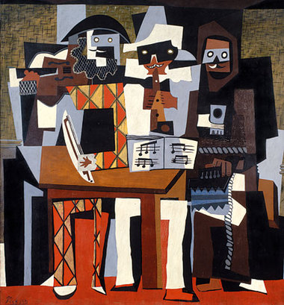
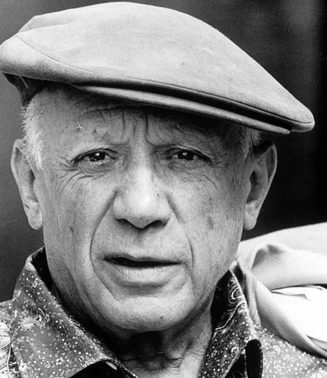
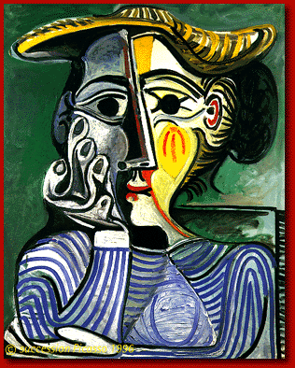
Pablo Picasso
Three Musicians
Over the Clouds
1881 – 1973

Slide 2
Pablo Picasso
(1881–1973), one of the best known Spanish artists of the twentieth century, had productive career
creating art in a wide range of styles and forms. He showed remarkable artistic talent as a child and had his first exhibition when he was 13 years old. Three Musicians is an example of Picasso’s painting style, known as “cubism.”

Slide 3
To talk about activities
Bailar :
to dance
Cantar :
to sing
Correr :
to run
Dibujar :
to draw
Escribir cuentos/historias :
to write stories
Escuchar música :
to listen to music
Esquiar :
to ski
Hablar por teléfono :
to talk on the phone
Ir a la escuela:
to go to school
Jugar videojuegos :
to play video games
Leer revistas:
to read magazines
Montar en bicicleta:
to ride a bicycle

Slide 4
To talk about activities
Montar en monopatín:
to skateboard
Nadar:
to swim
Pasar tiempo con amigos
to spend time with friends
Patinar:
to skate
Practicar deportes:
to play sports
Tocar la guitarra:
to play the guitar
Trabajar:
to work
Usar la computadora:
to use the computer
Ver la tele:
to watch television

Slide 5
To say what you like to do
(A mí) me gusta ___:
I like to_________ .
(A mí) me gusta más___:
I like to__better. (I prefer to__)
(A mí) me gusta mucho___:
I like to ____a lot.
A mí también:
I do too.
To say what you don’t like to do
(A mí) no me gusta ___:
I don’t like to_______ .
(A mí) no me gusta nada___:
I don’t like to___ at all.
A mí tampoco:
I don’t (like to) either.

Slide 6
To ask others what they like to do
¿Qué te gusta hacer? What do you like to do?
¿Qué te gusta más? What do you like (prefer) better?
¿Te gusta _____ ?: Do you like to___ ?
¿Y a ti? And you?
Other useful words and expressions
Ni . . . ni : neither . . . nor, not . . . or
O: or
Pues . . . well . . .
Sí: yes
También: also, too
Y: and

Slide 7
Infinitives
Verbs are words that are most often used to name actions. Verbs in English have different forms depending on who is doing
the action or when the action is occurring:
I walk, she walks, we walked, etc.
The most basic form of a verb is called the infinitive. In English, you can spot infinitives because they usually have the word “to” in front of them: to swim, to read, to write
Infinitives in Spanish, though, don’t have a separate word like “to” in front of them.
Spanish infinitives are only one word, and always end in -ar, -er, or -ir: nadar, leer, escribir

Slide 8
Infinitives
Bailar : to dance
Cantar : to sing
Correr : to run
Dibujar : to draw
Escribir : to write
Escuchar : to listen
Esquiar : to ski
Hablar : to talk
Ir : to go
Jugar : to play
Leer : to read
Montar : to ride

