Slide 1
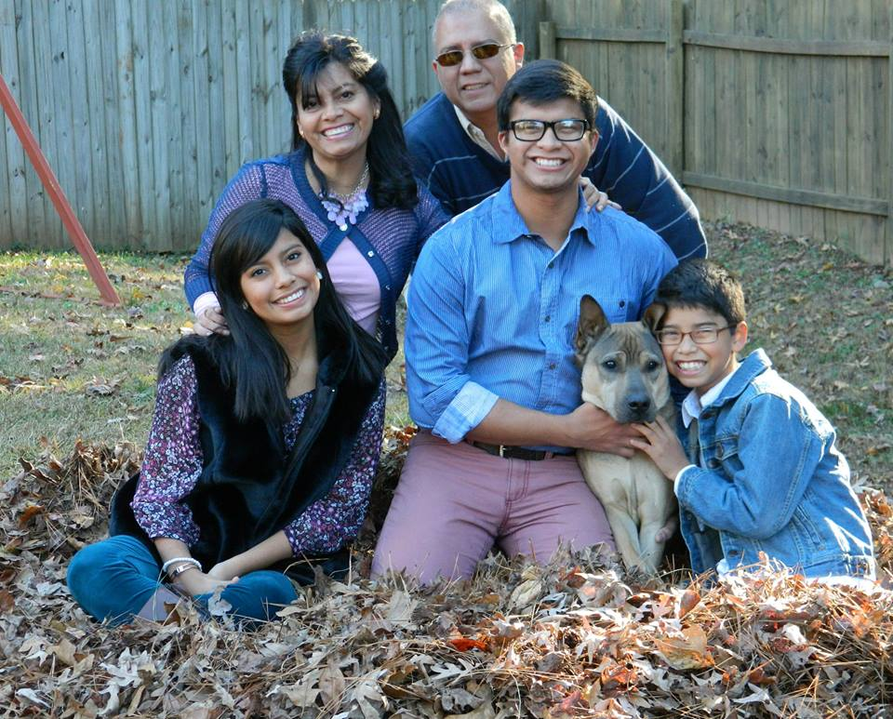
La familia: family
Yo: I
Tú: you
Él: he
Ella: she

Slide 2
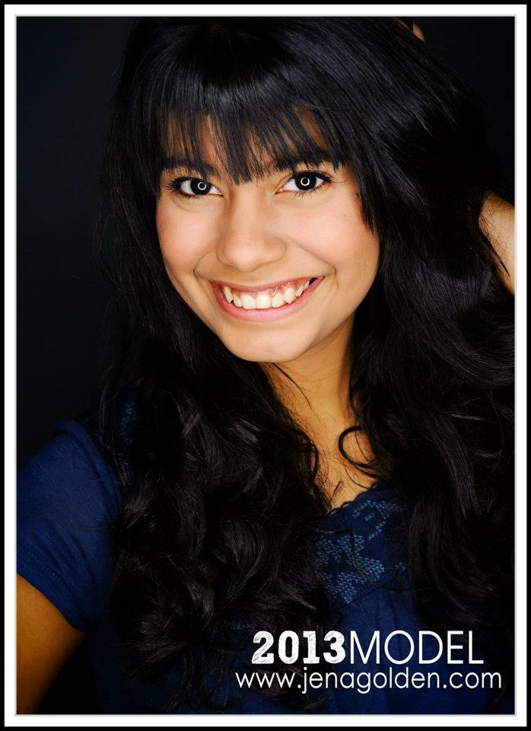
Yo soy: I am
Tú eres: You are
Él es: He is
Ella es: She is

Slide 3
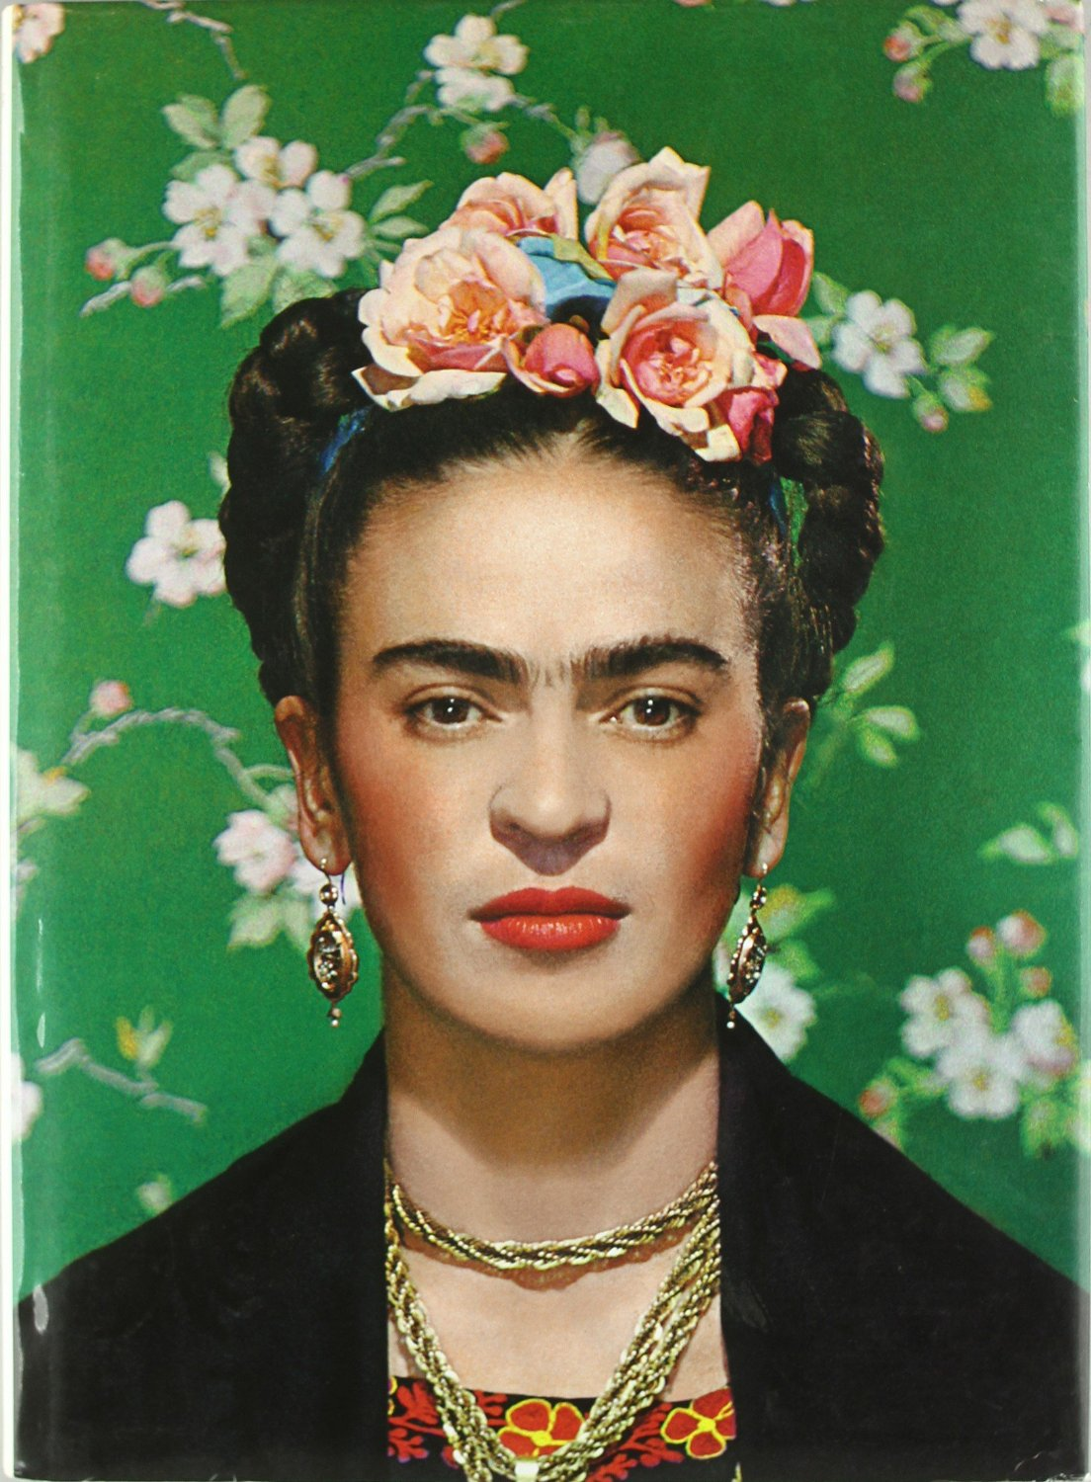
Frida Kahlo (1907–1954) is one of the best known Mexican painters. In spite of a
childhood illness, a crippling traffic accident, and many hospital stays throughout her life, Kahlo was a successful
painter and led a very active social life. She used her artwork as an outlet for her physical and emotional suffering.

Slide 4
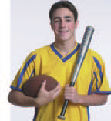
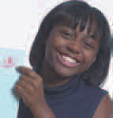
To tell whom you are talking about
El amigo: male friend
El chico: boy
La amiga female friend
La chica: girl

Slide 5
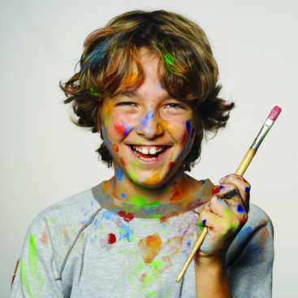
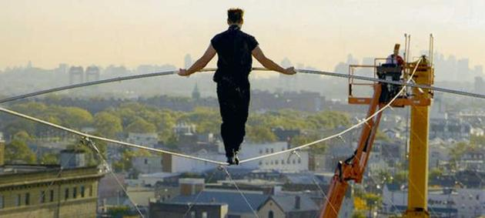
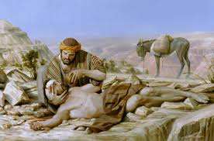
Adjetivos -Adjectives
Artístico, -a: Artistic
Atrevido, -a: Daring
Bueno, -a: Good

Slide 6
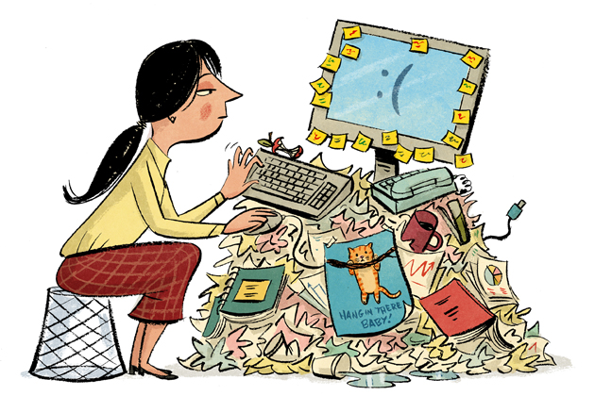
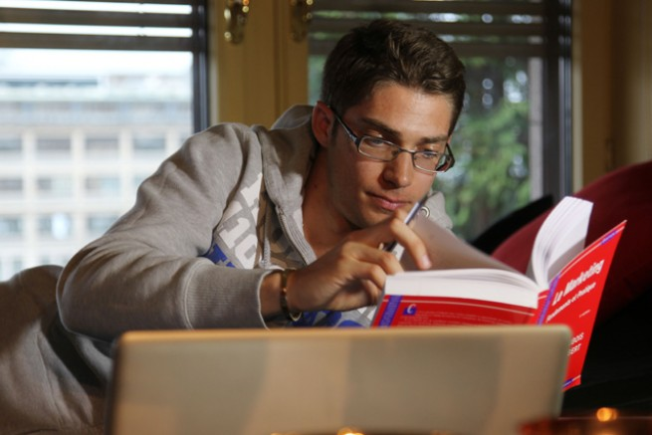
Adjetivos -Adjectives
Deportista: Sports-minded
Desordenado, -a: Messy
Estudioso, -a: Studious

Slide 7
Adjetivos -Adjectives
Impaciente: Impatient
Ordenado, a: Neat
Inteligente: Intelligent

Slide 8
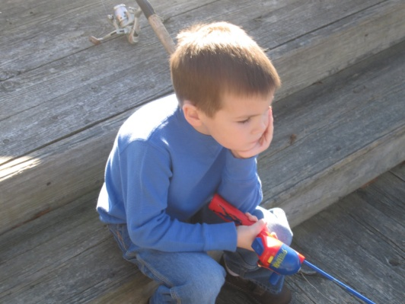
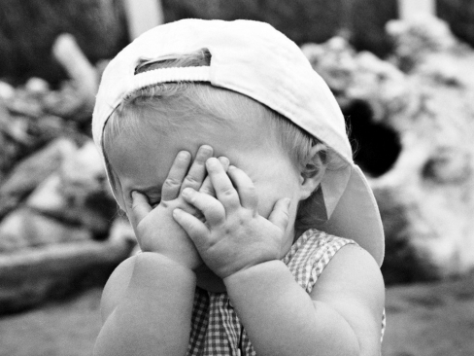
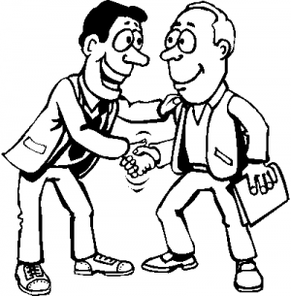
Adjetivos -Adjectives
Paciente: Patient
Reservado, a: Shy
Tímido, a
Simpático, a: Nice, friendly

Slide 9
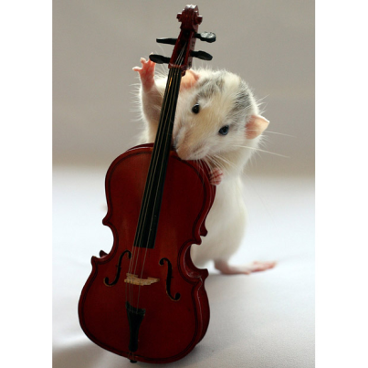
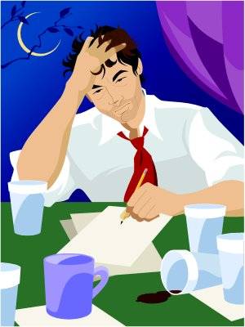
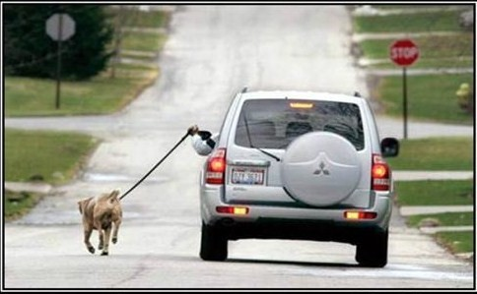
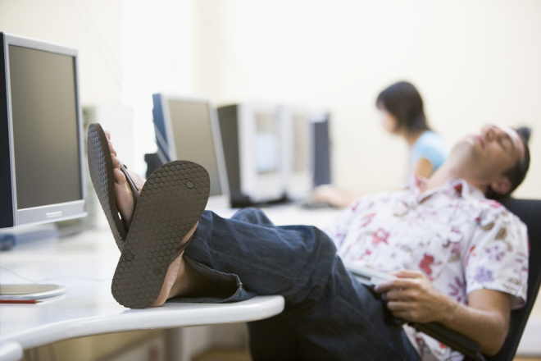
Adjetivos -Adjectives
Talentoso, a: Talented
Trabajador, a: Hardworking
Perezoso, a: Lazy

Slide 10
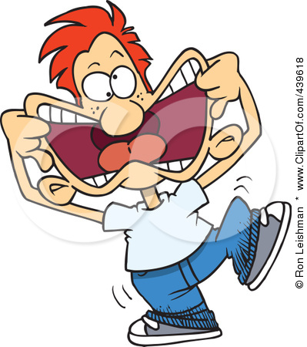
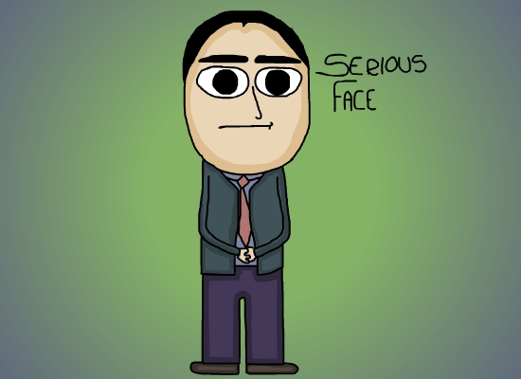
Adjetivos -Adjectives
Gracioso, -a: funny
Serio, -a: serious
Sociable: sociable

Slide 11
Adjetivos -Adjectives

Slide 12
Adjetivos -Adjectives

Slide 13
Adjetivos -Adjectives

Slide 14
Adjetivos -Adjectives

Slide 15
Adjetivos -Adjectives

Slide 16
Adjetivos -Adjectives

Slide 17
Adjetivos -Adjectives

Slide 18
Adjetivos -Adjectives

Slide 19
Adjetivos -Adjectives

Slide 20
Adjetivos -Adjectives

Slide 21
Adjetivos -Adjectives

Slide 22
Adjetivos -Adjectives

Slide 23
Adjetivos -Adjectives

Slide 24
Adjetivos -Adjectives

Slide 25
Adjetivos -Adjectives

Slide 26
To ask people about themselves or others
¿Cómo eres? What are you like?
¿Cómo es? What is he / she like?
¿Cómo se llama? What’s his / her name?
¿Eres . . . ? Are you . . . ?
To describe someone
Soy: I am
No soy: I am not
Es: he / she is
No es: he/she is not

Slide 27
To talk about what someone likes or doesn’t like
Le gusta . . . he / she likes . . .
No le gusta . . . he / she doesn’t like . . .
Other useful words
A veces: sometimes
Muy: very
Pero: but
Según: according to
Según mi familia: according to my family

Slide 28
Artículos: Articles
Artículos definidos: Definite articles
El the (m,s)
La the (f,s)
Los the (m,p)
Las the (f,p)
Artículos indefinidos: Indefinite articles
Un a, an (m,s)
Una a, an (f,s)

Slide 29
Word order: Placement of adjectives
In Spanish, adjectives usually come after the noun they describe. Notice how artística follows chica in the Spanish sentence.
Margarita es una chica artística.
Margarita is an artistic girl.
In the English sentence the adjective comes before the noun. Here’s a pattern you can follow when writing a sentence in Spanish:
Subject + Verb + Indefinite Article + Noun + Adjective

Slide 30
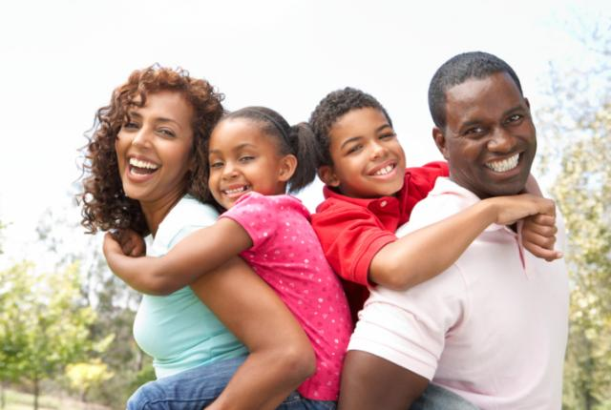
La familia: family

Slide 31
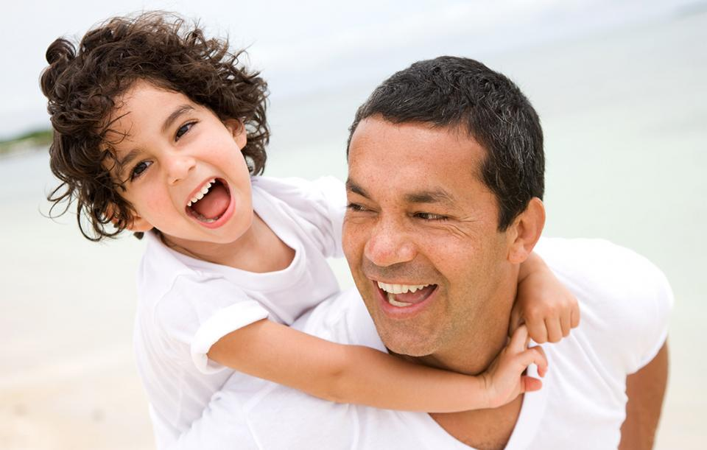
El Padre
Father
El Papá
Dad

Slide 32
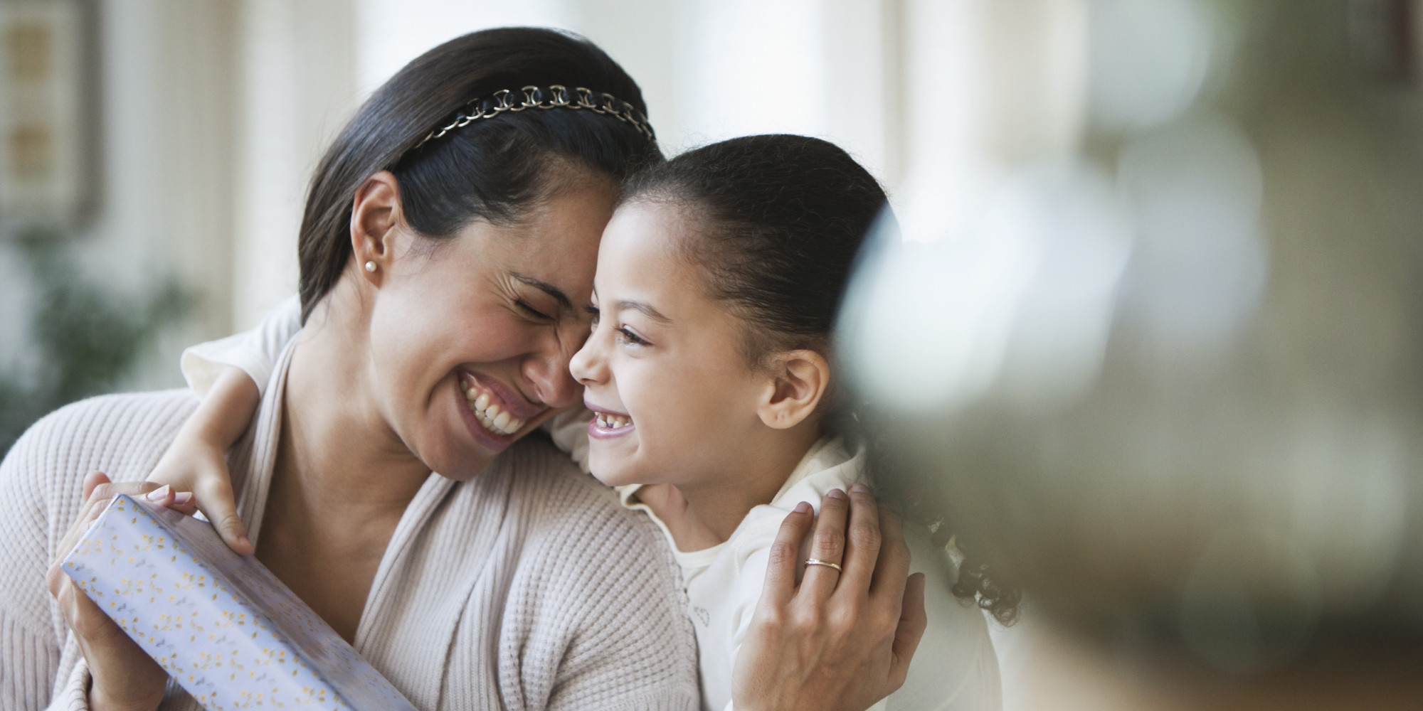
La Madre
Mother
La mamá
Mom

Slide 33
El hijo
son

Slide 34
La hija
Daughter

Slide 35
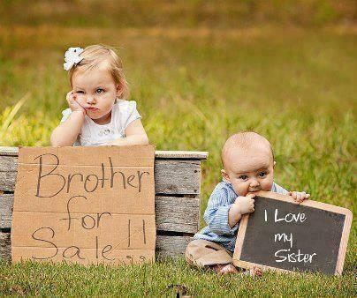
El hermano
Brother
La hermana
Sister

