Slide 1
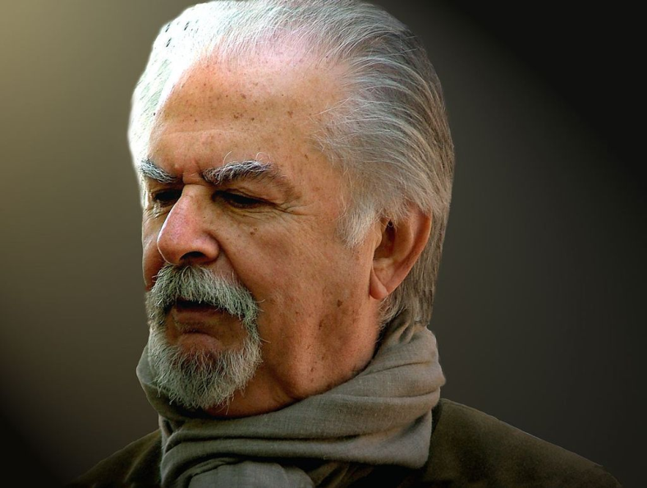
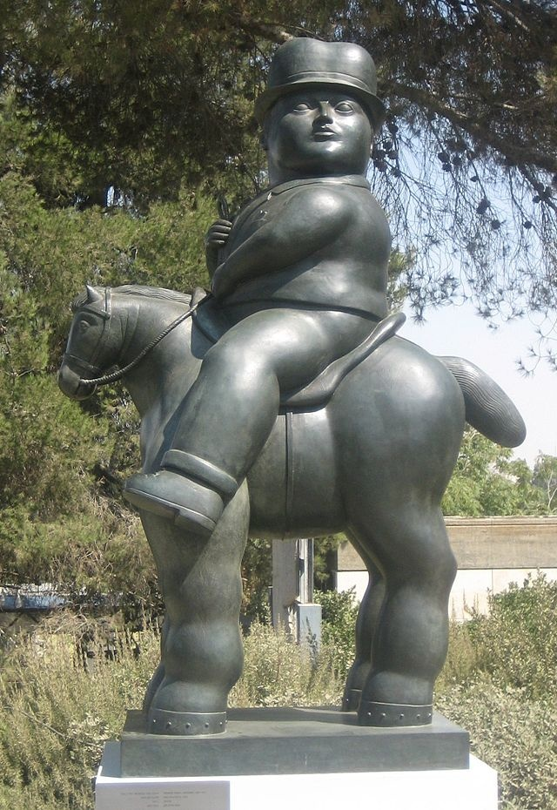
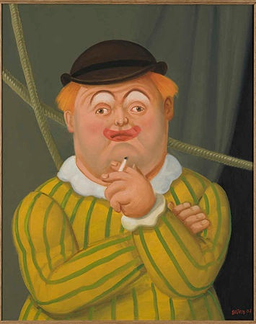
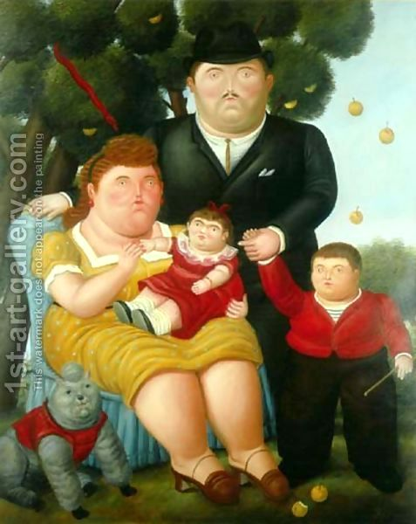
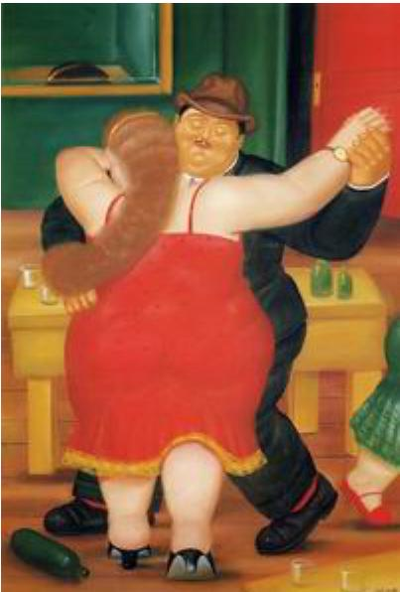
Fernando Botero

Slide 2
Fernando Botero
Fernando Botero (born 19 April 1932) is a figurative artist and sculptor from Colombia.
His signature style, also known as "Boterismo", depicts people and figures in large, exaggerated volume. He is considered the most recognized living artist from Latin America

Slide 3
To talk about your school day
El almuerzo: lunch
La clase: class
Arte: art
Español : Spanish
Ciencias naturales : science
Ciencias sociales : social studies
Educación física: physical education
Inglés: English
Matemáticas : mathematics
Tecnología: technology/computers

Slide 4
To describe school activities
El horario : schedule
En la . . . hora: in the . . . hour (class period)
La tarea: homework
Enseñar to teach
Estudiar to study
Hablar to talk
(yo) tengo I have
(tú) tienes you have

Slide 5
To talk about order of things
Primero*, -a: first
Segundo, -a: second
Tercero*, -a: third
Cuarto, -a: fourth
Quinto, -a: fifth
Sexto, -a: sixth
Séptimo, -a: seventh
Octavo, -a: eighth
Noveno, -a: ninth
Décimo, -a: tenth
*Changes to “primer”, “tercer” before a masculine singular noun.

Slide 6
To talk about things you need for school
La calculadora calculator
La carpeta de argollas three-ring binder
El diccionario dictionary
Mucho a lot
Tengo I have
Tienes you have
Necesito I need
Necesitas you need

Slide 7
To describe your classes
Aburrido, -a: boring
Difícil: difficult
Divertido, -a: amusing, fun
Fácil: easy
Favorito, -a: favorite
Interesante: interesting
Práctico, -a: practical
Más . . . Que: more . . . Than
A ver . . .: let’s see
¿Quién? Who?
Para: for

Slide 8
Subject pronouns in Spanish Pronombres Personales en español
PERSON
PERSON
S
I
N
G
U
L
A
R
1ST
1ST
P
L
U
R
A
L
2ND
2ND
3RD
3RD

Slide 9
Pronombres Personales: Subject Pronouns
Yo I (masc./fem.)
Tú you (informal)
Usted (Ud.) you (formal)
Él he
Ella she
Nosotras we (fem.)
Nosotros we (masc.)
Vosotros you (masc.) used in Spain only
Vosotras you (fem.) used in Spain only
Ustedes (Uds.) you (plural, fem. & masc.)
Ellos they (masc.)
Ellas they (fem.)

Slide 10
Personal pronouns in Spanish Pronombres Personales en español
Tú, usted, ustedes, and vosotros(as) all mean “you.”
Use tú with family, friends, people your age or younger, and anyone you call by his or her first name.
Use usted with adults you address with a title, such as señor, señora, profesor(a), etc.
In Latin America, use ustedes when speaking to two or more people,regardless of age.

Slide 11
Personal pronouns in Spanish Pronombres Personales en español
In Spain, use vosotros(as) when speaking to two or more people you call tú individually: tú + tú = vosotros(as). Or when talking to two or more people you call usted individually.
If a group is made up of males only or of both males and females together, use the masculine forms: nosotros, vosotros, ellos.
If a group is all females, use the feminine forms: nosotras, vosotras, ellas.

Slide 12
Pronombres Personales: Subject Pronouns
Yo I (masc./fem.)
Tú you (informal)
Usted (Ud.) you (formal)
Él he
Ella she
Nosotras we (fem.)
Nosotros we (masc.)
Vosotros you (masc.) used in Spain only
Vosotras you (fem.) used in Spain only
Ustedes (Uds.) you (plural, fem. & masc.)
Ellos they (masc.)
Ellas they (fem.)

Slide 14
How to conjugate a verb in Spanish?
1st Almost each personal pronoun has its own conjugation.
2nd The difference between each conjugation is the ending.
3rd The ending of the conjugation varies depending on the infinitive ending verb.
4th The conjugation endings for “ar” infinitive endings verbs are:
The ending for “Yo” is:
o
The ending for “Tú” is:
as
The ending for “Él, Ella and usted” is:
a
The ending for “Nosotros and nosotras” is:
amos
The ending for “Ustedes ellos and ellas” is:
an

Slide 15
If we are conjugating to teach: enseñar
For I teach, we will put together the stem: enseñ + the ending o
And we get…
Yo enseño
For You teach, we will put together the stem: enseñ + the ending as
And we get…
Tú enseñas
For He or she teaches and you teach (formal):
we have: Él, ella or usted enseña
for we teach, we’ll have:
Nosotros or nosotras enseñamos
And for you teach (plural) and they teach
Ustedes, ellos, ellas enseñan

