Slide 1

Steps to achieving your eligibility

Slide 2
START EARLY!!
Grades 11 & 12
Students should work with their counselor to make sure they are on track to graduate on time.
Register with the NCAA Eligibility Center at www.eligibilitycenter.org. Cost is $80. Fee waivers are available for eligible students.
Students should register to take the ACT, SAT or both. Use the NCAA Eligibility Center code “9999” as a score recipient.
At the end of the year, official transcripts are submitted for all 11th and 12th graders registered with the NCAA Eligibility Center. Transcript releases are available in School Counseling
Grades 9 & 10:
Prepare now by working hard to earn the best grades possible.
Make sure you are taking NCAA-approved courses.
Your school’s list of NCAA courses can be found at: www.eligibilitycenter.org
Notes:
Mention waiver eligibility

Slide 3
What are the academic requirements?
Graduate from high school.
Complete 16 NCAA approved courses. (10 of these must be completed by the end of Junior year and 7 must be in math, english or science )
Earn a minimum required core course grade- point average (GPA).
Achieve the required SAT or ACT sum score.

Slide 4
Division I
Core-Course Requirements
16 Core Courses
4 years of English
3 years of math (Algebra/Math I or higher)
2 years of natural/physical science
2 years of social science
1 year additional English, math, or science
4 years additional academic courses (can include world language)

Slide 5
What is the “Core Course GPA”?
Students earn credit for each course passed. Quality points are also given for the grade earned in the course.
Total points earned ÷ Total credits =
Core GPA
Core Course | Grade | Quality Pts | Credit | GPA
English I | A | 4 | 1 | 4
Earth Science | B | 3 | 1 | 3
Sociology | C | 2 | 0.5 | 1
Honors World History | C | 2 | 1 | 2
 |  | 11.0 | 3.5 | 3.142
Notes:
Electives and non-approved courses (Essentials of College Math) cannot be used for core GPA calculation.

Slide 6
Sample Sliding Scale for
Division I Athletics Aid
*Academic Redshirt – Under 2.3. You may receive a scholarship and may practice but you may NOT compete during your first year of enrollment
Core GPA | SAT (Reading/ Math only) | ACT Sum Score
3.50 | 430 | 39
3.00 | 720 | 52
2.75 | 810 | 59
2.60 | 860 | 64
2.50 | 900 | 68
2.30 | 980 | 75
2.299* | 990 | 76
2.100* | 1060 | 83
2.000* | 1100 | 86
The full sliding
scale can be found
at eligibilitycenter.org
Click on “Help”, then Resources.

Slide 7
NCAA Division I Initial-Eligibility
Academic Requirements
There are three possible academic outcomes:
Qualifier = competition, athletics aid (scholarship), and practice the first year
Academic Redshirt = athletics aid the first year, practice in first regular academic term (semester or quarter). Not eligible for competition the first year.
Nonqualifier = no athletics aid, practice or competition the first year.

Slide 8
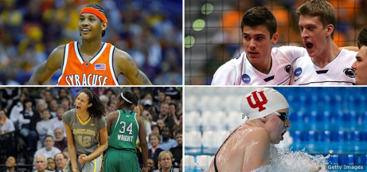
NCAA Division I
Requirements
For Full Qualifier:
Minimum GPA of 2.300 in those 16 core courses
Earn the SAT (math and critical reading) or ACT sum score matching the Division I sliding scale.
Graduate high school on time.
For Academic Redshirt:
Core-course GPA of 2.00 – 2.29
Earn the SAT (math and critical reading) or ACT sum score matching the GPA on the Division I sliding scale.
Graduate high school on time.

Slide 9
What If You Do Not Meet Either Set of Requirements?
If you do not meet either set of requirements, you are a nonqualifier.
A nonqualifier:
Cannot receive athletics aid during the first year at an NCAA Division I school
Cannot practice or compete during the first year at a Division I school.

Slide 10





What about Division II?

Slide 11
Division II
Core-Course Requirements
16 Core Courses
3 years of English
2 years of Math (Algebra I/Math I or higher)
2 years of Natural/Physical science
3 additional years of English/Math/Science
2 years of Social Science
4 years of additional academic courses (can include world language)

Slide 12
New NCAA Division II Competition
Academic Requirements
Full Qualifier: A student-athlete will be allowed to compete and receive athletic aid during their first year of enrollment if he or she…
Completes the required 16 core courses.
Earns a minimum 2.20 GPA or better in your core courses.
Earns a Minimum SAT or ACT score that matches the 16 core course GPA on the full qualifier sliding scale.
Partial Qualifier: A student-athlete will be allowed to practice (but not compete) and receive athletic aid in first academic year if he or she:
Completes the required 16 core courses; and
Has a minimum GPA of 2.000 with corresponding test score on the partial qualifier sliding scale.

Slide 13
Division III Core-Course Requirements
Unlike Divisions I and II, there is no uniform set of eligibility requirements for Division III schools.
Division III schools do not offer athletic scholarships, and set their own standards for admission, financial aid, practice and competition.
The NCAA Eligibility Center does not perform certifications for Division III college-bound student-athletes, however, you are able to create a “student profile page” on the Eligibility Center website.
Notes:
Student Profile Page can be converted to a Certification Page

Slide 14
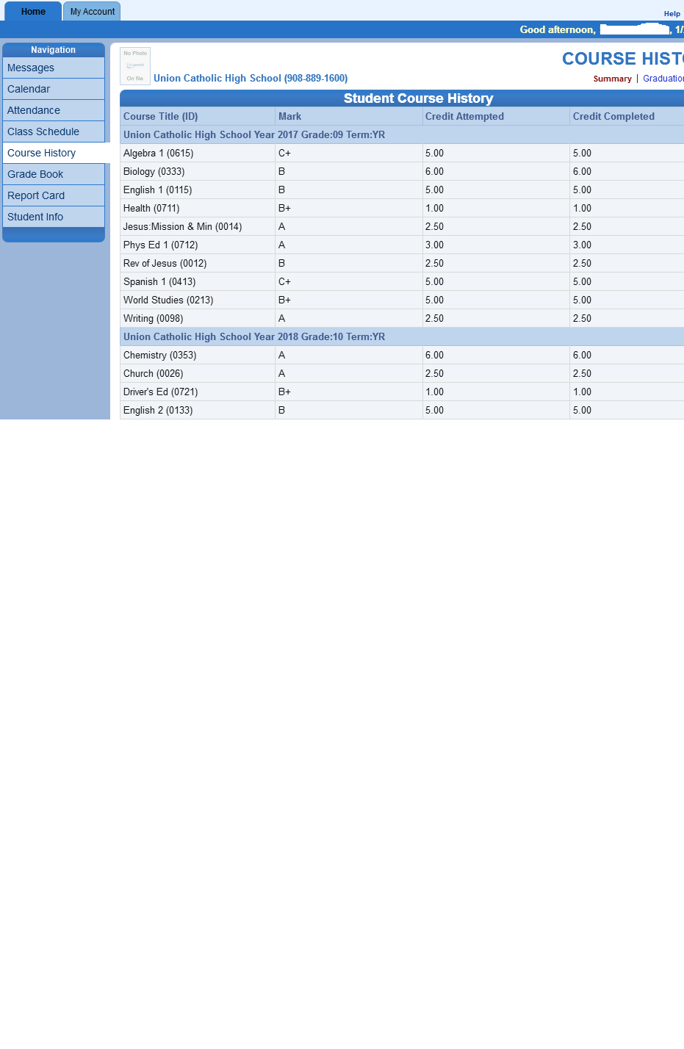

Slide 15
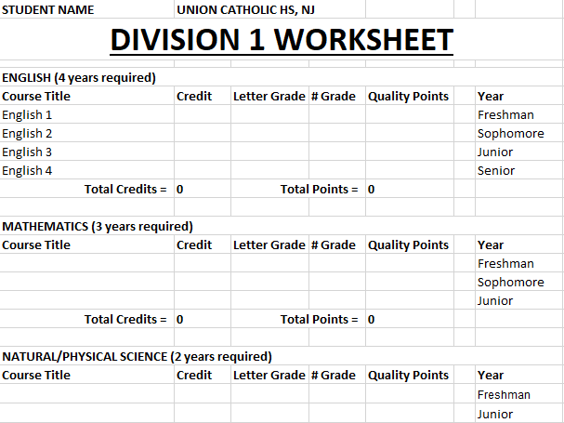

Slide 16
For more information:
Contact the UC School Counseling or Athletic Office
Visit the NCAA eligibility website @
www. eligibilitycenter.org

