Slide 1
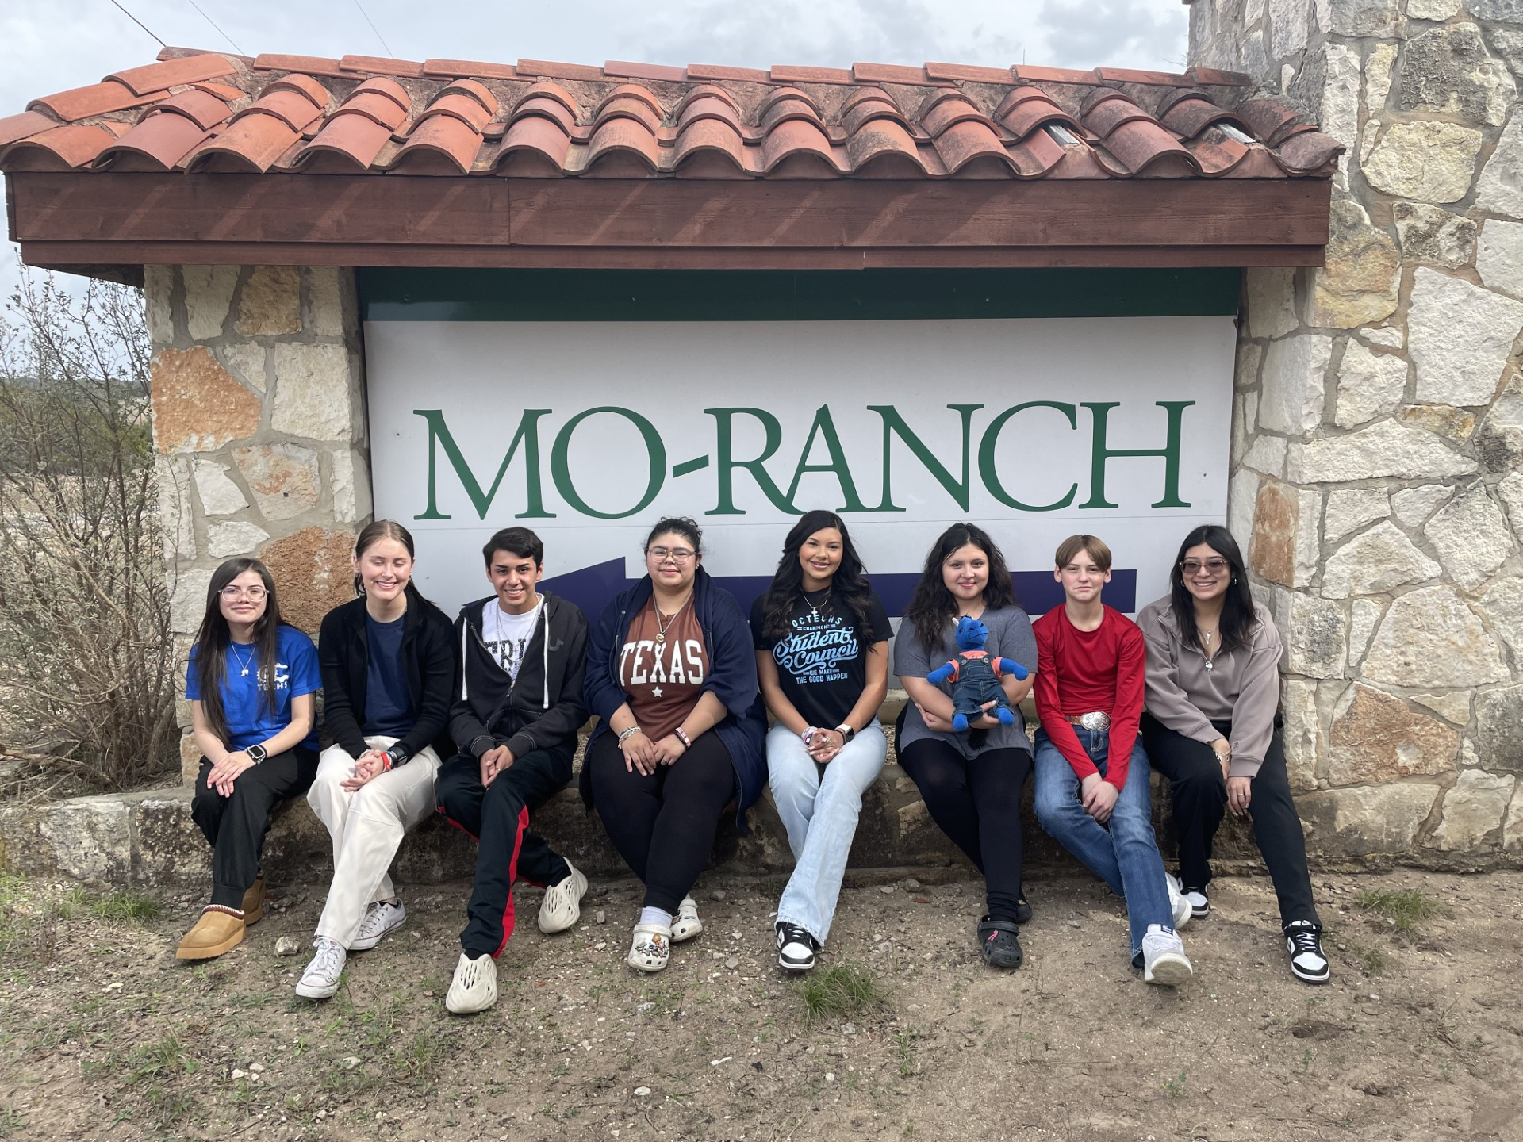
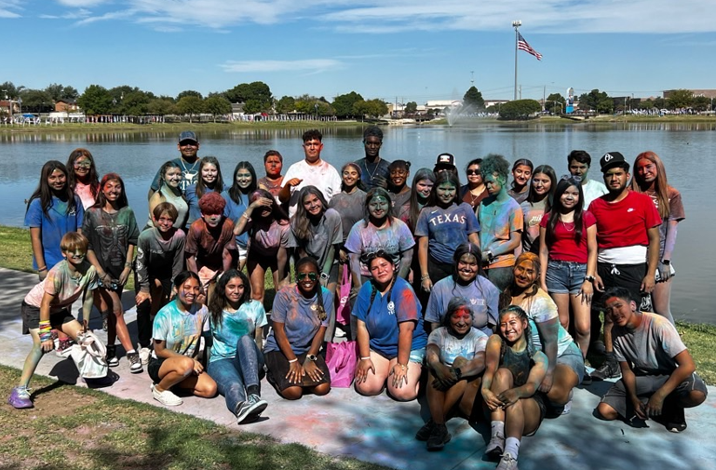
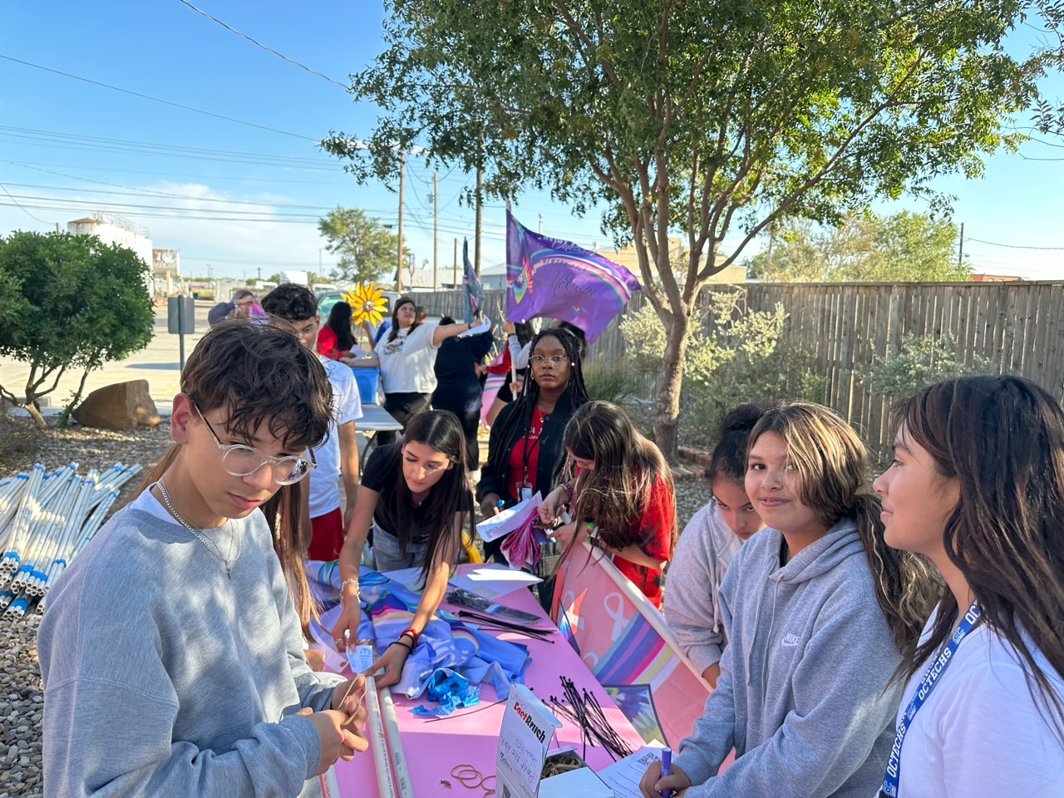
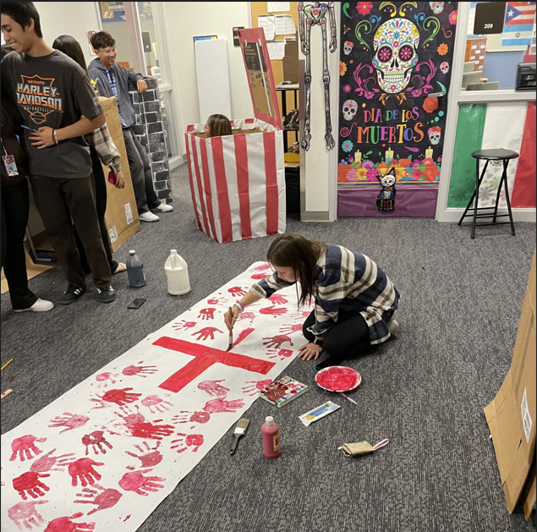
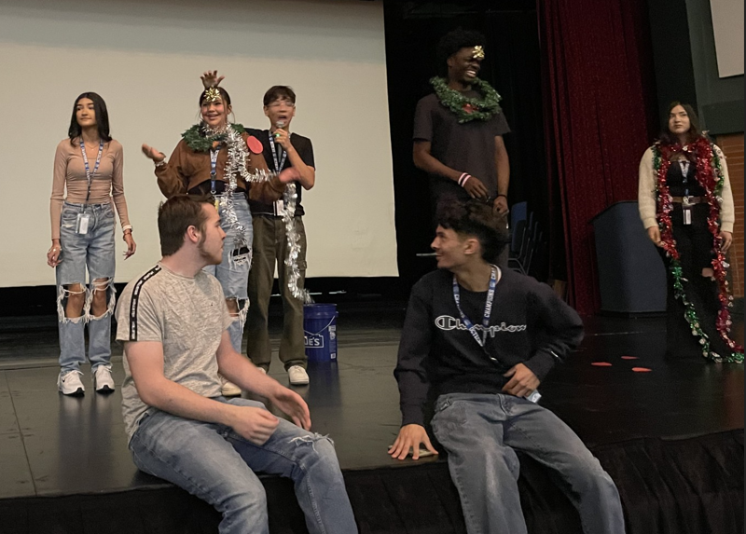

WELCOME TO
OCTECHS
Odessa Career & Technical Early College High School 456-6409

Slide 2
CORE VALUES
RESPECT
RESPONSIBILITY
INITIATIVE
PRIDE
HONESTY
INTEGRITY

Slide 3
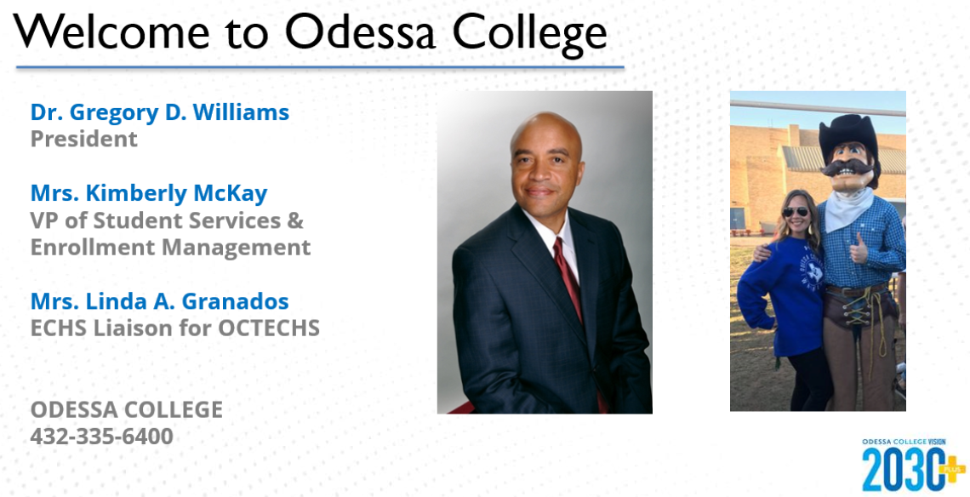

Slide 4
CYNTHIA (CINDY) LANE
cynthia.lane@ectorcountyisd.org
432-456-6403
Campus Contact Number:
432-456-6409

Slide 5



  UNDERSTANDING YOUR FEELINGS
  RECOGNIZING YOUR STRENGTHS
  MAKING NEW FRIENDS
  HOW IS SCHOOL GOING?
  HOW IS EVERYTHING GOING AT HOME?
  DEVELOPING NEW SKILLS TO BE GREAT COMMUNITY HELPERS
What is a
School Counselor?
A SCHOOL COUNSELOR IS A SAFE PERSON YOU CAN TALK TO AT SCHOOL.
  FEELINGS
  FRIENDSHIPS
  CONFLICT RESOLUTIONS
  COPING SKILLS
  STRESS
  GOAL SETTINGS
AND MUCH MORE
A SCHOOL COUNSELOR WILL VISIT YOUR CLASS AND TEACH YOU ABOUT:
A SCHOOL COUNSELOR WORKS WITH STUDENTS ONE- TO-ONE OR IN A GROUP SETTING. THINGS WE WILL LEARN:

Slide 6


Slide 7

We are trying something new this year with open communication between Odessa College teachers and OCTECHS students/Parents.
By filling out and submitting this form, you are giving the college permission to speak directly with you regarding the progress or lack of progress, that may happen with your child.
We believe it works best if you, your son/daughter and their teacher are able to speak freely with each other about progress and success!
Scan the QR Code.
Student will need to complete the form giving parent/guardian access to college academic record.
The student will need to submit by the student’s college email to RECORDS@Odessa.edu or you can print it out and deliver to Wrangler Express in the Saulsbury Campus Center.
OC WEBSITE : https://www.odessa.edu/current-students/documents/
pdfs/FERPA_GRANT%20Access%20to%20Student%20Records.pdf

Slide 8
Estamos intentando algo nuevo este año con una comunicación abierta entre los profesores de Odessa College y los estudiantes/padres de OCTECHS.
Al completar y enviar este formulario, le está dando permiso al colegio para hablar directamente con usted sobre el progreso o la falta de progreso que pueda suceder con su hijo.
¡Creemos que funciona mejor si usted, su hijo/hija y su maestro pueden hablar libremente entre sí sobre el progreso y el éxito!
Escanee el código QR.
Su estudiante necesita completar el formulario dándole acceso a los récords académicos del colegio a usted como padre o guardián.
Su estudiante necesitara enviar el formulario usando su correo electrónico de colegio de estudiante a RECORDS@Odessa.edu o imprimir y llevar a el Departamento de Récords localizado en el Wrangler Express en el Saulsbury Campus Center.
Pagina de OC : https://www.odessa.edu/current-students/documents/
pdfs/FERPA_GRANT%20Access%20to%20Student%20Records.pdf

Slide 9
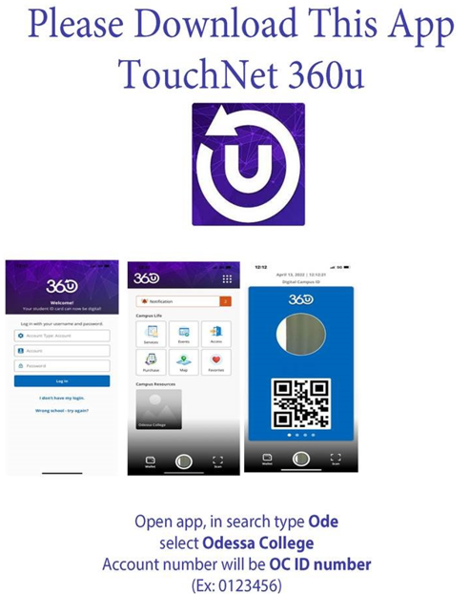
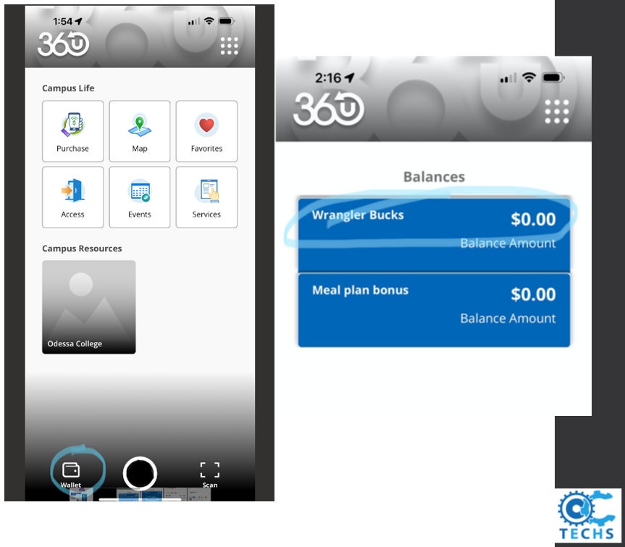
Default Password will be:
OCoc!!_ _ _ _ !!
Last 4 digits of your SSN.
ex. OCoc!!5678!!

Slide 10
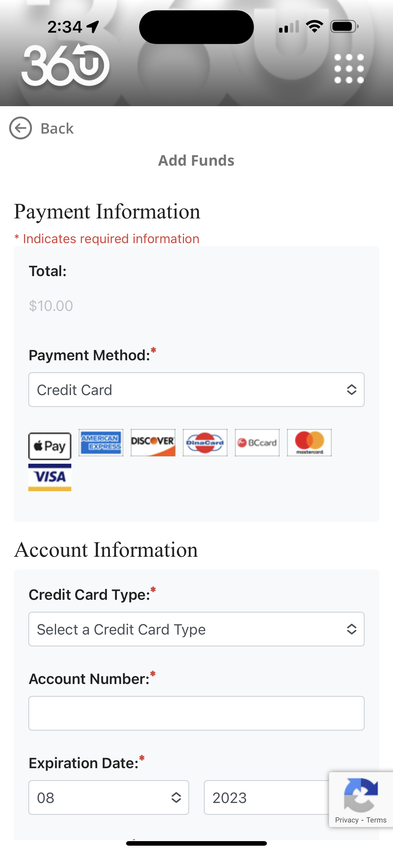
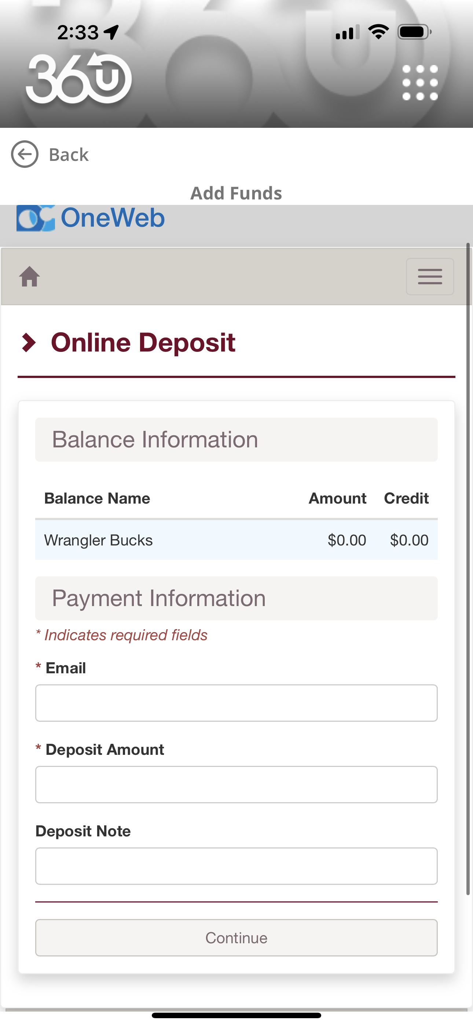
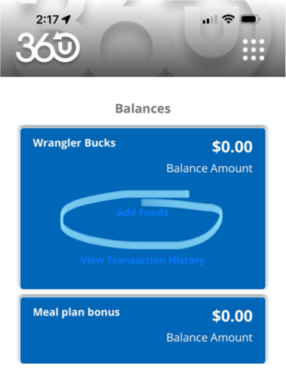

Slide 11
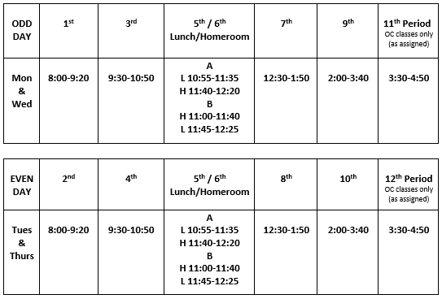

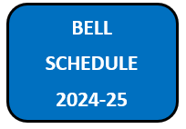

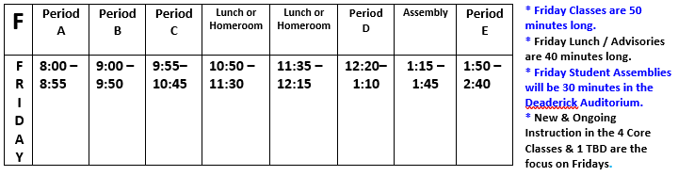

Slide 12
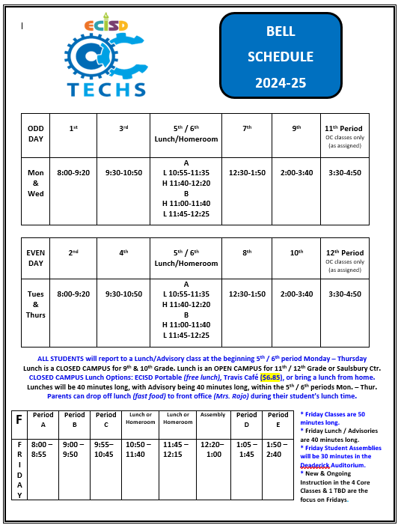
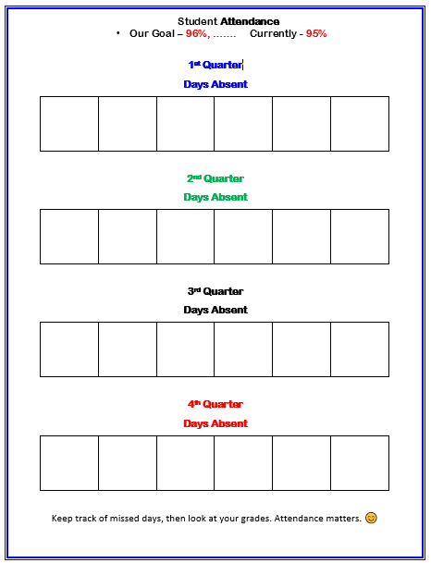
8/15

Slide 14
Student Attendance Our Goal – 96%, Currently - 95%
Student Dress Code, (No bellies showing, no holes in pants above mid thigh, no spaghetti strap tops, no short-shorts). If not dressed correctly you will be sent home. We are done dealing with this. Period.
ECISD Breakfast & Lunch are FREE.
OC Meals are $ 5.85 w/ Wrangler Card or $ 6.85 w/ cash or Credit Card.
If your son or daughter needs any kind of accommodation, (IEP/504/LEP) and we haven’t already contacted you, Please let us know.
Our School Nurse is Mrs. Lira, Her contact number is: 432–456–6419
in Deaderick Rm. 146.
Absolute Dismissal = Pulling a Fire Alarm, Drugs, VAPEs, Fighting, Sexual Misconduct, Vandalism, Weapons, OC Dismissal, Quitting…

Slide 15
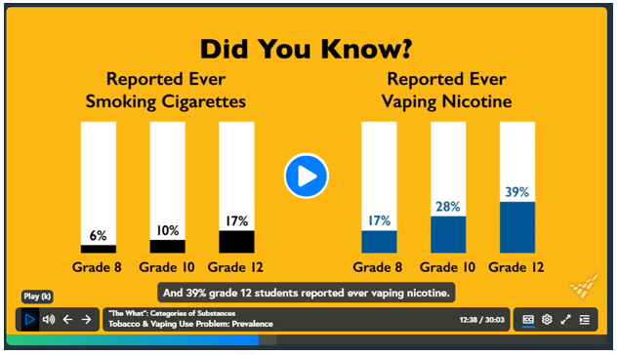

Slide 16
How Will We Continue to be an “A” Campus?
We will continue to offer all Standard H.S. Classes (ELAR, Math, Science, History, P.E., Foreign Language, Health, Art
& AVID.)
2. We will continue to offer all College Classes needed for
each of the 11 Pathways as they are part of the Associates
Degree Plan.
3. We will continue to offer After School Tutoring in person
from 4 – 5 PM, Mon. – Thur.
4. Odessa College will continue to make After School Tutoring
available in the LRC Library from 4 PM – 10 PM, M – Th., (by
appointment & as requested).

Slide 17
Odessa College & OCTECHS Teachers are asking that ALL STUDENTS:
- Come to Class On Time Every Day
- Wear you student ID 100% of the time you are on campus.
- Complete the Assignments Given in Class & Turn them in on time.
Daily Attendance is Critical for All of our students. Nine (9) Absences are all that’s allowed this entire Semester (Aug. 9th – Dec. 19th). If you have more than 9 absences you won’t receive Credit for your classes – even if you Pass them…

Slide 18
Seniors who drive will need to register their vehicles with Mrs. Miranda in the main office by September 3rd, 2024. OC will be ticketing vehicles if they park in the Blue spaces or if we have OCTECHS students parking on the North side of Campus.
OCTECHS lots are Wood, ET & Sedate, as well as the Sports Center lot.
      Drivers Licence
      Proof of Insurance w/ Students Name printed on coverage.
      Year, Make, Model, Color of Vehicles
      License Plate Number/s (if driving multiple vehicles to campus.)

Slide 19
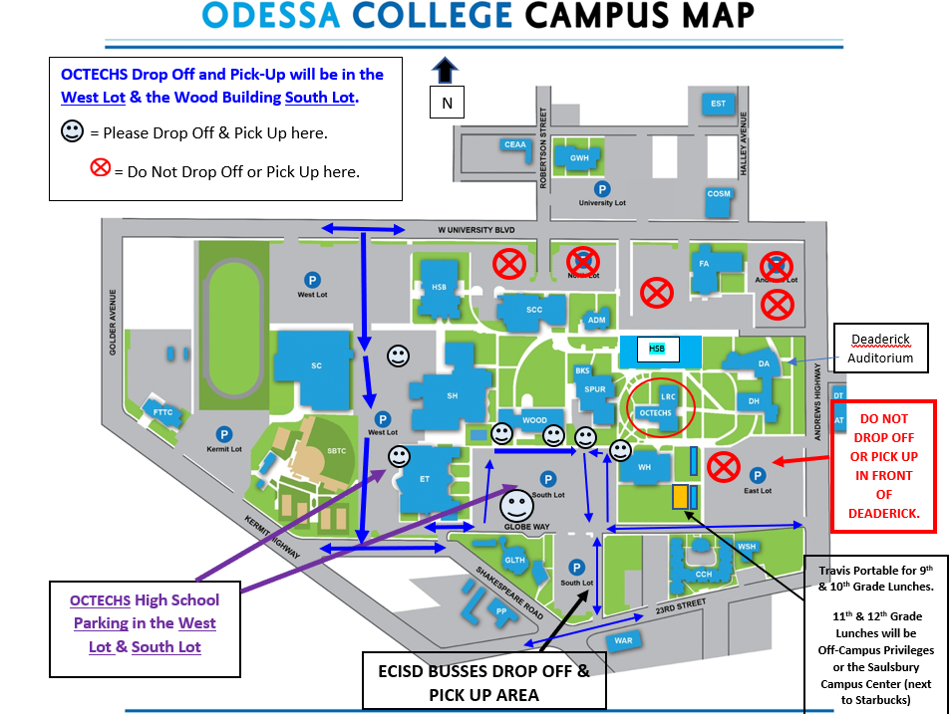

Slide 20

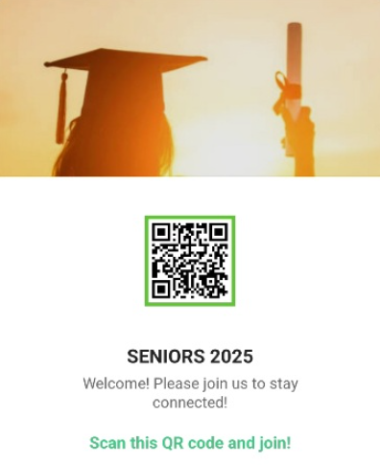

Slide 21

We encourage all students to participate in the Texas Scholars program to receive scholarships, track volunteer hours and make students more marketable for the real-world.
District Website
or
See Mrs. Jones in LRC 204.
5 – 10 – 15 – 20 for Recognition
50 +
for
Scholarships

Slide 22




Announcements will be made via Social Media, Schoology & Through a Weekly Newsletter.

Slide 23



Slide 24

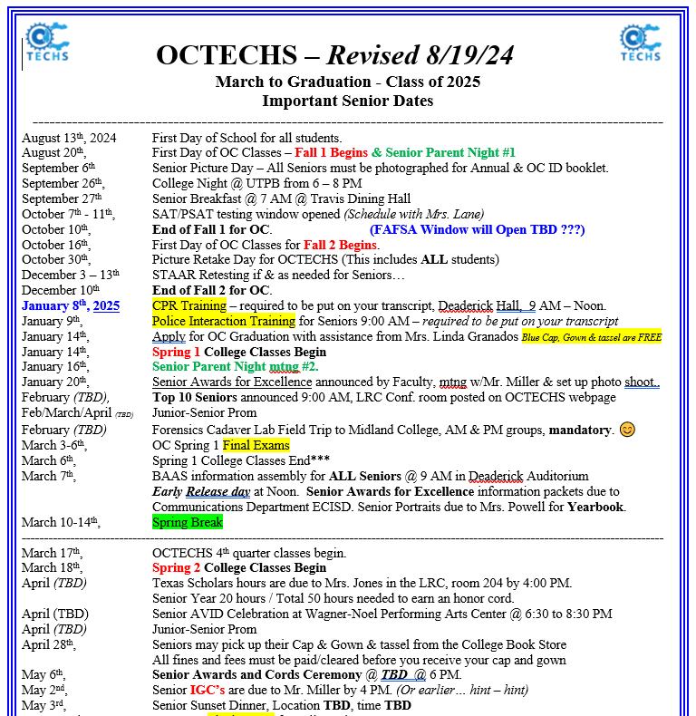

Slide 25
THANK YOU
FOR ATTENDING
TONIGHT!
Let’s Have a Great
Year @ OCTECHS
☺

