Slide 1
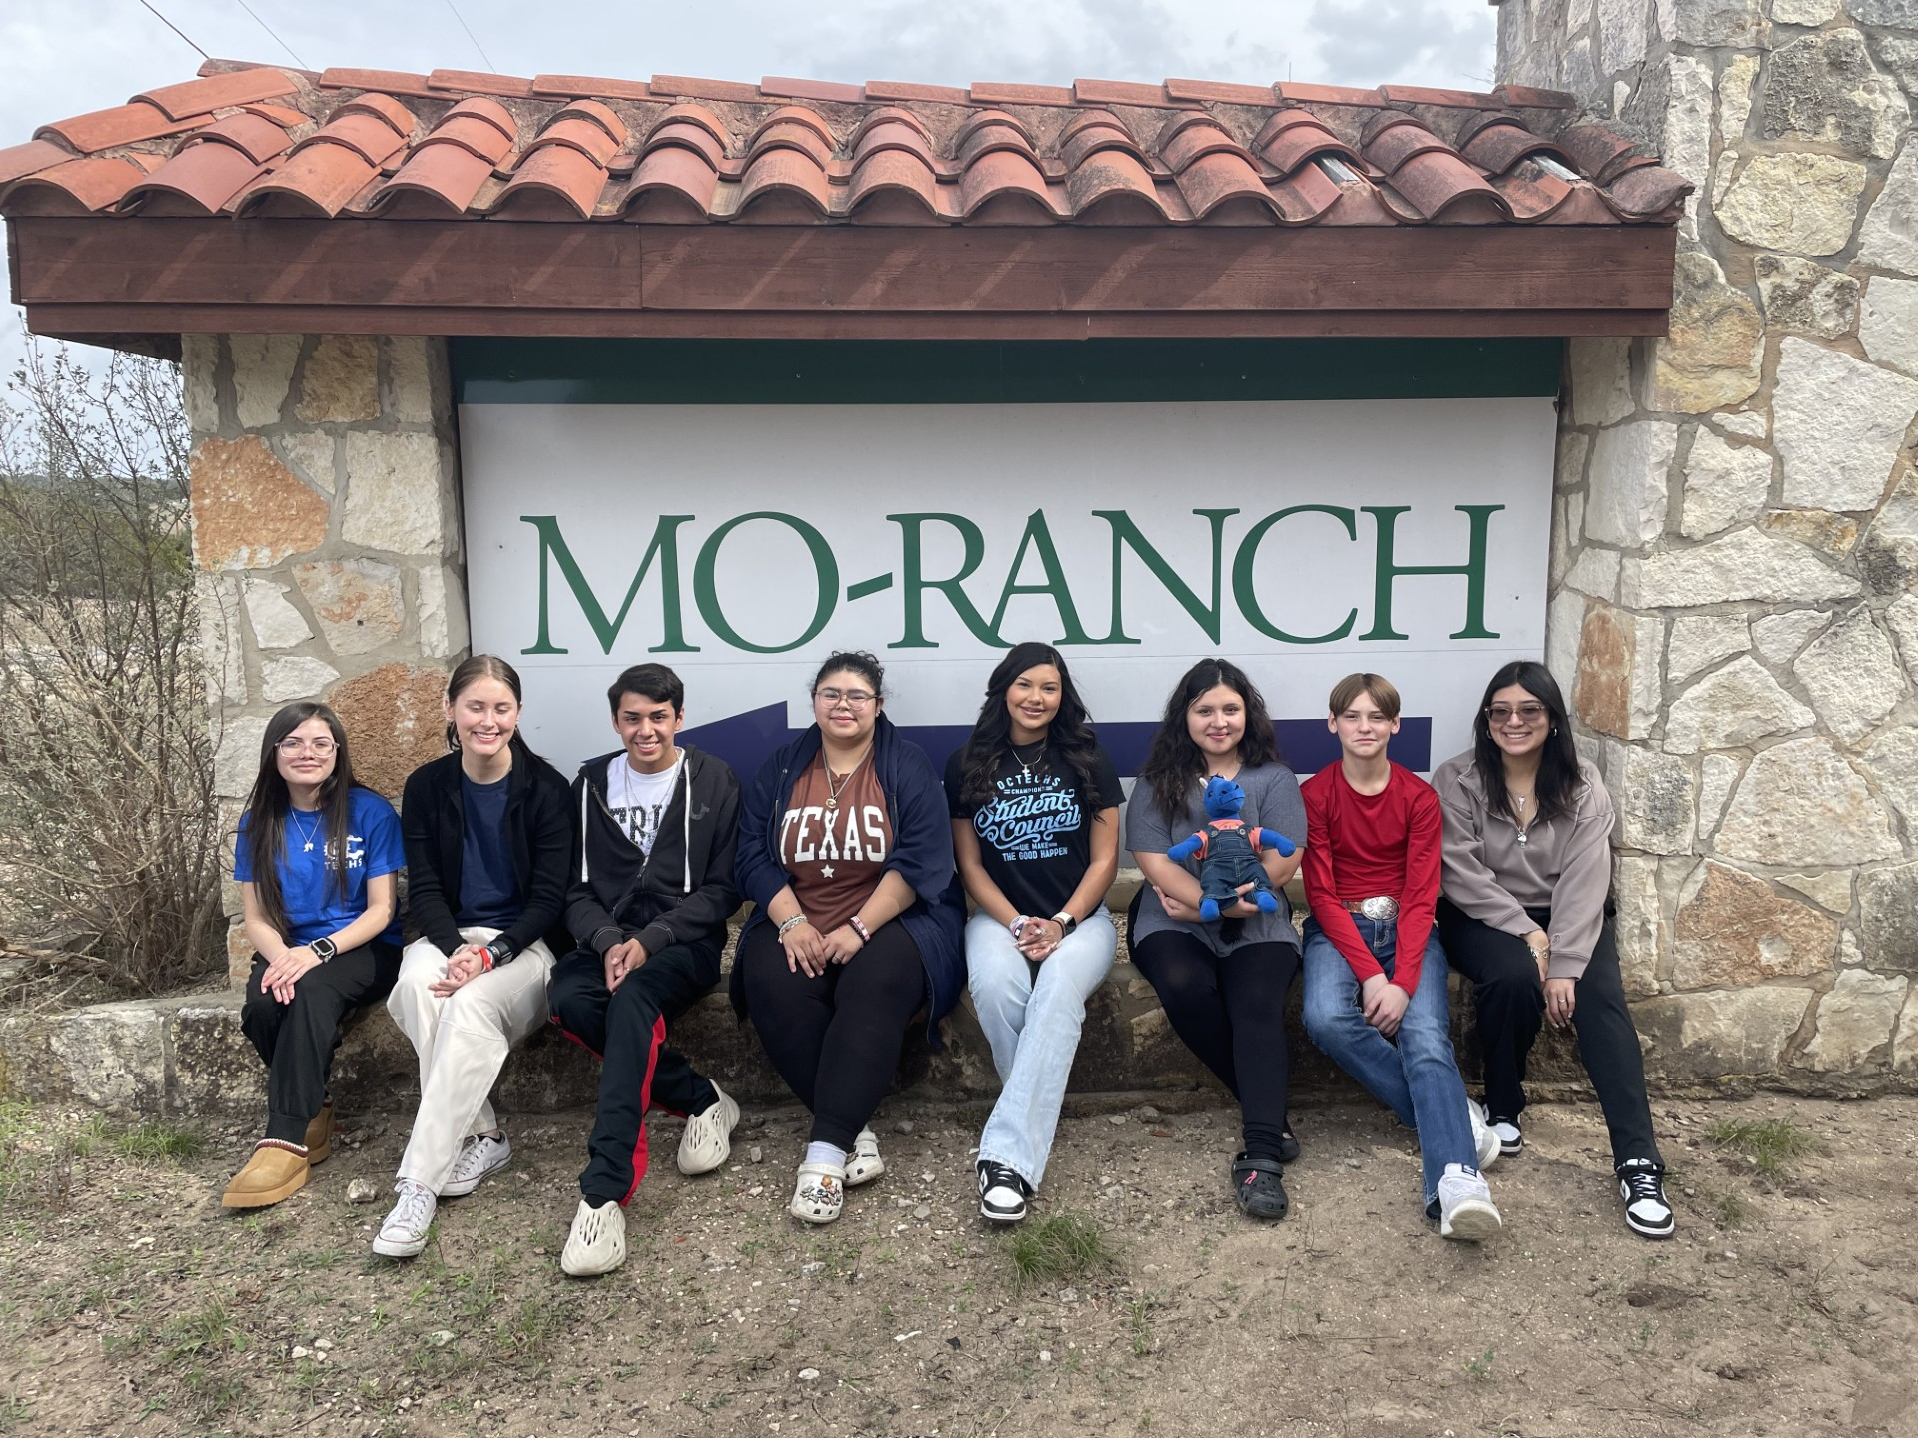
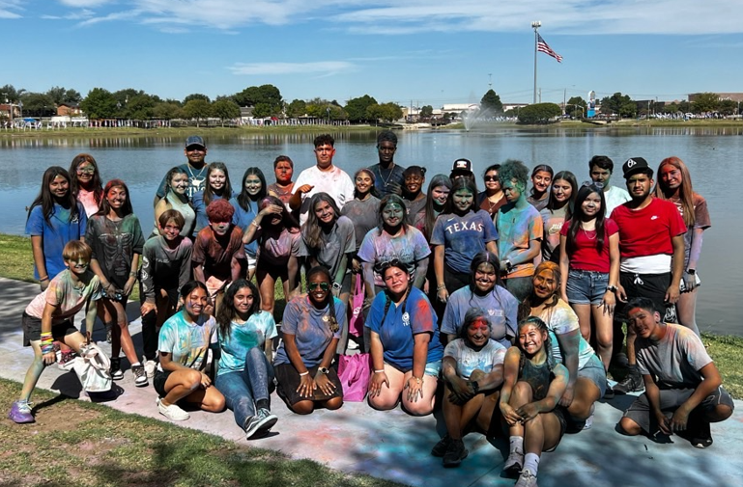
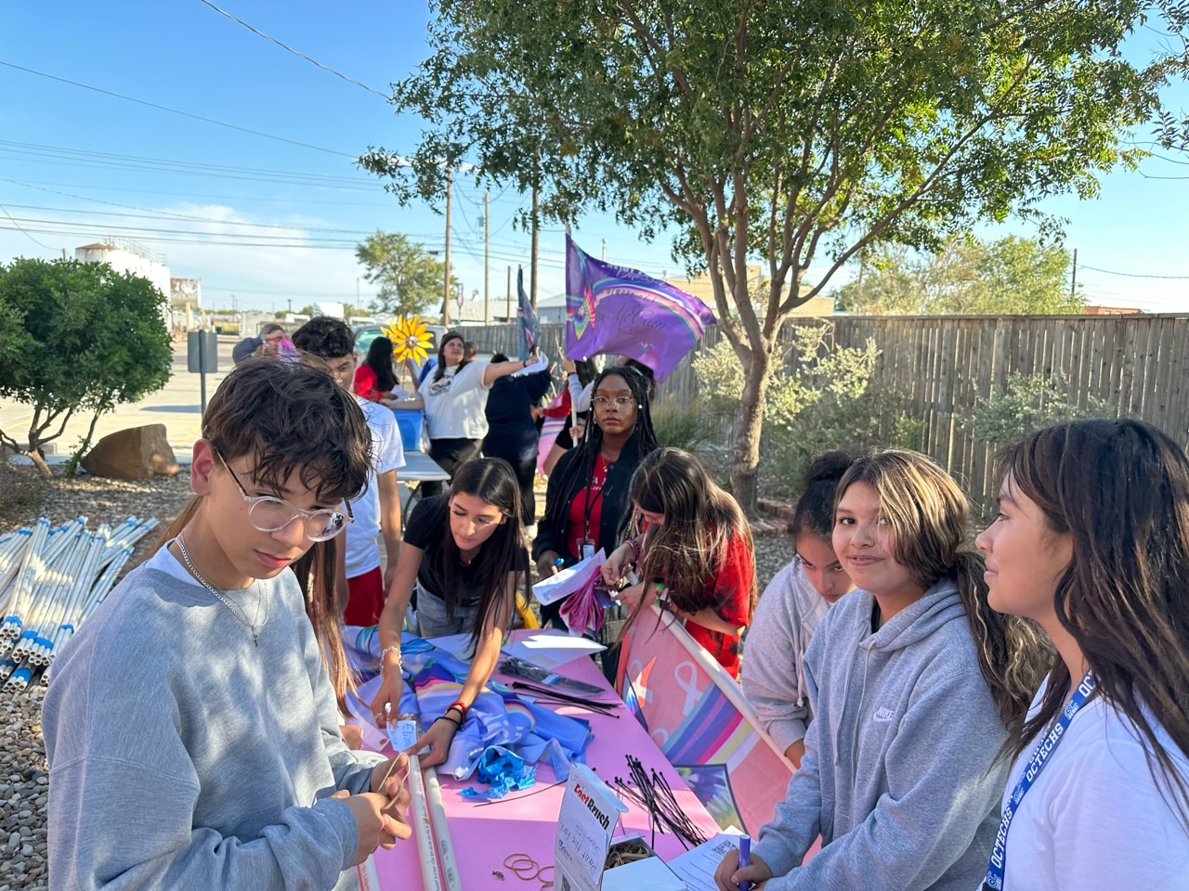
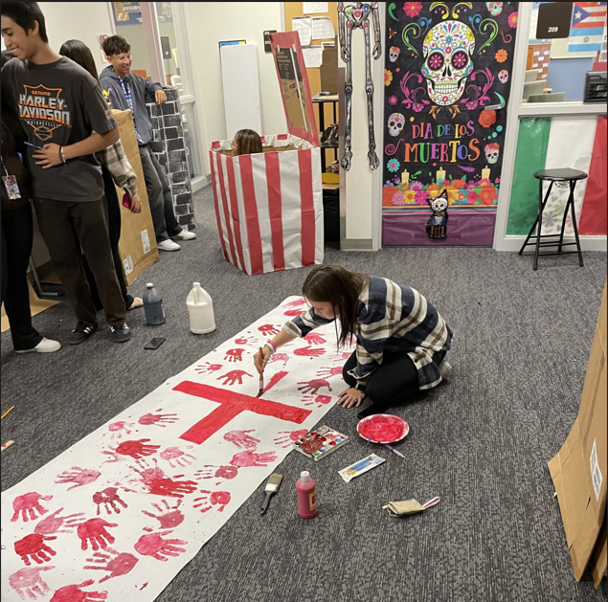
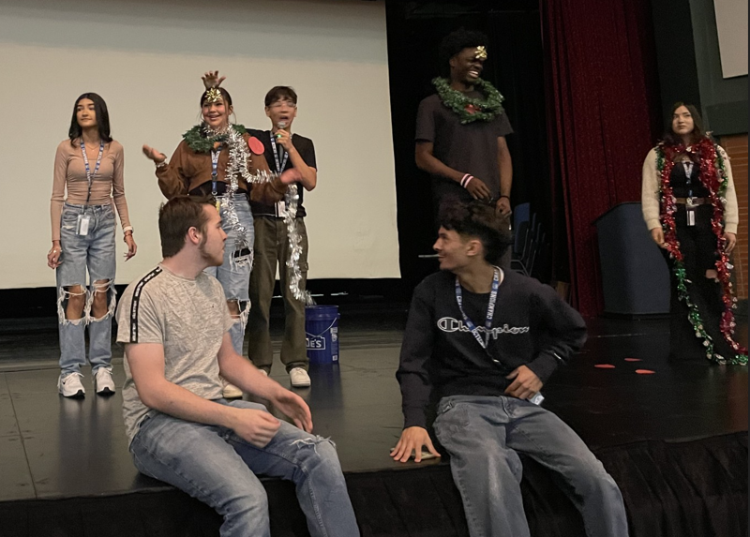


WELCOME TO
OCTECHS
Odessa Career & Technical Early College High School 456-6409

Slide 2
CORE VALUES
RESPECT
RESPONSIBILITY
INITIATIVE
PRIDE
HONESTY
INTEGRITY

Slide 3
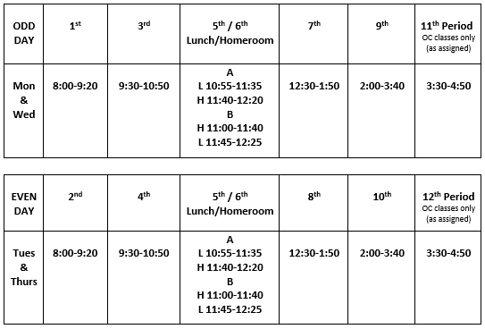

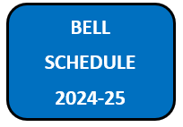

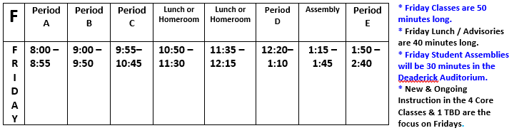

Slide 4
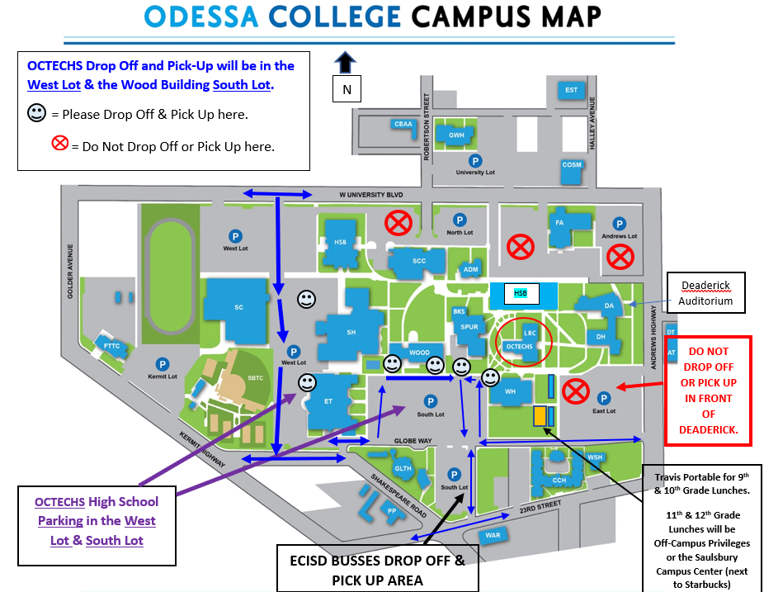

Slide 5
CYNTHIA (CINDY) LANE
cynthia.lane@ectorcountyisd.org
432-456-6403
Campus Contact Number:
432-456-6409

Slide 6



  UNDERSTANDING YOUR FEELINGS
  RECOGNIZING YOUR STRENGTHS
  MAKING NEW FRIENDS
  HOW IS SCHOOL GOING?
  HOW IS EVERYTHING GOING AT HOME?
  DEVELOPING NEW SKILLS TO BE GREAT COMMUNITY HELPERS
What is a
School Counselor?
A SCHOOL COUNSELOR IS A SAFE PERSON YOU CAN TALK TO AT SCHOOL.
  FEELINGS
  FRIENDSHIPS
  CONFLICT RESOLUTIONS
  COPING SKILLS
  STRESS
  GOAL SETTINGS
AND MUCH MORE
A SCHOOL COUNSELOR WILL VISIT YOUR CLASS AND TEACH YOU ABOUT:
A SCHOOL COUNSELOR WORKS WITH STUDENTS ONE- TO-ONE OR IN A GROUP SETTING. THINGS WE WILL LEARN:

Slide 7


Slide 8

FERPA Information
We are trying something new this year with open communication between Odessa College teachers and OCTECHS students/Parents.
By filling out and submitting this form, you are giving the college permission to speak directly with you regarding the progress or lack of progress, that may happen with your child.
We believe it works best if you, your son/daughter and their teacher are able to speak freely with each other about progress and success!
Once completed the form will need to be EMAILED TO:
RECORDS@ODESSA.EDU
to officially be added to their student record at Odessa college.

Slide 9
Estamos intentando algo nuevo este año con una comunicación abierta entre los profesores de Odessa College y los estudiantes/padres de OCTECHS.
Al completar y enviar este formulario, le está dando permiso a la universidad para hablar directamente con usted sobre el progreso o la falta de progreso que pueda suceder con su hijo.
¡Creemos que funciona mejor si usted, su hijo/hija y su maestro pueden hablar libremente entre sí sobre el progreso y el éxito!
Una vez completado, el formulario deberá enviarse por correo electrónico a: RECORDS@ODESSA.EDU para agregarlo oficialmente a su registro de estudiante en Odessa College.

Slide 10

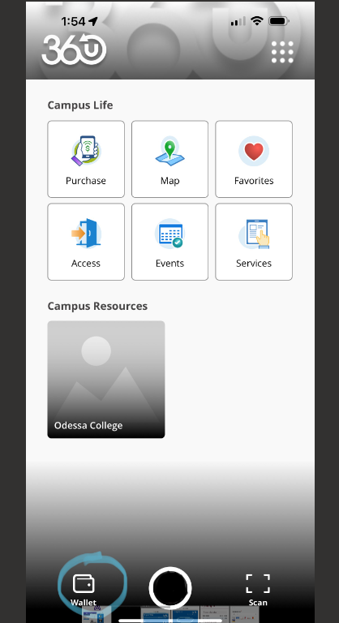
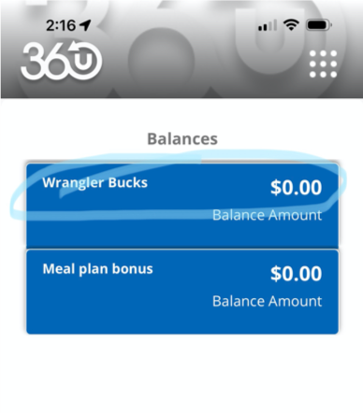

Slide 11
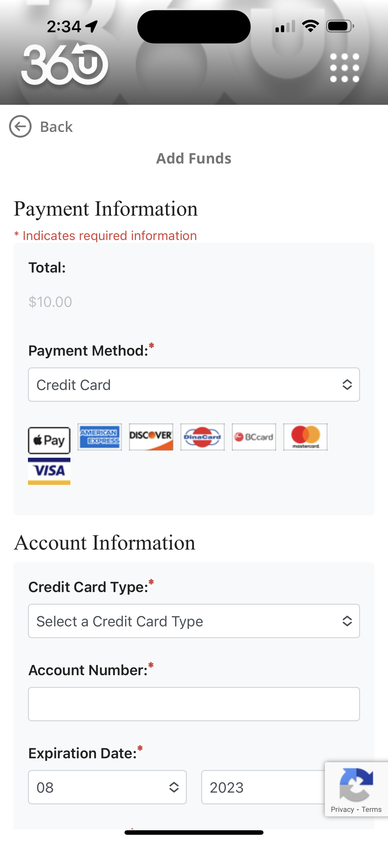
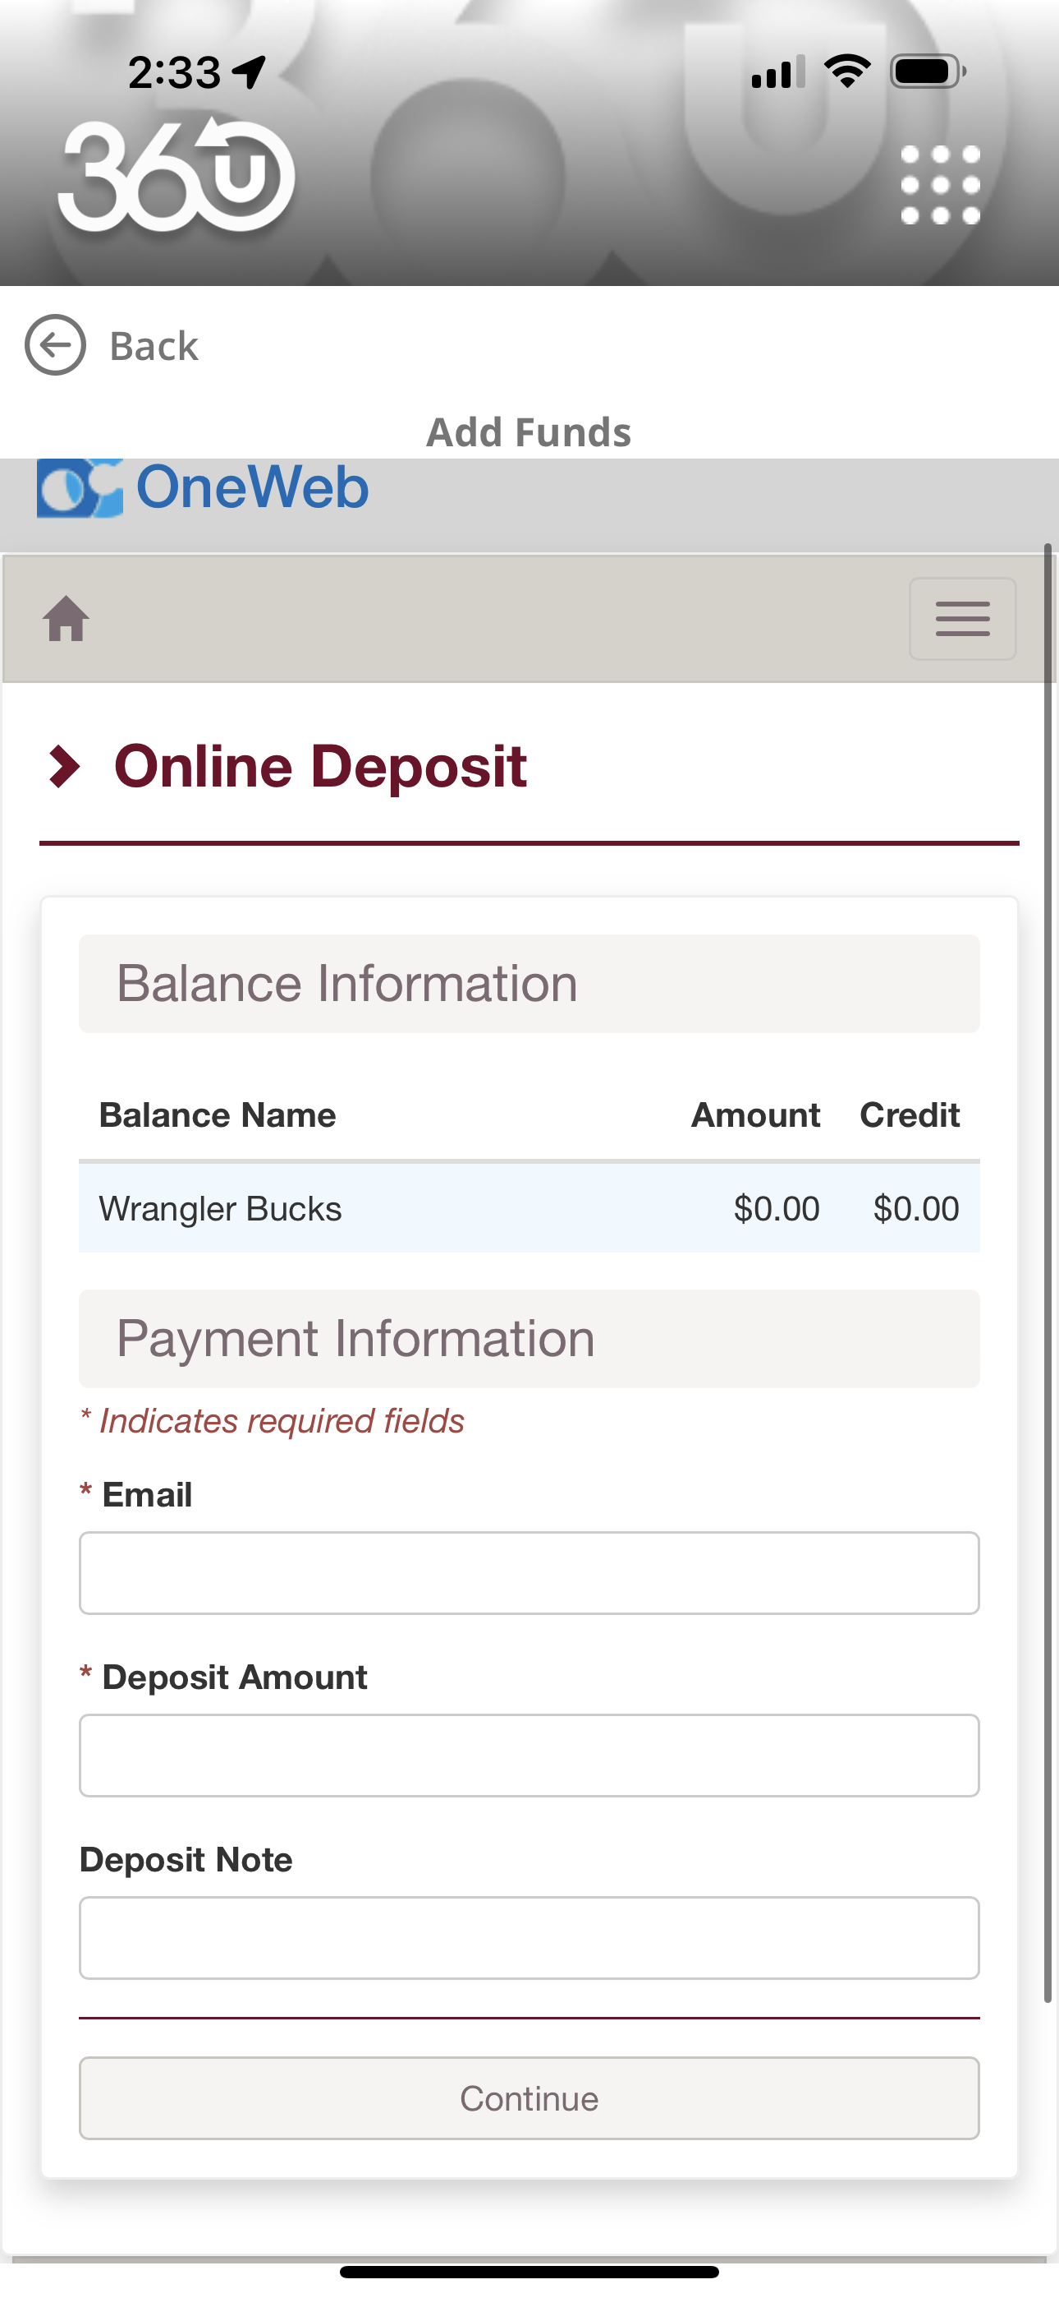
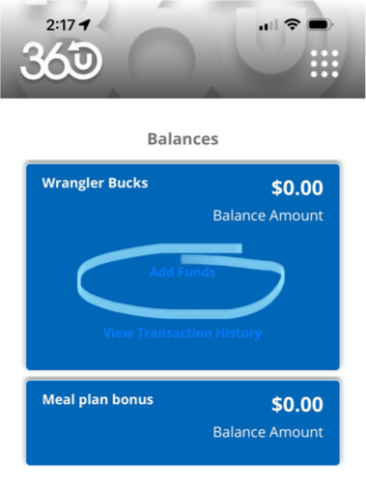

Slide 13
Additional Information:
Student Attendance Our Goal – 96%, Currently - 95%
Student Dress Code, & College Campus = College Consequences
Parent Portal through FOCUS for Grades & Registration.
** FOCUS for Communication
Closed Campus for Lunches 9th & 10th. (If Parents ‘Drop Off Food’ it must be delivered to the front desk & Mrs. Rojo’s work area.)
ECISD Breakfast & Lunch are FREE.
OC Meals are $ 5.85 w/ Wrangler Card or $ 6.85 w/ cash or Credit Card.

Slide 14
Student/Parent/School Engagement = Panorama Survey
[Goal – 90%+, Currently – 28%]
If your son or daughter needs any kind of accommodation, (IEP/504/LEP) and we haven’t already contacted you, Please let us know.
Our School Nurse is Mrs. Lira, Her contact number is: 432–456–6419
in Deaderick Rm. 146.
Homework Red Folder – Red folders, Please check these daily. Please set up a learning space at home for studying. Check on their progress. Plagiarism – photos of work shared, AI created = a ‘0’ grade.
Absolute Dismissal = Pulling a Fire Alarm, Drugs, VAPEs, Fighting, Sexual Misconduct, Vandalism, Weapons, OC Dismissal

Slide 15
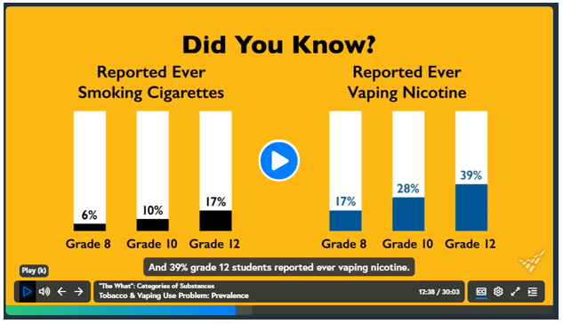

Slide 16
How Will We Continue to be an “A” Campus?
We will continue to offer all Standard H.S. Classes (ELAR, Math, Science, History, P.E., Foreign Language, Health, Art
& AVID.)
2. We will continue to offer all College Classes needed for
each of the 11 Pathways as they are part of the Associates
Degree Plan.
3. We will continue to offer After School Tutoring in person
from 4 – 5 PM, Mon. – Thur.
4. We will continue to assign student Tutoring sessions for
specific subjects.

Slide 17
5. Odessa College will continue to make After School Tutoring available in the LRC Library from 4 PM – 10 PM, M – Th., (by appointment & as requested).
6. Teacher in Eng. 1, Eng. 2, Alg. 1, Biology & US History will make use of testing Benchmarks & MAP Assessment Data to track each students Growth in that subject matter and then set growth targets for the rest of the year in their respective classrooms.
7. We will continue to conduct grade checks weekly and we’ll ask Parents to do the same.
8. We will hold Parent/Student/Admin/Teacher meetings when needed.

Slide 18
Odessa College & OCTECHS Teachers are asking that ALL STUDENTS:
- Come to Class On Time Every Day
- Wear you student ID 100% of the time you are on
campus.
- Complete the Assignments Given in Class
- Turn ALL of the Assignments IN on Time
Daily Attendance is Critical for All of our students. Nine (9) Absences are all that’s allowed this entire Semester (Aug. 9th – Dec. 19th). If you have more than 9 absences you won’t receive Credit for your classes – even if you Pass them…

Slide 19
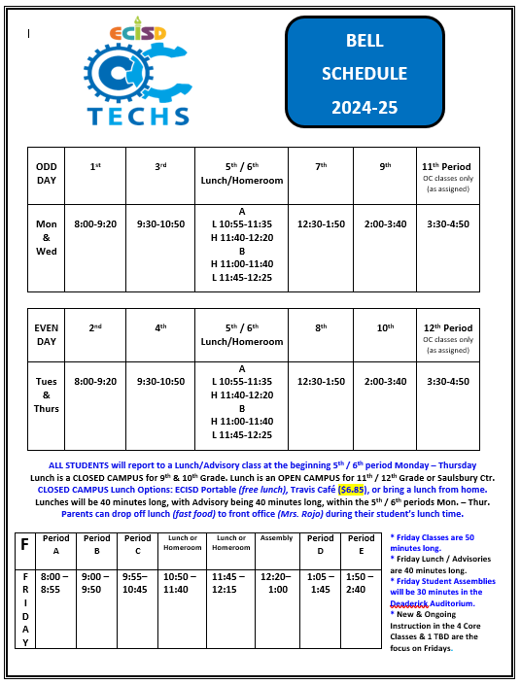
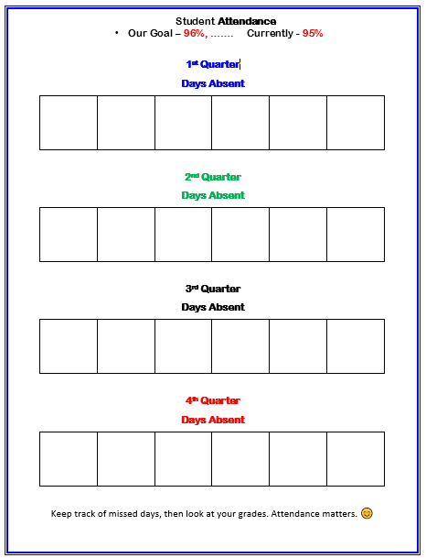
8/15

Slide 20


Slide 21

We encourage all students to participate in the Texas Scholars program to receive scholarships, track volunteer hours and make students more marketable for the real-world.
District Website
or
See Mrs. Jones in LRC 204.
5 – 10 – 15 – 20 for Recognition
50 +
for
Scholarships

Slide 22




Announcements will be made via Social Media, Schoology & Through a Weekly Newsletter.

Slide 23



Slide 24


Please snap the QR & register for attendance tonight – Thank You.

Slide 25
THANK YOU
FOR ATTENDING
TONIGHT!
Let’s Have a Great
Year @ OCTECHS
☺

