Slide 1
Holland Central
School District
2024-2025 BUDGET HEARING
Eric Lawton
Superintendent of Schools
Brittany Carey
School Business Administrator
MAY 7, 2024

Slide 2
District Goals
PRESENTATION OVERVIEW
We are unwavering in our commitment to meeting the needs and interests of our students.
We are committed to exercising care and good judgement in managing the resources with which we are entrusted by our community.
We are committed to conducting our business in an objective, professional, and transparent manner.

Slide 3
Enrollment Data
PRESENTATION OVERVIEW
 | 16-17 | 17-18 | 18-19 | 19-20 | 20-21 | 21-22 | 22-23 | 23-24 | 24-25
Actual Enrollment | 870 | 881 | 864 | 829 | 758 | 727 | 732 | 703 | cumulative
 |  | +11 | -17 | -35 | -71 | -31 | +5 | -29 | -167
data.nysed.gov

Slide 4
2024-2025 Revenues
PRESENTATION OVERVIEW
 | 2023-2024 | 2024-2025 | $ Change | % Change
Interfund Transfers & Appropriated Fund Balance | $1,149,032 | $663,296 | ($485,736) | (42.27)
Misc. Revenues | $457,036 | $465,240 | $8,204 | 1.80
Property Tax Levy | $8,424,381 | $8,759,346 | $334,965 | 3.98
Sales Tax | $1,250,000 | $1,150,000 | ($100,000) | (8.00)
State Aid | $11,269,576 | $11,614,565 | $344,989 | 3.06
Total | $22,550,025 | $22,652,447 | $102,422 | 0.45

Slide 5
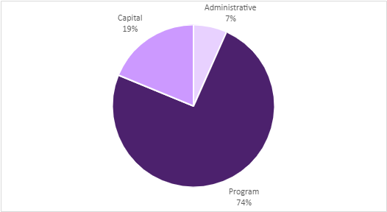
Three Part Budget
PRESENTATION OVERVIEW
 | 2023-2024 | 2024-2025 | $ Change | % Change
Program | $16,990,143 | $16,878,136 | ($112,007) | (-0.66)%
Capital | $3,449,919 | $4,257,317 | $807,398 | 23.40%
Administration | $2,109,963 | $1,516,994 | ($592,969) | (-28.1)%
Total | $22,550,025 | $22,652,447 | $102,422 | 0.45%

Slide 6
Component Budget
PRESENTATION OVERVIEW
 | 2023-2024 | 2024-2025 | $ Change | % Change
General Support | $ 2,755,179 | $2,960,696 | $205,517 | 7.46%
Instruction | $12,106,324 | $11,730,080 | ($376,244) | -3.10%
Transportation | $ 1,140,057 | $1,119,849 | ($20,208) | -1.77%
Employee Benefits | $ 4,482,380 | $4,596,100 | $113,720 | 2.54%
Debt Service | $ 2,066,085 | $2,245,722 | $179,637 | 8.69%
Total | $22,550,025 | $22,652,447 | $102,422 | 0.45%

Slide 7
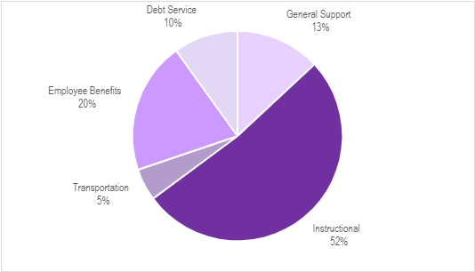
Component Budget
PRESENTATION OVERVIEW

Slide 8
Ten-Year Tax Levy History
PRESENTATION OVERVIEW
2015-2016 | 1.50%
2016-2017 | 0.00%
2017-2018 | 0.00%
2018-2019 | 1.98%
2019-2020 | 2.73%
2020-2021 | 3.33%
2021-2022 | 1.90%
2022-2023 | 2.99%
2023-2024 | 3.08%
2024-2025 | 3.98%

Slide 9
24-25 Tax Levy: 3.98%
PRESENTATION OVERVIEW
Does not exceed NYS Tax Cap or require a supermajority vote
Tax Levy: $8,759,346
Increase from 23-24: $334,965
 | Rate in 2023-2024 | *Rate in 2024-2025 | Increase Per $1000
Aurora | $42.16 | $43.84 | $1.68
Colden | $36.12 | $37.56 | $1.44
Concord | $31.61 | $32.87 | $1.26
Holland | $16.86 | $17.53 | $0.67
Sardinia | $25.94 | $26.97 | $1.03
Wales | $36.12 | $37.56 | $1.44
Java | $12.62 | $13.12 | $0.50
Sheldon | $13.49 | $14.03 | $0.54
* Rates are estimates based on assessment values, equalization rates, and exemptions from 23-24

Slide 10
Vehicle Proposition - $264,774
PRESENTATION OVERVIEW
One Collins DH516 34 Passenger School Bus $99,433
One Collins DE516WR Wheelchair Bus $117,341
Ford Explorer $48,000
Total Vehicle Proposition $264,774

Slide 11
Board of Education Seats
PRESENTATION OVERVIEW
An election for members of the Board shall be held to fill one (1) at-large position on the Board resulting from the expiration, on June 30, 2024, of the term of Mary Jo Szucs. The candidate receiving the highest vote total will be elected to a five (5) year term commencing July 1, 2024, and ending on June 30, 2029.
Candidates:
Mary Jo Szucs

Slide 12
2024-2025 Proposed Budget
PRESENTATION OVERVIEW
$22,652,447
Overall Increase: $102,422 or 0.45%
Budget Vote
May 21, 2024
7am – 8pm
Holland Community Center
3 Legion Drive, Holland NY

