Slide 1
Holland Central
School District
2024-2025 BUDGET PRESENTATION
#3 BUDGET FINAL
APRIL 16, 2024

Slide 2
Presentation Overview
PRESENTATION OVERVIEW
Tax Levy Review
Holland’s State Aid
Proposed Revenues & Expenditures
Vehicle Proposition
Proposed Budget

Slide 3
24-25 Tax Levy: 3.98%
PRESENTATION OVERVIEW
Does not exceed NYS Tax Cap or require a supermajority vote
Tax Levy: $8,759,346
Increase from 23-24: $334,965
 | Rate in 2023-2024 | *Rate in 2024-2025 | Increase Per $1000
Aurora | $42.16 | $43.84 | $1.68
Colden | $36.12 | $37.56 | $1.44
Concord | $31.61 | $32.87 | $1.26
Holland | $16.86 | $17.53 | $0.67
Sardinia | $25.94 | $26.97 | $1.03
Wales | $36.12 | $37.56 | $1.44
Java | $12.62 | $13.12 | $0.50
Sheldon | $13.49 | $14.03 | $0.54
* Rates are estimates based on assessment values, equalization rates, and exemptions from 23-24

Slide 4
State Aid – April xx, 2024 Run
PRESENTATION OVERVIEW

Slide 5
2024-2025 Revenues
PRESENTATION OVERVIEW
 | 2023-2024 | 2024-2025 | $ Change | % Change
Interfund Transfers & Appropriated Fund Balance | $1,149,032 | $663,296 | ($485,736) | (42.27)
Misc. Revenues | $457,036 | $465,240 | $8,204 | 1.80
Property Tax Levy | $8,424,381 | $8,759,346 | $334,965 | 3.98
Sales Tax | $1,250,000 | $1,150,000 | ($100,000) | (8.00)
State Aid | $11,269,576 | $11,614,565 | $344,989 | 3.06
Total | $22,550,025 | $22,652,447 | $102,422 | 0.45

Slide 6
2024-2025 Expenditures
PRESENTATION OVERVIEW
 | 2023-2024 | 2024-2025 | $ Change | % Change
General Support | $ 2,755,179 | $2,960,696 | $205,517 | 7.46
Instruction | $12,106,324 | $11,730,080 | ($376,244) | (3.10)
Transportation | $ 1,140,057 | $1,119,849 | ($20,208) | (1.77)
Employee Benefits | $ 4,482,380 | $4,596,100 | $113,720 | 2.54
Debt Service | $ 2,066,085 | $2,245,722 | $179,637 | 8.69%
Total | $22,550,025 | $22,652,447 | $102,422 | 0.45

Slide 7
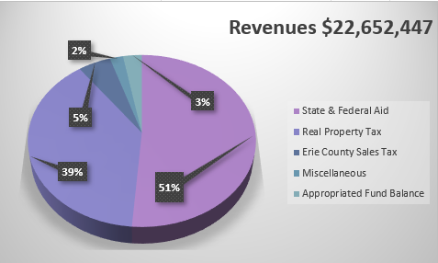
2024-2025 Revenues Snapshot
PRESENTATION OVERVIEW

Slide 8
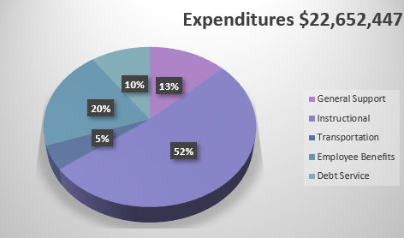
2024-2025 Expenses Snapshot
PRESENTATION OVERVIEW

Slide 9
Current Budget Gap
PRESENTATION OVERVIEW
Total Revenues $22,652,447
Total Expenditures $22,652,447
Proposed Use of Fund Balance & Reserves $663,296
(Included in Revenues)
Budget Gap -----------------

Slide 10
Vehicle Proposition - $264,774
PRESENTATION OVERVIEW
One Collins DH516 34 Passenger School Bus $99,433
One Collins DE516WR Wheelchair Bus $117,341
Ford Explorer $48,000
Total Vehicle Proposition $264,774

Slide 11
Board of Education Seats
PRESENTATION OVERVIEW
An election for members of the Board shall be held to fill one (1) at-large position on the Board resulting from the expiration, on June 30, 2024, of the term of Mary Jo Szucs. The candidate receiving the highest vote total will be elected to a five (5) year term commencing July 1, 2024 and ending on June 30, 2029.
Candidates:
Mary Jo Szucs

Slide 12
2024-2025 Proposed Budget
PRESENTATION OVERVIEW
$22,652,447
Overall Increase: $102,422 or 0.45%
Budget Vote
May 21, 2024
7am – 8pm
Holland Community Center
3 Legion Drive, Holland NY

