Slide 1
The Uniform Policy
Respect . Responsibility . Loyalty

Slide 2
IHS Mission Statement
To empower all students to achieve their potential.

Slide 3
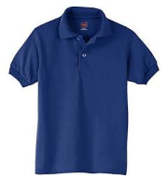
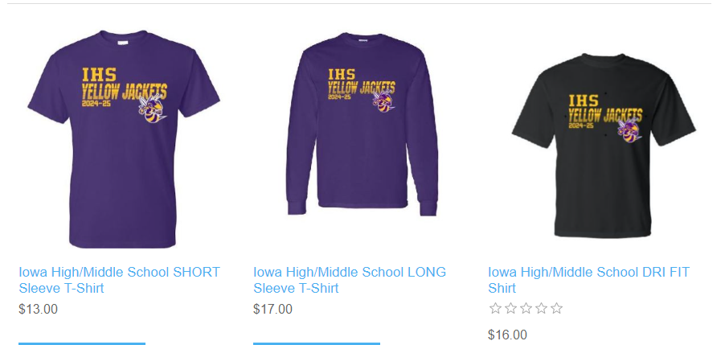
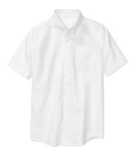
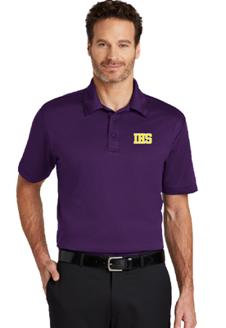
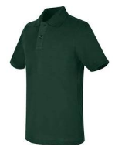
WHITE, HUNTER GREEN,
NAVY, or PURPLE MONOGRAMMED CPSB APPROVED
POLO OR BUTTON-DOWN
WITH A COLLAR
2024-2025 School Approved TOPS!
Navy Blue
White
ANY DAY OF THE WEEK!
Hunter Green
UNIFORM APPROVED SHORTSLEEVE OR LONGSLEEVE SPIRIT TSHIRT OR SWEATSHIRT
FROM ONLINE SPIRIT STORE
The CPSB Uniform Policy can be found online at:
https://www.cpsb.org/cms/lib/LA01907308/Centricity/Domain/170/Slide%201.pdf
Notes:
Image Credits:
www.walmart.com
iowaspirit.itemorder.com

Slide 4
CPSB SCHOOL DRESS CODE
1. Uniform shirts will be white, hunter green or navy blue polo/golf style shirts (short or long sleeves with a collar) or shirts that button down the front with a collar. No emblem, logo, decoration, or decorative trim is allowed. School Administrators have the option to choose a uniform shirt in one of the school’s colors.
2. White, hunter green or navy blue turtlenecks with no emblem, logo, decoration or decorative trim are acceptable. Turtlenecks can be worn separately or under uniform shirt.
3. T-shirts (solid white, hunter green or navy blue) will be allowed under uniform shirt.
4. Spirit shirt/club shirt may be worn on day(s) determined by the school administrator.
5. Administrators may option to have students wear the official school logo on the school’s designated shirt.

Slide 5
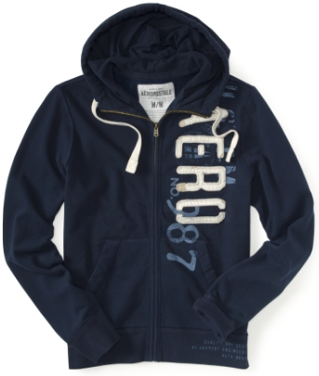
Logos on uniforms are acceptable ONLY if the logo can be fully covered by the Student ID.
If the logo is larger in size than the Student ID, then it is unacceptable.
UNACCEPTABLE
ACCEPTABLE
The CPSB Uniform Policy can be found online at:
https://www.cpsb.org/site/handlers/filedownload.ashx?moduleinstanceid=290&dataid=105&FileName=uniformpolicy.pdf

Slide 6
FRIDAYS ONLY!
Any IOWA spirit, athletic, or club t-shirt
may be worn on Fridays
with approved uniform bottoms.
These t-shirts MAY NOT be worn on any other day of the week other than Friday regardless of game days or club meetings.

Slide 7
CPSB SCHOOL DRESS CODE!
7. "Khaki or navy-blue pants (shades may vary) or blue jeans (shades of blue may vary), skirts, shorts, skorts, or jumpers must be uniform style and color. Blue jeans pants only (shades of blue may vary) shall not have any holes, rips, or tears. No blue jeans shorts, no corduroy or wind-suit materials, no sweatpants, no stretch pants or leggings, no jeggings, no joggers, no spandex, no baggy pants, no bell-bottoms, no carpenter or cargo styles, no hip-huggers, no side-knee pockets, no capris. Emblems, logos, or decorations are not allowed.
8. Shorts, skorts, skirts and jumpers must measure (front and back) no shorter than three inches above the knee and no longer than mid-knee.

Slide 8
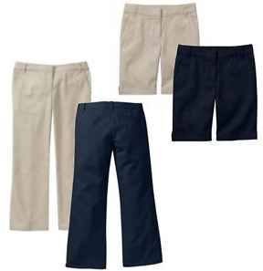
School Approved
BOTTOMS!
KHAKI OR NAVY
CPSB APPROVED
PANTS OR SHORTS
OR JEANS
*The above images are only some examples of school approved bottoms. Please review the CPSB School Dress Code for further explanations.
The CPSB Uniform Policy can be found online at:
https://www.cpsb.org/site/handlers/filedownload.ashx?moduleinstanceid=290&dataid=105&FileName=uniformpolicy.pdf
Notes:
Image Credits
www.ebay.com

Slide 9
CPSB SCHOOL DRESS CODE
9. Belts should be black, brown, navy blue, hunter green, or khaki with no emblem, logo or decoration and must be worn with slacks and shorts that are designed to have belt loops. Belts must be visible and worn around the waist. Belts are optional for pre-k, kindergarten, and first grade students.
10. Socks (or stockings/tights for girls) are required and should be hunter green, navy blue, khaki, black or white with no emblem, logo or decoration and must cover the ankle and be visible. Middle and High School students are not required to wear socks or stockings with sandals.
11. Appropriate shoes must be worn at all times. Sandals must have a back on them…no “slip-on” sandals, slippers, backless crocs, or flip flops.
The CPSB Uniform Policy can be found online at:
https://www.cpsb.org/site/handlers/filedownload.ashx?moduleinstanceid=290&dataid=105&FileName=uniformpolicy.pdf

Slide 10
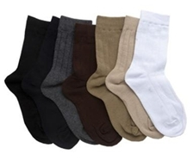
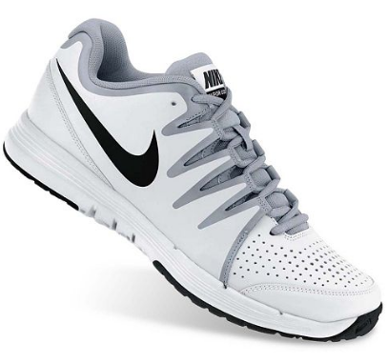
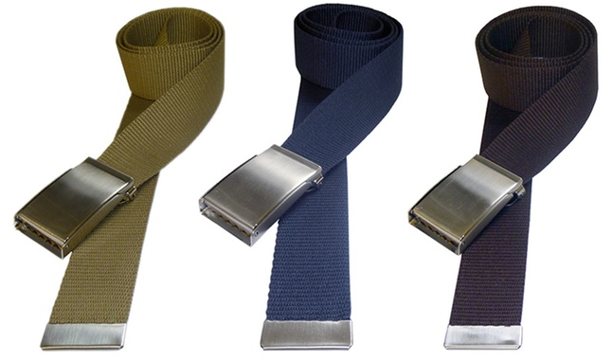
School Approved
BELTS, SOCKS, AND SHOES!
*The above images are only some examples of school approved belts, socks, and shoes. Please review the CPSB School Dress Code for further explanations.
The CPSB Uniform Policy can be found online at:
https://www.cpsb.org/site/handlers/filedownload.ashx?moduleinstanceid=290&dataid=105&FileName=uniformpolicy.pdf
Notes:
Image Credits:
www.kohls.com
www.kidssocks.com
www.groupon.com

Slide 11
CPSB SCHOOL DRESS CODE!
12. Acceptable outerwear for classroom is limited to include sweater, sweater vest, sweatshirt, and light jacket. During class time, jackets are to remain open, not zipped or buttoned. Colors for classroom outerwear include khaki, navy blue, hunter green and white. No emblem, logo, or decoration is allowed on classroom outerwear. If the logo is larger in size than the Student ID, then it is unacceptable. The uniform shirt must be worn under outerwear.
13. Heavy coats and jackets worn to and from school and/or outdoors are not restricted. Should be navy blue, white, khaki and hunter green.
The CPSB Uniform Policy can be found online at:
https://www.cpsb.org/site/handlers/filedownload.ashx?moduleinstanceid=290&dataid=105&FileName=uniformpolicy.pdf

Slide 12
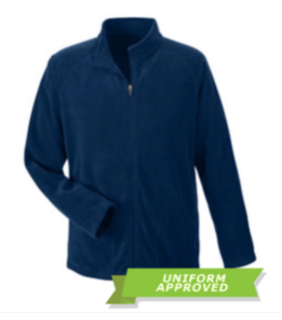
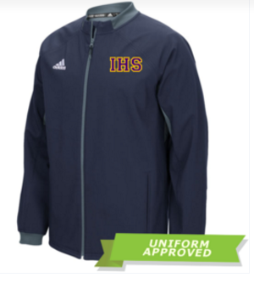
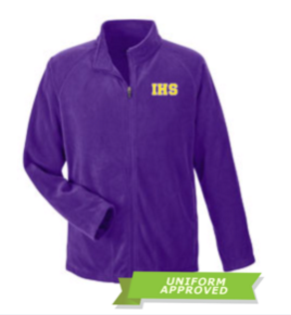
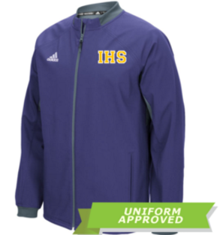
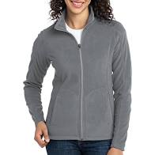
School Approved Outerwear!
KHAKI, NAVY, HUNTER GREEN, WHITE, BLACK, or GREY CPSB
APPROVED OUTERWEAR
AND QUARTER-ZIP JACKETS IN SCHOOL APPROVED COLORS
UNIFORM APPROVED OUTERWEAR
FROM ONLINE SPIRIT STORE
*The above images are only some examples of school approved outerwear. Please review the CPSB School Dress Code for further explanations.
The CPSB Uniform Policy can be found online at:
https://www.cpsb.org/site/handlers/filedownload.ashx?moduleinstanceid=290&dataid=105&FileName=uniformpolicy.pdf
Notes:
Image Credits:
www.zumiez.com
iowaspirit.itemorder.com

Slide 13
No Hoodies on campus!!
Hoods are not to be worn on your head at any time!!!

Slide 14
“During class time, jackets are to remain open, not zipped or buttoned.”
-CPSB School Dress Code
The CPSB Uniform Policy can be found online at:
https://www.cpsb.org/site/handlers/filedownload.ashx?moduleinstanceid=290&dataid=105&FileName=uniformpolicy.pdf

Slide 15
CPSB SCHOOL DRESS CODE
14. No headwear shall be worn on campus with the exception of knit caps in extremely cold weather.
15. Wearing dress or attire signifying gang affiliations is strictly prohibited on campus and at school-related activities.
16. Body Armor (bullet-resistant metal or other material intended to provide protection from weapons or bodily injury) is prohibited.
The CPSB Uniform Policy can be found online at:
https://www.cpsb.org/site/handlers/filedownload.ashx?moduleinstanceid=290&dataid=105&FileName=uniformpolicy.pdf

Slide 16
Other Dress Code Regulations:
Prohibited items include bandanas, hair rollers, extremes in hair styles, psychedelic hair colors, lines, letters, or designs shaved in the head.
Sunglasses, nose rings, visible body piercing, and excessive or inappropriate jewelry are prohibited.
Prohibited items include excessive and inappropriate makeup, painted faces, inappropriate tattoos, and stick-on tattoos.
Clothing worn is not to be suggestive or indecent.
Clothing, jewelry, and general appearance are not to be of the type that would cause a disturbance or distract or interfere with the instructional programs.
Clothing, jewelry, and general appearance are to be such as not to constitute a health or safety hazard.

Slide 17
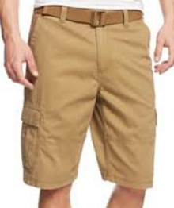
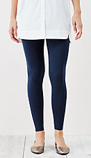
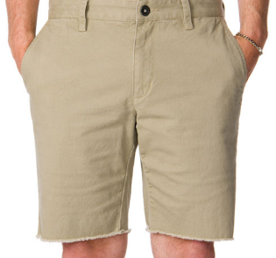
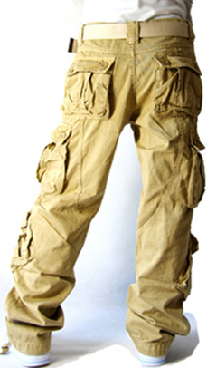
What NOT to wear at IHS!
CARGOS
CUTOFFS
LEGGINGS
*The above images are only some examples of unapproved uniform bottoms. Please review the CPSB School Dress Code for further explanations.
The CPSB Uniform Policy can be found online at:
https://www.cpsb.org/site/handlers/filedownload.ashx?moduleinstanceid=290&dataid=105&FileName=uniformpolicy.pdf
Notes:
Image Credits:
www.aliexpress.com
www1.macys.com
bonobos.com
www.ae.com

Slide 18
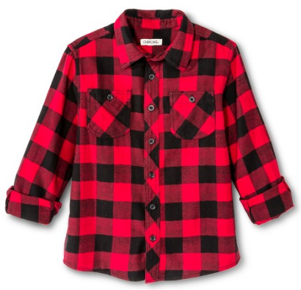
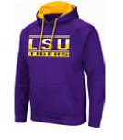
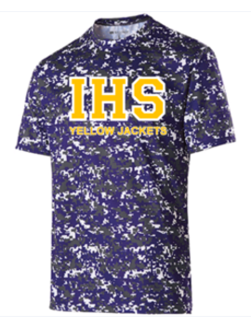
What NOT to wear at IHS!
No UNAPPROVED HOODIES…. Only those purchased from the school spirit store (black and yellow) or club approved hoodies are allowed.
No FLANNEL, NON-SOLID, OR UNAPPROVED CPSB COLOR
SHIRTS
No CLUB SHIRTS OR UNAPPROVED SPIRIT SHIRTS ON MON-THURS
*The above images are only some examples of unapproved uniform tops. Please review the CPSB School Dress Code for further explanations.
The CPSB Uniform Policy can be found online at:
https://www.cpsb.org/site/handlers/filedownload.ashx?moduleinstanceid=290&dataid=105&FileName=uniformpolicy.pdf
Notes:
Image Credits:
Dickies.com
www.target.com

Slide 19
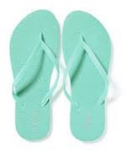
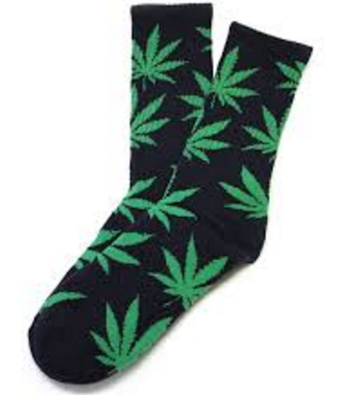
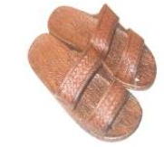
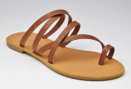
What NOT to wear at IHS!
FLIPFLOPS
INAPPROPRIATE
BELTS OR SOCKS
SANDALS
WITHOUT BACKSTRAPS
JANDALS
*The above images are only some examples of unapproved belts, socks, and shoes. Please review the CPSB School Dress Code for further explanations.
The CPSB Uniform Policy can be found online at:
https://www.cpsb.org/site/handlers/filedownload.ashx?moduleinstanceid=290&dataid=105&FileName=uniformpolicy.pdf
Notes:
Image Credits:
www.oldnavy.com
www.zappos.com
http://palihawaiiretailer.com
www.lyst.com
www.essentialsoles.com
marijuana-socks.com

Slide 20
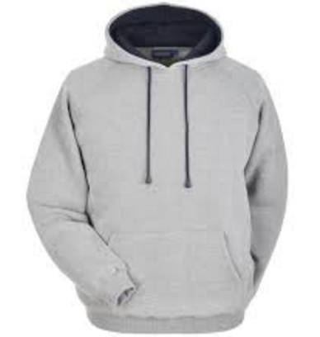
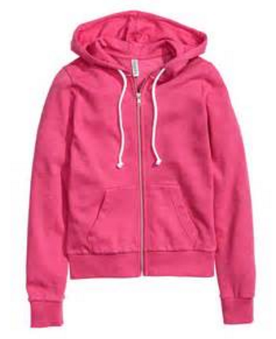
What NOT to wear at IHS!
HOODIES
UNAPPROVED
COLORS
Non-approved hoodies are not allowed. Only those purchased from Southern Custom Prints or a school athletic team are permitted on campus.
HATS
*The above images are only some examples of unapproved outerwear. Please review the CPSB School Dress Code for further explanations.
The CPSB Uniform Policy can be found online at:
https://www.cpsb.org/site/handlers/filedownload.ashx?moduleinstanceid=290&dataid=105&FileName=uniformpolicy.pdf
Notes:
Image Credits
papini.co.uk
iowaspirit.itemorder.com
www.customink.com

Slide 21
IDs must be worn at ALL times while ON CAMPUS.
The ID must be worn on an appropriate lanyard around the neck.
No DEFACING of the ID of any kind is allowed.
If a student does not have an ID, then they are to report to the designated area during appropriate times to purchase a temporary ID. This temporary ID is to be worn on either side of the upper chest area of the school uniform shirt.
The CPSB Uniform Policy can be found online at:
https://www.cpsb.org/site/handlers/filedownload.ashx?moduleinstanceid=290&dataid=105&FileName=uniformpolicy.pdf

Slide 22
CELLPHONES should not be SEEN or HEARD between 7:48 and 3:06!!
**High School Students can use respectfully in courtyard at lunch**
Ear buds or any form of headphones are not to be worn on campus at any time. Smart watches must be powered off in classrooms.
Please review the CPSB Cell Phone Policy for further explanations.
The CPSB Uniform Policy can be found online at:
https://www.cpsb.org/site/handlers/filedownload.ashx?moduleinstanceid=290&dataid=105&FileName=uniformpolicy.pdf

Slide 23
Violation tickets start
Monday
August 26!!
Tardy and Uniform tickets accumulate separately.

Slide 24
Tardy and Uniform tickets accumulate separately.
3 tickets = letter to parents/warning
4 tickets = call home/lunch detention
5 tickets = call home/ISI (1 day)
8 tickets = ISI (1 day)
11 tickets = ISI (2 days)
14 tickets = ISI (2 days)
17 tickets = Out of School SUSPENSION!

Slide 25
Respect
Responsibility
Loyalty

