Slide 1
Pickleball
Morris Tech
Physical Education Dept.

Slide 2
History of Pickleball
Pickleball was created during the summer of 1965 on Bainbridge Island - a short ferry ride from Seattle, WA. The original purpose of the game was to provide a sport for the entire family, according to co-inventors U.S. Congressman Joel Pritchard, William Bell, and Barney McCallum.
Pickles was the family dog that would chase after the errant balls and then hide in the bushes, thus Pickle's ball which was later shortened to the namesake of Pickleball.
Initially, families played Pickleball in their backyards on a hard surface, on driveways, and on residential dead-end streets.
Since the mid-1970's, Pickleball has grown and expanded from a family activity game to a paddle court sport with formalized rules. Now, over 20 years later, Pickleball is played in thousands of school P.E. programs, parks and recreation centers, correctional facilities, camps, YMCAs and retirement communities. This sport is becoming very popular among active senior adults at community centers and is growing in popularity on high school and college campuses.

Slide 3
PowerPoint Template Subtitle color
Example of a slide with a subhead
Set the slide title in “title case”
Set subheads in “sentence case”
Generally set subhead to 36pt or smaller so it will fit on a single line
The subhead color is defined for this template but must be selected. In PowerPoint 2007, it is the fourth font color from the left

Slide 4
Pickleball Court

Slide 5
Rules of Pickleball
Serve: Player must keep one foot behind the back line when serving.
The serve is made underhand.
The server must contact the ball in the air; it cannot be hit after a bounce.
The service is made diagonally cross court and should land between the non-volley zone and the baseline.
Only one serve attempt is allowed, except if the ball touches the net on the serve and lands in the proper service court.
At the start of each game, the first serving team is allowed only one fault before giving up the serve to the opponents. Thereafter, both members of each team will serve than default before the ball is turned over to the opposing team (in doubles).

Slide 6
More Rules
A point is scored by the serving team when the receiving team makes a fault.
A team shall only score a point when serving.
When the serving team makes its first fault, players will stay on the same courts and turn the ball over to the other team.
Players switch courts only after scoring.

Slide 7
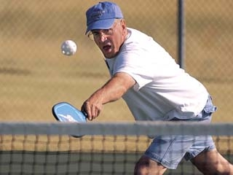
Volley
All volleying (hitting the ball before it bounces) must be done with player's feet behind the non-volley zone line.
It is a fault if the player steps over the line on the volley follow through.

Slide 8
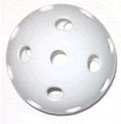
Double Bounce Rule
Each team must play their first shot off the bounce. That is, the receiving team must let the serve bounce and the serving team must let the return of serve bounce before playing it. After the two bounces have occurred, the ball can be either volleyed or played off a bounce.

Slide 9
Fault
It is a fault when:
a) Hitting a ball out of bounds. A ball landing on the line is good;
b) The ball does not clear the net;
c) Stepping into the non-volley zone and volleying the ball;
d) Volleying the ball before it has bounced once on each side of the net
j

Slide 10
Singles Play
All rules apply with one exception; when serving in singles, each player serves from the right hand court when the score is 0 or an even number and from the left hand court when the score is odd numbered.

Slide 11
Partner Title
partner
Name
Title
Company

Slide 12
Customer Title
customer
Name
Title
Company

Slide 13
Announcement Title
announcing

