Slide 1
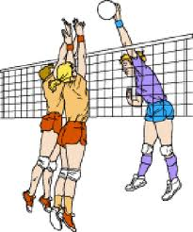
Volleyball
Morris Tech
Physical Education Dept.

Slide 2
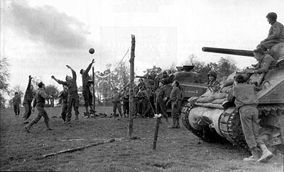
History
Volleyball was created in 1985 by William G. Morgan, an instructor at the YMCA in Holyhoke, Massachusetts. He decided to blend elements of basketball, baseball, tennis and handball to create what he called “mintonette”. As observers watched the game, they noticed that players were “volleying” the ball back and forth. Thus, its name was changed to volleyball. The first game was played at Springfield College in 1896.
In 1928 it became apparent that official rules were needed, and the USVBA (United States Volleyball Association) was formed.
Today both men and women play professional volleyball, and more than 46 million Americans enjoy playing the game as pare of leisure time activity.

Slide 3
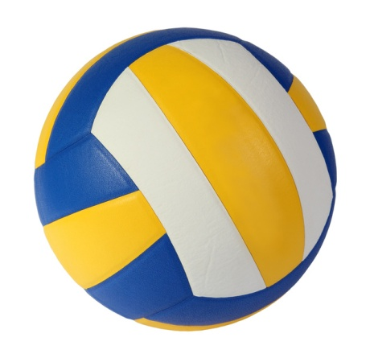
Basic Volleyball Rules
Scoring
The Serve
Rotation
Basic Violations
Game Play

Slide 4
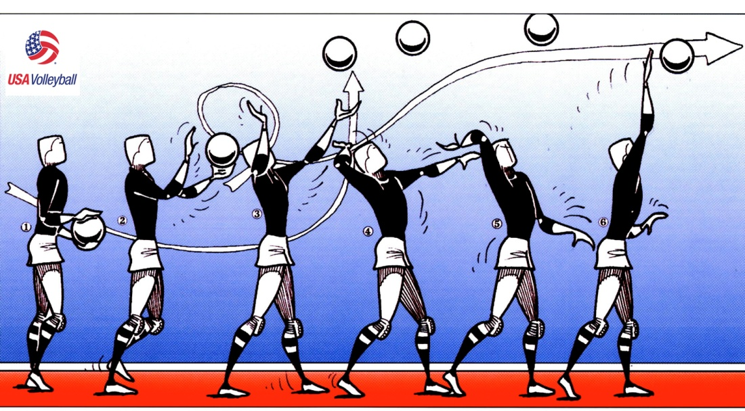
The Serve
Server must serve from behind the restraining line (end line).
Ball may be served underhand OR overhand.
Ball must be clearly visible to opponents before serve.
Served ball may graze the net and drop to the other side for a point.
First game serve is determined by a volley, each subsequent game shall be served by the previous game loser.
Serve must be returned by a bump only, no setting or attacking a serve.

Slide 5
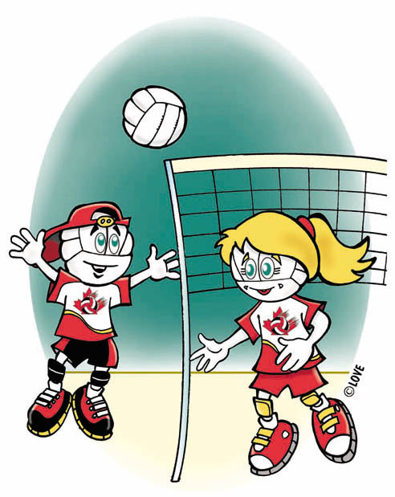
Scoring
Rally scoring will be used. (There will be a point scored on every score of the ball).
Offense will score on a defensive miss or out of bounds hit.
Defense will score on an offensive miss, out of bounds hit, or a serve into the net.
Game will be played to 25 points.
Must win by 2 points.

Slide 6
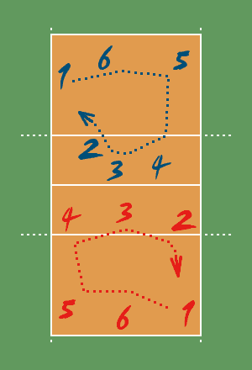
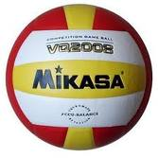
Rotation
Team will rotate one position each time they win the serve.
Players rotate in a clockwise manner (see rotation diagram).
There shall be 4 – 6 players on each side

Slide 7


Game Play
Maximum of 3 hits per side.
Player may not hit the ball twice in succession (a block is NOT considered a hit).
Ball may be played off the net during a volley and on a serve.
A ball touching a boundary line is good.
A legal hit is contact with the ball by a player’s body above and including the waist which does not allow the ball to visibly come to a rest.
If two or more players contact the ball simultaneously, it is considered one play and the players involved may not participate in the next play.
A player must not block or attack a serve.
Switching positions will be allowed strictly for front line players. (After the serve only).

Slide 8
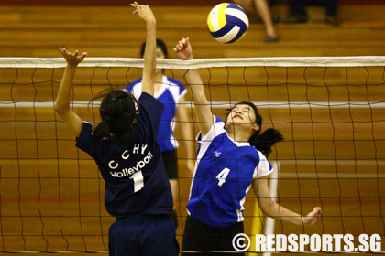
Basic Violations
Stepping on or over the line on a serve
Failure to serve the ball over the net successfully
Hitting the ball illegally (carrying, palming, throwing, etc.)
Touching the net with any part of your body while the ball is in play
Reaching over the net, except in these conditions:
  When executing a follow through
  When blocking a ball which is in the opponents court but is being returned (Block cannot contact the ball until AFTER the opponent attempting to return the ball makes contact)
  Reaching under the net
  Failure to serve in the correct order
  Blocks or spikes from a position in which is clearly not behind the 10-foot line while in the back row position.

Slide 9
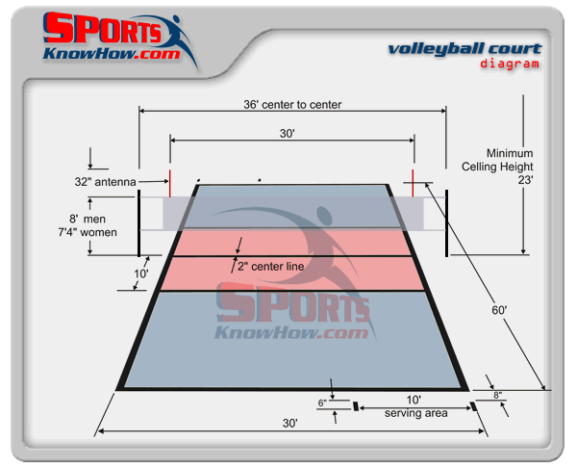
The Court

Slide 10
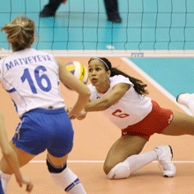
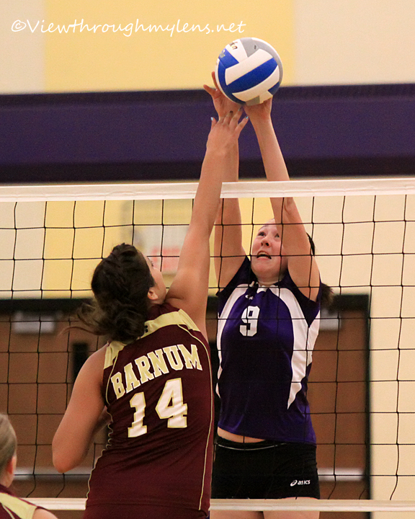
Volleyball Lingo
“ACE” when the ball is served to the other team,
and no one touches it.
“Sideout” When the team that served the ball makes a mistake,
causing the ball to go to the other team.
“Stuff” When a player jumps the height of the net,
  blocks the ball, and the ball goes back to the person who attacked (spiked) it.
“Dig” When a player makes a save
from a very difficult spike.
“Kill” When a team spikes the ball and
  it either ends in a point or a sideout.

