Slide 1
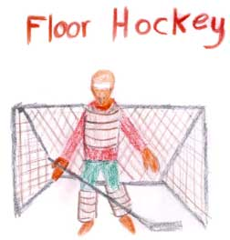
MCST
Mr. Prentice, Miss Murphy, Mr. Brophy, and Mrs. Adler

Slide 2
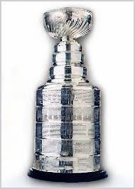
The History of Ice Hockey
Hockey officially came together as a sport in 1877 when a group of students from McGill University in Montreal came up with a set of rules to govern the game.
Lord Stanley of Preston saw hockey for the first time at the Montreal Winter Carnival in 1888. He liked it so much that he helped create the Stanley Cup as an award to the best hockey team in the country.

Slide 3
VS.
In 1890 the first official game in the US was played.
Johns Hopkins vs. Yale University.
The first professional hockey team was created in 1899.
The National Hockey League (or NHL), was formed in November 1917
Hockey joined the Olympics in 1920 and made its first official appearance in 1924.
Women's hockey played their first game in the Olympics in 1998.
On February 16, 2005 the NHL became the first major professional team sport in North America to cancel an entire season.

Slide 4
Equipment – Ice Hockey

Slide 6
The Game
Typically, hockey games are divided into 3-20 minute periods with 2 intermissions between them.
The object is to score points by hitting the puck into the goal or net.

Slide 7
Rules and Regulations
5 players on floor plus goalie.
Game begins with face off at centerline and resume there after each goal.
Face off is called when ball is out of play, thrown or caught by any player other than goalie. Official will drop ball during face off.
Ball may be stopped by hand, but not held, passed or advanced by hand.
Ties will stand.

Slide 8
Goal is scored when player hits, sweeps or pushes the ball into the net directly off stick or it is deflected off one of their teammates or defensive player into net.
A player may touch, but not advance ball with their feet, but MAY NOT kick it directly into the goal.
A ball CANNOT be thrown into the goal to score.
When a goalie catches or stops the ball, they must be given room to release it to one of their players by hand or stick.
If a goalie falls onto a ball and is unable to release it, face-off is called to the front of the goal.

Slide 9
Fouls and Penalties
High Sticking - occur when a player intentionally or inadvertently plays with his or her stick above the height of the shoulders or above the cross bar of a hockey goal. Results in a one minute power play.
Offensive player in the crease – defense is awarded a free pass from the centerline.
Defensive player in the crease – offense is awarded a free corner pass in from the offensive side.

Slide 10
Floor Hockey
Floor Hockey is a modification of ice hockey with some clear differences.
Played on a hard floor – not ice
No skates are used
Balls can be used instead of pucks.
Smaller goals can be used to increase shooting accuracy / control
Bully – used instead of a traditional face-off.
When the centers from each team face each other with the ball between them and tap sticks three times to begin play.

Slide 11
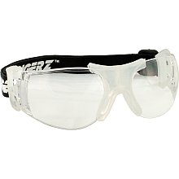
Equipment – Floor Hockey
Stick
Safety goggles
Floor hockey ball

