Slide 2
Chapter 19
Dealing with Conflict, Violence, and Abuse
Lesson 19.1 Understanding Conflict
Lesson 19.2 Understanding Violent Behavior
Lesson 19.3 The Reality of Family Violence
Lesson 19.4 Unwanted Sexual Activity

Slide 3
Lesson 19.1
Understanding Conflict

Slide 4
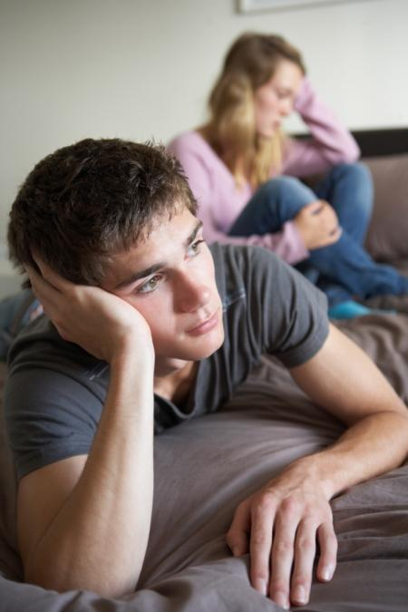
Warm-Up
Give some examples of violence, abuse, or conflict that could occur in family, peer, or dating relationships.
How would you resolve or deal with these issues?
Monkey Business Images/shutterstock.com

Slide 5
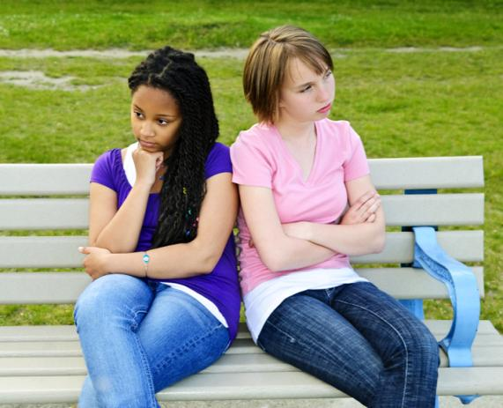
Causes and Consequences of Conflict
Conflicts occur when
People have different priorities, values, and needs
People or groups have misunderstandings
Consequences
Negative effects on psychological and emotional well-being
Stress that impacts physical health
Elena Elisseeva/shutterstock.com

Slide 6
Why should you always try to resolve conflicts?
Unresolved conflicts can have negative effects on a person’s psychological and emotional well-being. Conflict is a type of stress that can cause people to develop serious health problems. Working through conflicts can even strengthen relationships.

Slide 7
Strategies for Resolving Conflict
Conflict is inevitable, but you can learn strategies for resolving conflict productively
Embrace differences
Keep calm
Share your feelings
Listen to what the other person is saying
Find compromise
Be assertive (but not aggressive)
Monkey Business Images/shutterstock.com

Slide 8
Critical Thinking
What is the difference between being assertive and being aggressive? Why is one more effective than the other in resolving conflicts?
Assertive means to speak honestly about your feelings, needs, and goals.
Aggressive means to speak or act toward others in a demanding and insulting way.
Being aggressive often makes it harder to effectively resolve conflicts and can cause conflicts to escalate.

Slide 9
Seeking Outside Help
Sometimes a conflict is too serious or difficult for the people involved to manage it
A mediator—or neutral third party—can step in to help mediate a compromise or other solution to the conflict
Dragon Images/shutterstock.com

Slide 10
Lesson 19.2
Understanding Violent Behavior

Slide 11
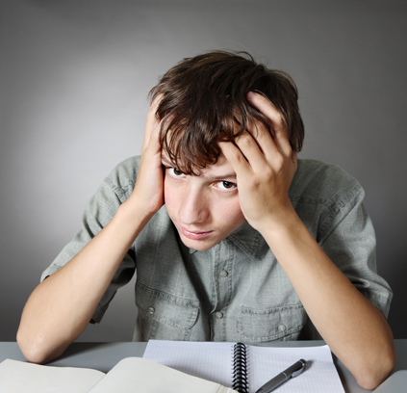
Risk Factors for Violence
Frustrated mental or emotional state
Personal gain
Exposure to violence (in the neighborhood or in the media)
Alcohol and drug use
Availability of a weapon
Larisa Lofitskaya/shutterstock.com

Slide 12
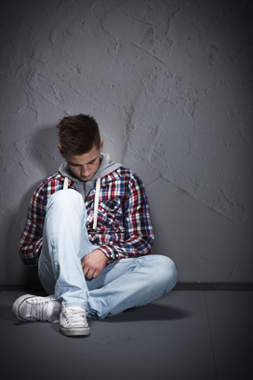
Types of Violence
Bullying—aggressive behavior intended to cause injury or discomfort
Hazing—humiliating or dangerous activity done to gain entrance to a group
Gang violence
Hate crimes
Sexual violence
Click here for the Unit 7 video, “Can Bullies Be Stopped?”
Amir Kaljikovic/shutterstock.com

Slide 13
Cyberbullying
Cyberbullying may include
Sending mean or threatening e-mails or text messages
“Unfriending” people for no reason
Spreading embarrassing or personal information about a person
Hacking into people’s accounts to impersonate them
gemphoto/shutterstock.com

Slide 14
What can you do if you or someone you know is being cyberbullied?
Tell a trusted adult
Do not respond to online taunts
Print out threatening or abusive messages
Avoid the bullies or stay off the Internet as much as possible
Keep your passwords secret
Use privacy settings on social media
Let your parents or guardians know what you are doing online and with whom you are interacting

Slide 15
Internet Violence
In addition to cyberbullying, identity theft is a type of violence that takes place on the Internet
Use of your personal information (birth date, address, social security number) without permission
Child sexual abuse can also begin or take place on the Internet
Online predators meet and develop trusting relationships with potential victims, later suggesting meeting in person
Keep your passwords secret, use social media privacy settings, and let a trusted adult know if anything online makes you uncomfortable

Slide 16
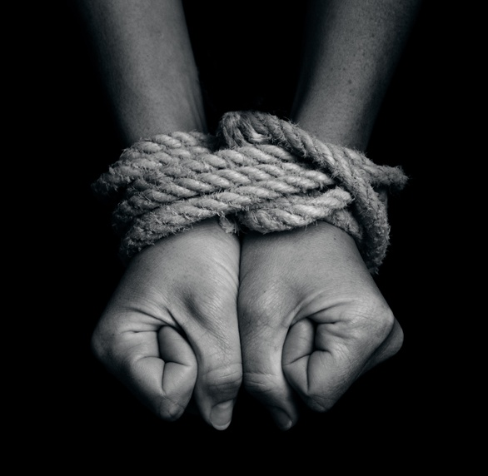
Human Trafficking
A form of modern slavery
People are forced to perform a type of job or service against their will
Threats of violence or other types of pressure from employers
Sex trafficking (including prostitution)
ChameleonsEye/shutterstock.com

Slide 17
What Schools Are Doing
Create a culture that has zero tolerance for violent behaviors
School violence prevention programs teach students the skills to
identify situations that can lead to violence
solve problems without violence
communicate effectively
manage conflict
AntonioDiaz/shutterstock.com

Slide 18
What are some actions being taken by bullying programs in schools?
Selecting strong, positive, responsible student leaders
Develop positive team-building activities
Make sure that all students know there is zero tolerance for violence. Be specific about consequences
Install a buddy system for older students to look out for younger students
Encourage students to immediately report any violent behaviors they observe

Slide 19
Lesson 19.3
The Reality of
Family Violence

Slide 20
Domestic Violence
Abuse that involves couples who are married, dating, or in a romantic relationship
Occurs when one person in a relationship uses physical violence or mental or emotional abuse to control or dominate the other person
Abuse and violence should not occur in healthy relationships
Halfpoint/shutterstock.com

Slide 21
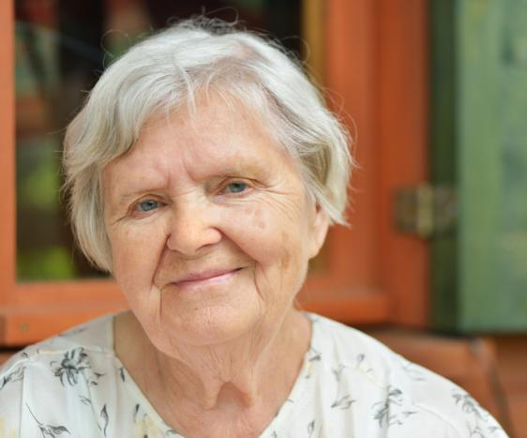
Elder Abuse
Any abuse or neglect that harms or seeks to harm an older adult
Typically committed by family members or paid caregivers
Abuse can be physical, emotional, sexual, or financial
Abuse can also be neglect, a failure to provide for an older adult’s basic needs
itsmejust/shutterstock.com

Slide 22
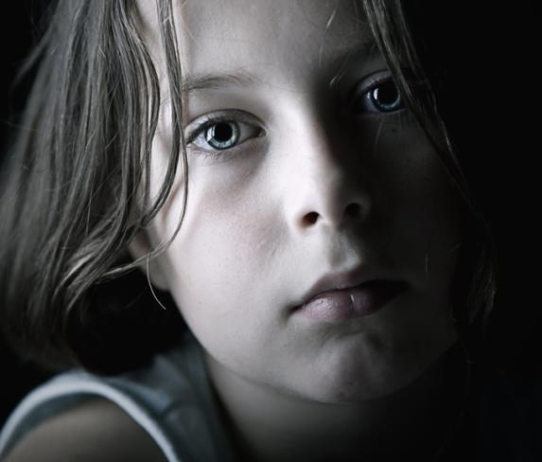
Child Abuse
Physical, emotional, psychological, or sexual abuse committed by parents or caregivers
Child sexual abuse—type of abuse in which an adult uses a child for sexual stimulation
Neglect—type of abuse that involves caregivers not meeting a dependent person’s basic needs
JPagetRFPhotos/shutterstock.com

Slide 23
Critical Thinking
What are some consequences of child abuse?
The child’s sense of well-being is shattered
Physical injuries—brain damage, blindness, motor impairments, cognitive impairments
Greater likelihood of developing diseases as adults
Greater likelihood of engaging in behaviors that could harm their health (smoking, drinking, abusing drugs)
Greater likelihood of experiencing psychological problems (depression, anxiety, eating disorders, PTSD)
Can impair the ability to establish and maintain healthy relationships in adulthood

Slide 24
Lesson 19.4
Unwanted Sexual Activity

Slide 25
What Is Sexual Violence?
Includes rape, or nonconsensual sexual intercourse
Can include kissing and sexual touching if consent is not given
Includes sexual abuse of children by family members, domestic abuse of one spouse by another, stranger rape, and date rape
More males than females carry out acts of sexual violence
Both males and females can be victims of sexual attacks

Slide 26
The Importance of Consent
A direct, verbal agreement that occurs when a person clearly says yes
Consent does not occur if a person says no or nothing at all
Without mutual consent—consent by both people—unwanted sexual activity is sexual abuse or rape
People do not consent to sexual activity if they are
Pressured or coerced by someone else
Under the influence of alcohol or drugs
Asleep or unconscious
Younger than a particular age—typically 16, 17, or 18

Slide 27
Give examples of how sexual violence can impact physical, emotional, and social health.
Physical: bruises, broken bones, pelvic pain, gastrointestinal disorders, migraines, back pain
Emotional: shock, denial, fear, anxiety, shame, guilt, confusion, depression, post-traumatic stress disorder
Social: hesitancy to trust people, alienation from friends and family members, unfair shame or blame from society

Slide 28
Rape
Involves sexual violence, but is often described as an act of power and aggression
Rapists can be strangers or acquaintances
Acquaintance rape—rape committed by someone the victim knows
Rapists use force, violence, weapons, or alcohol or drugs to make other people submit to sexual acts
RomanRuzicka/shutterstock.com

Slide 29
Getting Treatment
Get to a safe place
Get medical care to treat injuries and prevent sexually transmitted infections
Talk to doctors about preventing pregnancy
Contact police to report rape
Save clothing as evidence
Share your experience with a trusted adult
Get psychological counseling
Know that rape is only the rapist’s fault
Wavebreak Media/thinkstock.com

Slide 30
Although sexual assault is never the victim’s fault, you can take steps to reduce your risk of becoming a victim. What are some steps you can take to prevent assault?
Be aware of your surroundings
Avoid walking alone, especially at night
Never accept a ride from a stranger
If you are attacked, yell stop to attract attention
Avoid using alcohol or drugs
Let people know where you are going
Do not leave a drink unattended
Get out of any situation that makes you uncomfortable

Slide 31
Sexual Harassment
Any unwanted sexual attention
Verbal—the use of words, gossip, threats, sexual jokes, or inappropriate comments
Nonverbal—sexual gestures, pinching, rubbing, or brushing up against someone in an inappropriate way
LDprod/shutterstock.com

Slide 32
Critical Thinking
What can you do if you are experiencing sexual harassment?
Record details of events, dates, locations, and possible witnesses to the harassment
Save e-mails, texts, and other communication as evidence
At work, speak to a supervisor or human resources
At school, speak to a teacher, counselor, or principal
What can a bystander do to help?
Try to get the person being harassed out of the situation
Notify someone who can stop the harassment

