Slide 1




ACM Cheer & Mascot Tryouts
Parent Informational Meeting
Monday, March 6, 2023 - 5:00 PM - ACM Cafe’

Slide 2
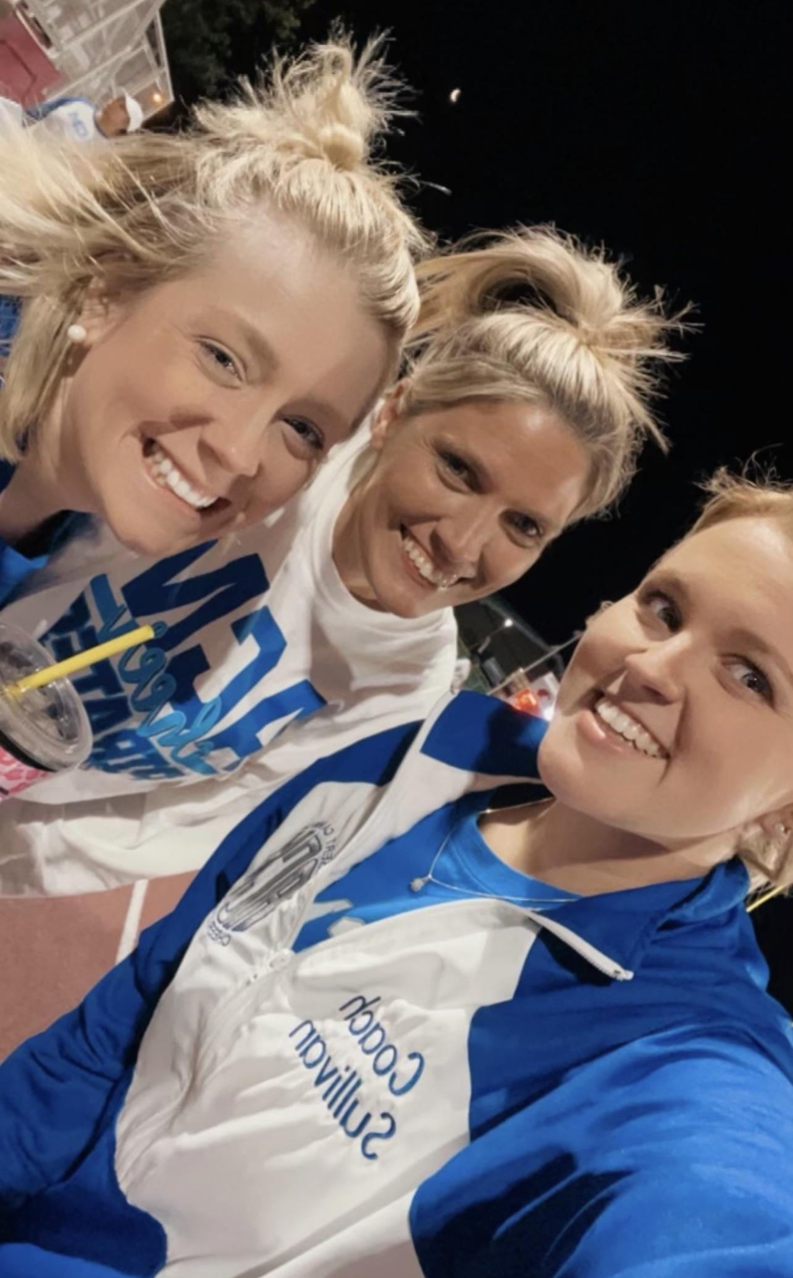
mEET THE COACHES
HEAD COACH - aDRIENNE dOZIER
ASSISTANT COACH - LAURA SULLIVAN
vOLUNTEER COACH - bETSY LOPER

Slide 3
COACH CONTACT INFO
adozier@stcharles.k12.la.us
lsullivan@stcharles.k12.la.us
ACM PHONE (504) 467-4536

Slide 4
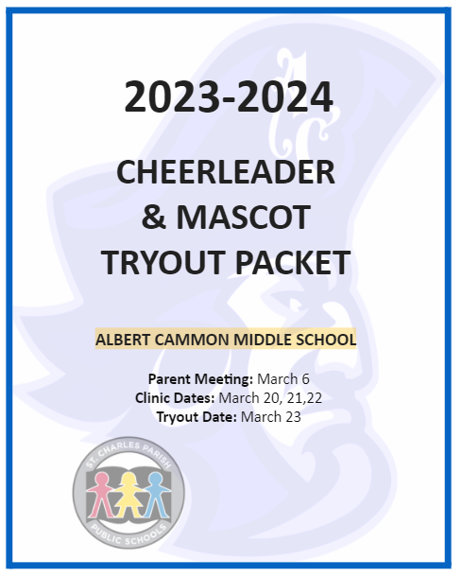
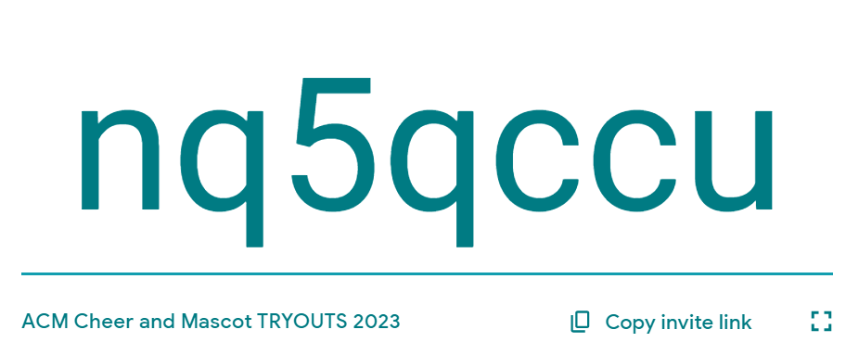
TRYOUT PACKET AND GOOGLE CLASSROOM
GOOGLE CLASSROOM CODE
All required forms are included in this packeT, as well as our ACM Cheer Handbook and the District Handbook. the remaining contents of the packet must be kept to refer to throughout the season should you make the team. pLEASE JOIN THE GOOGLE CLASSROOM!

Slide 5
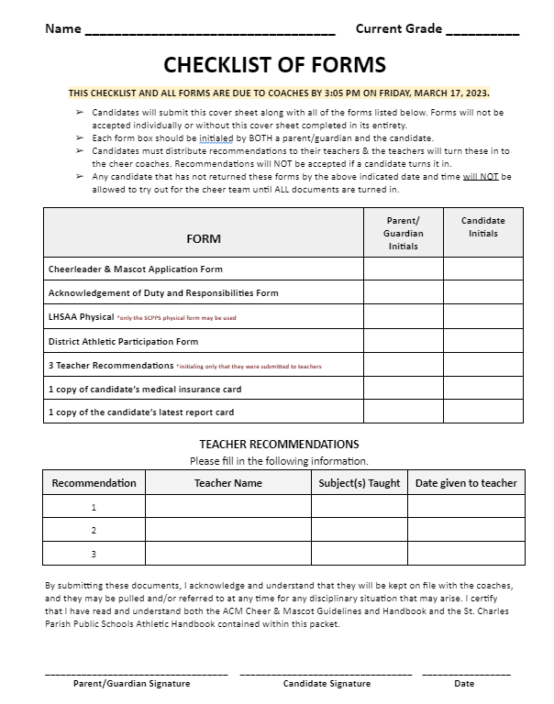
CHECKLIST OF FORMS
Submit this cover sheet along with all of the forms listed below.
  Forms will not be accepted individually or without this cover sheet completed in its entirety.
Initialing
Teacher Recommendations
Any candidate that has not returned these forms by the above indicated date and time will NOT be allowed to try out for the cheer team until ALL documents are turned in.

Slide 6
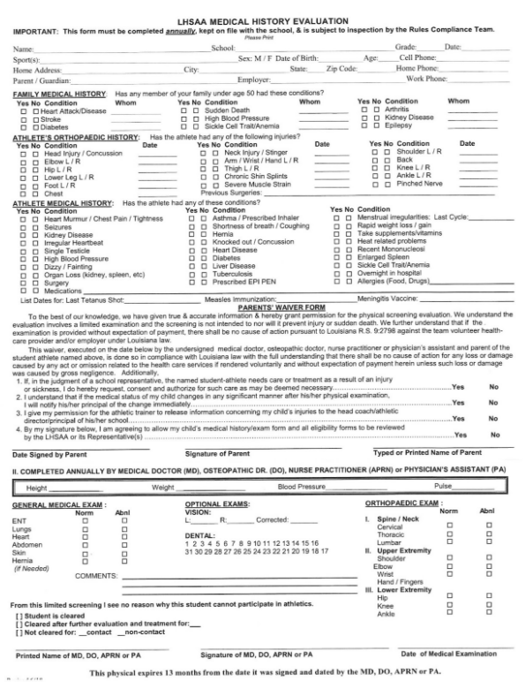
Lhsaa physical form
***Only the SCPPS physical form may be used!

Slide 7
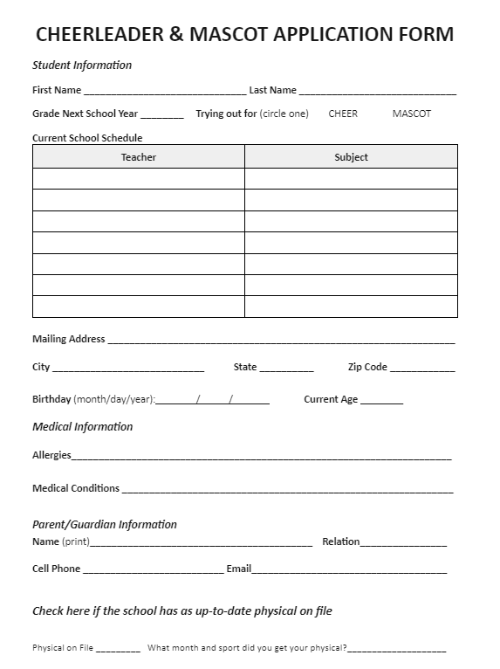
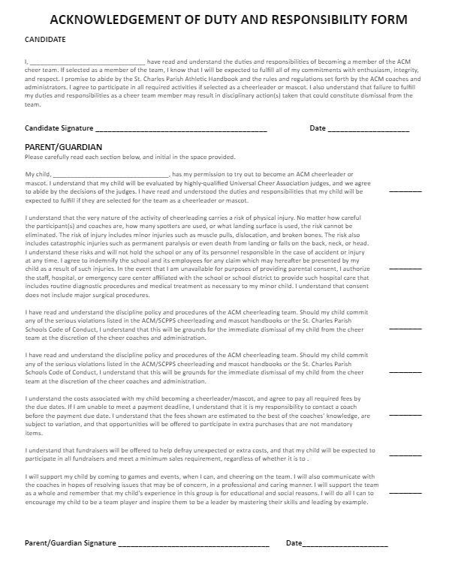
Application & adrf forms

Slide 8
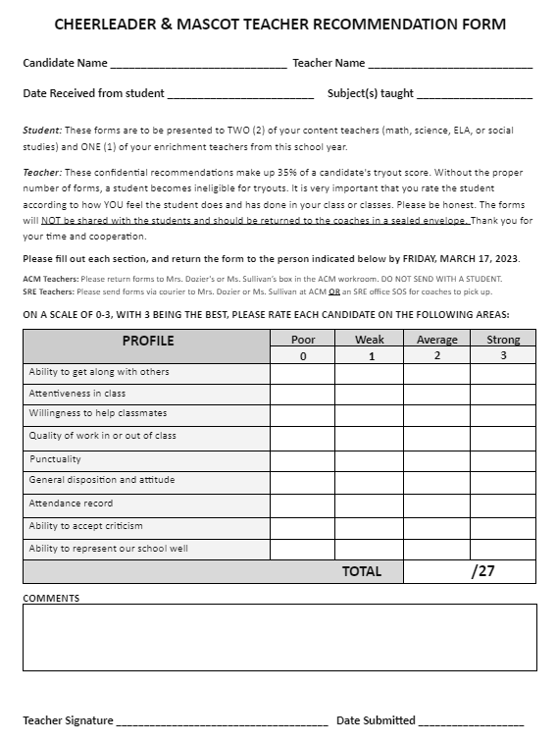
TEACHER RECOMMENDATIONS
THREE (3) teacher recommendations are required
  math, science, ELA, or social studies
2 core teachers, 1 enrichment
MUST GIVE TO TEACHERS IMMEDIATELY

Slide 9
ATTIRE GUIDELINES FOR CLINIC & TRYOUTS
On clinic days, candidates should wear:
Any appropriate t-shirt
Any color appropriate shorts
Bikers/bloomers underneath shorts
Tennis shoes
On tryout day, cheer candidates MUST wear:
PLAIN white t-shirt (no logos
Black shorts
Bikers/bloomers underneath shorts
White socks
Tennis shoes
On tryout day, mascot candidates may wear any appropriate attire described under clinic days, as they will be dressing out in the full mascot costume to try out.

Slide 10
Clinic & tryout dates
Tryout clinic will be held March 20th, 21st, and 22nd from SRE (3:35) & ACM (3:00) dismissal times until the conclusion of after-school activities at 4:50.
  SRE candidates will be escorted to ACM by a cheer coach OR an SRE faculty/staff member.
  All candidates will need to be picked up and signed out in the office by 4:50 PM each day, or they will ride the activity bus home.
  Practice buses will be available to transport students home when practice is over on Monday-Wednesday. Please be advised that practice buses do not drop students off at individual addresses.
Tryouts will be held from 3:05 PM - till on Thursday, March 23rd.
  All candidates should report to the office and be picked up IMMEDIATELY after their tryout is over if they do not have another supervised after-school activity.
Candidates must be present each day to be considered for the team.

Slide 11
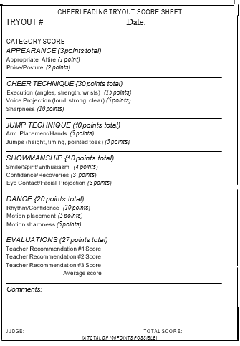
Judging rubric
This is the rubric that judges will use to score each individual CANDIDATE.
The team will be selected based upon the natural break in scores from the judges.
The natural break is defined as a point at which scores differ significantly. We have no way to know how many candidates will make the team until SCORES ARE CALCULATED.

Slide 12
Important and Mandatory Dates
UCA Cheer & Mascot Overnight Camp on June 5-8 is MANDATORY.
Candidates should NOT try out if they are unable to be present for camp in its entirety.
If you are already committed to another activity that interferes with our football games, you should not try out.
Please note the following:
For practices taking place in April and May, SRE 5th graders will be walked to ACM after their dismissal by a cheer coach or SRE faculty/staff member.
Additional practices MAY BE ADDED OR CANCELED at any time.
Coaches will make every effort to communicate cancellations and/or additions in a timely manner via SchoolStatus and school announcements.
It is very important that cheerleaders pay attention to the school announcements and check the Google Classroom daily.

Slide 13
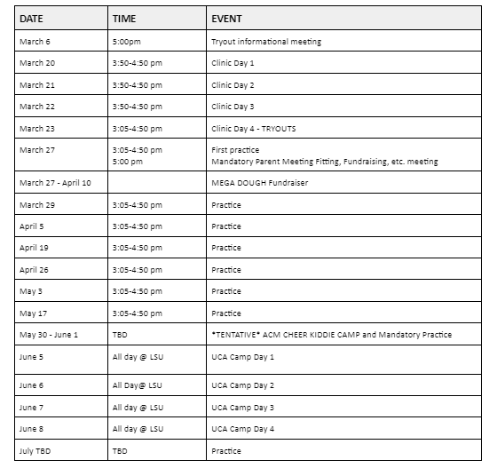

Slide 14
fundraisers
The ACM cheer team participates in a variety of fundraisers throughout the year to specifically help offset both individual and team costs and expenses. They are spaced out throughout the season, and participation is REQUIRED by all members of the team, as well as the coaches.
MegaDough
Kiddie Camp
Nothing Bundt Cakes
Details outlining all of these set fundraisers can be found in the packet.

Slide 15
Approximate costs
PLEASE DO NOT ALLOW THE COSTS OUTLINED BELOW TO DETER YOU FROM ALLOWING YOUR CHILD TO TRY OUT TO BECOME A CHEERLEADER OR MASCOT. AS COACHES, WE WOULD NEVER WANT ANY INTERESTED CHILD TO MISS OUT ON THE OPPORTUNITY TO BE A PART OF SUCH AN EXCITING, REWARDING, AND FULFILLING TEAM THAT SPREADS SCHOOL SPIRIT YEAR-ROUND. IF YOU HAVE FINANCIAL NEED OR DIFFICULTIES, PLEASE REACH OUT TO A COACH, AND WE WILL MAKE EVERY EFFORT POSSIBLE TO ACCOMMODATE YOUR NEEDS.

Slide 16
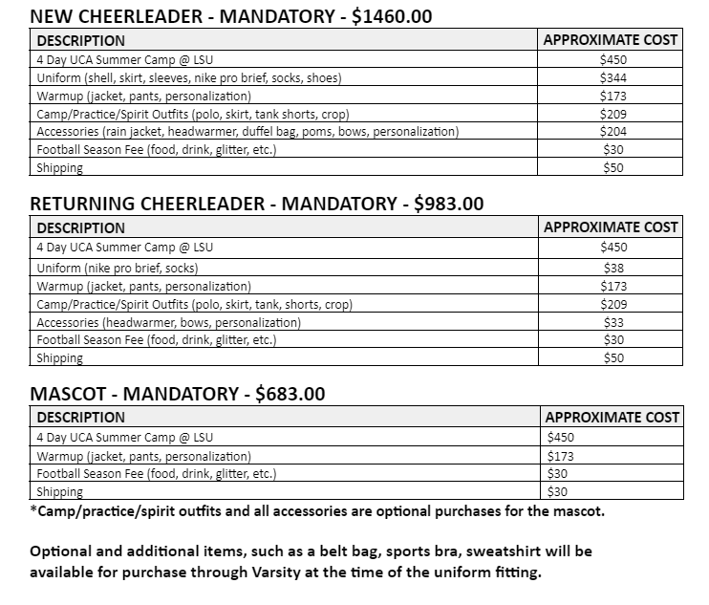
Approximate costs

Slide 17
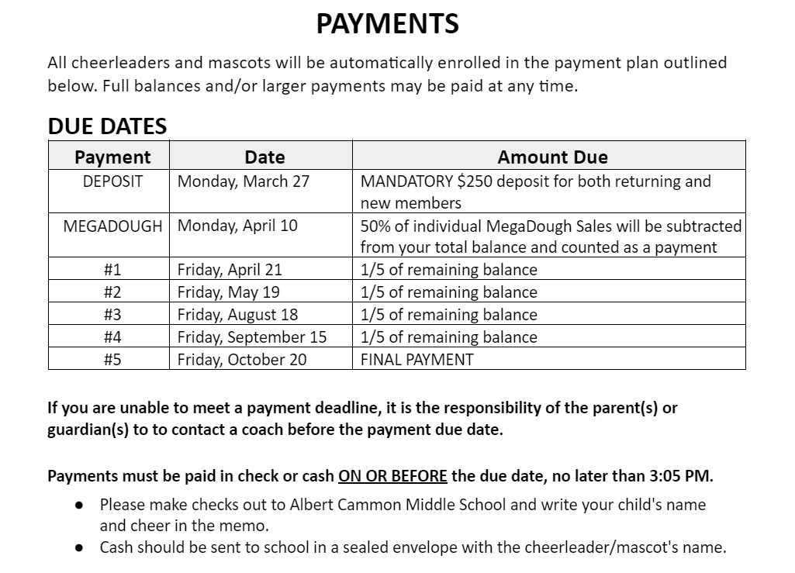
Payment plans

Slide 18
Discipline and Attendance
Our handbook EXPLAINS exactly how to handle attendance and excuses. Absences affect the entire team, therefore you should make every effort to be present at all practices and performances.
Discipline is outlined in the handbook. Cheerleaders and Mascots can receive a variety of consequences including, but not limited to: demerits, physical conditioning, being removed from a stunt and/or routine, being benched for an event, and up to removal from the team.

Slide 19
QUESTIONS?

Slide 20
Thank you for coming!

