Slide 1
Scheduling 101
A Guide to Scheduling Gifted, Honors, & AP classes
An overview for Gifted, Honors, & Advanced Placement students

Slide 2
What is the Honors Program?
The Honors Program is the highest academic recognition offered at DHS. The benefits include earning college credit, increasing your ACT scores, and recognition with a letterman’s jacket and stole/cord at graduation.
Honors Program Recognition REQUIREMENTS
Pass 18 Honors, Gifted, DE, and/or AP classes with a grade of C or better.
  4 Honors, Gifted, Dual Enrollment, & AP English classes
  4 Honors, Gifted, Dual Enrollment, & AP Math classes
  4 Honors, Dual Enrollment, & AP Science classes
  4 Honors, Dual Enrollment, & AP Social Studies classes (must include H Civics, APUSH)
  2 additional Honors, Dual Enrollment, & AP classes of your choice
Earn an overall 85 B average in all Honors, Gifted, DE and AP classes.
Remember :
You MUST start this journey in 9th grade.

Slide 3

What are my choices?
Choice 1:
Pursue Honors Program Recognition.
Choice 2:
Take Honors, DE, and AP classes in your area(s) of strength and/or interest.
Students can take 1, 2, 3, or 4 Honors courses in 9th-grade.
Choices include: Honors English I, Honors Geometry, Honors Biology, and Honors Civics.
Note: If a 9th-grader is in Algebra I and wants to pursue Honor Program Recognition, he/she must also take Honors Geometry in 9th grade.

Slide 4
9 Honors Classes are offered at DHS
Honors English I
Honors English II
Honors Geometry
Honors Algebra II
Honors Pre-Calculus
Honors Calculus
Honors Biology I
**Honors Chemistry I
Honors Physics
Honors Civics
HONORS classes are offered in core areas only …

Slide 5
11 Gifted Classes are offered at DHS
English:
Gifted English I
Gifted English II
Gifted English Seminar
Gifted AP Language & Composition
Gifted AP Literature & Composition
Gifted Independent Study
Math:
Gifted Geometry
Gifted Algebra II
Gifted Pre-Calculus
Gifted Calculus (Differential)
Gifted AP Calculus AB (Integral)
Remember that only students who have been identified as “gifted” are eligible to enroll in gifted classes.

Slide 6

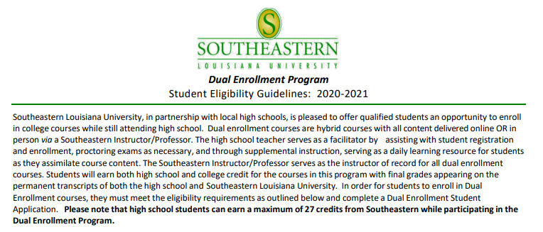
Dual Enrollment**
Requirements: 2.5 overall GPA, min 11th grade, ACT composite of 19 (ELA – 19, Math – 18)
**Only DE courses that qualify on the TOPS University 5-point scale are acceptable as Honors Program Recognition .
https://www.southeastern.edu/future_students/dual_enrollment/index.html

Slide 7
Dual Enrollment** classes offered at DHS
  11th grade: DE English III: English Comp I in lieu of AP Language & Composition
  12th grade: DE English IV: English Comp II in lieu of AP Literature & Composition
  11th or 12th grade: DE College Algebra in lieu of Honors Pre-Calculus
  11th or 12th grade: DE College Trigonometry (must take DE College Algebra first)
  11th or 12th grade: DE Statistics (must take DE College Algebra first)
  11th grade: DE Chemistry I in lieu of Honors Chemistry I
  12th grade: DE Chemistry II
  12th grade: DE Biology I
  11th or 12th grade: DE Spanish 101 and DE Spanish 102

Slide 8
Dual Enrollment** classes offered at DHS
*Please note: Dual enrollment credit is only honored at Louisiana public universities and some private/out-of-state universities. Students planning to attend private and/or out-of-state schools should check with that potential university to determine if DE courses are accepted. All students are encouraged to consider AP courses as well.
**Only DE courses that qualify on the TOPS University 5-point scale are acceptable as Advanced Studies Diploma courses.

Slide 9
What’s the difference between Advanced Placement and Dual Enrollment?
Advanced Placement Dual Enrollment
- AP credit is honored nationally/ - *DE credit is recognized by LA public globally. universities and some private/out-of- state universities.
- AP courses are taught by DHS - DE courses are taught by
faculty with AP-approved faculty in a course designed
curricula. by Southeastern University.
- The AP test is given in May and - DE credit is awarded to 11th & 12th grade
course credit it awarded for scores students who meet the initial ACT
of 3, 4, or 5, based on the guidelines requirement and pass required the
set by that university. in-course tests/assessments.
- Does not impact college transcript - College credit on the permanent college transcript

Slide 10
15 AP Classes are offered at DHS
English
  AP Language & Composition
  AP Literature & Composition
STEM
  AP Calculus AB
  AP Biology II
  AP Environmental Science
  AP Computer Science Principles
  AP Computer Science A
History & Social Sciences
  AP Human Geography
  AP US History
  AP World History
  AP Psychology
Arts
  AP Art History
  AP Studio Art (2-D,3-D, and Drawing)
  AP Music Theory

Slide 11
ACT ALL STARS
All thirty students who scored a 28 or higher on the ACT are in the honors program.
Also, all twenty students who have a 30+ on the ACT are in the honors program.

Slide 12
AP AWARDS
We had 64 students last year qualify as AP Scholars, meaning they earned a 3 or higher on at least three or more exams.

Slide 13
AP AWARDS
We had 11 students qualify as an AP Scholar with Honor: students earned an average of 3.25 on AP exams, with a 3 or higher on at least four exams.
Students who earn at least this much credit are essentially earning a semester or more of college, before they even start.

Slide 14
AP AWARDS
We had 13 students qualify as an AP Scholar with Distinction: students earned an average of 3.5 on AP exams, with a 3 or higher on at least five exams
One of these students went to LSU with 29 credit hours, which she says allows her to take the classes she wanted in her major.

Slide 15
NATIONAL MERIT SCHOLARS
All four of our National Merit Scholar Semi-Finalists are honors students
If they become finalists, then they have the opportunity to earn scholarships to over 160 schools, including LSU, LA Tech, and Tulane.
Many of these schools offer full rides, opportunities for travel, and internships.

Slide 16
WHAT HONORS STUDENTS HAVE TO SAY
It is statistically proven that just taking honors classes increases college acceptability, while also promoting a work-life balance necessary for later life.
Instead of being forced to gain all the skills needed for college while already in college, honors classes are a risk-free test run of sorts. If you mess up in high school, it's a lot easier to recover from than a slip-up in college.

Slide 17
Sample 9th-grade Honors schedule
Fall
1. Honors English I
2. Algebra I or other elective
3. Honors Civics
4. PE I
Spring
1. Band or another elective
2. Honors Geometry
3. Honors Biology I
4. Elective
Additional electives: Electives for 9th-graders are somewhat limited, and are listed in the DHS Course Catalog. Suggestions are included below.
**Quest for Success (You will be scheduled in this elective if you are NOT in 4 honors classes.)
Foreign Language | Fine & Applied Arts | STEM | Talented
Spanish I | Art I | Basic Drafting | Talented Drama
 | Cadet Band | IBCA | Talented Music
(Only students who are taking ALL Honors/gifted courses can start foreign language in 9th grade.) | Choir | General Tech | Talented Visual Arts
 | Family and Consumer Sciences | AP Computer Science Principles

Slide 18
Who can apply for Honors Program classes?
ELIGIBILITY REQUIREMENTS
To enroll in an Honors class at the freshman level, a student should …
have earned an A or a B in the preceding class.
have a core GPA of 3.0.
have scored Mastery or Advanced on LEAP tests.
have strong teacher recommendations.
THIS IS A FULL YEAR COMMITMENT!

Slide 19
How do I express interest in Honors Program?
The Honors Program Letter of Intent:
Access the DHS Honors Program-Portal Google Classroom. Email dsniezak@stcharles.k12.la.us or ask your counselor if you need the class code.
There are 3 simple steps to the process:
  1. Complete the Google Form: DHS Student Survey of Intent for DHS Honors Program.
  2. Submit a copy of your most recent report card to dsniezak@stcharles.k12.la.us.
  3. Email two of your core teachers and ask them to complete a teacher recommendation form on your behalf.
Submit all components by February 2, 2024.

Slide 20
How does the scheduling process work?
Our responsibilities:
  By early May:
    The Honors Team will review intention, recommendations, and grades.
  In late May:
    Placement letters will be emailed to the parent’s email address.
Your responsibilities:
Complete an Honors Program Intent to Enroll
Packet, choose your classes, sign the commitment oath, copy your report card, and submit all materials to DHS by
February 2, 2024.

Slide 21
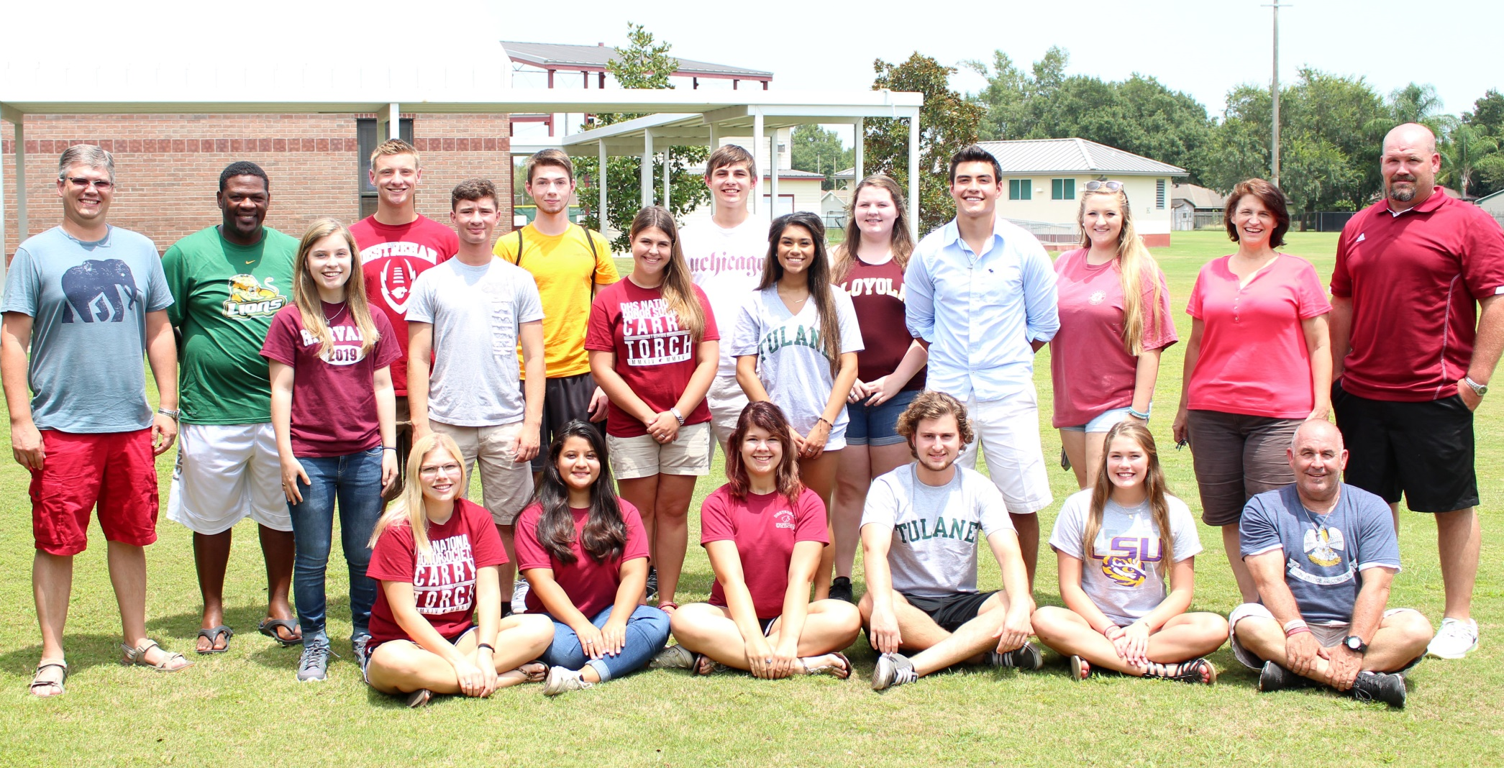
APPLICATION DEADLINE: February 2, 2024
No excuses …

Slide 22
Speaking of NO EXCUSES … Need a life?
It could be here!
DHS Honors Program students are leaders and participants in all of the following and more:
Sports: football, soccer, tennis, basketball, baseball, softball, swimming, wrestling
Clubs: National Honor Society, Beta, Interact, Mu Alpha Theta, WISE Ecology Club,
Culture Club, National English Honor Society, Anime Club, Newspaper,
Yearbook, and Film Club
Robotics JROTC
Pride of Destrehan Band DHS Indoor Percussion
Desty Darlings DHS Cheerleaders
Student Council E-Board DHS Choir, Show Choir
Athletic Trainers Girls & Boys State
Gifted, Talented Art, Talented Theater, Talented Music Wildcat Mentors
State, District, and Parish Honor Band and Honor Choir Young Authors
District and State Literary Rally
Find your place . . .

Slide 23
Contact Us
All information is available on the DHS website
      Academics
      Advanced Placement
Email an Honors Program Representative:
  D’Otta Sniezak, 9th - 12th-grade Gifted English Teacher dsniezak@stcharles.k12.la.us
  William Plasse, 11th & 12th-grade AP English Teacher wplasse@stcharles.k12.la.us
  Jordyn Vicknair, 9th - 12th-grade Gifted Math Teacher jvicknair3@stcharles.k12.la.us
  Max Suitt, 11th & 12th-grade AP Social Studies Teacher msuitt@stcharles.k12.la.us
  Sarah Vines, 9th & 12th grade Honors/AP Biology Teacher svines@stcharles.k12.la.us
  Laura Abbey, AP administrator, labbey@stcharles.k12.la.us

Slide 24
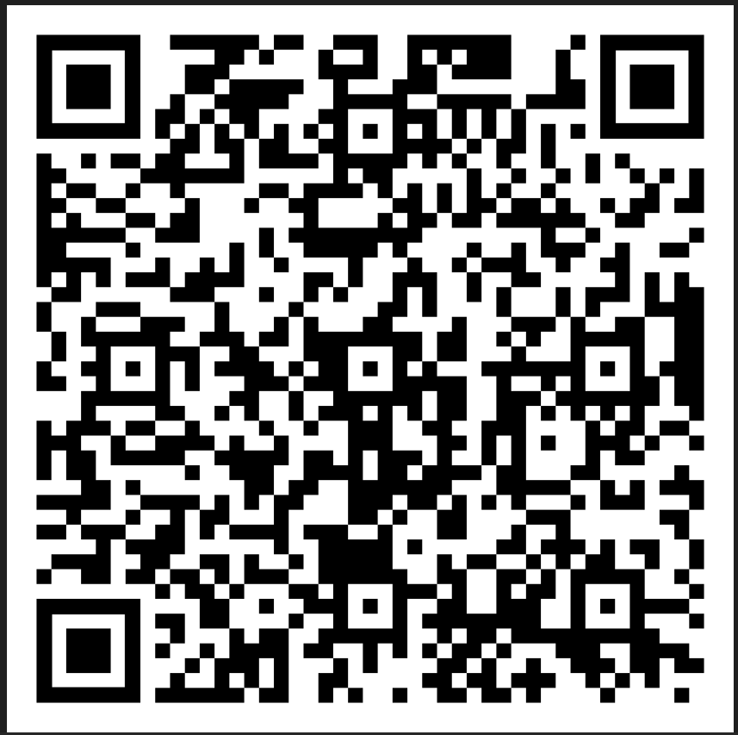
Contact Us
Classroom Code
qntarcp

