Slide 1
2024-2025 SCOC Disciplinary Updates
SCHOOL
DISCIPLINE

Slide 2
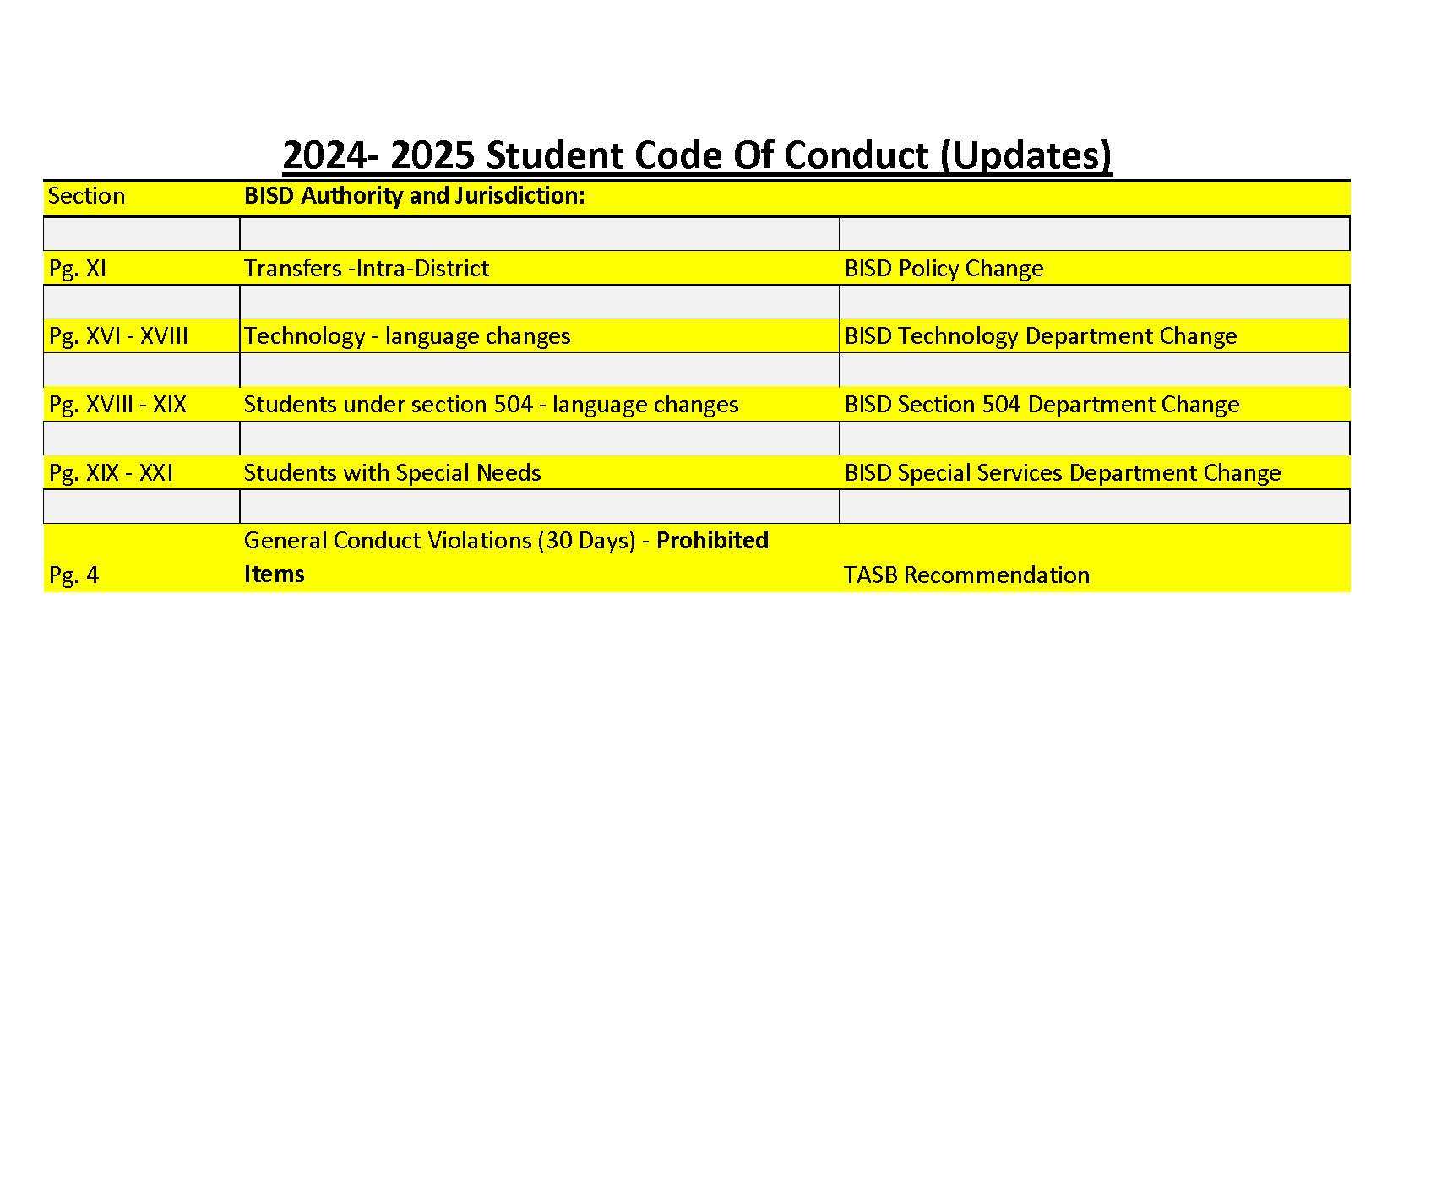
Brownsville Independent School District Department of Pupil Services
708 Palm Blvd., Brownsville, Texas 78521
Office (956) 544-3966

Slide 3
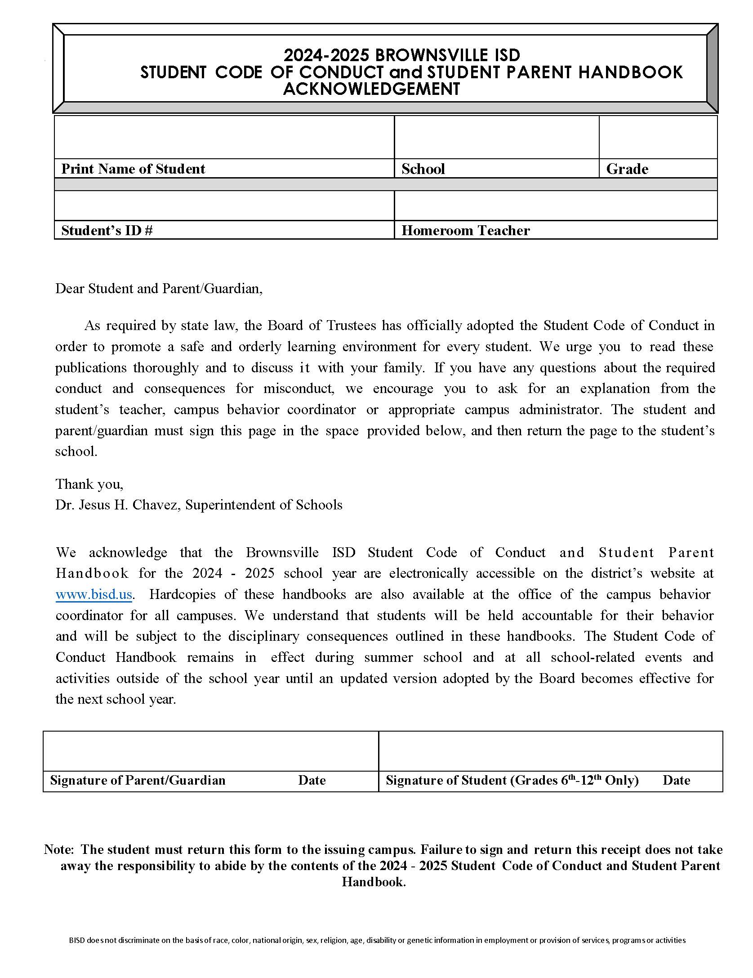
Brownsville Independent School District Department of Pupil Services
708 Palm Blvd., Brownsville, Texas 78521
Office (956) 544-3966

Slide 4
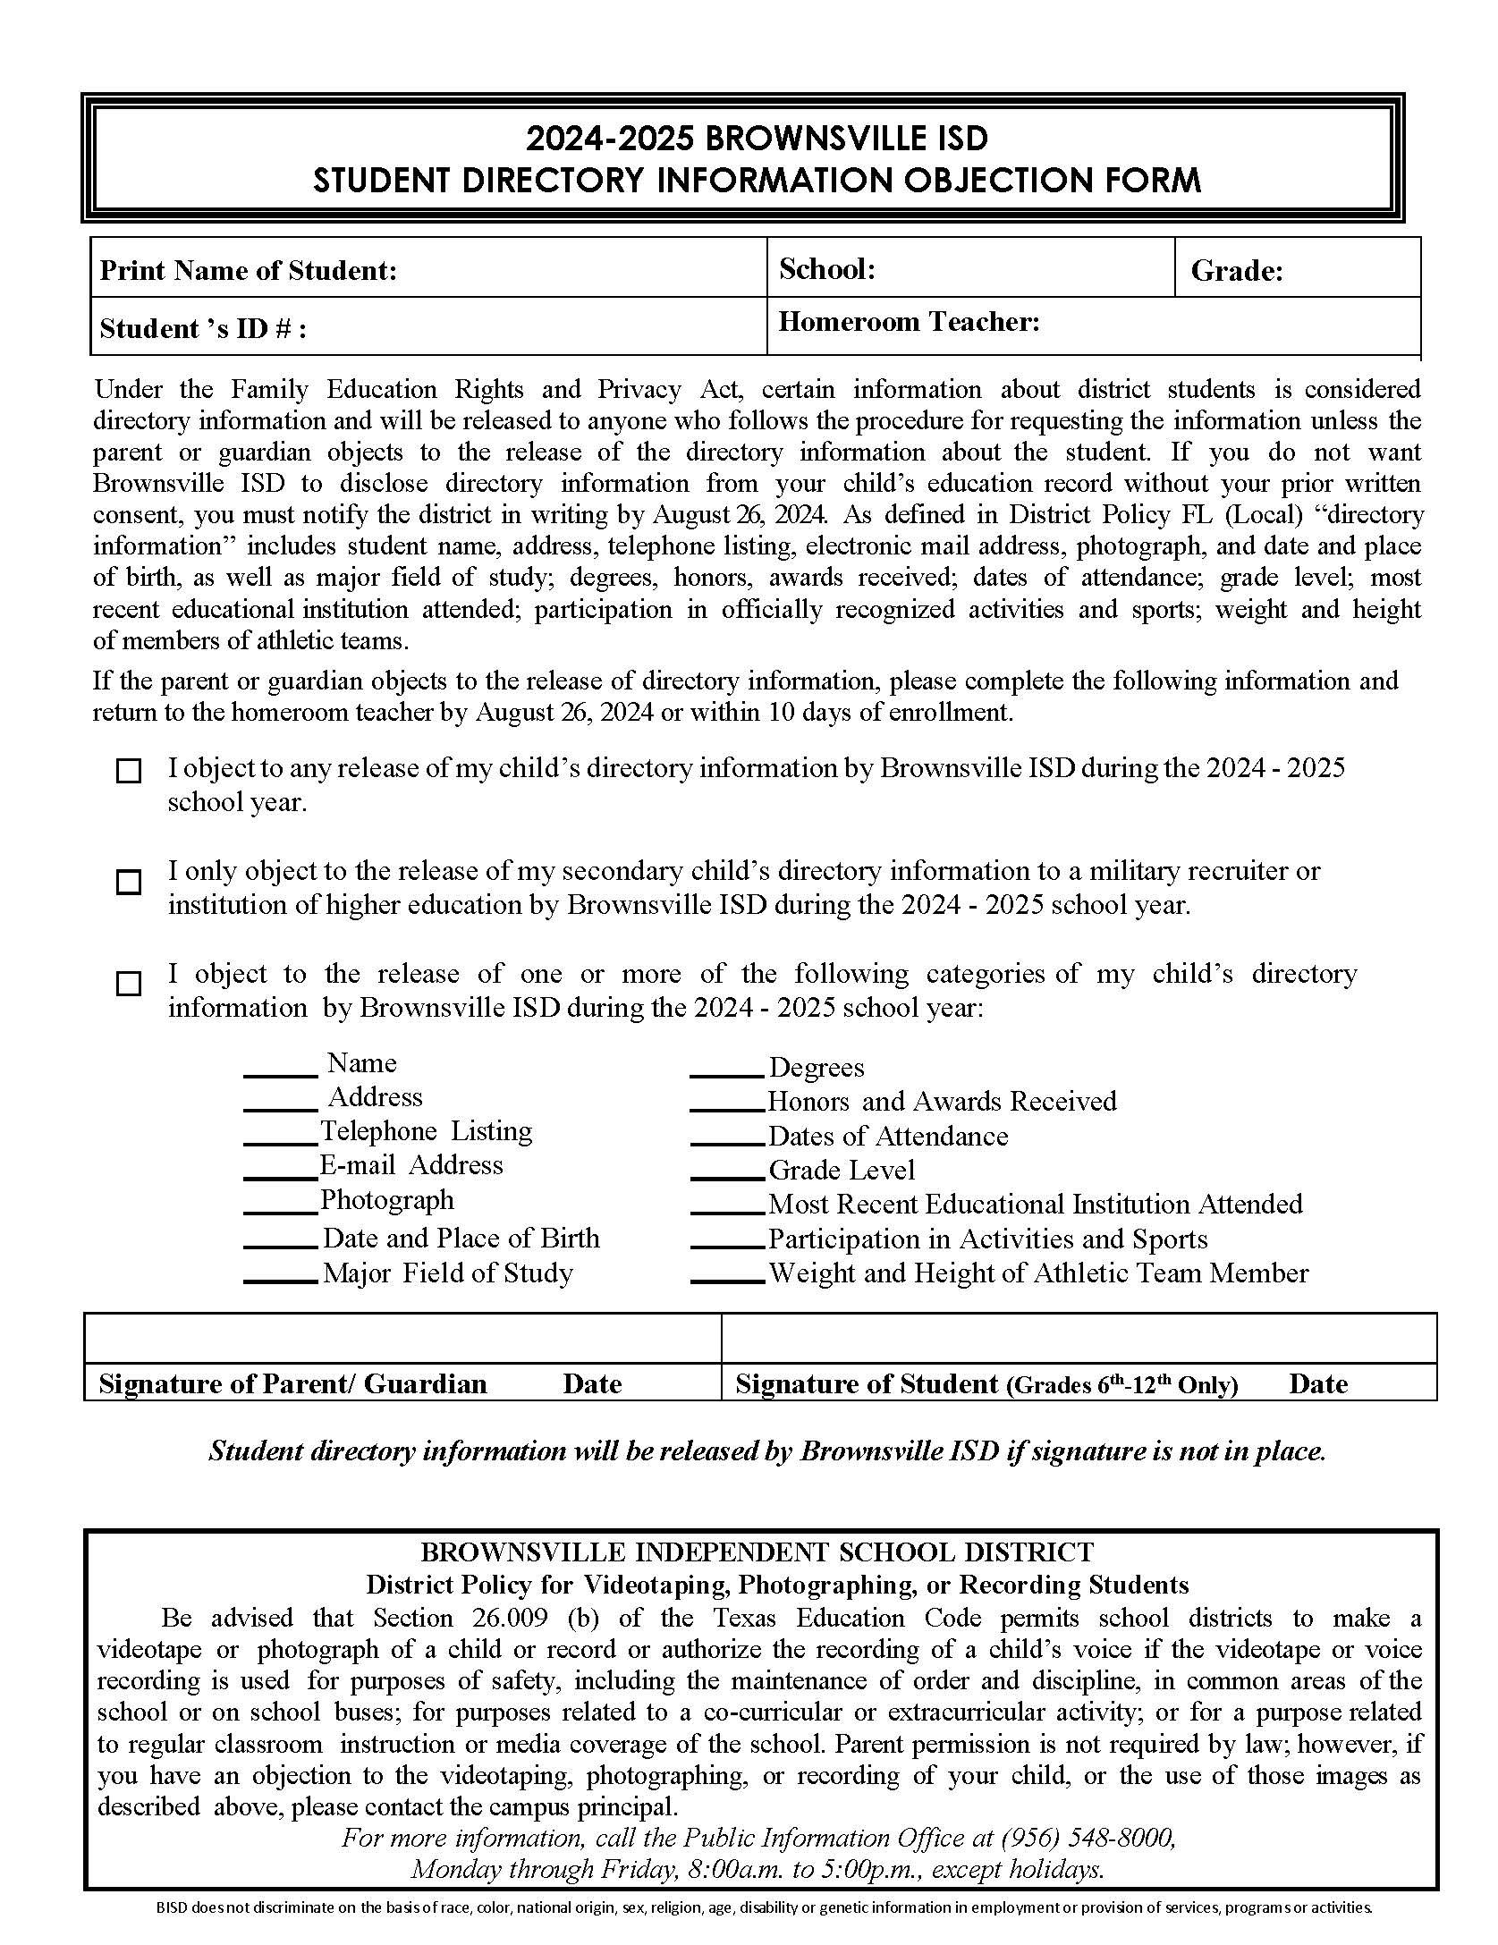
Brownsville Independent School District Department of Pupil Services
708 Palm Blvd., Brownsville, Texas 78521
Office (956) 544-3966

Slide 5
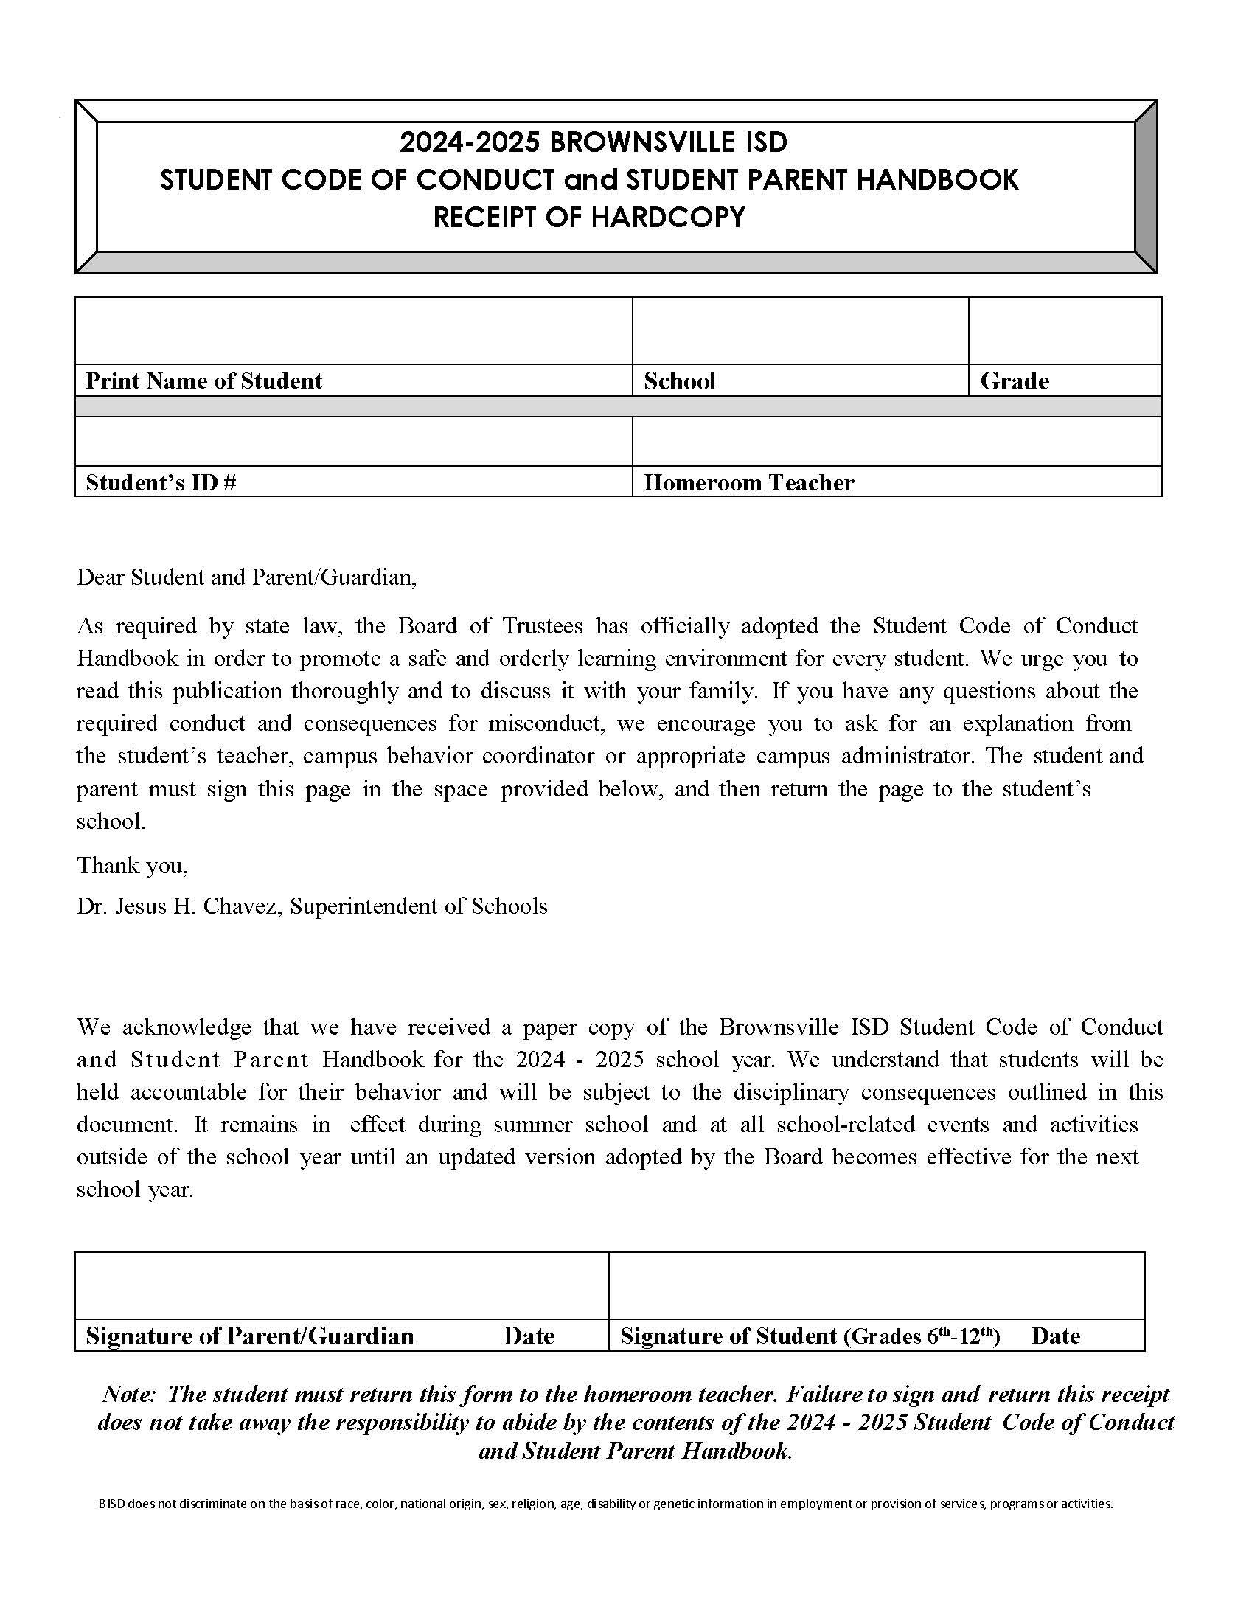
Brownsville Independent School District Department of Pupil Services
708 Palm Blvd., Brownsville, Texas 78521
Office (956) 544-3966
.

Slide 6
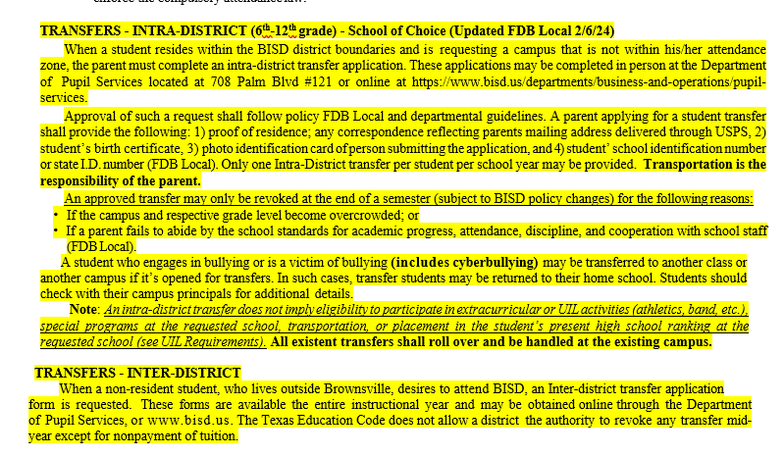
Brownsville Independent School District Department of Pupil Services
708 Palm Blvd., Brownsville, Texas 78521
Office (956) 544-3966
FDB Local Policy Update 2/2024

Slide 7
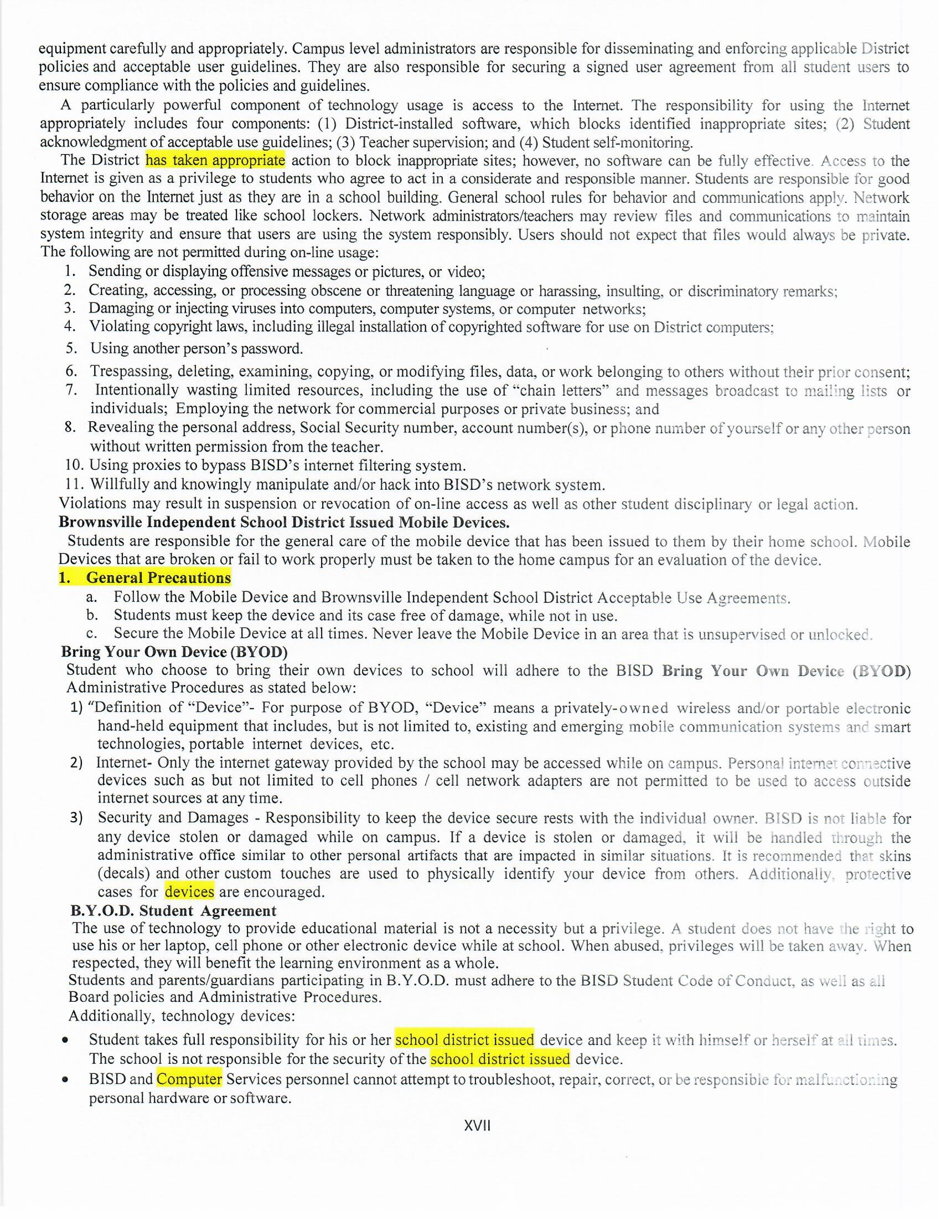
Brownsville Independent School District Department of Pupil Services
708 Palm Blvd., Brownsville, Texas 78521
Office (956) 544-3966
TECHNOLOGY UPDATE

Slide 8
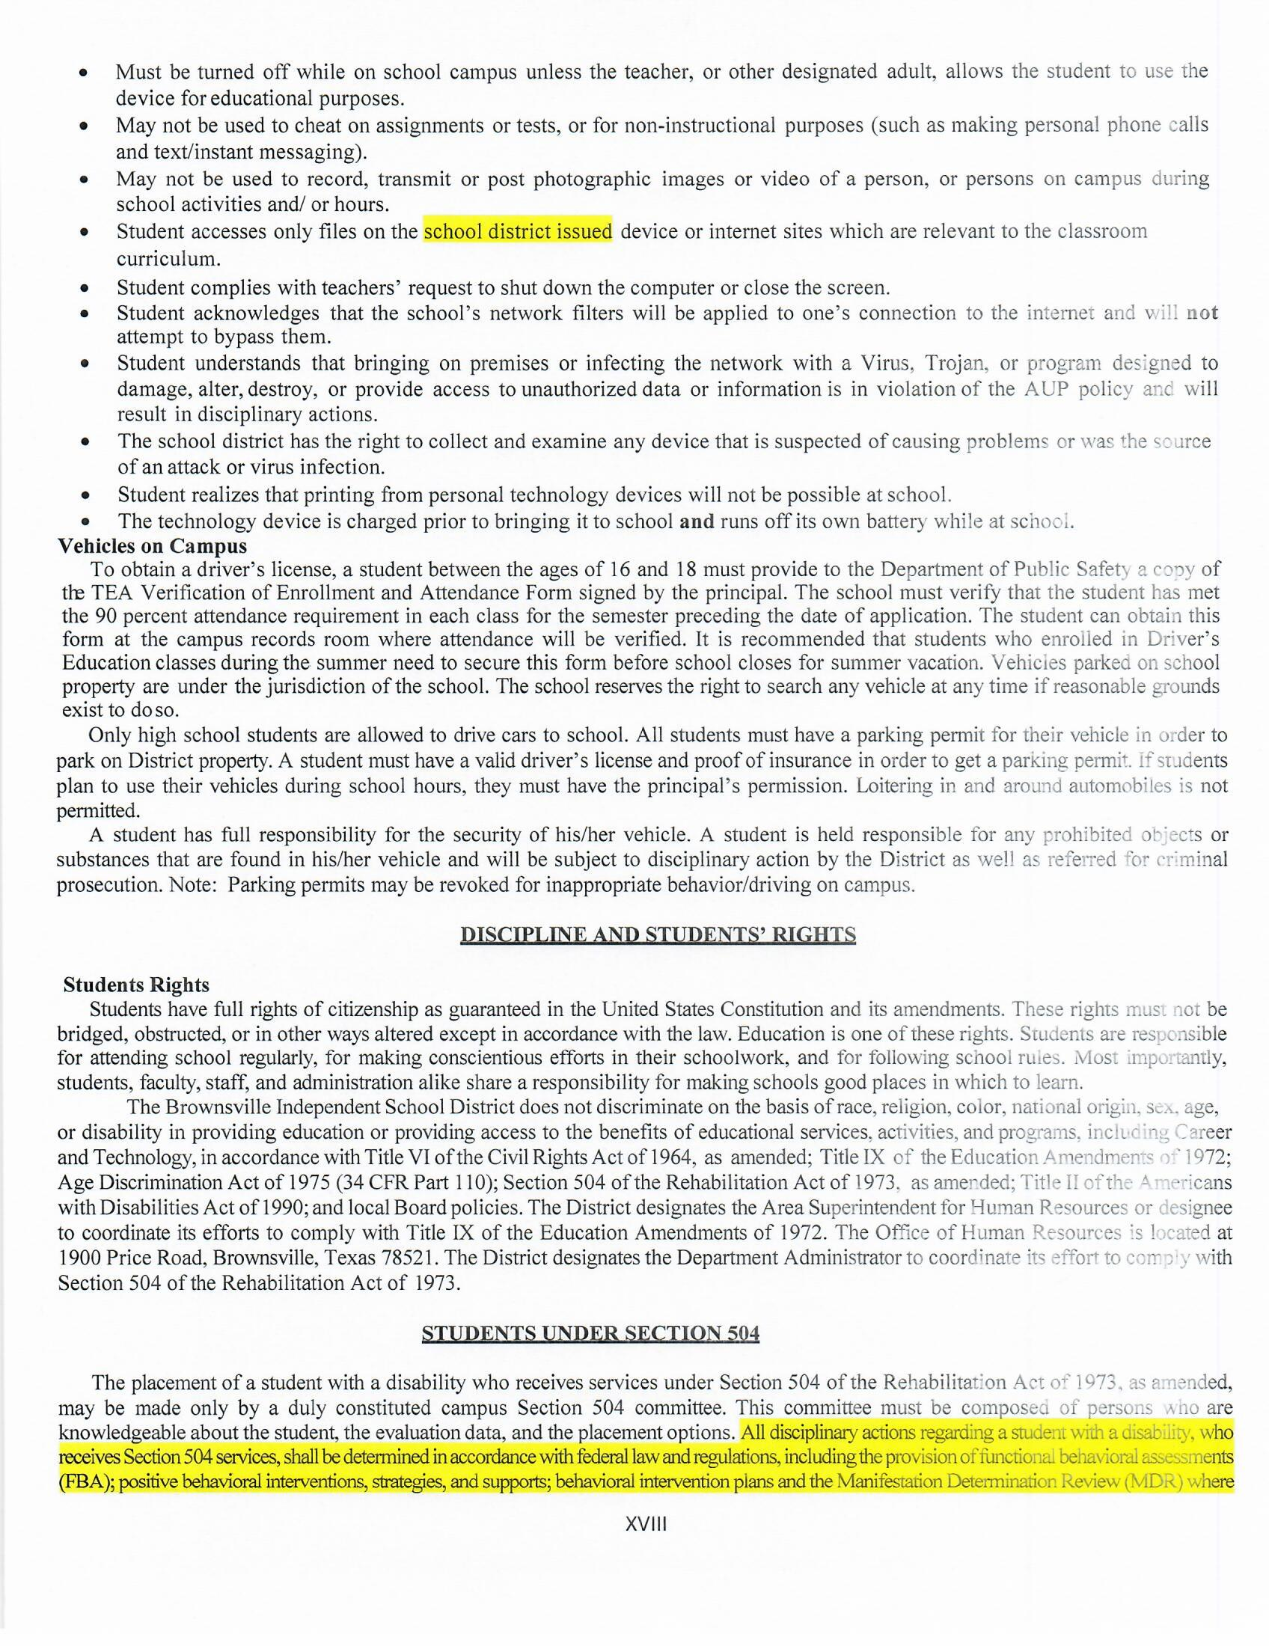
Brownsville Independent School District Department of Pupil Services
708 Palm Blvd., Brownsville, Texas 78521
Office (956) 544-3966
TECHNOLOGY UPDATE
504 UPDATE

Slide 9
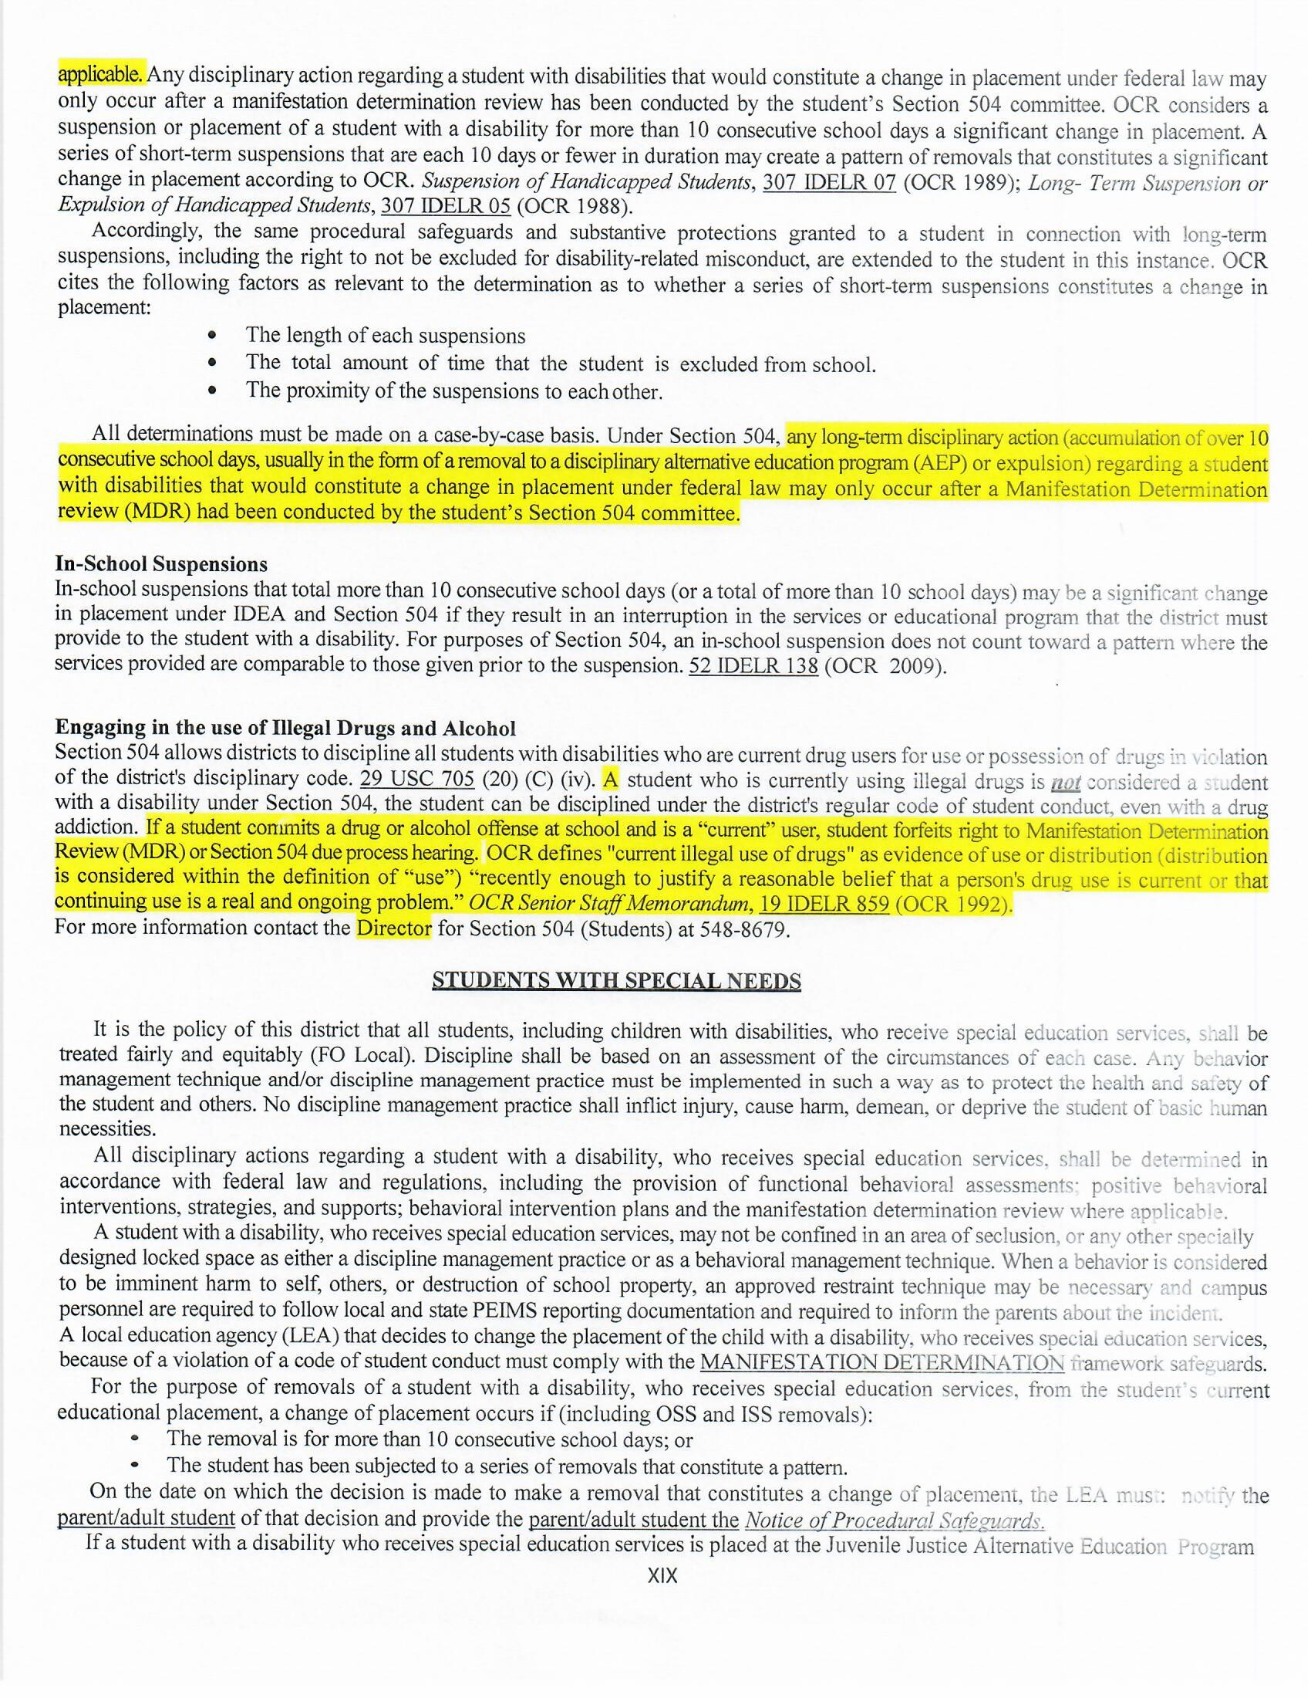
Brownsville Independent School District Department of Pupil Services
708 Palm Blvd., Brownsville, Texas 78521
Office (956) 544-3966
504 UPDATE

Slide 10
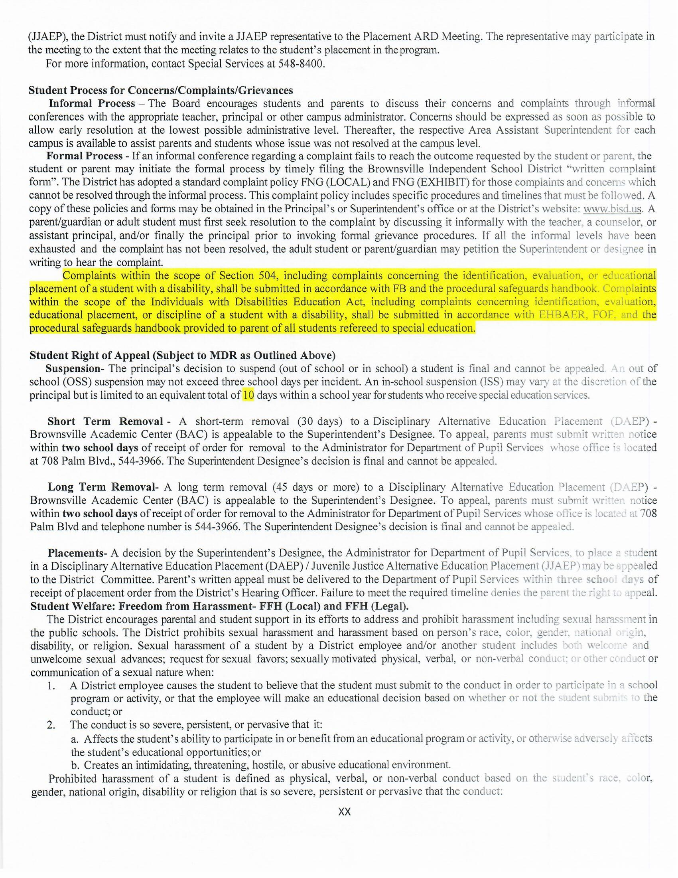
Brownsville Independent School District Department of Pupil Services
708 Palm Blvd., Brownsville, Texas 78521
Office (956) 544-3966
504 UPDATE

Slide 11
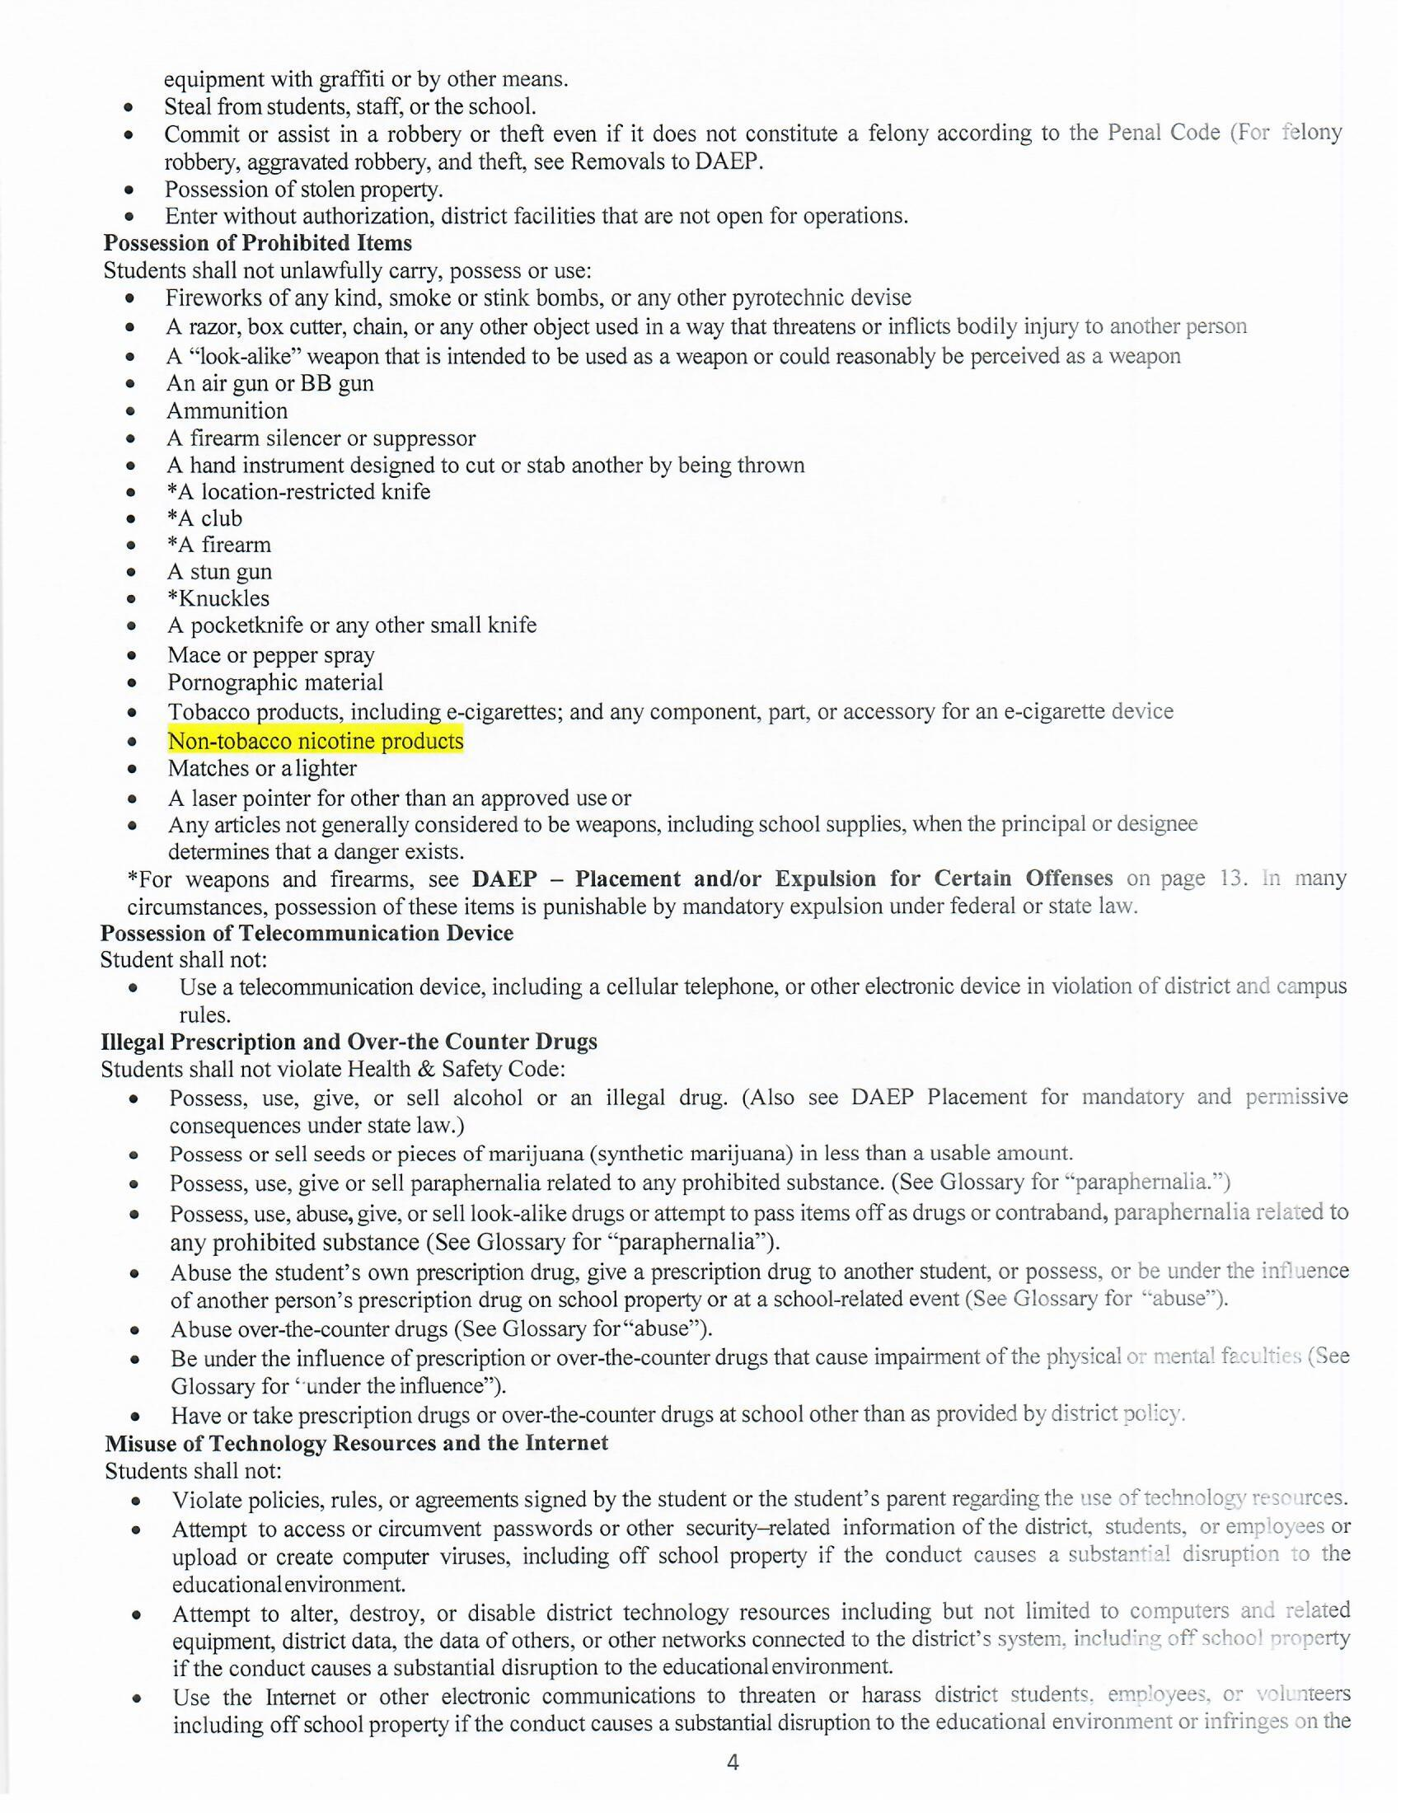
Brownsville Independent School District Department of Pupil Services
708 Palm Blvd., Brownsville, Texas 78521
Office (956) 544-3966
TASB UPDATE

Slide 12
Brownsville Independent School District Department of Pupil Services
708 Palm Blvd., Brownsville, Texas 78521
Office (956) 544-3966

Slide 13
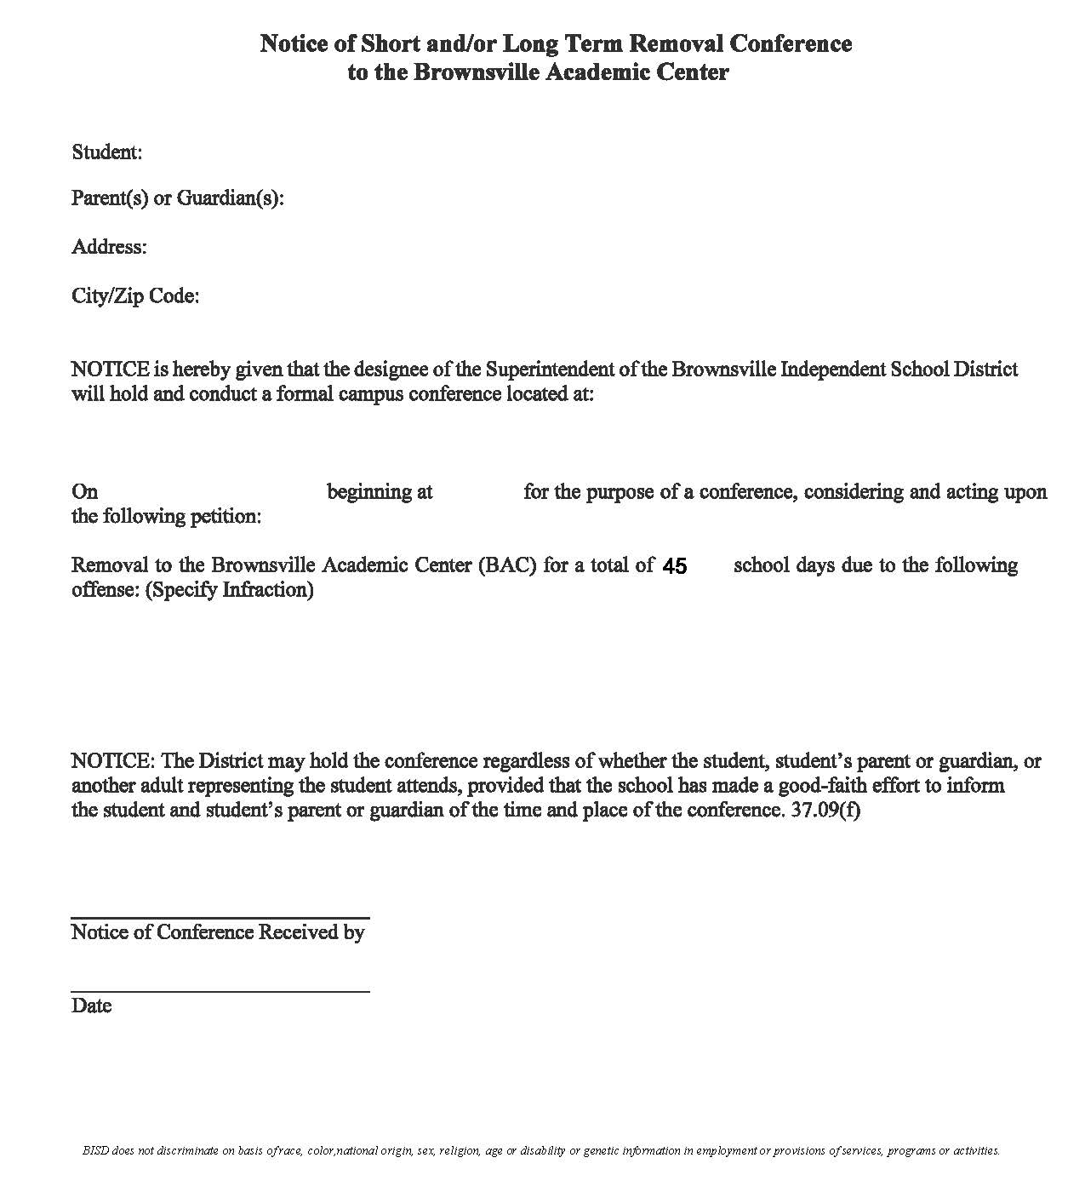
Brownsville Independent School District Department of Pupil Services
708 Palm Blvd., Brownsville, Texas 78521
Office (956) 544-3966
Notice must be signed and date prior to conference. The Notice form cannot be signed at the time the conference is held.

Slide 14
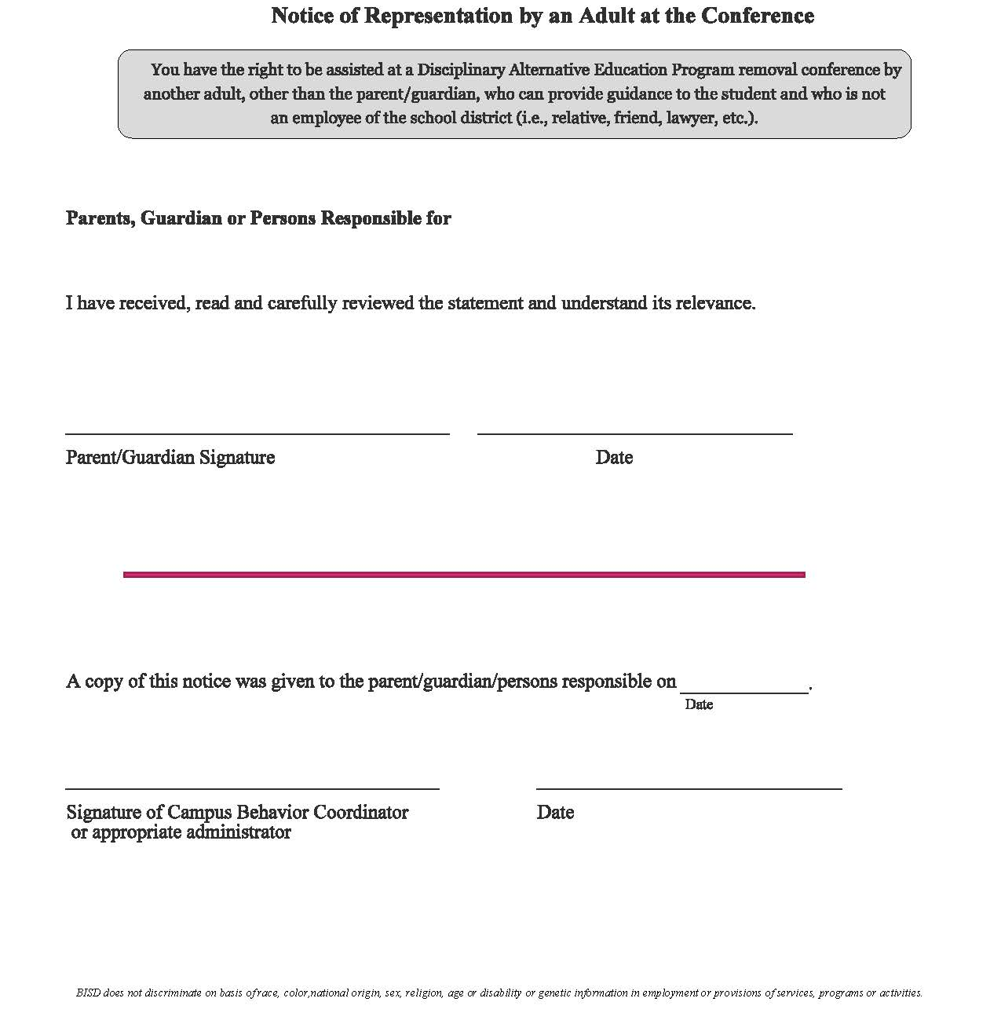
Brownsville Independent School District Department of Pupil Services
708 Palm Blvd., Brownsville, Texas 78521
Office (956) 544-3966
Notice must be signed and date prior to conference. The Notice form cannot be signed at the time the conference is held.

Slide 15
Brownsville Independent School District Department of Pupil Services
708 Palm Blvd., Brownsville, Texas 78521
Office (956) 544-3966
504 Manifestation Determination is held PRIOR to conference.

Slide 16
Brownsville Independent School District Department of Pupil Services
708 Palm Blvd., Brownsville, Texas 78521
Office (956) 544-3966
SPED Manifestation Determination is held AFTER conference.

Slide 17
Brownsville Independent School District Department of Pupil Services
708 Palm Blvd., Brownsville, Texas 78521
Office (956) 544-3966
Friendly Reminders
HB 674 and HB 692 prohibits BISD from placing students who are homeless or below third grade in out of school suspension except for certain violations of weapons or alcohol/drug related conduct (After consideration form is applied) 2024-2025 SCOC pg. 5.
HB 114 Mandatory Removal to BAC 45 Days – Sells, gives or delivers to another person or possesses, uses, or is under the influence of marijuana or THC. (No longer JJAEP). 2024-2025 SCOC pg. 10.
BAC extension requests are emailed to Mr. N. Garcia at BAC via email at nogarcia@bisd.us.
JJAEP extension requests are emailed to Mr. Randy Park at Pupil Services at rampark@bisd.us
More than 3 days of ISS is a Special Warning as per TEA.
1 Period of OSS counts for 1 day of OSS .
Total of 3 days Max OSS Per incident.
MAKE SURE THAT THE STUDENT STATEMENT CONTAINING THE STUDENT’S VERSION OF THE INCIDENT IS INCLUDED IN THE DISCIPLINE REFERAL.
All BAC/JJAEP Packets are found on the Pupil Services Website under Campus Resources -> Discipline Information & Forms. All packets are fillable so please download and save to your desktop
Parents have two days to appeal (original conference day is day zero).
504 Manifestation Determination is held prior to conference.
Special Services MD is held after conference.
All BAC Appeal Packets must be submitted to Pupil Services for review two (2) days before the Appeal Conference is held.
All JJAEP Placement Packets must be submitted to Pupil Services for review three (3) days before the Placement Conference is held.

Slide 18
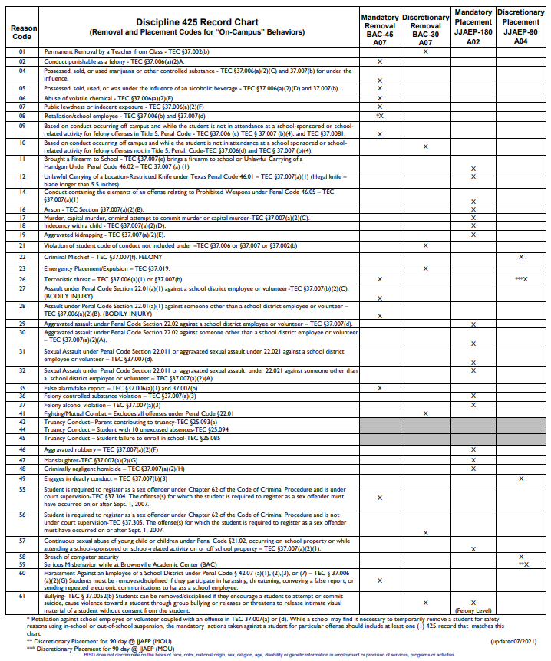
Brownsville Independent School District Department of Pupil Services
708 Palm Blvd., Brownsville, Texas 78521
Office (956) 544-3966

Slide 19
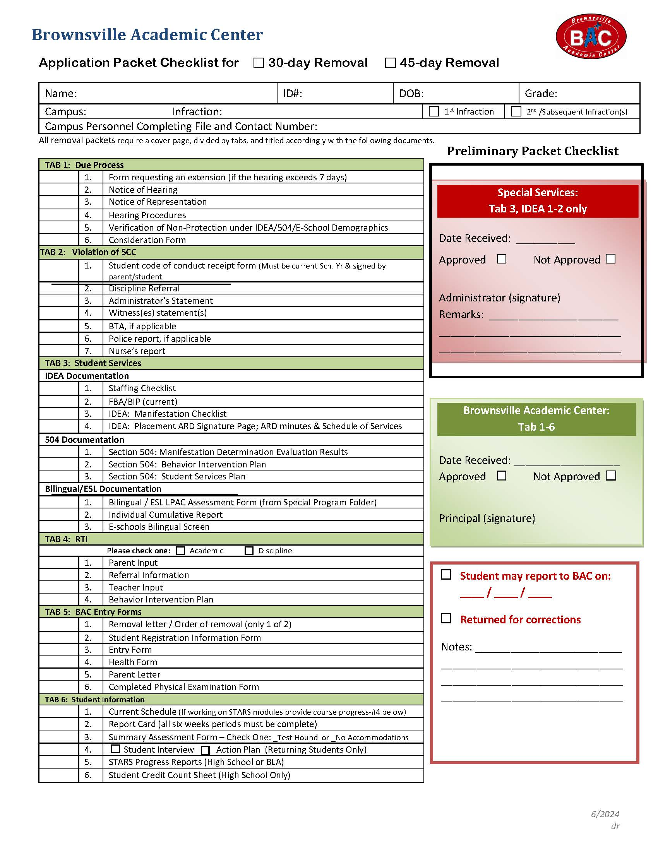
Brownsville Independent School District Department of Pupil Services
708 Palm Blvd., Brownsville, Texas 78521
Office (956) 544-3966
NEW BAC PACKET CHECKLIST ON PUPIL SERVICES WEBSITE
For a BAC Appeal please send TABS 1 and 2 to Pupil Services
SAMPLE

Slide 20
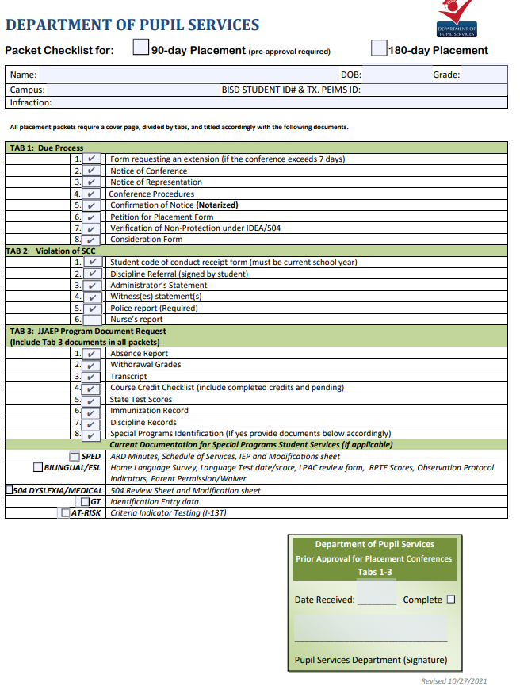
Brownsville Independent School District Department of Pupil Services
708 Palm Blvd., Brownsville, Texas 78521
Office (956) 544-3966
For a JJAEP Appeal please send TABS 1, 2 and 3 to Pupil Services
SAMPLE

Slide 21
Brownsville Independent School District Department of Pupil Services
708 Palm Blvd., Brownsville, Texas 78521
Office (956) 544-3966
For Questions please contact the Pupil Services Department:
Pupil Services, 956-544-3966
Randy Park, Director
rampark@bisd.us
Veronica Avila
vavila@bisd.us
Veronica Cisneros
vcisneros3@bisd.us

